Slide 1
Service Failures and Recovery in Tourism and Hospitality: A Practical Manual
Erdogan Koc

Slide 2
Chapter 12
The Role of Empowerment, Internal Communication, Waiting Time and Speed in Service Recovery

Slide 3
Learning Objectives
Understand and explain the importance of empowerment in relation to service recovery.
Understand the concept and types of internal communication.
Explain the relationship between integrated internal communication and service recovery.
Explain the theories regarding waiting time.
Understand the role of waiting time in service failures and recovery processes.

Slide 4
Employee Empowerment
Employee empowerment: A process of increasing the sense of self-sufficiency among the members of an organisation.
The provision or sharing of information together with training and encouragement are essential components of employee empowerment (Tan, 2007: 55).

Slide 5
Employee Empowerment
When empowered, service employees will have more power and autonomy while performing their individual tasks, thus:
Empowered employees are expected to make faster decisions to meet customers’ needs and expectations (Gazzoli, Hancer and Park, 2012: 5).
Empowered employees will have the ability and authority to engage in recovery of service failures (Thomas and Velthouse, 1990: 678).

Slide 6
Importance of Employee Empowerment in Relation to Service Recovery
Service encounters in tourism and hospitality businesses are prone to service failures (Koc, 2013).
Employee empowerment provides employees with opportunities to make decisions for recovering service failures (Sparks et al., 1997: 479).

Slide 7
Importance of Employee Empowerment in Relation to Service Recovery
Training for service recoveries need to concentrate on three guidelines (Jones, 2015):
Achievable => The recovery must be realistic and the individual service employee should be in a position to carry out the recovery.
Accessible => Solutions must be readily obtainable.
Appropriate => The recovery action should fit the particular service failure to be resolved.

Slide 8
Importance of Employee Empowerment in Relation to Service Recovery
Employee empowerment practices require service employees to be enthusiastic and eager (Koc, 2015: p.282). If the employees are empowered but unenthusiastic and reluctant, service recoveries will be ineffective (Carson et al., 1998)

Slide 9
Importance of Employee Empowerment in Relation to Service Recovery
Carson et al. (1998) classifies employees;
who may be empowered but reluctant to handle service recoveries and neglect service recovery as empowered neglecters
who may not be empowered but eager to handle service recoveries and avoid service recovery as learned avoiders
who may not be empowered but eager to handle service recoveries as recovery riskers
who may be both empowered and eager to handle service recoveries as effective recoverers.

Slide 10
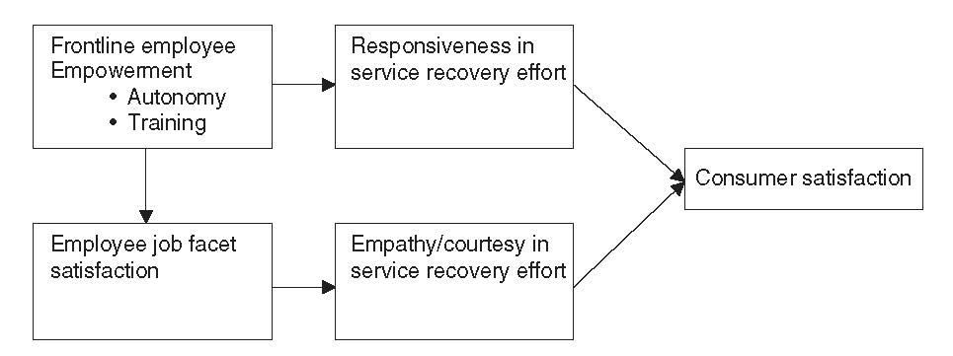
Importance of Employee Empowerment in Relation to Service Recovery
Hocutt and Stone’s (1998) service recovery model emphasises the role of empowerment and autonomy in job satisfaction.

Slide 11
The Theory and Types of Internal Communication
Internal Communication is;
an exchange of information within the organization.
a structure providing information flow (Argenti, 2009).

Slide 12
The Theory and Types of Internal Communication
Kalla (2005: 305-307) defines complex structure as integrated internal communication. This complex structure consists of four dimensions;
(a) business communication in regard to all employees’ communication skills;
(b) management communication in regard to all managers’ communication skills and capabilities;
(c) corporate communication focusing on the formal corporate communication function;
(d) organisational communication focusing on philosophically- and theoretically-oriented issues.

Slide 13
The Theory and Types of Internal Communication
Internal communication;
helps employees become more service-focused (Melton and Hartline, 2010: 415-416).
which becomes more effective through training is regarded as an important means for getting feedback from the customers regarding service failures, conveying a feedback to relevant departments, and providing service recovery
(Michel, Bowen and Johnston, 2009).

Slide 14
The Theories Regarding Waiting Time
The perception that the time spent by the customers may be excessive could lead to many negative circumstances (Groth and Gilliland, 2001: 78).
Waiting time may vary due to many factors such as queue, delay and customer’s early arrival for an appointment (Lin and Chang, 2011: 1054).

Slide 15
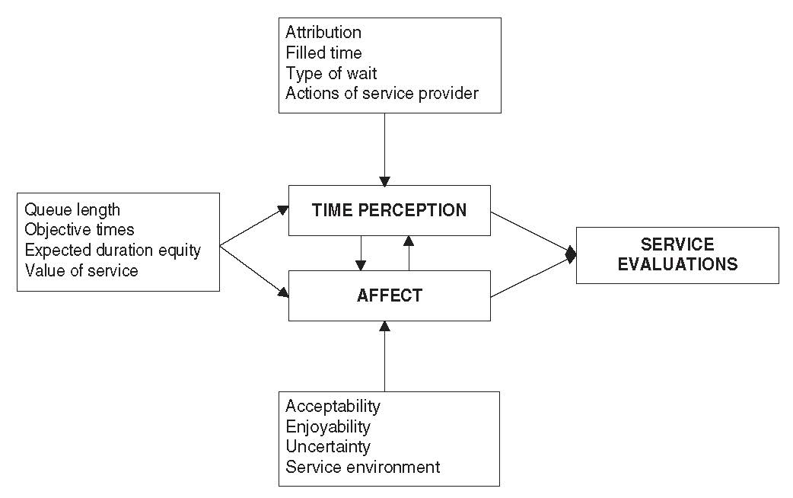
The Theories Regarding Waiting Time
Waiting types can be examined under three groups named as pre-process, in-process and post-process (Taylor, 1994: 56).

Slide 16
The Theories Regarding Waiting Time
Factors resulting from being crowded and effects of hunger on individuals’ behaviours and feelings (field theory)
Long queues (Maister’s theory)
Negative factors during service procurements (attribution theory) may extend perceived waiting time and may require service recovery

Slide 17
The Theories Regarding Waiting Time
Field Theory: Field Theory states that people’s behaviours and feelings are affected by some psychological forces. These psychological forces may be internal (within the individual) or external (outside of the individual) (Hui, Thakor and Gill, 1998: 470).

Slide 18
The Theories Regarding Waiting Time
An individual who goes to a restaurant may feel under pressure because of the crowd in the restaurant. As a result, the individual may perceive the waiting time is longer or they may not be pleased with the service they receive (Nie, 2000, p.625).

Slide 19
The Theories Regarding Waiting Time
Maister’s Theory: Customers’ waiting time to receive service affects their satisfaction levels (Maister, 1984).
Maister (1984) suggests taking the factors below into consideration:
- Occupied time feels shorter than unoccupied time.
- Uncertain waits seem to be longer than certain and finite waits.
- Anxiety makes waits seem longer.

Slide 20
The Theories Regarding Waiting Time
- Solo waiting feels longer than group waiting.
- The more valuable the service, the longer the customer will wait.
- Unfair waits are longer than equitable waits.
- Unexplained waits are longer than explained waits.
- Pre-process waits are longer than in-process waits.

Slide 21
The Theories Regarding Waiting Time
Attribution Theory: The major argument of attribution theory is that ‘…people want to know the reasons or the causes for any undesirable events’ (Lou, Liberatore et al., 2004: p.79).

Slide 22
The Theories Regarding Waiting Time
Weiner (1985) underlined that there are three dimensions of attribution theory.
- Locus: A dimension related to the person responsible for service failure by considering internal and external reasons.
- Stability: A dimension related to whether causal elements undergo a change and whether causal elements may be changed by the individuals.
- Controllability: An attribution dimension about whether reasons can be controlled or not.

Slide 23
Understand the Role of Waiting Time in Service Failures and Recovery Processes
Solving the problems arising from service failure swiftly is of vital importance for customer satisfaction (Koc, 2013).

Slide 24
Understand the Role of Waiting Time in Service Failures and Recovery Processes
Davidow (2000) emphasizes that service mistakes result in a variety of customer behaviours represented by six dimensions. These dimensions are:
- timeliness
- facilitation
- redress
- apology
- credibility
- attentiveness

Slide 25
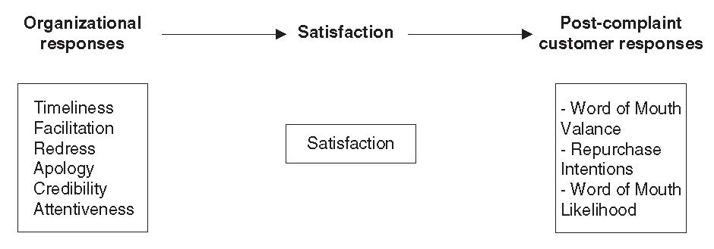
Understand the Role of Waiting Time in Service Failures and Recovery Processes
Post complaint behaviour model constituted by Davidow (2000).

Slide 26
Understand the Role of Waiting Time in Service Failures and Recovery Processes
The speed of service recovery has a positive relationship with a customer’s intentions to repurchase, and lower service recovery time leads to a higher repurchase ratio.
The service recovery time has an impact on the business-customer relationship and a positive association with customers’ intentions to repurchase (Davidow, 2000).

Slide 27
Understand the Role of Waiting Time in Service Failures and Recovery Processes
Time spent during service recovery has an effect on satisfaction, intention to repurchase, positive perceptions of recovery and word-of-mouth.
(Swanson and Kelley, 2001)

Slide 28
Understand the Role of Waiting Time in Service Failures and Recovery Processes
When service speed is combined with an apology and recovery, customers’ intention to repurchase increases and negative word-of-mouth decreases (Wirtz and Mattila, 2004).

Slide 29
Understand the Role of Waiting Time in Service Failures and Recovery Processes
Disney managers follow a method which includes five steps in order to recover service failure.This method is composed of:
hear (listening to customers carefully)
empathize (employees putting themselves in the place of customers)
apologize (apologizing for service failure)
resolve (providing service compensation as soon as possible)
diagnose (faultlessly carrying out service compensation)
(Jones, 2013)

Slide 30
Understand the Role of Waiting Time in Service Failures and Recovery Processes
Justice theory is concerned with whether a situation, behaviour or decision is fair with regard to individuals (Ha and Jang, 2009: p.319).

Slide 31
Understand the Role of Waiting Time in Service Failures and Recovery Processes
Justice theory comprises three dimensions: distributive justice, procedural justice and interactional justice (Wirtz and Mattila, 2004: 151).
- Distributive Justice: Justice perceived in outputs at the end of the service recovery process by the customers.
- Procedural Justice: Justice perceived during the course of service failure recovery by the customers.
- Interactional Justice: Emerging from service providers’ behaviours regarding the customers.

