Slide 1
Service Failures and Recovery in Tourism and Hospitality: A Practical Manual
Erdogan Koc

Slide 2
Chapter 10
Emotional Contagion and the Influence of Groups on Service Failures and Recovery

Slide 3
Learning Objectives
Understand the role and potential of group consumption in tourism and hospitality.
Explain the group service interaction process.
Understand the contexts in which group service failures take place.
Understand and explain the concept of emotional contagion and its influence on service failures and recovery processes.

Slide 4
Introduction
The tourism and hospitality industry mostly promotes family and group consumption through early bookings,
package tours, online group buying,
coupons etc.

Slide 5
Introduction
Group and family purchases (e.g. package holidays) are encouraged.
Individual purchases (e.g. individuals participating in package holidays) are discouraged.

Slide 6
Introduction
53% of all tourist arrivals (632 million)
are people on family and group holidays.
A further 27% (320 million) travelled to visit friends and relatives (UNWTO, 2016: 4-5).

Slide 7
Family and Group Consumption
2014 Consumer Holiday Trends Report (ABTA - Association of British Travel Agents) :
50% of people go on a holiday with their partners
35% of people go on a holiday with immediate family

Slide 8
Family and Group Consumption
One in five consumers (20%) go on holiday with an adult only group of friends
and
19% go on holiday with their extended family (family members from outside the household).

Slide 9
Family and Group Consumption
Families travelling with children represent one of the largest and most steady markets for tourism and leisure.
The levels of interaction and communication are quite strong within families.
Families have a significant influence on family members’ travel and consumption decisions.
More than two thirds of children between the age of 13-21 influence their parents’ travel decisions (Kotler & Keller, 2012: 176)

Slide 10
Risk
Tourism and hospitality purchases involve various unknowns and risks:
General Service Characteristics:
Intangibility, inseparability and hetereogneity
Specific Tourism and Hospitality Service Characteristics:
Unknown places & people
Long time period between purchase and consumption
Relatively expensive
Risk Perception
Collective Decision Making

Slide 11
Family Buying
Family or group buying behaviour is different from individual buying behaviour.
Members have different needs, wishes, roles and influences.

Slide 12
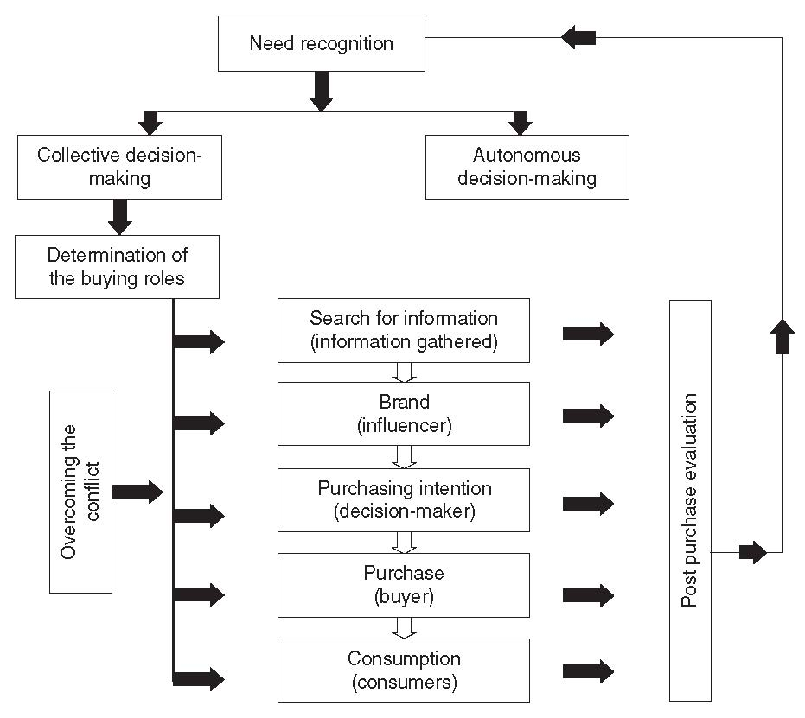
Family buying model
Source: Koç, E. (2016:448). Tüketici Davranışı ve Pazarlama Stratejileri: Global ve Yerel Yaklaşım. Ankara: Seçkin Yayıncılık.

Slide 13
Effect of Internet on Group Buying
Group buying situation – an item must be bought at a minimum quantity or price.
Several people have to agree to approach the vendor in order to obtain discounts.

Slide 14
Effect of Internet on Group Buying
Internet platforms such as Groupon.com and Livingsocial.com provide discounted sales for group consumers.
In Canada, local companies offer their services at a discount of between 30% and 90% to groups.

Slide 15
Group Buying in the Tourism and Hospitality Industry
Group buying platforms such as Groupon.com, Livingsocial.com, Weecation.com, deals.touristorama.com and expedia.com provide tourism and hospitality services such as hotel, restaurant, tour services, transportation, entertainment, events, etc.

Slide 16
Group Buying in the Tourism and Hospitality Industry
Online coupons currently have a wide and fast adoption in the tourism & hospitality industry.
Online coupons promise substantial savings, often 50% or more for tourism and hospitality services.

Slide 17
From Group Buying to Group Service Failures
Group sales provide opportunities in terms of revenue management and differential pricing strategies for restaurants, hotels, travel agencies, spa services, museums etc.
However, these opporunities may necessitate different service interactions, expectations and performances compared to individual buying.

Slide 18
From Group Buying to Group Service Failures
Customers use accommodation facilities, travel and eat together with their families, friends and colleagues.

Slide 19
From Group Buying to Group Service Failures
Service failures are inevitable
Employee response to service delivery system failures
Employee response to customer needs and requests
Unprompted and unsolicited employee actions
Problematic customer behaviours

Slide 20
From Group Buying to Group Service Failures
For tourism and hospitality establishments, groups constitute a difficult segment to cater for.
During the group consumption process common impulsive, cognitive and emotional reactions may occur.
In particular, service failures may lead to the sharing of a high degree of negative emotions during group consumpiton.

Slide 21
From Group Buying to Group Service Consumption
How can a tourism and hospitality business offer a unique service for each person without impairing the group’s integrated perception of service quality and standardization?
Group service failure is a service disconfirmation situation – resulting in unmet expectations of all or the majority of the customers in a group (Du et al., 2014).

Slide 22
Factors Influencing A Group’s Service Failure Perceptions
Group size
Group familiarity (structure and homogeneity)
Group potential
Collective productivity
Group productivity
Group moods and emotions
Group beliefs
(Mason & Griffin, 2002: 272)

Slide 23
Emotional Contagion in Group Service Encountering
When individuals take part in a group, they tend to expose emotions in line with the group’s emotions in terms of:
  type (positive or negative)
  intensity (high or low)
Hence, service failures may cause common negative emotions – emotional contagion.

Slide 24
Emotional Contagion in Group Service Encounters
Emotional contagion - derived from the Latin word ‘contagio’ meaning ‘… from touch’
Emotional contagion – ‘the tendency to catch (experience/express) another person’s emotions (his or her emotional appraisals, subjective feelings, expressions, patterned physiological processes, action tendencies, and instrumental behaviours)’.
(Hatfield, Cacioppo & Rapson, 1993: 96)

Slide 25
Emotional Contagion in Group Service Encounters
Positive and negative emotional contagion may occur between:
a group of customers served
employees in a service business
employees and customers collectively in a service business
Hereditary factors, gender, personality, upringing and past experience are the major factors and influences on emotional contagion.

Slide 26
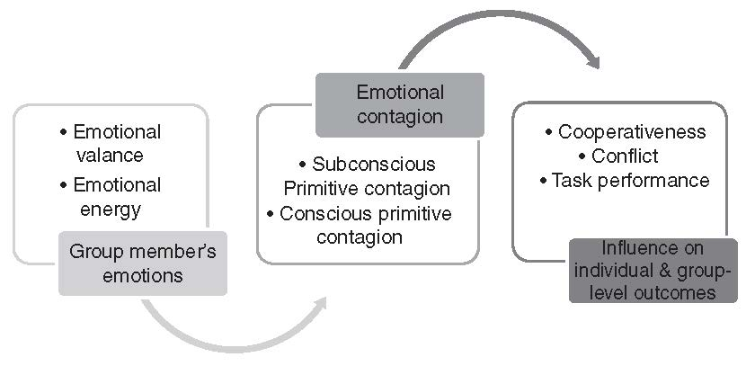
Emotional Contagion in Group Service Encountering
According to Emotional Contagion Theory, an individual’s emotional contagion is shaped in three stages.
Barsade, S. G. (2002). The ripple effect: Emotional contagion and its influence on group behavior. Administrative Science Quarterly, 47(4), 644-675.

Slide 27
Role of Emotional Contagion in Group Service Failures
Evaluation of personal emotions, group members’ emotions and the level of empathy are influential in determining the type of emotional contagion.
Positive emotional contagion – turns a person’s mood and emotion into a positive state.
Negative emotional contagion – turns a person’s mood and emotion into a negative state.

Slide 28
Role of Emotional Contagion in Group Service Failures
Negative emotional contagion may result in:
negative emotions
low service quality perceptions
low level of satisfaction derived from the service
complaint behaviour
negative behavioral intentions (e.g. customer switching, negative WOM).

Slide 29
Role of Emotional Contagion in Group Service Failures
Service staff’s body language, attitudes and behaviours may reveal their real emotions to customers.
Service staff need to be careful so that they do not cause negative contagion.

Slide 30
Role of Emotional Contagion in Group Service Failures
Tourism and hospitality services involve a high level of human contact and interaction – this increases the ability to be emphatetic.
Service staff need to be able to put themselves in customers’ shoes and understand that customers in a group are markedly different from individuals on their own.

Slide 31
Role of Emotional Contagion in Group Service Failures
Tourism and hospitality are not limited to the satisfaction of customers’ physiological needs. Customers need psychological/emotional satisfaction too (e.g. tourism and hospitality services may be instrumental in satisfying customers needs for status, popularity, love, esteem, prestige, respect, etc.) – making customers more vulnerable to influence from group emotions.

Slide 32
Role of Emotional Contagion in Group Service Failures
Emotional contagion frequently derives not from group members but employees.
Customers’ attitudes and behaviours are generally shaped by group members’ and third parties’ moods and emotions.

Slide 33
Role of Emotional Contagion in Group Service Failure
Unhappy or unsatisfied customers in or out-group could remind other group members of his/her previous unsuccesful experience.
Besides, individuals are more likely to share their consumption ideas, experiences and emotions in a group.

Slide 34
Role of Emotional Contagion in Group Service Failures
Group familiarity and group size are influential on the intensity and level of emotional contagion.
As the relational distance between the group members gets shorter, customers may become more vulnerable to emotional contagion.
As the relational distance between the group members increases, customers’ group loyalty would decrease gradually.

Slide 35
Role of Emotional Contagion in Group Service Failures
Group size is a controversial issue in service failures as the group familiarity is a dominant factor regardless of group size.
It is believed that the more customers are sharing common emotions, the higher the level of their emotional responses and contagion.

Slide 36
Role of Emotional Contagion in Group Service Failure
Research shows that:
  Customers are negatively influenced by group members’ negative emotions
  Customers emotional responses become more negative in group service failures compared with individual service failures
  Negative emotional contagions lead to higher recovery expectations among group members.

Slide 37
Conclusion
Companies should focus on decreasing the number of unhappy customers instead of reducing the service failure incidents.
Companies should take customers’ pyschological and emotional satisfaction into account, in addition to physiological satisfaction.
Employees should comprehend the main reason why the customers pay the premium prices.

Slide 38
Conclusion
Employees have to keep in mind that the consumers (tourists) make a huge effort to experience their aims which impair psychological health, lack of energy, memory lapses and depressed moods.
Hence, their tolerance to service failure could be lower than the norm and they could easily incline to others’ negative emotional contagions.

Slide 39
Conclusion
All service personnel and managers in tourism and hospitality establishments need to be aware of and prepared for emotional contagion.
Marketing managers need to provide information to other managers and service staff on:
  The socio-economic and socio-cultural characteristics of the customers
  The leader / opinion leader of the group.

Slide 40
Conclusion
Service employees need to be able to determine the customer who is most active in the group’s decision-making process.
Human Resource Managers should nurture their staff’s emotional contagion skills, from recruitment to performance appraisal.
Employees need to be be trained on emotional intelligence techniques, emotional labour, empathy, complaint handling, communication skills, etc.

Slide 41
Conclusion
Employees should be equipped with authorisation, responsibility and initiative to handle group service failures.
Employees should be empowered by their managers and rewarded following successful group service recovery incidents.

