Slide 1
Service Failures and Recovery in Tourism and Hospitality: A Practical Manual
Erdogan Koc

Slide 2
Chapter 1
Introduction

Slide 3
Learning Objectives
Understand the importance of service failures.
Explain the types of gaps which cause service failures.
Understand the scope of service failures and recovery.

Slide 4
Service Failure
A service failure is any type of error, mistake, deficiency or problem occurring during the provision or performance of a service.

Slide 5
Service Failure
The inherent variability in hospitality services is attributable to:
A) the heavy reliance on human service providers.
B) the near impossibility of quality inspections prior to consumption (Zeithaml et al., 1990; Chan et al., 2007).

Slide 6
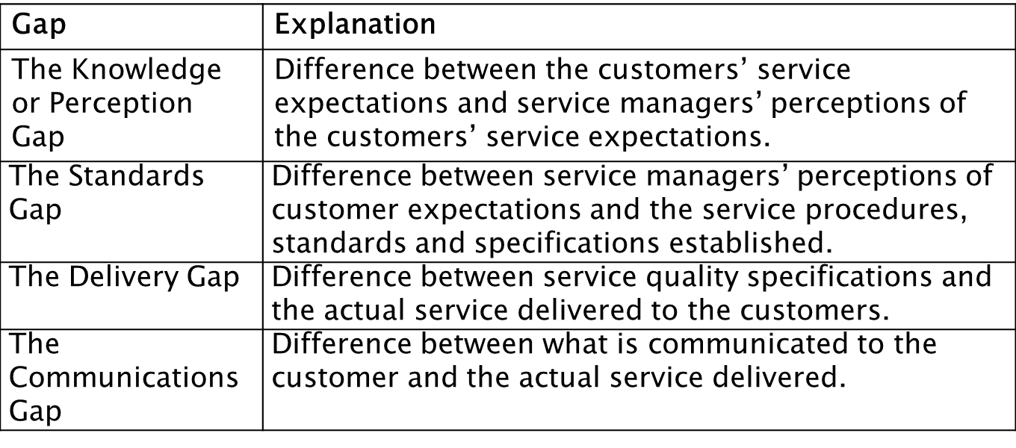
Gap Model: Service quality problems / service failures occur due to the following service quality gaps: (Parasuraman et al. 1991)

Slide 7
Gap Model (Parasuraman et al., 1991)
Service quality models (e.g. SERVQUAL) can be used to:
identify
measure
the probable causes of gaps in the service processes.

Slide 8
SERVQUAL (Parasuraman et al., 1988)
SERVQUAL focuses on the service quality elements of:
reliability
assurance
tangibles
empathy
responsiveness

Slide 9

SERVQUAL (Parasuraman et al., 1988)
No matter how good the service quality, service failures are inevitable.
But dissatisfied customers are not.
(Goodwin and Ross, 1992; Levesque and McDougall, 2000; Michel, 2001).
Why?

Slide 10
Why are service failures inevitable?
Due to the following service characteristics:
intangibility
inseparability
heterogeneity
perishability
What are the implications of service characteristics
for service encounters and service failures?

Slide 11
Importance of Service Failures
Service failures cause customer dissatisfaction.
They threaten the survival and growth of service
businesses (Koc, 2006; Coulter, 2009; Weber, 2009;
Koc, 2010 and 2013; Wang et al., 2014).
Service failures trigger negative emotions and
negative behavioural intentions for customers
(Gregoire et al., 2009; Ha and Jang, 2009; Wen and
Chi, 2013).

Slide 12
Importance of Service Failures
Negative emotions and ensuing behavioural intentions:
Customer dissatisfaction
Customer switching
Increased costs
Lower employee performance
Lower employee morale

Slide 13
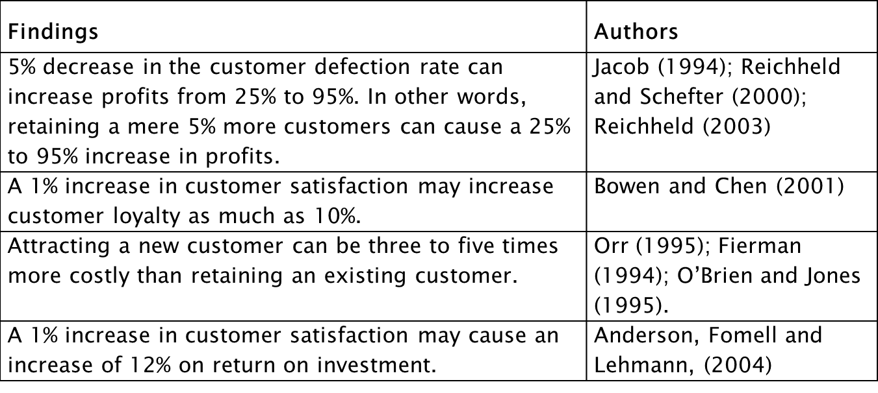
Summary of Research Findings on Customer Satisfaction, Service Failures and Service Recovery -1

Slide 14
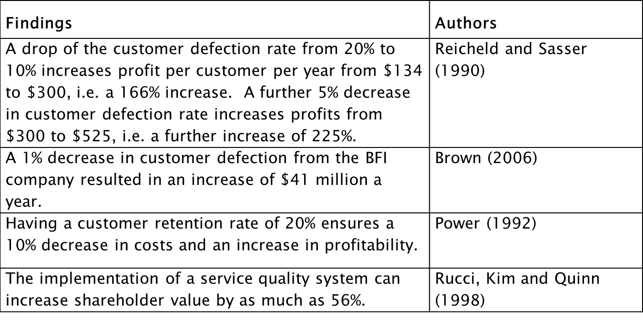
Summary of Research Findings on Customer Satisfaction, Service Failures and Service Recovery -2

Slide 15
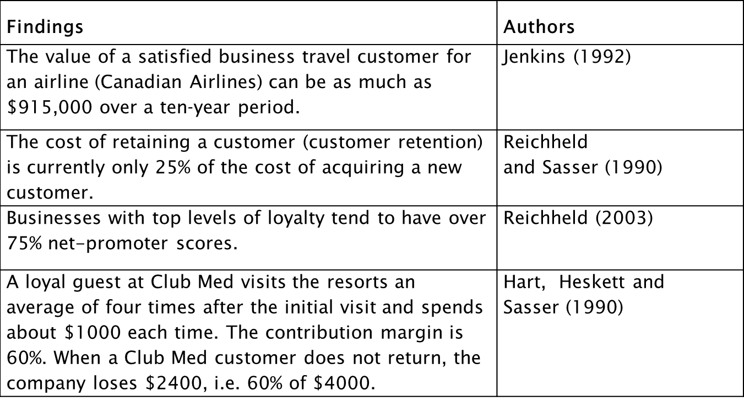
Summary of Research Findings on Customer Satisfaction, Service Failures and Service Recovery -3

Slide 16
Dyadic Nature of Service Failures
Inseparability
Customers – Service Personnel Interaction
Multi-Disciplinary Approach (e.g. Marketing & HRM)

Slide 17
Outline
Chapter 1 Introduction: Service Failures and Recovery
PART 1 – Understanding Service Failures and Recovery
Chapter 2 Understanding and Dealing with Service Failures in Tourism and Hospitality
Chapter 3 Service Failures and Recovery: Theories and Models
PART 2 – Understanding Emotions in Service Encounters, Service Failures and Recovery
Chapter 4 Emotions and Emotional Abilities in Service Failures and Recovery
Chapter 5 Memorable Service Experiences: A Service Failure and Recovery Perspective
Chapter 6 Customer Attribution in Service Failures and Recovery

Slide 18
Outline
PART 3 – The Influence of Technology, Systems and People
Chapter 7 Technology, Customer Satisfaction and Service Excellence
Chapter 8 Self-Service Technologies: Service Failures and Recovery
Chapter 9 The Influence of Other Customers in Service Failure and Recovery
Chapter 10 Emotional Contagion and the Influence of Groups on Service Failures and Recovery

Slide 19
Outline
PART 4 –Training for Service Failures and Recovery
Chapter 11 Staff Training for Service Failures and Recovery
Chapter 12 The Role of Empowerment, Internal Communication, Waiting Time and Speed in Service Recovery
Chapter 13 Cross-Cultural Aspects of Service Failures and Recovery
Chapter 14 Disappointment in Tourism and Hospitality: the Influence of Films on Destinations

