Slide 1
Risk and Safety Management in the Leisure, Events, Tourism and Sports Industries
Mark Piekarz, Ian Jenkins and Peter Mills

Slide 2
Chapter 8 - The Law of Tort and its Relevance for Risk Management

Slide 3
To identify the key concepts of tort.
To understand how tort is a very important legal area for managers.
To use exemplars to explain the principles of tort.
To demonstrate how the law of tort is a key element in the tool box of risk management of an organisation.

Slide 4
‘Tort law compensates, deters, educates and provides psychological comfort to many. It reflects and reinforces our values of respect for the individual. It can act as an ombudsman focusing public attention on social problems, and as an empowerer of individuals wronged by the powerful forces in our society.’ (Linden 2007).

Slide 5
One of the most important areas for managers.
Chapter considers the aspect of civil law.
Most managers will be frequently concerned with tort.
Increase in litigation has been mainly focused on tort, especially related to accidents.

Slide 6
Tort
What is it?
  A civil ‘wrong’ dated to C19th.
  Legal action of a person against another person.
  It is based upon the balance of probabilities for civil actions (51% likely).
  Precedent set by UK case ‘Ginger Ale and the Snail’. Donoghue vs Stevenson (1932).

Slide 7
Tort covers: defamation of character, trespass, economic loss, wrongful imprisonment, nuisance, and negligence.
Principle concern is usually negligence related to accidents/incidents
  ‘it is an action or non-action that falls below what an average person would expect, resulting in significant detrimental loss’.
  Negligence judged by a principle of a prudent and reasonable person.

Slide 8
DIFFERENT TYPES OF EFFECTS ON TORT
• Malfeasance
This is a deliberate act or lack of the act of commission, resulting in a wrong, leading to a detrimental outcome for the person.
• Misfeasance
Another aspect of tort can be regarded as an unintentional, but badly performed act of commission, resulting in loss or injury to a person.
• Nonfeasance
This can be defined as a lack of action, unintentionally resulting in damage or loss to an individual.

Slide 9
TORTS BASED ON NEGLIGENCE
‘Negligence is therefore measured by the conduct of the defendant relative to that of a notional moral exemplar, ‘reasonable man’. Negligence does not require ‘fault’ on the part of the defendant, in the sense of moral blameworthiness, however it does require fault insofar as a defendant’s conduct is not of the standard of a reasonable man.’ (Pannett 1997)

Slide 10
A PRUDENT AND REASONABLE PERSON
What are the characteristics of this imaginary person?
Appropriate Knowledge
  Which means?
Competency and Experience
  And will include?
    Physical Ability.
    Skill Level.
Perception
  What is this?
    Being able to foresee reasonable risks.

Slide 11
PROVING TORT
1. Duty of Care: There has to be a ‘proximity’, neighbour principle.
2. Breach of Duty: ‘Duty of Care’ was not performed = breach, causing the person’s loss or injury.
3. Significant Damage/Loss: ‘Serious nature’ and injury is ‘permanent’.

Slide 12
POSSIBLE DEFENCES AGAINST TORT
• Contributory Negligence
  Plaintiff had contributed partially or wholly to their loss/ injury.
• Comparative Negligence
  Offset the damage (compensation) made to the plaintiff, involves at least one other company or person supplying the goods or service, resulting in loss or damage.
• Vicarious Liability
  Where responsibility for the accident lies with another individual. An employee may not be liable, but the manager is if a breach of their duty of care is proven. (See Lyme Bay Tragedy).

Slide 13
DEFENCES CONTINUED…
Waivers
  Hope that customers sign a waiver concerning injury or loss, absolves them from liability.
Act of God
  Event resulting in injury has occurred through circumstances that could not have been controlled or regulated.
Volition of Risk, High Risk Activity
  Certain activities require higher competences than others, necessitating participants to be more aware of possible perils and hazards.
Government Protection
  Before 1947, in the UK certain organisations were protected under state legislation from prosecution. However, since 1987, even the Armed Forces in the UK can now be prosecuted under tort.

Slide 14
SPECIAL CONDITIONS
Some activities and customers require extra vigilance and abilities.
Vulnerable people require this extra service related to ‘duty of care’ and ‘protection’.
Closer supervision (ratio of instructors) and adaptation of equipment (special equipment) may be needed.

Slide 15
APPROPRIATE KNOWLEDGE AND TRAINING
It is the responsibility of a company or operator to be up-to-date on knowledge, skills and training.
Need to explore all possible sources of information.
Some activities are not represented by governing bodies or standards.

Slide 16
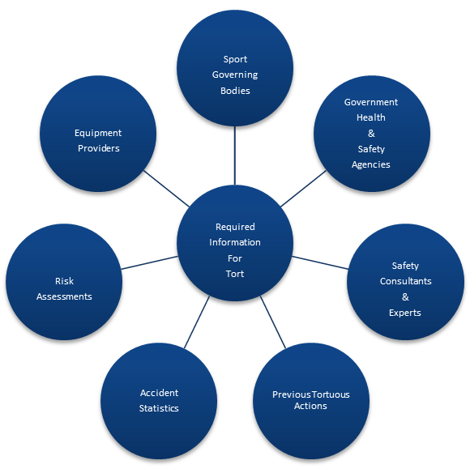
SOURCES OF INFORMATION
Source: Jenkins, 2015 (author)

Slide 17
TORT IN OTHER COUNTRIES
English speaking countries tend to follow the UK legislative model and many of their laws have been adapted from UK precedents, e.g.
Australia
Canada
New Zealand (exception, has replaced negligence with a state compensation system).

Slide 18
CASE STUDIES
There are some good examples of negligence cases to be found in the literature relating to:
Mountain Bikes
Lyme Bay
Everest’s Death Zone.

Slide 19
Questions:
1. What are the key elements that a manager should ensure are in place to prevent any tortuous action being brought against an organisation?
2. What are the key publications that a manager should be aware of to ensure adequate knowledge of activities he is managing?
3. What has given rise to the growth in tortuous cases in the UK?
4. Why is non-action just as important as commission in the law ?

Slide 20
FURTHER READING
• Palmer, G. (1994) New Zealand's Accident Compensation Scheme: Twenty Years On, Legal Research Paper and University of Toronto Law Journal 223-273
For a good general overview of Tort in the UK see:
• Giliker, P. & Beckwith, S. (2011) Tort 4th Ed., Sweet & Maxwell, London
On the aspect of volition of risk and Tort see:
• Horton, D. (2010) Extreme Sports and Assumption of Risk: A Blueprint
Law Review, Vol. 38, 2004, University of San Francisco
Specific activities and the aspect of negligence, the case of surfing:
• Fitzgerald, B. & Harrison, J. (2003) Law of the Surf. Australian Law Journal 77, 109-116.

Slide 21
Thank You
Name: Dr. Ian Jenkins
Email: dr.isjenkins@gmail.com

