Slide 1
Risk and Safety Management in the Leisure, Events, Tourism and Sports Industries
Mark Piekarz, Ian Jenkins and Peter Mills

Slide 2
Chapter 6 – Documentation 2
(Checklists)

Slide 3
These relate to the chapter objectives in Chapter 6:
To identify and explain points of good practice.
To explain the importance of developing checklist documentation.

Slide 4
This lecture focuses on developing checklists.
Checklists are likely to be familiar to many, from simple shopping lists, management to-do lists, or following the checks to be done before a piece of machinery is used.
They can have a superficial simplicity to them which can mean they are regarded as unimportant, or something which adds to workloads.
This is wrong!
Checklists offer a mechanism to:
  identify control measures;
  communicate risks and controls;
  track and monitor control measures;
  develop procedures to comply with legal regulations, good practice and quality assurance systems;
  provide ways to deal with crisis situations.
-

Slide 5
THE VARIETY OF CHECKLISTS
Project work checklists
Crisis checklists
Operational work checklists
Procedural safety checklists
Operational work checklists: the day-to-day to-do checklists of jobs.
Project work checklists: the jobs which have to be done and their order.
Procedural safety checklists: What has to be done to comply with good and legal practice (main focus in this lecture).
Crisis checklists: what has to be done when a crisis situation is faced.

Slide 6
A CRITICAL UNDERPINNING OF EFFECTIVE MANAGEMENT
Identify all the work/jobs which have to be done with any activity.
Organise these into lists.
Prioritise them and place them in a scheduling order.
Monitor and control.
Key element of operational and project management.
Requires imagination.
From here one can develop checklists.

Slide 7
M&Ms, QUALITY SYSTEMS AND SAFETY
Gwande (2010) gives this story about M&Ms®:
One of the examples relates to David Lee Roth, the lead singer of the rock band Van Halen. He relates the story of how he had a clause specifying that a bowl of chocolate M&M’s was provided backstage, with every brown sweet removed on pain of forfeiture of the show and compensation to the band.
Was this an extreme type of rock star vanity?
This may seem extreme and vain, but there was a purpose. The shows had become so large and complex that the risk of technical errors when setting up increased, which could risk not only the quality of the production, but also the lives of the performers and audience.
The M&M was a test, if they had ignored this small hidden detail, they could easily have overlooked other details, such as not securing key bolts, not checking the weight capacity of the stage, etc.
It was a test to see if the checklist had been followed.

Slide 8
THE KEY UNDERLYING PRINCIPLE
‘For the want of a nail the shoe was lost,
For the want of a shoe the horse was lost,
For the want of a horse the rider was lost,
For the want of a rider the battle was lost,
For the want of a battle the kingdom was lost,
And all for the want of a horseshoe-nail.’ (often cited to Benjamin Franklin, but there are a number of variations)
It is a reminder about the interconnections of work.
Small details count!
Look at the number of disasters due to small details being missed.

Slide 9
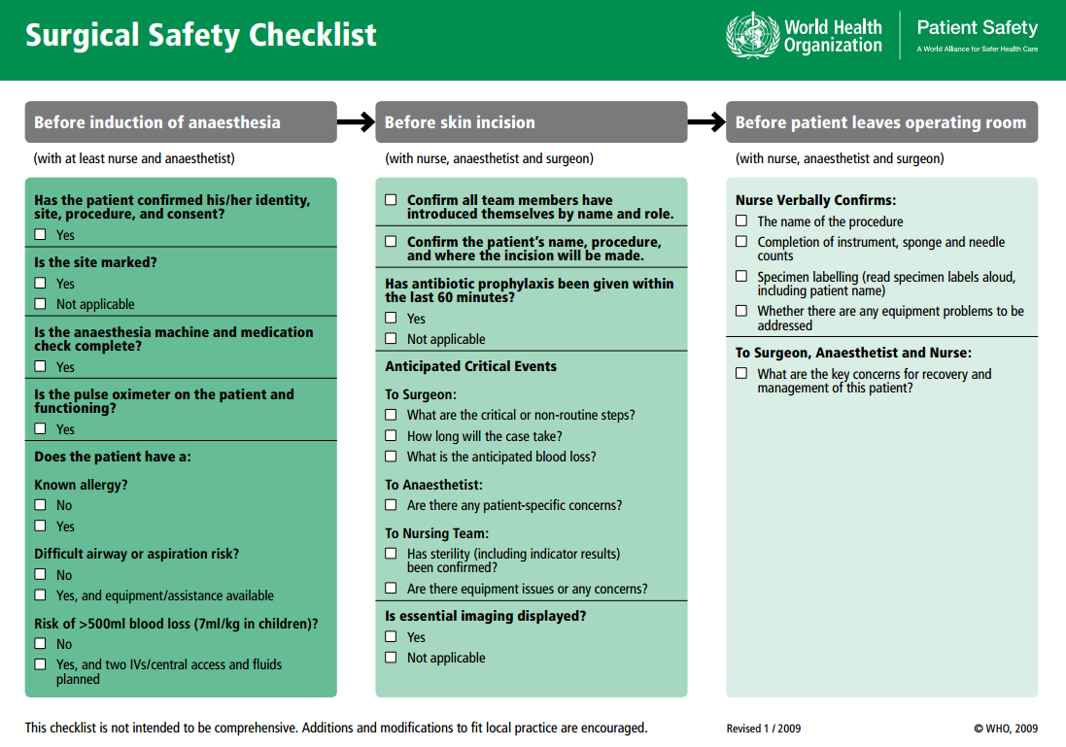
GWANDE’S CHALLENGE: PRODUCE A CHECKLIST WHICH COULD SAVE LIVES DURING SURGERY
-Produced this checklist after much trial and error.
-Learnt from aviation and events industry.
-Had demonstrable impacts on saving lives around the world.
Notes:
Gwande (2010) Q13 is a leading advocate of the use of clear and simple checklists to deal with the problem of complexity. This advocacy was informed by his experience as a surgeon and the highly complex surgical procedures which have developed, where if one small detail is overlooked, it really can mean the difference between life and death

Slide 10
TYPES OF CHECKLISTS
Gwande (2010) problems can be:
Simple (e.g. steps for making a cake).
Complicated (e.g. the steps for a moon mission, staging a large scale event).
Complex (e.g. bringing up children).
The risk register can, in some instances, suffice as a checklist.
In other instances, separate checklists and procedures may need to be developed.
Checklists can range from DO –CONFIRM (i.e. confirm you have done an action) and READ – DO (i.e. read what has been written and do it).
If it is an operational checklist, identify points where verification can be confirmed.

Slide 11
HOW TO DEVELOP A CHECKLIST
Ask what can go wrong, or will go wrong using mind maps and scenario planning.
Check insurance.
Check chains of command.
Select staff/train and prepare.
Emergency procedures.
Contacts – are they clear and up-to-date?
Ask yourself this – “How could I justify this decision in courts?”
Develop a checklist manual which is easy to understand (or links into other checklists).
Date and sign the forms with any subsequent amendments or reviews.

Slide 12
WHAT MAKES A GOOD CHECKLIST
Must be easy to understand.
People must be utterly disciplined in adhering to the checklists of actions where failure to complete an action can result in a catastrophic risk event.
No one should see themselves as ‘above’ or too experienced to adhere to a checklist. Memory and knowledge can be imperfect, so learn to trust procedures.
The key is not necessarily about remembering everything, but remembering where to access information.
Checklists must be tested with staff to ensure they avoid being vague, imprecise and too long. Running live scenarios are useful for testing and refining procedures.
Checklists should make reference to industry or regulatory standards.
Waivers (discussed in Chapter 5) although they do not remove liability, can be turned into checklists to remind people of the risks and to check that they have adopted any recommended measures (e.g. safety equipment, medical declarations, securing belongings, etc.).
Must be dated.
Must be reviewed.
Think holistically.
Identify all the hazards and dangers.
Evaluate the probability/frequency and the severity.
Identify who is vulnerable.
Identify the chain of responsibility and command.
Develop proactive strategies to deal with the potential risks.
Develop strategies that deal with accidents.

Slide 13
CONTEXTUALISATION AND APPLICATION TO THE DIFFERENT SECTORS
At the end of the chapter in the book, a variety of examples are given to illustrate how these concepts can be applied to specific industry sector examples.
You are encouraged to select the most relevant sector examples related to your teaching and learning needs.

Slide 14
CONCLUSION
Checklists cannot solve all problems, or deal with all crisis situations.
Sometimes a person’s judgement at the time of the crisis is what is of critical importance, whereby a checklist may be used as a barrier to decisive action.
‘Generally, however, if the crisis checklist has been designed well, it will prove to be more beneficial than not, and provide a strategy for dealing with complex risk situations.’

Slide 15
REFERENCES
Gwande,. E. (2010). Checklist Manifesto. Profile Books, London.

Slide 16
ADDITIONAL REFERENCES/LINKS
This is a link for the benefits of using aviation checklists: http://flighttraining.aopa.org/students/presolo/
skills/checklist.html (accessed 5th August 2015).
BBC link (has the link to the checklist): http://news.bbc.co.uk/1/hi/health/8493922.stm (accessed 5th August 2015).

Slide 17
Thank You
Name: Dr Mark Piekarz
Email: m.piekarz@worc.ac.uk

