Slide 1
Risk and Safety Management in the Leisure, Events, Tourism and Sports Industries
Mark Piekarz, Ian Jenkins and Peter Mills

Slide 2
Chapter 4 – Risk Management Research, Models and Tool Application (Part 2 - Tools)

Slide 3
These relate to the chapter objectives in Chapter 4
To explain the difference between theories, tools and models.
To provide an overview of the many different tools which can be used to identify, analyse and assess risks.
To provide a variety of examples to illustrate how the tools can be used for the different sectors.
To explain the basic principles of the research process and where data can be accessed from.

Slide 4
-This is the first of a two part lecture on Tools and Research.
-Analysing risk is a key component of the practical risk process (H & S, project and strategic risk analysis).
-It is the most complex stage.
-It involves research to collect data (separate lecture) which can be used for various tools to identify past, present and future hazards and risks.

Slide 5
CLARIFYING THE KEY TERMS
Tools
Techniques for analysing or assessing the risks, such as using checklists, or scenario exercises are used at various stages in the risk process.
Theory
These are the foundation for models and tools and give insights, understanding or explanations about the world, or in this instance, how and why risks manifest themselves in particular ways.
Models
A simplification of the world (e.g. see chapter 2 and the anatomy of risk model) to help with analysis.
Tools need data, which can then be used to:
Help identify risk and hazards.
Help analyse patterns of causation.
Help assess possible impacts.
Help guide actions/make decisions.

Slide 6
AN OVERVIEW OF THE PROCESS STAGES AND TOOLS
 | What needs to be considered | Examples of tools
Stage 1 - Context | -What is the nature of the organisation? -Who, what, how and where of risk | -Mind-mapping -SWOT (leading into PESTLE and process stage 2) useful for project and strategic assessments
Stage 2 - Analysis | -Identifying key risks -Identifying key hazards -Identifying key causation factors -Identifying any triggers -Analysing the relationships of factors -Identifying and analysing suitable indicators of causation | - SWOT & PESTLE (expanded from the previous stage) Mind mapping (see section 4.6.1) -Fishbone analysis (see section 4.6.2) Causal loops (see section 4.6.3) -Event and fault tree analysis (see section 4.6.4) -Spatial analysis (see section 4.6.5) -Checklists (see also Chapter 6) -Financial tools, such costs of capital returns, cash flow forecasts, etc.
Stage 3 – Assessment | -Assessing type of impacts and severity -Assessing likelihood -Applying assessment scales to represent or categorise the risk (e.g. high, low, medium) | -Statistical analysis of frequency profiles, impact matrixes, spatial analysis (see Chapter 3) -Risk mapping on grids -Monte Carlo method -Trend extrapolation
Stage 4 - Control | -Prioritising resources -Reviewing points where control measures can be put in place Measures to reduce severity of impact -Producing action checklists | -Review critical paths, scenarios and assessments -Scenario training -Checklists of actions (Chapter 6) -Decision tree scenario analysis
Stage 5 – Monitor | -Review checklists, forms, assessments and analysis. -Amend control measures | -Reviewing key performance indicators (Section 4.7) -Responding to events

Slide 7
TOOLS 1: MIND MAPPING (See chapter 4)
Relaxed, open and rule nothing in or out.
Focus on key words, then let ideas flow or branch off/radiate.
Various methods/software packages such as the Buzan method (links at the end of this chapter).
It draws on ideas of lateral thinking (Edward de Bono 2009).
If doing it as part of a group mind map, avoid criticising ideas and draw on different people’s knowledge and experiences.
Use it to both understand the breadth and variety of risks, then use it later to develop solutions and control measures.

Slide 8
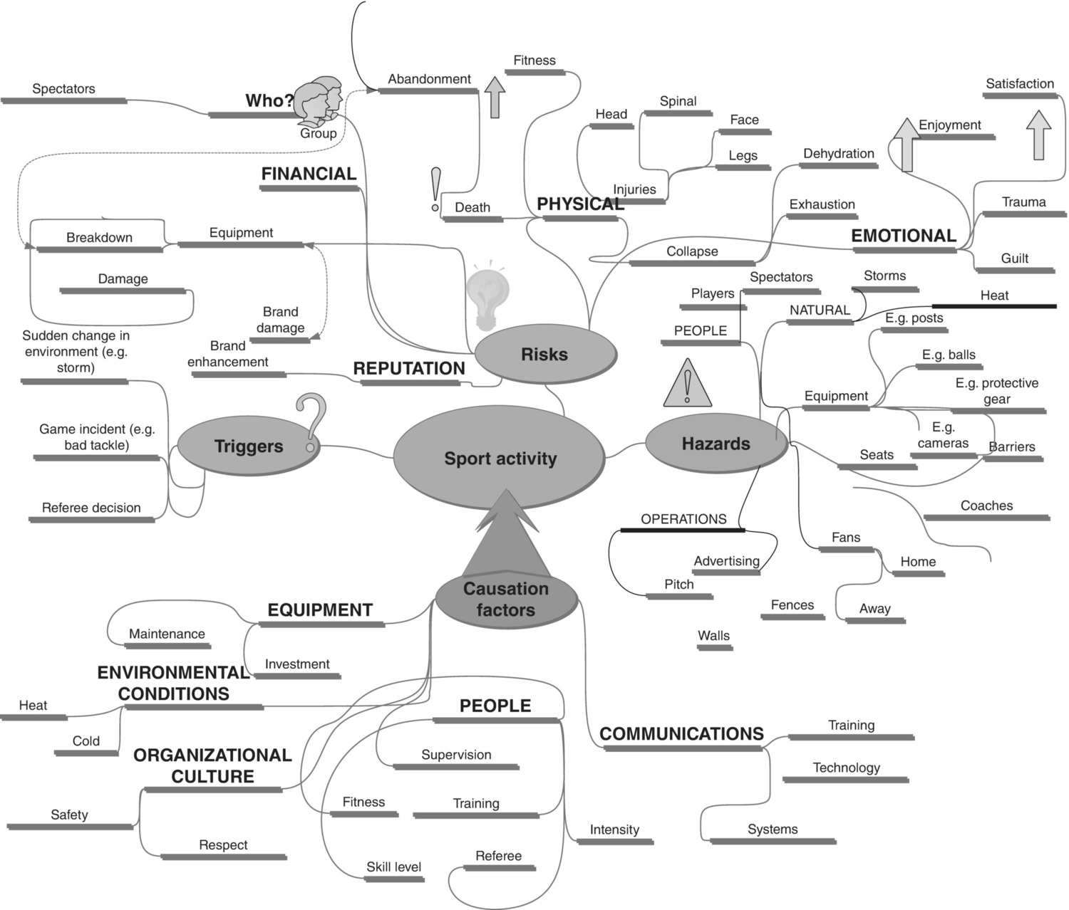
MIND MAPPING EXAMPLE
-Starting point
-Share experiences and ideas
-Encapsulated by such clichés as ‘thinking outside of the box’ or ‘blue sky thinking’
- This example uses the simple anatomy of risk model (Chapter 2) to identify a range of risks, hazards and causation factors.

Slide 9
TOOLS 2: FISHBONE ANALYSIS
Head of the fish encapsulates the problem, or the risk.
From the head, work backwards to create the diagram.
The bones represent the key causation factors.
The broad causation factors spur of the main spine (e.g., causation factors based around people, equipment, communications, organisational culture, using PESTLE, etc).
Some of the earlier checklist questions in the process stages can be used to generate ideas for the main spurs.

Slide 10
EXAMPLE OF A FISHBONE DIAGRAM: SPORT INJURIES

Slide 11
TOOLS 3: CAUSATION LOOPS
Represent complexity and how multiple factors can contribute to an outcome.
There are different types of loops, such as reinforcing loops (it will see an increase or improved effect, indicated by a + sign), or a balancing loop (as something is put in, something leaves, or has a negative effect indicated by - sign).
Systems have feedback, where events lead to other events.
Systems can also stabilise themselves (the theory of homeostasis).
It can be useful to identify key stakeholders and relationships.
It can be useful in project risk management analysis.
It can consider how one factor can affect another factor, or identify which factors are related.

Slide 12
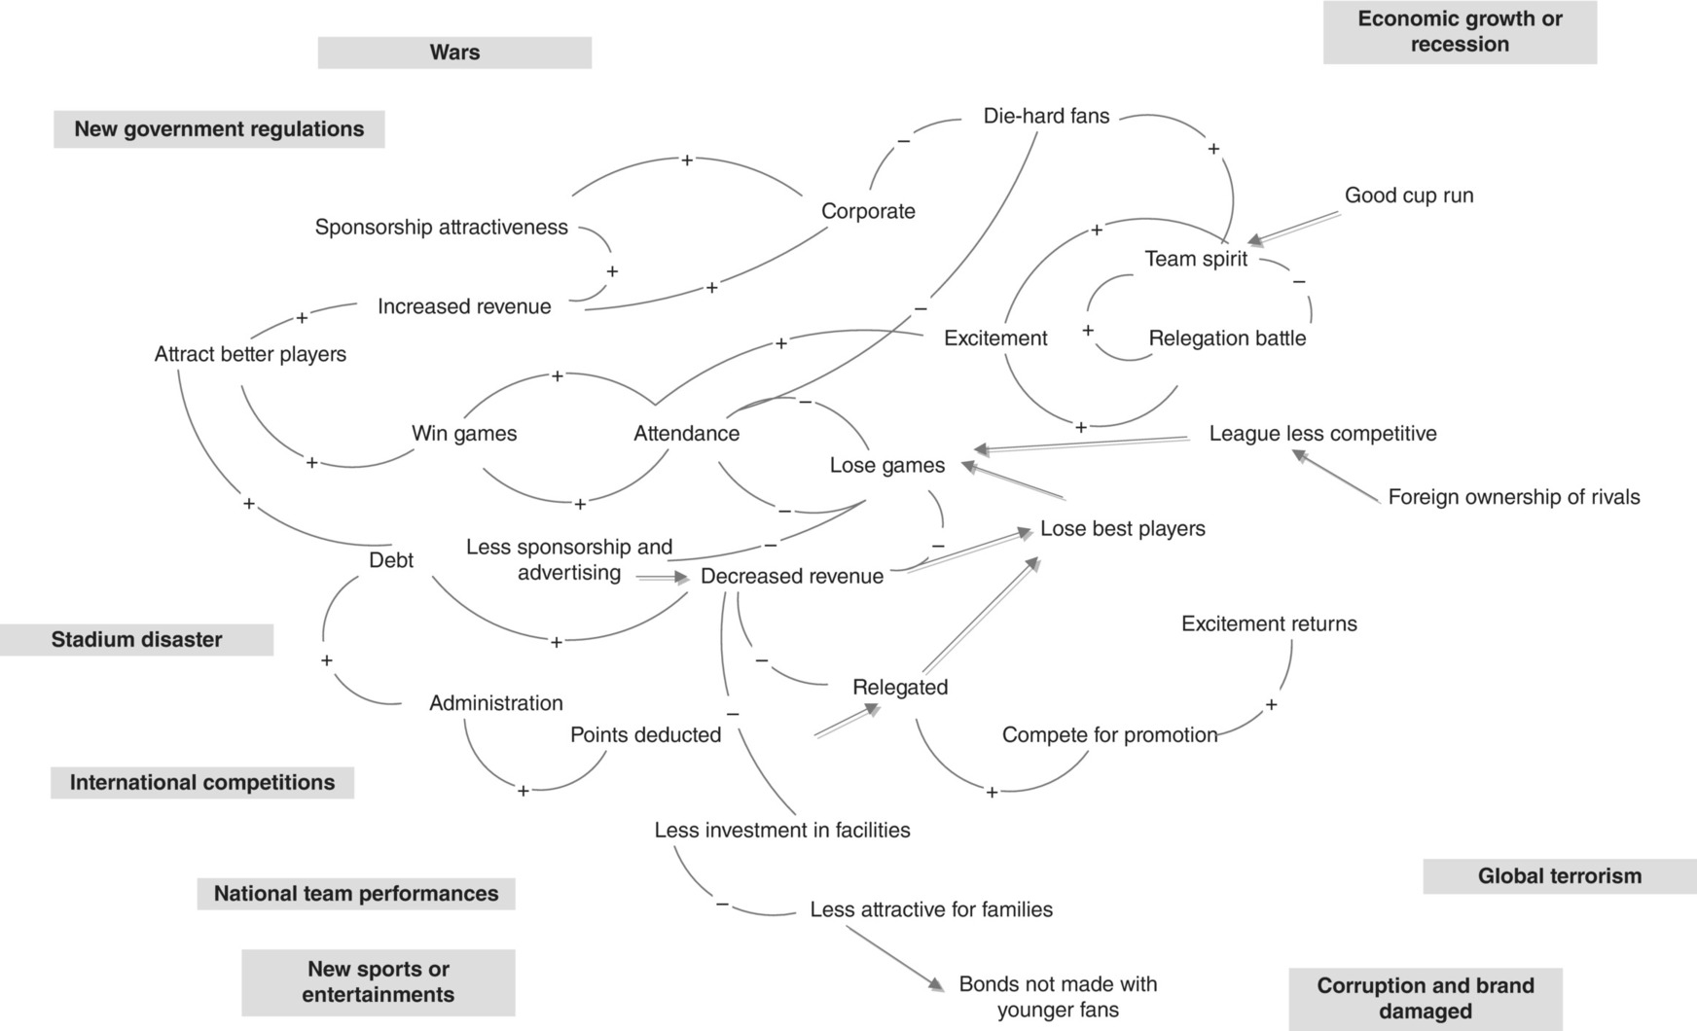
CAUSATION LOOP: A STRATEGIC FOOTBALL CLUB FAILING OR SUCCEEDING

Slide 13
TOOLS 4: EVENT AND FAULT TREE ANALYSIS
Begin with mind mapping to identify potential failure points or risks.
Consideration given to the key elements or ingredients which can lead to that event (e.g., a house fire needs oxygen, fuel and a source of ignition).
Causal factors are linked to the incident by ‘OR’ or ‘AND’ gates.
An ‘OR’ gate indicates that only one of the causes need be present to cause the event, whilst the ‘AND’ gate indicates that all the causation factors were, or are needed (e.g., a fire to occur would have the AND gates of oxygen, fuel and ignition as all must be present, whilst for the ignition, this could have a number of possible OR gates, such as an electronic failure, or a dropped cigarette, etc.).
It should form a tree-like flow chart.
The different pathways are called ‘nodes’ and represent deviations which could occur.
Use some of the following terms to convey a sense of probability: None; More of; Less of; Reverse; Other than; Part of ; More than.

Slide 14
FAULT TREE FOR A SUDDEN DEATH OF A PARTICIPANT

Slide 15
CRITICAL PATH FOR AN EVENT TREE FOR A TERRORIST BOMB ATTACK

Slide 16
EVENT TREE DIAGRAM FOR SUDDEN DEATH OF A PARTICIPANT

Slide 17
FAULT TREE: WHAT CAN LEAD TO A TERRORIST ATTACK

Slide 18
TOOLS 5: SPATIAL ANALYSIS
At its simplest level it is about looking at maps and plans where activities take place and identifying potential hazards and risks.
It can also represent data collected as part of a frequency table.
Can work on the same sort of lines as a police hotspot map, whereby they may highlight acts of criminality.
In the past these would be done with pins on a map, now they are done electronically.

Slide 19
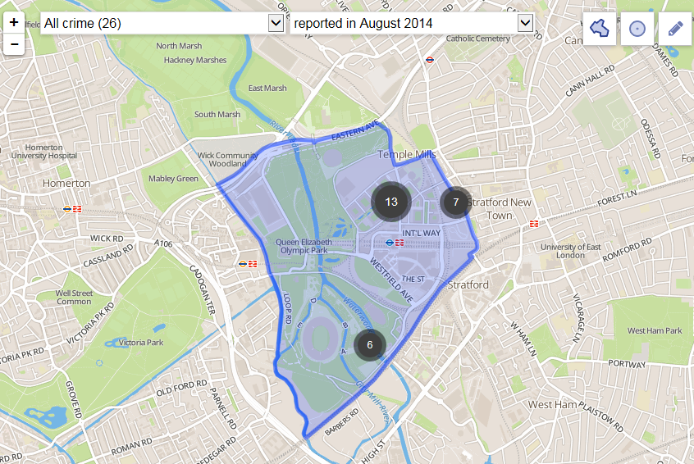
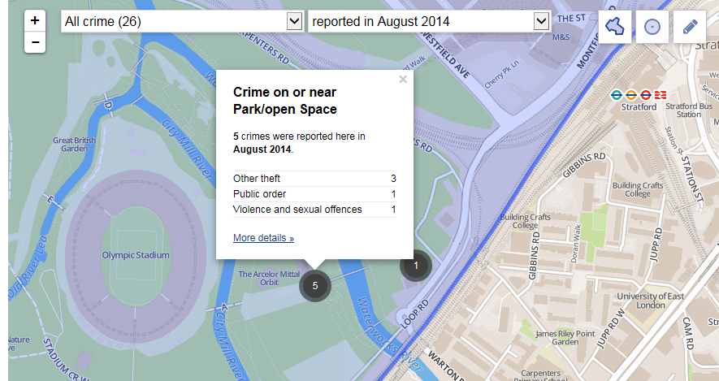
Shown here is a map of the Olympic park area in London, where the 2012 Olympic Games took place. The numbers highlighted give a snapshot of the crimes which took place for 2014, showing the total number of recorded incidents, with the second map giving a more detailed breakdown of the crimes which took place near the stadium. This spatial analysis quickly and easily helps to identify hazards (e.g. thieves), risks (e.g. loss of property) and where resources can be placed to deal with the risk of theft, such as placing more stewards in certain locations.

Slide 20
CONCLUSION
Many other possible tools which can be used.
The various tools described are not purely risk management techniques.
They illustrate that risk management should blend in with everyday practices, whereby risk management is not seen as an onerous, additional activity.
Although the tools may seem initially complex, once one or two are mastered, they are drawn on to help a variety of working problems, particularly the ones which encourage creativity.

Slide 21
Thank You
Name: Mark Piekarz
Email: m.piekarz@worc.ac.uk

