Slide 1
Risk and Safety Management in the Leisure, Events, Tourism and Sports Industries
Mark Piekarz, Ian Jenkins and Peter Mills

Slide 2
Chapter 3 – Key Theories Underpinning Risk Management

Slide 3
To understand the key scientific theories that have underpinned risk definitions, processes and practices.
To explain the theory of probability and how it can be used by practitioners.
To explain how chaos and complexity theory has influenced more recent theoretical approaches to risk management.

Slide 4
INTRODUCTION
Does risk actually exist?
Why do we try and reduce risk to a number or value?
What’s the theory behind having to record all accidents?
Why do so many forms use numeric values to assess risk?
Can one reduce risk assessments down to numeric values?
…All these questions are considered in this lecture

Slide 5
TWO SCIENTIFIC TRADITIONS HAVE INFLUENCED HOW WE CONDUCT RISK ANALYSIS AND ASSESSMENT
Scientific school 1 – Positivism
- Decisions made on the basis of collecting past data and studying the patterns to help quantify risks. “…anything exists, then it exists in some quantity and can therefore be measured and so verified (Adams, 1995, p10, citing Lord Calvin).
- Belief that we can be objective (free from bias) when looking at data.
- Associated with traditional sciences, medicine and engineering.
Scientific school 2 –Interpretivism
-We cannot remove biases and emotions from analysis, therefore it will always be subjective.
-Associated with social sciences of sociology and anthropology.
-Offer an important critique of the positivist scientific method.

Slide 6
IMPACTS OF THESE DIFFERENT POSITIONS ON RISK MANAGEMENT
Positivist
-Dominated many practical risk approaches.
-Understanding the founding principles gives an insight into:
The legal compulsions to record accidents in work places;
the use of the concepts of probability and severity;
the use of various scales to represent the degree of risk based on the belief that risk can be objectively measured and quantified.
Interpretivism
Critiques remind managers that their decisions can always be prone to error and bias.
-Show that scientific or expert opinion about risks can change over time, sometimes because of more research, or sometimes because social attitudes change.
Try this link to see how ‘objective’ risk can change over time: https://www.youtube.com/watch?v=D-y_N4u0uRQ (accessed 12 June 2015).

Slide 7
THE DIFFERENT TYPES OF RISK
Objective (expert)
Inherent (part of activity)
Subjective (non-expert)
Objective risk: The experts’, or scientists’ definition of risk, who (in theory)make probability risk assessments in an unbiased, unemotional manner, usually based on statistical evidence.
Subjective/perceived risk: The lay persons, or non-expert assessment, which can be biased or distorted by a person’s preconceived views, emotions, experiences or a lack of information.
Virtual risks: Adams (2011) describes this as the areas which are contested between scientific research and people’s direct experiences, or even perceptions of fear.
Inherent/real risks: The risks associated with the activity, but which cannot be removed without destroying the essence of the activity. These can be further refined by distinguishing between subjective real risk, those which can be controlled through skill, judgment and equipment and objective real risk, which cannot be controlled, such as a rock fall.
Virtual risk (contested)

Slide 8
KEY CONCEPTS 1: PROBABILITY AND HOW TO MAKE AN ASSESSMENT OF RISK
Professional judgments, heuristics or the guesstimate
Analysis of specific case studies
Identification of frequency of past events
Identifying frequency of similar events
Key approaches which vary in the degree of accuracy and the amount of research needed:
Professional judgements: Based on past experiences and knowledge (known as heuristics and explored in Chapter 7).
Analysis of specific case studies: focus on one or two case studies in more detail, which can reveal insights into the factors of causation, the failures in systems and the critical paths which lead to the outcomes of the event.
Identifying frequency of similar events: For some activities which are new, or have little precedent, looking at the frequency of past events may not be an option, such as tour operators developing services in a new destination, or sports or adventure activities taking place in less familiar environments.
Identification of frequency of past events: Classic method, ground in positivist scientific methods. Here it can be a process of looking at the frequency of past incidents to try and: a) identify all the key risks, then b) build up an assessment of the likelihood of these risk events occurring in the future.
It should also be noted that whilst frequency and probability are sometimes used inter-changeably, these are in fact different concepts, as observing frequency is a means to build up probability estimates.

Slide 9
Theory 2 - Incident triangle
One major incident/accident
A few incidents with minor injury
Tens of ‘near misses’
Thousands of ‘unsafe acts’

Slide 10
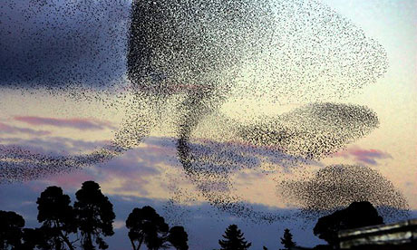
KEY CONCEPTS 3: CHAOS AND COMPLEXITY THEORY
Linear order and causation?
Complexity and chaos?
The problem has been that analysing causation in a simple, linear way (i.e. do A, then B occurs, such as one domino knocking over the next, etc.), does not represent the complexity of how risk and crisis events actually emerge.
Therefore other theories have developed to try and represent this complexity and a deeper analysis of causation.
To gain a sense of this, just look at the various case studies and analyse the complex interaction of causation factors that lead to the risk event.

Slide 11
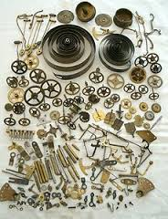
KEY CONCEPTS 3 (continued): CHAOS AND COMPLEXITY THEORY
Complexity theory
-Complexity theory and chaos theory can be intimately related, but have some different strands.
-Simply put, whilst the world is complex, it is not always chaotic.
-It can in theory, be easier to determine the outcomes if all the variables are known.
-Baggio (2008) says a system is considered complex if its parts react in non-linear ways, in that there is not a simple pattern of cause and effect.
-Complexity theory looks to understand aspects of the world as part of a wider system, where many different elements connect and can influence each other.
-It has been an attractive theory to try and adapt to the world of business and risk.
-Attempt to discover a complex interaction of factors which may lead to a risk or crisis event.
Chaos theory
- Developed to understand natural systems, such as the weather.
- Adapted to many other areas of business, politics and economics.
-Refers to the idea that systems are interconnected, where small changes can reverberate through the system, leading to more profound changes.
-Encapsulated by the analogy of the butterfly flapping its wings, with the small changes in air currents, leading to a hurricane the other side of the world.
-Has causation feedback loops and is more difficult to predict (i.e. chaotic).
- Sensitivity to small changes.
A watch can be complex, but it
works in a predictable manner

Slide 12
KEY CONCEPTS 3 (continued): CHAOS AND COMPLEXITY THEORY
-These theories have helped shape the 4th age risk paradigm: that risk should be considered in terms of upsides and downsides and as embedded in complex systems.
-Managers rarely analyse systems which are closed (i.e. all the outcomes are known), but systems which are open and therefore complex, potentially chaotic.
-It is useful as a way of thinking, whereby the view can be adopted in risk management that businesses and organisations are always operating on the edge of chaos.
-Johnson (2006) argues that businesses should run their operations so they can adapt, or are agile enough to change practices as the external business environmental conditions change.
-It is a process where change is embraced and which can nurture innovation, with such systems being described as a complex adaptive system, because they change as the environmental conditions change.
-Adams (1995) represents complexity using
his Risk Thermostat theory.
Failure to adapt and the analogy of the Dodo. The dodo was a bird which had become so specialized to its eco system it meant that it was unable to adapt when the equilibrium of its environment was disturbed (i.e. humans arriving) and so it became extinct. The same can be said of businesses which fail to adapt to changing business environmental conditions
Flipping a coin where the chance of heads or tails is always 50/50 is an example of a simple closed system where the outcomes are known, therefore the outcome can be predicted with a degree of certainty. It is rare that the analysis of risk focuses on such simple, closed systems.

Slide 13
THE PROBLEMS WITH FUTURE PROBABILITY AND IMPACT ASSESSMENTS
No doubt that statistical analysis of past events is an important foundation in risk management.
It is essential that managers appreciate the potential problems, as it helps them question and reflect on their decisions and how their analysis of situations could be wrong.
Key problems:
Fooled by randomness.
Past sometimes a poor predictor of the future.
Heuristic traps (discussed in chapter/lecture on risk perceptions and heuristic traps).

Slide 14
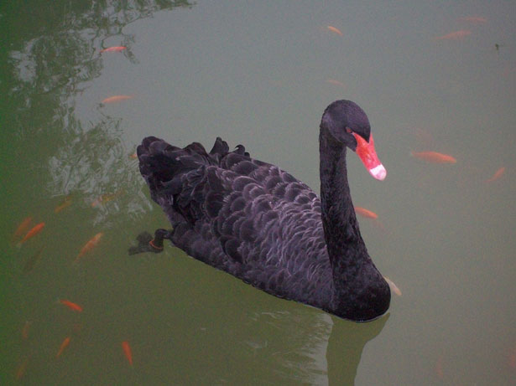
PROBLEMS 1: FOOLED BY RANDOMNESS
Chapter 3 identifies more issues.
People can see patterns that may not exist.
Data is used to validate decisions already made.
The black swan or unexpected event
The analogy goes that through the counting and observation of swans in Europe, one could collect a huge amount of historic statistical data (the empirical distributions mentioned earlier), which could be used to develop a conclusion that all swans are white. It would however need one example of a black swan to nullify this conclusion (as in fact they were when black swans were in found in Australia.

Slide 15
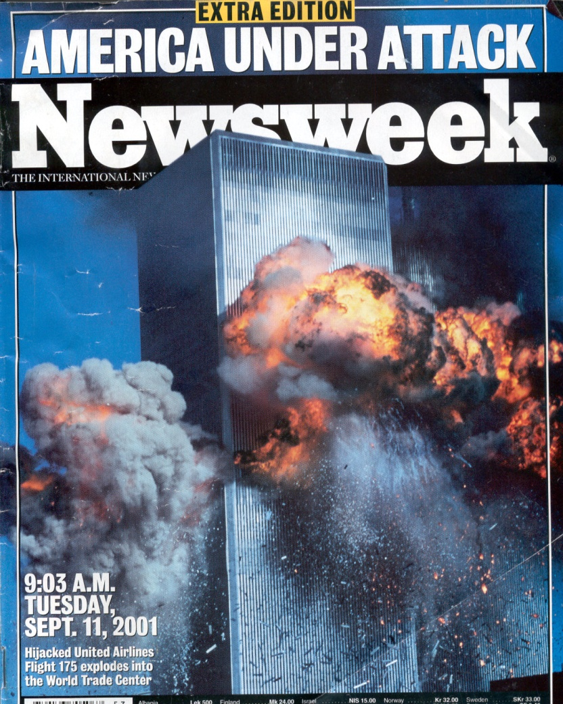
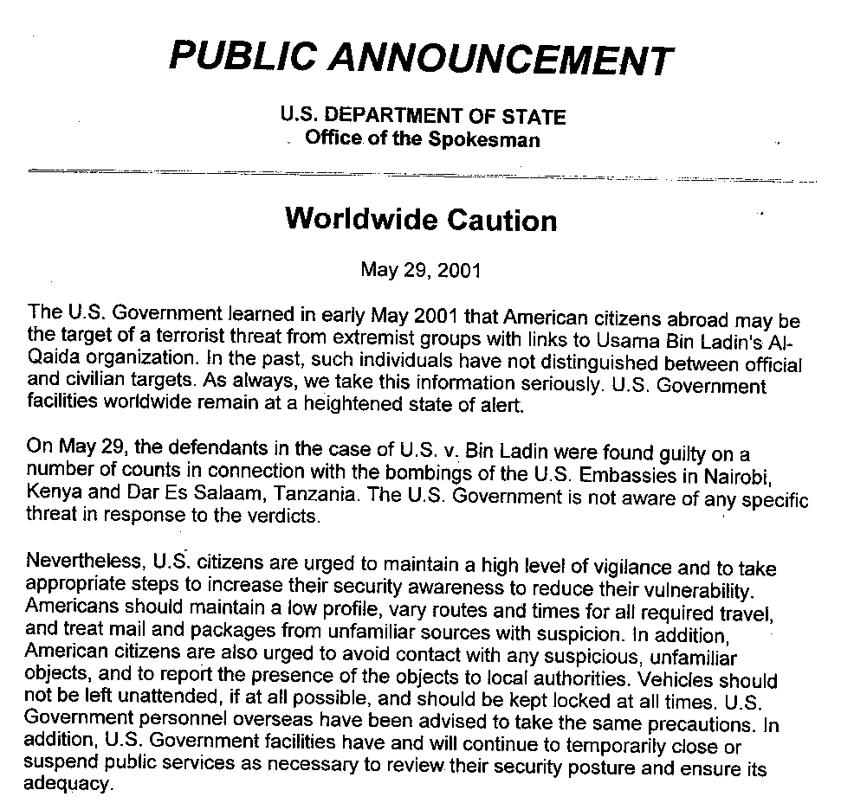
PROBLEMS 2: PAST SOMETIMES A POOR PREDICTOR OF THE FUTURE
Why is the past a poor predictor of the future?
Crisis creep and the analogy of cooking frogs.
The unexpected event where there is not history ….. 9/11, banking crisis, wars, accidents, etc…(not happened before so we cannot imagine it).
Even though there were warnings of a possible terrorist attack, and people had warned of using planes in terrorist attacks, the lack of precedent meant it was difficult for people to image this type of terrorist attack and the scale of devastation.
Handy’s (1990) analogy of frogs, who apparently will jump out of hot water, but will not do so if they are slowly boiled, because their skin is designed to spot sudden changes in temperatures, not gradual ones.

Slide 16
CONTEXTUALISATION AND APPLICATION TO THE DIFFERENT SECTORS
At the end of the chapter in the book, a variety of examples are given to illustrate how these concepts can be applied to specific industry sector examples.
You are encouraged to select the most relevant sector examples related to your teaching and learning needs.
It is recommended that the examples used should depend on the sector.

Slide 17
CONCLUSION
Using numbers can help us assess risk.
Numbers don’t make your decision, they should inform it.
Need to view risks as existing in more complex systems (4th age paradigm).
Always be aware of the limitations of your analysis and be prepared to adapt as circumstances change.

Slide 18
DISCUSSION QUESTIONS
Search for examples of an injury, such as concussion, or spinal injuries, in a number of sports and compare the incident rates and the control measures the sport has to deal with the injury.
Choose a country which has a challenging environment, such as a desert, rain forest or mountains, then go to the relevant government travel advice sites and:
Build up a table which identifies the key hazards and risks
Build up a frequency table of incidents.
Consider how this data could be used to inform an adventure expedition to the selected destination.
Explore a news story where people have been excluded from an activity where arguments of risk have been used.

Slide 19
IN CLASS ACTIVITY
Tennis ball exercise
Identify the key hazards and risks.
Throw ball 10 times: two hands, one hand, weaker hand throw and catch, one eye closed. Plot number of successful catches, drops, near misses.
Based on the data, which is the safest? Why?
How do rules change the risks? Which was the most fun? How do the changes change the odds/probability of dropping the ball?
How many near misses were there when the ball was nearly dropped?
Key points: This is frequency, which can be used to assess probability.

Slide 20
REFERENCES
Adams, J. (1995) Risk, UCL Press, London.
Adams, J. (2011) Not a 100% sure? The public understanding of risk. In Bennett, D.J. and Jennings, R.C. (eds.) Successful Science Communication. Cambridge University Press, Cambridge.
Aven, T. and Renn, O. (2009) On risk defined as an event where the outcome is uncertain, Journal of Risk Research, 12, 1-11.
Baggio, R. (2008) Symptoms of Complexity in a Tourism System, Tourism Analysis, 13, 1-20.
Bandolier (2014), Risk of dying and sporting activities, available at: http://www.medicine.ox.ac.uk/bandolier/booth/risk/sports.html (accessed 12 June 2015).
Handy, C. (1999) Beyond Certainty; The Changing World of Organizations, Harvard Business School, Boston.

Slide 21
Additional websites
Websites that can give information on accidents and incidents:
Bandolier is an online healthcare journal which has useful information about accidents, injuries and research, available at: http://www.medicine.ox.ac.uk/bandolier/index.html
National Safety Council is a useful database to find statistics and incidents, available at: http://www.nsc.org/about_us/Pages/Home.aspx
Stop Sport Injuries is a USA based charity and has a range of useful resources to help understand causation, track incidents and control measures, available at: http://www.stopsportsinjuries.org/
National Centre for Catastrophic Sport Injury Research (NCCSIR) has a variety of useful case study and statistical information available at: http://nccsir.unc.edu/
Headway is a charity which deals with brain injuries and has a range of useful information to help practitioners, available at: https://www.headway.org.uk/home.aspx
Travel advice and incident data:
Intelligent Life, available at: http://intelligenttravel.com.au/ (a consultancy which has all sorts of useful information)
Australian Department of Foreign Affairs, available at : http://www.dfat.gov.au/
UK: Foreign and Commonwealth Office, available at: https://www.gov.uk/government/organisations/foreign-commonwealth-office
USA: State Department (foreign travel), available at: http://travel.state.gov
New Zealand: Ministry of Foreign Affairs and Trade), available at: http://www.mfat.govt.nz/

Slide 22
Thank You
Name: Mark Piekarz
Email: m.piekarz@worc.ac.uk

