Slide 1
Risk and Safety Management in the Leisure, Events, Tourism and Sports Industries
Mark Piekarz, Ian Jenkins and Peter Mills

Slide 2
Chapter 2 – Risk Definitions, Cultures and Practical Processes

Slide 3
These relate to the chapter objectives in Chapter 2:
To examine and compare different risk definitions and how they can shape the risk cultures.
To explain what a risk culture is and how it can influence the way in which risks are analyzed and assessed.

Slide 4
INTRODUCTION
Risks can be considered in two ways:
  risk as a culture (how risk is defined and what is viewed as a risk);
  risk as a practical management process (the steps which need to be taken to identify, analyse, assess and control risks).
This presentation risk culture/definitions (see separate presentation on the ‘risk process’).
It then identifies the key risk concepts represented as a model Anatomy of Risk.

Slide 5
HISTORICAL ORIGINS OF THE WORD
Possible root word origins:
  From the Arabic word risq - anything given by God which creates or brings fortune
  Or, Latin word riscum - the challenge a barrier reef presents to a sailor for good or bad
  Or, Early Italian risicare, which means ‘to dare.’ (Bernstein, 1998)
  Or, French word risqué - the chance of a negative or positive outcome.
Enters the English language in the mid 17th century.
Strongly associated with the growing maritime and insurance industries of the time.
Today it is used in all fields of industry, at all levels of work.
As the next slide illustrates, it has many variations.

Slide 6
COMPARING DEFINITIONS: SOME EXAMPLES
Asymmetric definitions (negative focus) | Symmetric definitions (positive and negative focus)
1.’Risk is the chance, high or low, of somebody being harmed by the hazard, and how serious the harm could be. ‘(HSE 2012). UK based. | 2. Risk is defined as ‘…the possibility of something happening that impacts on your objectives. It is the chance to either make a gain or a loss. It is measured in terms of likelihood and consequence.’ (AS/NZS 4360:2004 cited by ACT 2004). New Zealand and Australia based.
3.‘Risk is the potential to lose something of value, or simply the potential accident’ (Brown 1999). UK based, adventure sector focused. | 4.‘Risk management is a rational approach to the problem of dealing with the risks faced by a business. It is about managing or optimising risks; it is not necessarily about eliminating them, because risk is inherent in adventure activities – and should remain so.’ (Cloutier 2002). UK, Australia and USA.
5. ‘A risk is the likelihood that the harm a particular hazard can cause will be realised.’ (CIMSPA 2014) | 6.‘Risk management is a strategic process that will protect the assets and ensure the financial stability of an organization from the consequences of competitive business decisions. Risk management will reduce uncertainty and the potential for accidental or unanticipated loss and will provide the basis for maximizing opportunity’ (Fitzgerald 2003). Tourism and international focus, adapting the Economic Intelligence Unit definition.
See Chapter 2 for more examples on discussion on the key concept

Slide 7
ANALYSIS OF DEFINITIONS
2 key categories/approaches:
  Symmetric definitions focus on the notions of harm and loss
  Asymmetric definitions refer to ideas of gains and benefits (symmetric definitions).
Risk can have an association with the concept of chance, probability or likelihood.
Risk can be associated with the consequences and magnitude of outcome, or, for symmetric definitions, the severity of outcome.
Risk can be associated with the notion of uncertainty.
Some definitions present risk in relation to the concept of a hazard.
Risk can be regarded by some as an essential part of adventure, sport and business enterprise.
Risk management is used at all levels of management (operational, project and strategic).
Definitions are not necessarily industry sector or country specific.

Slide 8
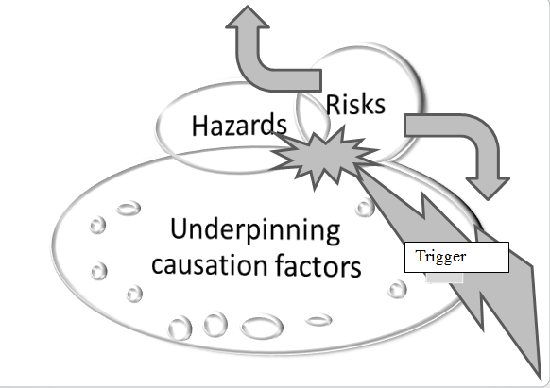
DISTILLING THE KEY CONCEPTS : THE ANATOMY OF RISKS
Looking at the different definitions, some of the following key concepts can be identified. These can be used for modelling

Slide 9
KEY CONCEPTS 1: RISK IS DIFFERENT FROM UNCERTAINTY
If the outcome of a project or event is not known, or highly biased because of a subjective viewpoint, then this can be categorised as uncertainty.
If something approaches 100% probability, it becomes a reality rather than a risk (Irwin 1998).
Some question how much we can actually make such distinctions in practice.

Slide 10

KEY CONCEPTS 2: HAZARDS
Hazards can either be seen as:
the cause of harm;
or the source of the risk.
Does it matter?
-Preference is to refer to the hazard as the source, because it encourages a more detailed analysis of causation (See the Anatomy of Risk diagram).
A simple illustration: golf and hazards
-Sand bunkers and water features are referred to as hazards.
-The risk can relate to the ball landing in these hazards resulting in shots being dropped, or a game lost.
-Bunkers don’t cause the risk – this is down to the shot played, weather conditions, player ability, but they are the source of the risks (e.g losing the game)
-The hazard is neither good or bad and must be interacted with to generate the risks.
-Part of the enjoyment and challenge.

Slide 11
KEY CONCEPTS 3: LIKELIHOOD AND OUTCOMES
Chance, probability or likelihood:
-What is the chance of a risk event occurring?
-Probability is the more precise statement of chance, derived from mathematical modelling and described in numeric terms, or given a percentage value, (e.g. a 50% probability of getting heads when flipping a coin).
-Likelihood can be a less precise term and is often expressed by qualitative statements, such as events having a ‘high’, ‘medium’ or ‘low likelihood’ of occurrence.
-The preference in this work is to use the term likelihood.
Severity, outcome, consequences, magnitude or impact:
What are the consequences if the risk event occurs?
-Work health and safety use the term severity, focusing primarily on the harm, or injuries that can occur to identified groups or people.
In other areas of risk management, or those organisations which adopt the symmetric ISO (2009) definition of risk, the preference can be to use one of the other, more neutral terms, such as outcome or consequence.
Should consider not only who can be exposed to injuries, but also what can be impacted upon.

Slide 12
KEY CONCEPTS 3 (CONTINUED): OUTCOMES AND RISK EXPOSURE
What assets/components are exposed to risks? Key stakeholders, buildings, equipment, operational schedules, finances, reputation or brand and market or league position.
How are these assets exposed? (Types)
Physical harm, emotional harm, physical damage to equipment or buildings, loss of building or equipment, operational time delays, financial losses or gains, imprisonment, competitiveness slippage or gains, credibility or reputation lost or enhanced.
Degree of risk exposure?
Relative stake of investment, client attribute (e.g., children compared with adults), the time invested, degree of captive investment (i.e. a building, such as a hotel, in a country cannot be moved, whereas some services have no physical investment in buildings or equipment).
Type of exposure
Degree of exposure
What is exposed to risks?

Slide 13
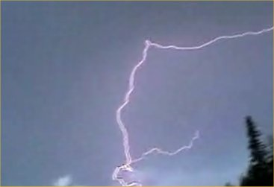
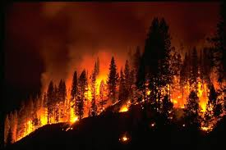

KEY CONCEPTS 4: TRIGGERS
A trigger, spark or catalyst event may sometimes be needed to unleash the hazards and risks.
McKelvey and Andriani (2010) notes how risk events can ‘incubate’ or smoulder away unnoticed, just needing a triggering event to create a risk or a more serious crisis.
Forest fire analogy :
Hazards: the forest fire
Causation factors: The underlying hazardous causation conditions or factors (source of risks): long, dry summer, dry forest, combustible materials
Risks: the fire hazard can be a source of various risks when the fire bisects (the point of interaction) with people, such as loss of life or property.
Triggers/catalyst: lightning strike, or a dropped cigarette, with the consequence that a hazardous event occurs: the actual forest fire.
Analysis: Analysed in terms of likelihood of occurrence, and assessed in terms of outcomes, which could relate to the cost of a home being burnt down, or the physical dangers presented to individuals.
Upsides? It should be noted how forest fires are in fact a necessary part of many forest eco -systems, and so produce many upsides, such as allowing new growth to develop.

Slide 14
CONTEXTUALISATION AND APPLICATION TO THE DIFFERENT SECTORS
At the end of the chapter in the book, a variety of examples are given to illustrate how these concepts can be applied to specific industry sectors.
You are encouraged to select the most relevant sector examples related to your teaching and learning needs.

Slide 15
CONCLUSION
Risk is about how likely risk events are and the magnitude of the impacts.
Risk is NOT just about removing all hazards and risks, or dealing only with threats.
It is about controlling them and making the most of the upside risks.
Risk is about decision making (operational) and planning (strategic).

Slide 16
DISCUSSION QUESTIONS
Write down what you understand about risk, or reflect on how your views and understanding of risk may have changed after reading this chapter.
Conduct a simple internet search looking for risk definitions. What emerges in relation to how they are defined and how do they compare with the approaches used in this book?
For an activity of your choice, try and identify as many hazards as you can, along with how people or the organisation may to interact with them to generate opportunistic or threatening risks.
Scan the news for an incident relating to a chosen industry sector and apply the anatomy of risk concepts. Ensure you try and analyse causation in relation to a complex interaction of factors.

Slide 17
REFERENCES
AS/NZS ISO 31000 (2009) Risk Management – Principles and guidelines. Joint Australia/New Zealand committee.
Brown, T., J. (1999) Adventure risk management, in Miles, J. C. and Priest, S (eds.) Adventure programming, Venture Publishing, Pennsylvania, USA,.
Cloutier, R. (2002) The business of adventure tourism, in Hudson, S. (ed.) Sport and Adventure Tourism, Haworth Hospitality Press, New York.
CIMSPA (2014) Risk Assessment Manual. 5th edition. (IMSPARAM). CISMPA, UK.
HSE (2012) Frequently asked questions, available at http://www.hse.gov.uk/risk/faq.htm#q7 (accessed 12 June 2015).
Fitgerald, P. (2003) Risk Management Guide for Tourism Operators, Canadian Tourism Commission, Ottawa.
Irwin, W., T. (1998) Political risk: a realistic view toward assessment, quantification, and mitigation, in Moran, T., H. (ed.) Managing International Political Risk, Blackwell Publishers, Oxford.
McKelvey, B and Andriani, P (2010) Avoiding extreme risk before it occurs: A complexity science approach to incubation, Risk Management, 12, 54 -82.
ISO (2009). Risk Management—Principles and Guidelines. Geneva: International Standards Organisation.

Slide 18
Thank You
Name: Dr Mark Piekarz
Email: m.piekarz@worc.ac.uk

