Slide 1
Risk and Safety Management in the Leisure, Events, Tourism and Sports Industries
Mark Piekarz, Ian Jenkins and Peter Mills

Slide 2
Overview – How to use the lecture slide

Slide 3
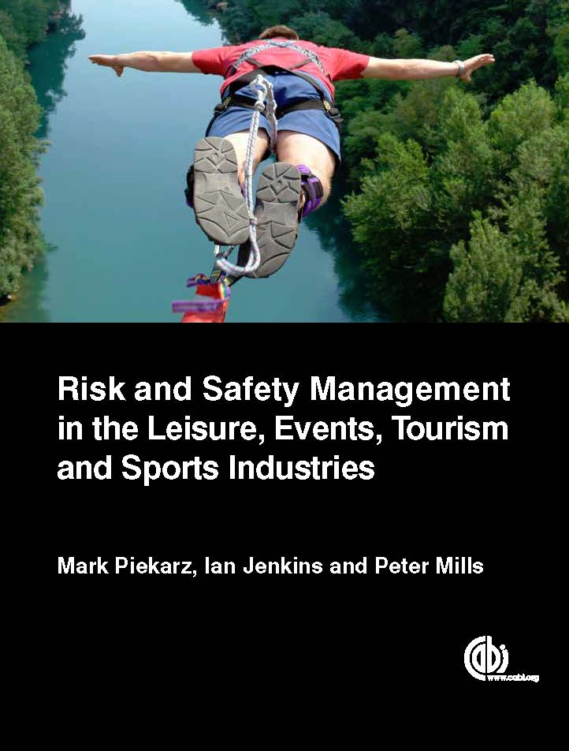
INTRODUCTION
There are a series of lectures which complement the book ‘Risk and Safety Management in the Leisure, Events, Tourism and Sports Industries’.
This book is about risk analysis, assessment and decision making.
It explains the key underpinning theories and concepts of risk management in relation to:
  The different levels of management (e.g. health and safety, operational, project and strategic).
  The different sector variations and similarities.
  The different countries variations and similarities.
The following slides give a simple overview of how risk management is approached and tips for how to use the book and lecture slides.

Slide 4
WHAT THE BOOK IS ABOUT
Understanding the theory and concepts of risk management to help analyse, assess and make better decisions about risk.
It is about not simply replicating past practices, but understanding why they are done and how they can be improved.
Risk management is a way of analysing the organisation and the business environment.
Ultimately, it is all about trying to make good management decisions.

Slide 5
HOW RISK IS APPROACHED AND DEFINED
Risk is examined as a practical process (how to risk manage) and as a culture (how risk is viewed and understood).
Risk DOES NOT use the simple definition of ‘risk as a danger which has the potential to create loss or injury’.
The preference is to use a broader based definition of risk as something which has the potential or chance of creating both threats (downsides) AND opportunities (upsides).
Why this approach?
  Risk is an integral part of many activities and businesses, so removal of risks is not realistic.
  Encouragement to see the benefits not just the problems of engaging with risks.

Slide 6
CASE STUDY APPLICATION TO THE SECTORS
Whilst the lectures give a basic overview of some of the key theories and tools, it is recommended that you explore the different chapters and examine the range of illustrative case studies and applications of theory to the different sectors.
You can then select the examples/case studies which are most appropriate to the area you are studying/teaching.

Slide 7
BENEFITS OF USING THIS BOOK
Understand theory.
Improve on practice, not just replicate it.
Comply with the law.
Better analysis of past incidents to improve practice.
Developing a single approach to risk practice suitable for all sectors, levels and countries.
……ALL OF WHICH CAN HELP MAKE BETTER MANAGEMENT DECISIONS.

