Slide 1
CABI TOURISM TEXTS
Practical Tourism
Research
2nd Edition
STEPHEN L.J. SMITH
COMPLEMENTARY TEACHING MATERIALS

Slide 2
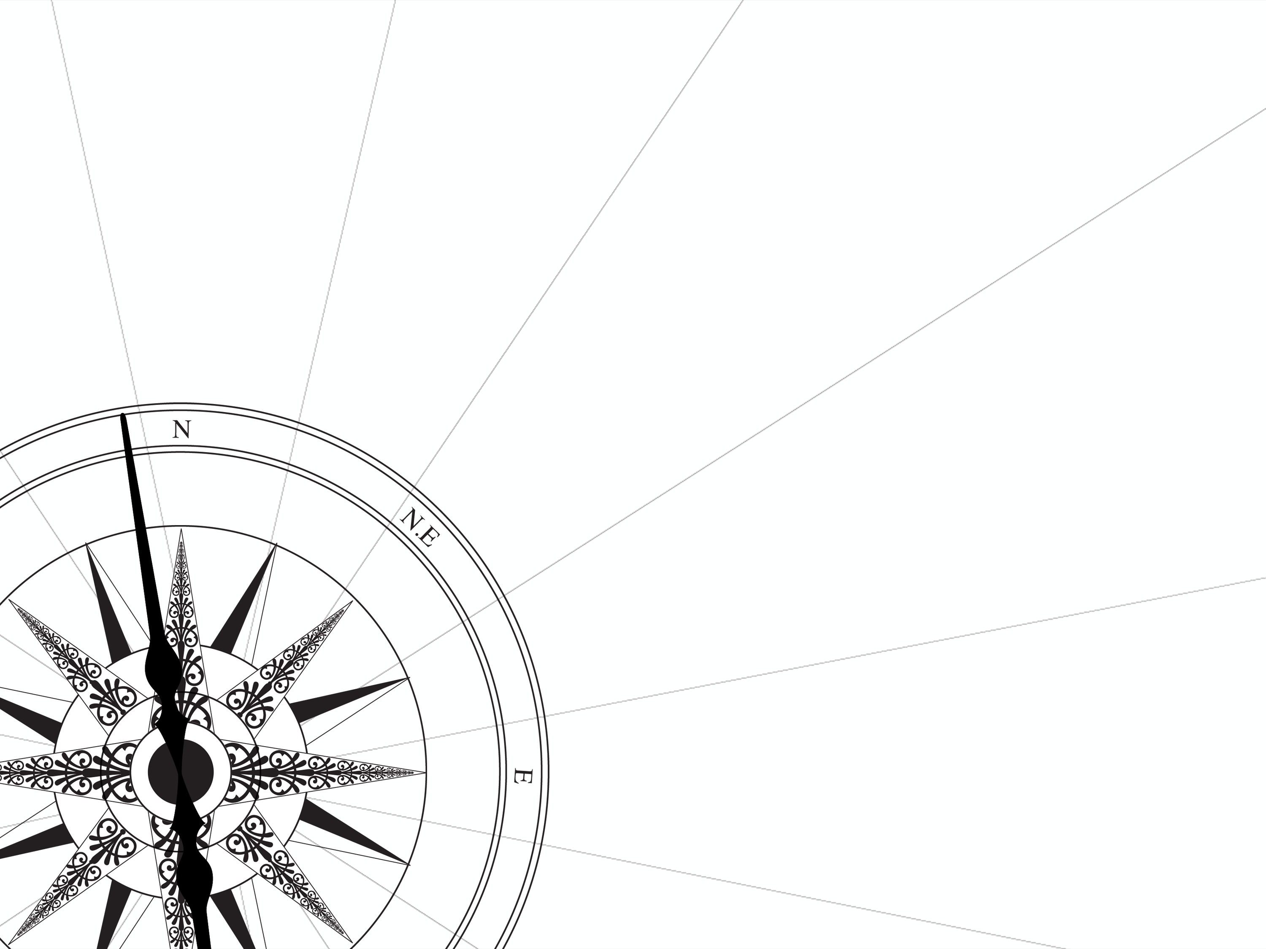
CHAPTER 8
CABI TOURISM TEXTS
Content Analysis

Slide 3
CABI TOURISM TEXTS
LEARNING OBJECTIVES
After reading this chapter, you will be able to:
Describe the nature of content analysis as a research strategy.
Identify the basic approaches used in content analysis and explain how they differ.
Explain different types of coding strategies.
Describe some basic concepts in rhetoric and their application in content analysis.
Outline the basic steps in doing a content analysis.
Discuss how content analysis can be applied to travel photographs.

Slide 4
CABI TOURISM TEXTS
1
Definition
A method to examine what is said or written (in some way) in some source and how it is said
May use written words, spoken words, visual images, electronic content such as television or radio broadcasts, or digital content such as blogs or other social media
Uses either empirical (counting) or subjective (patterns, themes) methods

Slide 5
CABI TOURISM TEXTS
2
Advantages
Not influenced by interaction between the researcher and the subject
Naturalistic data – based on direct observation
Usually does not require permission, access to individuals
Normally no need for ethics approvals
Inexpensive and usually efficient

Slide 6
CABI TOURISM TEXTS
3
Coding
A fundamental task
Manifest versus latent content
Manifest: observable by independent researcher
Latent: hidden messages or themes
Two general types
A priori: specified by researcher before data collection
May be as simple as counts of words
Emergent: patterns observed and refined by researcher in the source of the communication

Slide 7
CABI TOURISM TEXTS
4
Type of questions often asked
Who is initiating/articulating the communication?
What is the intent of the communication?
What is the content, meaning or form of communication?
Who is the intended audience of the communication?
How are words, assumptions, definitions, concepts, arguments or images used to shape the communication?

Slide 8
CABI TOURISM TEXTS
5
Modes of communication
Medium used: e.g. websites, blogs, newspapers
Format of communication: text, photographs, sound recordings, scripted versus unscripted presentations
Design/layout of communication content:
Use of and relative frequency/spacing of printed words, graphic images, data tables (such as price lists), spoken words, music
Column-inches, page fractions (e.g. quarter-page, half-page)
Time duration for recorded medium
Counts of and percentage frequencies of keywords

Slide 9
CABI TOURISM TEXTS
6
Presentation style
Narrative
Telling a story conveys context, findings, themes, important lessons
Objective
Reporting verifiable information
Evaluative
Subjective assessments of quality, experiences
Critical
Similar to evaluative but more ‘political’ or reflective of author’s predetermined perspective

Slide 10
CABI TOURISM TEXTS
7
Rhetoric
Logos
Induction: specific examples to make a point
Deduction: using principles to make a point
Abduction: most likely explanation for something through inference
Ethos: using one’s position to add weight to an argument
Pathos: using emotional statements for argument
Analogy: use of similarities or metaphors

Slide 11
CABI TOURISM TEXTS
8
General procedures
Formulate objectives
Operationalize key concepts
Develop sampling frame
Develop coding scheme
Recruit coders
Code
Exhaustive
Inclusive
Check intra- and inter-coder reliability
Report results

Slide 12
CABI TOURISM TEXTS
9
Coding photographs – 1
Visual record versus visual diary
As a diary: usually made by tourists
As a record: usually made for tourists
Possible coding categories
General subject (people, buildings, landscape, etc.)
Perspectives
Close-up, mid-range, distant/panorama
Stereotypical/famous versus idiosyncratic
Framing
Presence or absence of people
Public versus private space
Inclusion or exclusion of objects other than subject

Slide 13
CABI TOURISM TEXTS
10
Coding photographs – 2
People
Types (e.g. demographics, activity, dress)
Theme
Nature, urban, portraits, ‘elite’ culture, sports, etc.
Design
Colour versus black-and-white
Physical size of photo
Presence/absence of title or comment
Location (e.g. front cover versus interior of magazine)

