Slide 1
CABI TOURISM TEXTS
Practical Tourism
Research
2nd Edition
STEPHEN L.J. SMITH
COMPLEMENTARY TEACHING MATERIALS

Slide 2
CHAPTER 6
CABI TOURISM TEXTS
Indices and Scales

Slide 3
CABI TOURISM TEXTS
LEARNING OBJECTIVES
After reading this chapter, you will be able to:
Explain the use of indices and scales in tourism research.
Develop and interpret a location quotient.
Understand the nature of and basic use of GIS in tourism.
Develop and interpret a Gini coefficient.
Develop and interpret a semantic differential scale.
Develop and interpret a Likert scale.
Develop and interpret an importance/performance analysis.
Identify the limitations in each of these tools.

Slide 4
CABI TOURISM TEXTS
1
Indices
Multiple meanings
Here: the combination of two or more variables into a single measure
Reduces a number of variables into a single, easily comprehended measure for further analysis
Descriptive variables frequently used in explanation or prediction

Slide 5
CABI TOURISM TEXTS
2
Scales
Multiple meanings
Qualitative measure of the statistical ‘power’ of data (e.g. ordinal scale)
The magnitude of development, such as a large-scale resort
Here: empirical tools to measure some aspect of visitors’ attitudes, opinions or values, or business/destination performance

Slide 6
CABI TOURISM TEXTS
3
Geographical information systems (GIS)
Computerized spatial data management system
Spatial information
Latitude/longitude
Postal address
Attribute information
Statistical and other non-spatial information associated with entity

Slide 7
CABI TOURISM TEXTS
4
Typical GIS questions
What is it?
Where is it?
What has changed over time?
Which is best route between locations?
What is the pattern of distribution and why has that developed?
Explore ‘what if?’ scenarios

Slide 8
CABI TOURISM TEXTS
5
Location quotient
Measure of some aspect of tourism between two or more locations
Ratio of ratios
Example: comparing percentage of local employment in accommodation industry to national employment in accommodation industry
Complications
Destinations that overlap two nations
Are scales valid, reliable?

Slide 9
CABI TOURISM TEXTS
6
Gini quotient
Degree of concentration of some variable in a region or social group, e.g. concentration of income
Data must be expressible as percentages and these percentages should be meaningful when they are summed
No negative values

Slide 10
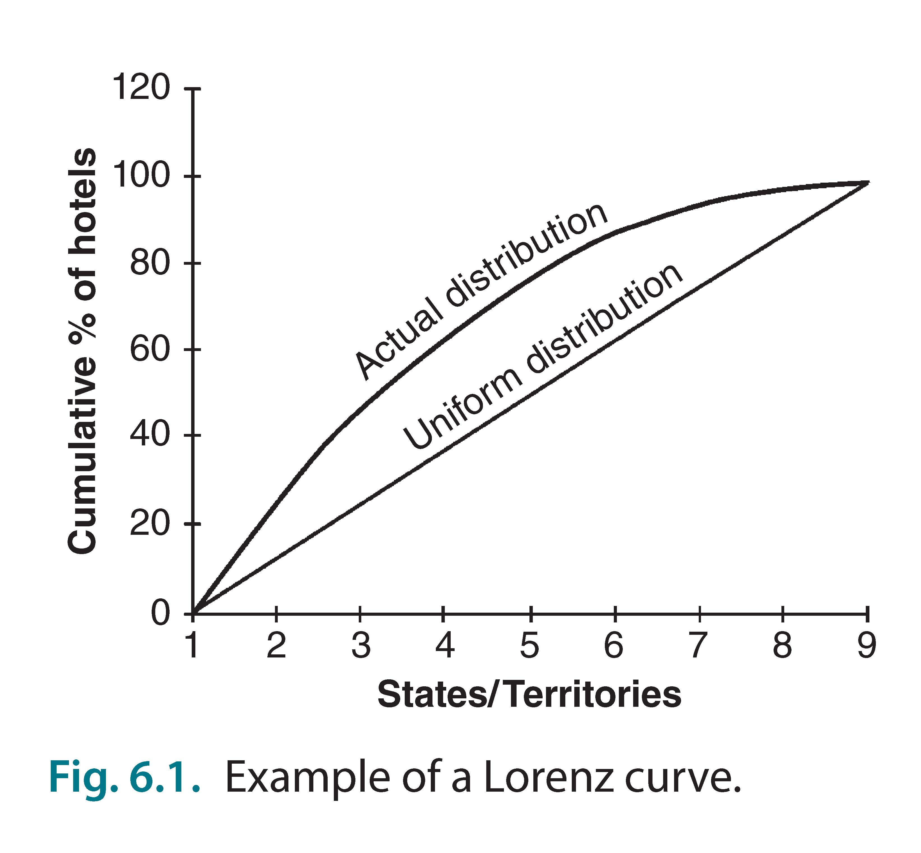
CABI TOURISM TEXTS
7
Lorenz curve
Graphic expression of Gini coefficient

Slide 11
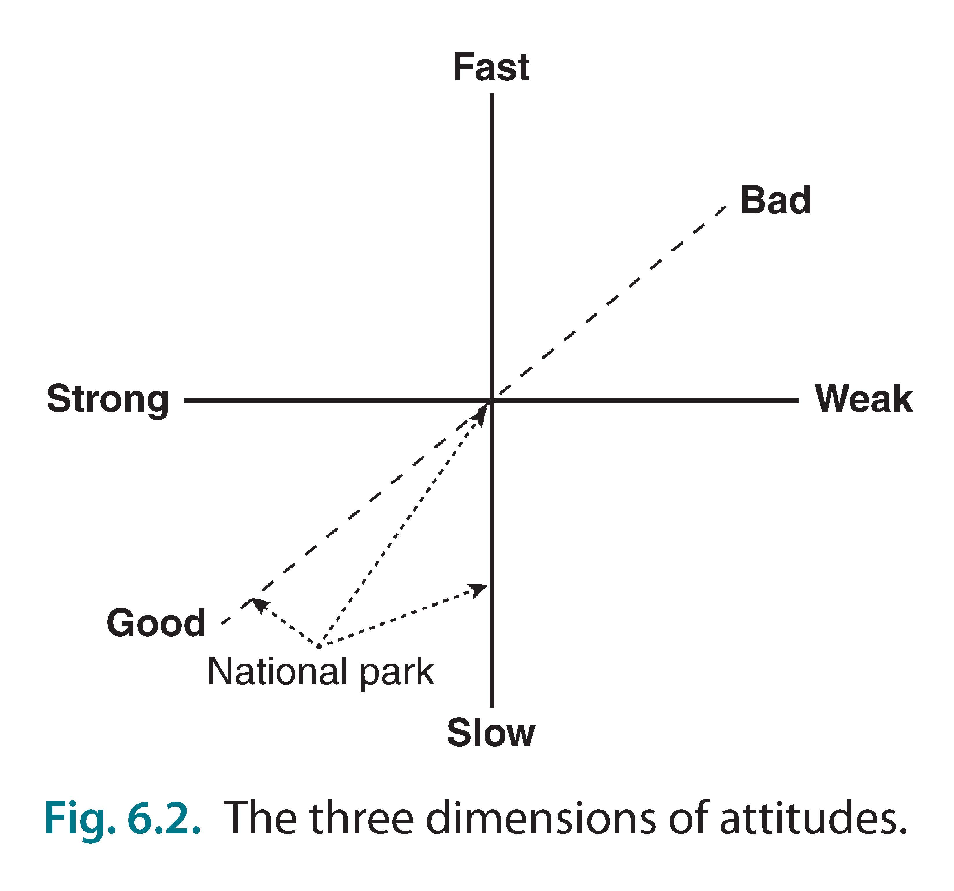
CABI TOURISM TEXTS
8
Semantic differential
Connotative (symbolic) meaning of a concept
Pairs of adjectives to characterize item
Most use measures of evaluation (good–bad), potency (strong–weak), and activity (fast–slow)
Results analysed statistically or graphically

Slide 12
CABI TOURISM TEXTS
9
Likert scales – 1
Apply to attitudes only, not importance, or other concepts
Bipolar (from very negative to very positive) – not monotonic (such as not at all satisfied to very satisfied) that begin low and increase
Begin by identifying issue: one concept at a time
Then identify possibly items for scale
50 – 100 to start
Narrow down to 10 – 15

Slide 13
CABI TOURISM TEXTS
10
Likert scales – 2
Issues to consider:
Response categories: about six usually sufficient
Avoid spurious precision (e.g. ten or more categories)
Even or odd response categories?
Odd has a mid-point
What is mid-point?
Don’t know
Don’t care
Never thought about it
Perhaps should be treated as missing response/data

Slide 14
CABI TOURISM TEXTS
11
Importance–performance analysis–1
Simultaneously examines importance of attributes and an entity’s performance on meeting those
e.g.: tourism service quality, tourism product quality, destination competitiveness
Presented as a two-axis graph: importance of an attribute versus how well a destination or product provides or performs each attribute
Produces four quadrants representing different assessments

Slide 15
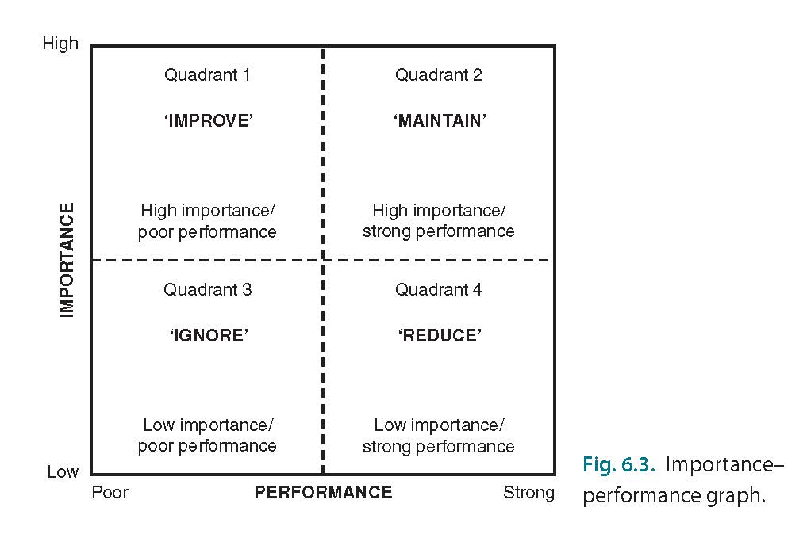
CABI TOURISM TEXTS
12
Importance–performance analysis – 2

Slide 16
CABI TOURISM TEXTS
13
Importance–performance analysis – methods
Specify objectives, situation
Develop list of attributes and alternatives or comparisons
Design two-part questionnaire:
Importance and performance
Administer questionnaire and plot results
Decide position of gridlines

Slide 17
CABI TOURISM TEXTS
14
Importance–performance analysis – potential problems
Some attributes can be vague or ambiguous
Climate: cold, snowy is good for skiing but bad for beaches
Price: ‘absolute’ or ‘value’ for what is offered?
Respondents may different levels of knowledge or experience
Position of grid line, and thus the quadrants, somewhat arbitrary

