Slide 1
CABI TOURISM TEXTS
Practical Tourism
Research
2nd Edition
STEPHEN L.J. SMITH
COMPLEMENTARY TEACHING MATERIALS

Slide 2
CHAPTER 4
CABI TOURISM TEXTS
Selecting a Sample

Slide 3
CABI TOURISM TEXTS
LEARNING OBJECTIVES
After reading this chapter, you will be able to:
Discuss the logic of sampling.
Explain the major forms of sampling.
Comment on the strengths and weaknesses of Internet panels.
Select an appropriate sample size for your study.
Be able to apply the concepts of confidence levels and confidence intervals to your survey.

Slide 4
CABI TOURISM TEXTS
1
Logic of sampling
More efficient and less costly approach to interviewing people than a census (talking to everyone in some population)
Conceptual population
Study population
Sampling frame
Sample

Slide 5
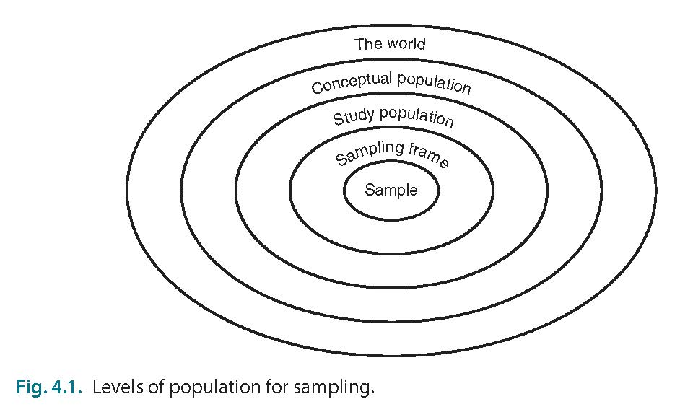
CABI TOURISM TEXTS
2

Slide 6
CABI TOURISM TEXTS
3
Proportional (probability) sampling
Simple random sampling
Random = everyone has same and known probability of being selected
Not efficient for large groups with important but different subgroups
Goal is a sample representative of population
Stratified random sampling
Random within selected subgroups
Cluster sampling
Random but targeted at certain geographic areas
Stratified cluster sampling
Combination of stratified and cluster

Slide 7
CABI TOURISM TEXTS
4
Non-probability sampling
Random sampling not always possible
Convenience sampling
Sample people to which you have access
Data saturation sampling
Sample until you don’t seem to be getting new information from respondents
Quota sampling
Setting targets for respondents in certain groups (e.g. age, gender)
Snowball
Getting reference from subjects for new subjects

Slide 8
CABI TOURISM TEXTS
5
Internet panels
Panel is constructed prior to survey, and exists after survey is administered
Effort is made to have a large panel that can represent different potential groups of interest
Other challenges
Time-consuming and expensive to develop/ maintain
Incentive for participation needs to be provided to panel members
Survey mortality (people dropping out of panel)
Members can become ‘conditioned’ with repeated surveys on similar topic
‘Professional survey-takers’

Slide 9
CABI TOURISM TEXTS
6
Sample size – 1
Importance of sample size varies with importance of topic (less important for ‘trivial’ topics; more important for topics affecting health, politics, business)
Statistical tests have differing requirements for sample size – be aware of requirements

Slide 10
CABI TOURISM TEXTS
7
Sample size – 2
Confidence interval
Range of possible values that probably contains the actual value you are trying to estimate, e.g. 48% ± 5%
Confidence level
How confident you are the true figure falls within your confidence interval (95% is common in tourism)
Confidence interval and level are inversely related: narrow intervals have a low confidence level; wide intervals have high confidence

