Slide 1


CABI TOURISM TEXTS
Practical Tourism
Research
2nd Edition
STEPHEN L.J. SMITH
COMPLEMENTARY TEACHING MATERIALS

Slide 2
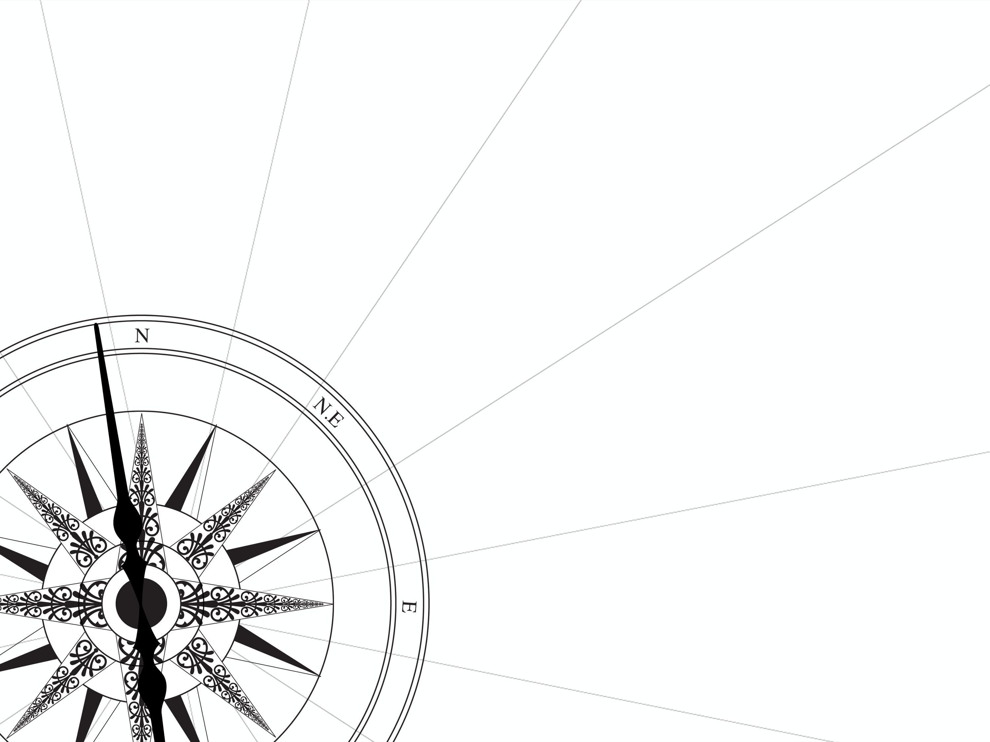
CHAPTER 3
CABI TOURISM TEXTS
Questionnaire Design and Delivery

Slide 3
CABI TOURISM TEXTS
LEARNING OBJECTIVES
After reading this chapter, you will be able to:
Explain why surveys are common research tools.
Articulate the difference between closed-ended and open-ended questions.
Design closed-ended and open-ended survey questions.
Design a basic questionnaire.
Describe techniques to improve response rates.
Discuss the relative merits of different ways of distributing questionnaires.

Slide 4
CABI TOURISM TEXTS
1
Why surveys
To collect empirical information on some topic on a population that shares something in common, e.g.:
  Visitors to a destination or event
  Specific segments of visitors
  Employees, supervisors, employers
  Residents of a community or region
Can access potentially large numbers of people
But generally not subtle or complex answers, insights

Slide 5
CABI TOURISM TEXTS
2
Types of questions – 1
Closed-ended
  Advantages
    Easy to administer, code
    Yes/no; demographics; limited choice with a priori answers
    Can be quick to complete
    Allows for more questions on a limited budget

Slide 6
CABI TOURISM TEXTS
3
Types of questions – 2
Closed-ended
  Disadvantages
    Little rapport or interaction with respondents
    Must anticipate possible answers
    Questions must be simple, clear, non-controversial
    No probing is possible
    Relatively easy to lie

Slide 7
CABI TOURISM TEXTS
4
‘Instant critic’ – 1
  What is your gender?
    Female
    Male
  What is your marital status?
    Single
    Married
    Widowed

Slide 8
CABI TOURISM TEXTS
5
‘Instant critic’ – 2
What is your age?
  < 15
  16 – 20
  21 – 30
  31 – 49
  50 and over
Have you ever used illegal drugs while on vacation?
  Yes
  No

Slide 9
CABI TOURISM TEXTS
6
Types of questions – 3
Open-ended
  Advantages
    Respondents free to elaborate
    Answers can be freer, more spontaneous
    Respondents free to elaborate
    Allows for probing

Slide 10
CABI TOURISM TEXTS
7
Types of questions – 4
Open-ended
  Disadvantages
    Difficult to code
    Potential for negative interactions with interviewer
    May generate only socially correct answers
    Can be difficult to analyse statistically
    Risk of confirmation bias in developing codes
    Risk of narrative fallacy in interpreting answers

Slide 11
CABI TOURISM TEXTS
8
General structure for questionnaires – 1
Title, maybe a logo from agency
Introduction
  Purpose and importance of questionnaire
  Assurances of confidentiality
  Special instructions
  How long it will likely take to complete
Initial questions
  Usually simple
  Screening questions, if needed

Slide 12
CABI TOURISM TEXTS
9
General structure for questionnaires – 2
Core of questionnaire – ‘crux’ questions
  Avoid temptation to add questions just because ‘it might be interesting to know’ or ‘everyone asks’
  Demographic questions often go at end, if you need them at all
    Explain why you are asking
A thank-you and instructions, if needed, how to return questionnaire

Slide 13
CABI TOURISM TEXTS
10
Wording (closed- and open-ended)
Language – be clear, concise, appropriate
Avoid sounding like an academic (using jargon or being wordy)
Be familiar but not vague
Avoid ambiguous questions – can identify through test
Avoid asking two questions as one
Avoid leading questions (phrasing questions to encourage a particular response)
Pay attention to flow – order of questions

Slide 14
CABI TOURISM TEXTS
11
Graphic design – 1
Important to keep respondent engaged
If Internet-based, design often set by software
For paper:
  Light blue often a good choice
  Good quality stock
Consider arrows or drawings to help respondent through flow of questions
Simple is better

Slide 15
CABI TOURISM TEXTS
12
Graphic design – 2
Likert scales and other ranking/spectrum questions often work well in a horizontal format
Simple choice questions (gender, age, education, etc.) often work well with vertical format
Know cultural norms – e.g. are items at top of vertical list seen as ‘superior’ to others? Do evaluations normally run from positive to negative or vice versa?

Slide 16
CABI TOURISM TEXTS
13
Distributing questionnaires
In-person
  Field interviews can be draining – be prepared
Mail-back
Web-based
  Pop-up surveys
  E-mail lists
  Internet panels
  Online survey services

