Slide 1
CABI TOURISM TEXTS
Practical Tourism
Research
2nd Edition
STEPHEN L.J. SMITH
COMPLEMENTARY TEACHING MATERIALS

Slide 2
CHAPTER 2
CABI TOURISM TEXTS
Planning a Research Project

Slide 3
CABI TOURISM TEXTS
LEARNING OBJECTIVES
After reading this chapter, you will be able to:
Explain the differences between goals and objectives.
Formulate research questions.
Design and read a request for proposal (RFP).
Explain the key purposes of a literature review, how to read a research paper and how to write a literature review.
Identify the differences between primary and secondary data sources and give examples of each.
Articulate the general principles of ethics in tourism research.

Slide 4
CABI TOURISM TEXTS
1
THE 4FS FOR SELECTING A RESEARCH TOPIC
Fun
Will you enjoy spending time on it?
Feasible
Can you get access to data; do you have the skills needed (or can acquire them)?
Fundable
Can you afford it – cost of data, travel, software, other needed services?
Functional
What difference will your research make?

Slide 5
CABI TOURISM TEXTS
2
Drafting an RFP
RFP: an invitation to bid on providing research
May go by many other labels
Generally includes:
Need for the research
Technical requirements such as sample size, data accuracy and reliability
How selection will be made
How to submit proposal
Deadlines

Slide 6
CABI TOURISM TEXTS
3
Formulating research questions and objectives for your proposal
Set overall goal or point of research
Specify objectives needed to be fulfilled to achieve goal
Articulate answerable questions; may be framed as hypotheses, but often are not

Slide 7
CABI TOURISM TEXTS
4
Literature review
An essential step in research even though it is sometimes seen as tedious or overwhelming
Critical summary of related studies; not just a citing of references
Be clear why you are reading each article or book:
To get an overview of topic
Ideas how to design your research
Looking for conceptual models or theories
How other authors have studied your topic (data sources, methods, research designs)
What worked for them, what didn’t
What they learned

Slide 8
CABI TOURISM TEXTS
5
Getting started
Scan books and articles for references
Journal articles generally not as broad as books but are more current and usually peer-reviewed (more reliable)
Online sources
Google Scholar
Wikipedia
Specialized encyclopædias
Other online sources
Online sources can be useful but be cautious in trusting them – not always reliable. Check multiple sources and compare.

Slide 9
CABI TOURISM TEXTS
6
Collecting data
Primary
Data you collect yourself
May be used for either empirical (statistical) or subjective analysis
Secondary
Data someone else collected for their own purposes
Most secondary data is statistical

Slide 10
CABI TOURISM TEXTS
7
Collecting data
Multiple sources and methods
Often very useful if data can be compared
Triangulation
Data collected from multiple sources with identical assumptions, definitions, methods
If assumptions, definitions and methods differ, data cannot be reliably compared
You can still use but call the technique ‘multiple methods’ or ‘multiple sources’

Slide 11
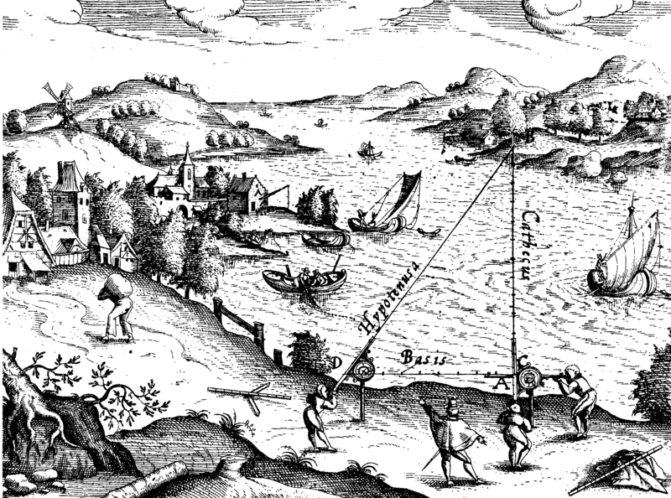
CABI TOURISM TEXTS
8
Triangulation
Requires measurements using identical methods, assumptions, definitions and comparable data
This old engraving illustrates the concept of triangulation
Levinus Hulsius, 16th century

Slide 12
CABI TOURISM TEXTS
9
Secondary data
Official statistics
Usually governmental
Provide coverage, volume, time series, quality an individual research would have trouble achieving
Business records (usually highly proprietary)
Administrative data
Orders and bookings
Reservations
Inventories, purchases
Syndicated surveys

Slide 13
CABI TOURISM TEXTS
10
Metadata
Important supplemental information for secondary data sources
Structure and content of data sets
Any codes and codebooks
Administrative details such as who created the data set and when
How the data were collected and processed

Slide 14
CABI TOURISM TEXTS
11
Primary data
Surveys
Travel diaries
Personal interviews
Field research/observations
Participant observation
Ethnography and netnography

Slide 15
CABI TOURISM TEXTS
12
Choosing an analytical method – 1
Decide the purpose or function of your analysis
Statistical description
Frequencies
Measures of central tendency (mean, median, mode)
Variance, range, standard deviation
Skewness and kurtosis
Maps
Organizational charts
Narrative descriptions
Case studies

Slide 16
CABI TOURISM TEXTS
13
Choosing an analytical method – 2
Explanation
Correlation
Means–end analysis
Many other techniques
Forecasting
Statistical
Linear extrapolation
Time series
Structural

Slide 17
CABI TOURISM TEXTS
14
Choosing an analytical method – 3
Forecasting (cont.)
Subjective
Travel intention surveys
Delphi technique
Panel of experts
Iterative until consensus is reached (or it is clear there is no consensus)

Slide 18
CABI TOURISM TEXTS
15
Research ethics
Important but often under-appreciated in tourism research
Morals: codes governing what is right or wrong
May be social norms, religious norms
Broader than laws
Ethics: how moral codes get applied in practice
General social norms as well as ethical codes for specific professions or occupations

Slide 19
CABI TOURISM TEXTS
16
Application of Research ethics – 1
General principles
Respect for persons: all persons, especially those who are vulnerable due to age, health, social status, other reasons
In practice, this means:
Voluntary participation
Informed consent (this may be subject to modification in rare circumstances)
Privacy protected
Can withdraw from participation without penalty

Slide 20
CABI TOURISM TEXTS
17
Application of Research ethics – 2
General principles
Beneficence
Benefits to persons and society must outweigh potential risks to participants
The researcher must do no harm and prevent future harm
The researcher should also promote good
Prevent harm
Any risk in research is justified by its benefits
Risks are minimized
Conflicts of interest are managed to avoid bias

Slide 21
CABI TOURISM TEXTS
Application of Research ethics – 3
18
General principles
Justice
Subjects are treated fairly
Risk, rewards and burdens of research are shared equitably
The distinction between procedural justice and distributive justice is respected
Vulnerable subjects are not targeted for the researcher’s convenience
Subjects are not selected just because of their ease of availability or compromised position
People likely to benefit are not excluded

