Slide 1
CABI TOURISM TEXTS
Practical Tourism
Research
2nd Edition
STEPHEN L.J. SMITH
COMPLEMENTARY TEACHING MATERIALS

Slide 2
CHAPTER 10
CABI TOURISM TEXTS
Research Reports and Presentations

Slide 3
CABI TOURISM TEXTS
LEARNING OBJECTIVES
After reading this chapter, you will be able to:
Apply general guidelines to writing research papers, including citations, abstracts and appendices.
Recognize and analyse the various rhetorical approaches used in media stories related to tourism and hospitality.
Have strategies for dealing with ‘writer’s block’.
Have strategies for preparing an oral presentation.
Design an effective PowerPoint.
Design an effective research poster.

Slide 4
CABI TOURISM TEXTS
1
Why this is important
Final step in research
Clear communication essential in many aspects of your career
Hemingway’s four rules of writing
Use short sentences
Use short first paragraphs
Use vigorous English
Be positive, not negative

Slide 5
CABI TOURISM TEXTS
2
Writing your paper – 1
Clear statement of your purpose
Why it is significant
Objectives (see Chapter 2)
Explain definitions, concepts
Avoid jargon as much as possible
Citations
Essential, a matter of ethics
Build on previous research
Quotations: quote for colour or evidence
Use original sources, not secondary sources

Slide 6
CABI TOURISM TEXTS
3
Writing your paper – 2
Abstracts
Not always required; when required, word limits vary
Introduction
Statement of research problem
Research design (methods, data)
Results
Conclusion/significance of study
Writer’s block
Self-reflection
Change of scene, environment

Slide 7
CABI TOURISM TEXTS
4
Oral presentations – 1
Ironic to be reading about it
You are the medium of communication
Room, facilities influence presentation
Respect time limits

Slide 8
CABI TOURISM TEXTS
5
Oral presentations – 2
Key questions:
Who is your audience? How big?
What is room like?
What information do you need to share? What is best way to communicate it?
Begin with comfortable volume and pitch of voice
Slowly, sincerely, thoughtfully
Figure out what to do with your hands
Maintain eye contact
Practise, practise, practise

Slide 9
CABI TOURISM TEXTS
6
PowerPoint and similar software
Visual aid only: don’t read your slides – talk to your audience
Don’t be too creative with fonts, colours
Understand basics of visual communication e.g. dark text on light background
Avoid distracting backgrounds
Minimize special effects such as motion
Size matters

Slide 10
CABI TOURISM TEXTS
7
PowerPoint and similar software
6×6 rule
Six words per point, six points per slide
These PowerPoint slides don’t adhere to that rule, but it is a principle to keep in mind!
Strive for simplicity
Don’t present entire script and then just read it!
Humour, subtlety, poetry difficult to achieve in PowerPoint
Linear logic is limiting
Check your spelling
Check your file on presentation computer

Slide 11
CABI TOURISM TEXTS
8
Posters
Elements of written report and oral report
Graphic design is essential – not just words on a large piece of paper
FOG:
Focus
Order
Graphic

Slide 12
CABI TOURISM TEXTS
9
Design – macro
Size of poster
Often prescribed by organizers
Use of specialized software recommended
Overall design
‘Landscape’ common
Select symmetry
Relative space commitments
40–50% – graphics
30–40% – open space
15–20% – text

Slide 13
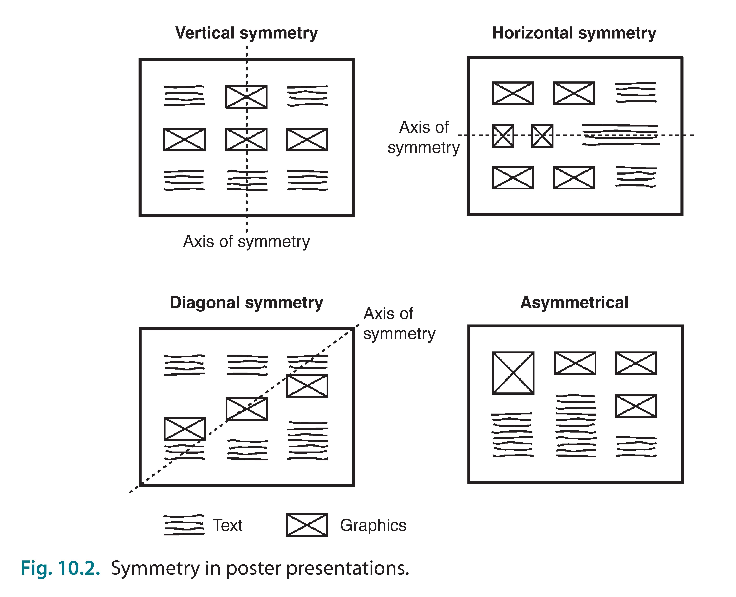
CABI TOURISM TEXTS
10
Design – symmetry

Slide 14
CABI TOURISM TEXTS
11
Design – micro
Use simple graphic/text cues to divide poster into sections
Blocks of text: under 50 words
Use logical, readable point sizes
Title: no more than two lines
Use colour – but carefully
Proofread before printing

Slide 15
CABI TOURISM TEXTS
11
Presentation
Poster should “speak for itself”
When you are present:
Usually stand to viewer’s left
Make eye-contact, brief words of welcome – let viewer set pace
Practice brief answers to likely questions
Have business card handy

