Slide 1
CABI TOURISM TEXTS
Practical Tourism
Research
2nd Edition
STEPHEN L.J. SMITH
COMPLEMENTARY TEACHING MATERIALS

Slide 2
CHAPTER 1
CABI TOURISM TEXTS
The Nature of Tourism Research

Slide 3
CABI TOURISM TEXTS
LEARNING OBJECTIVES
After reading this chapter, you will be able to:
Discuss alternative definitions of tourism.
Explain why tourism is not an industry.
Identify and compare different forms of research in the study of tourism.
Define and explain the differences among the terms: models, concepts, hypotheses and theories.
Explain generally what epistemology means and describe some of the major epistemologies used to study tourism.

Slide 4
CABI TOURISM TEXTS
1
DEFINITIONS OF TOURISM
Supply-side
Demand-side
‘Comprehensive’
UNWTO definition, terminology and concepts
Temporary travel outside usual environment
Defining ‘usual environment’
Included in tourism statistics: ‘visitors’
Not included: migrants, refugees, diplomatic personnel, military

Slide 5
CABI TOURISM TEXTS
2
BASIC FORMS OF TOURISM
Domestic
Tourism travel with the person’s country of residence (not necessarily citizenship)
Outbound
Tourism travel outside a person’s country of residence
Inbound
Tourism travel into a reference nation – crosses an international border

Slide 6
CABI TOURISM TEXTS
3
BASIC FORMS OF TOURISM
National
All tourism travel by residents of a nation: domestic + outbound
Internal
Tourism travel within a nation whether by residents or non-residents: domestic + inbound
International
Tourism travel across a nation’s border: inbound + outbound

Slide 7
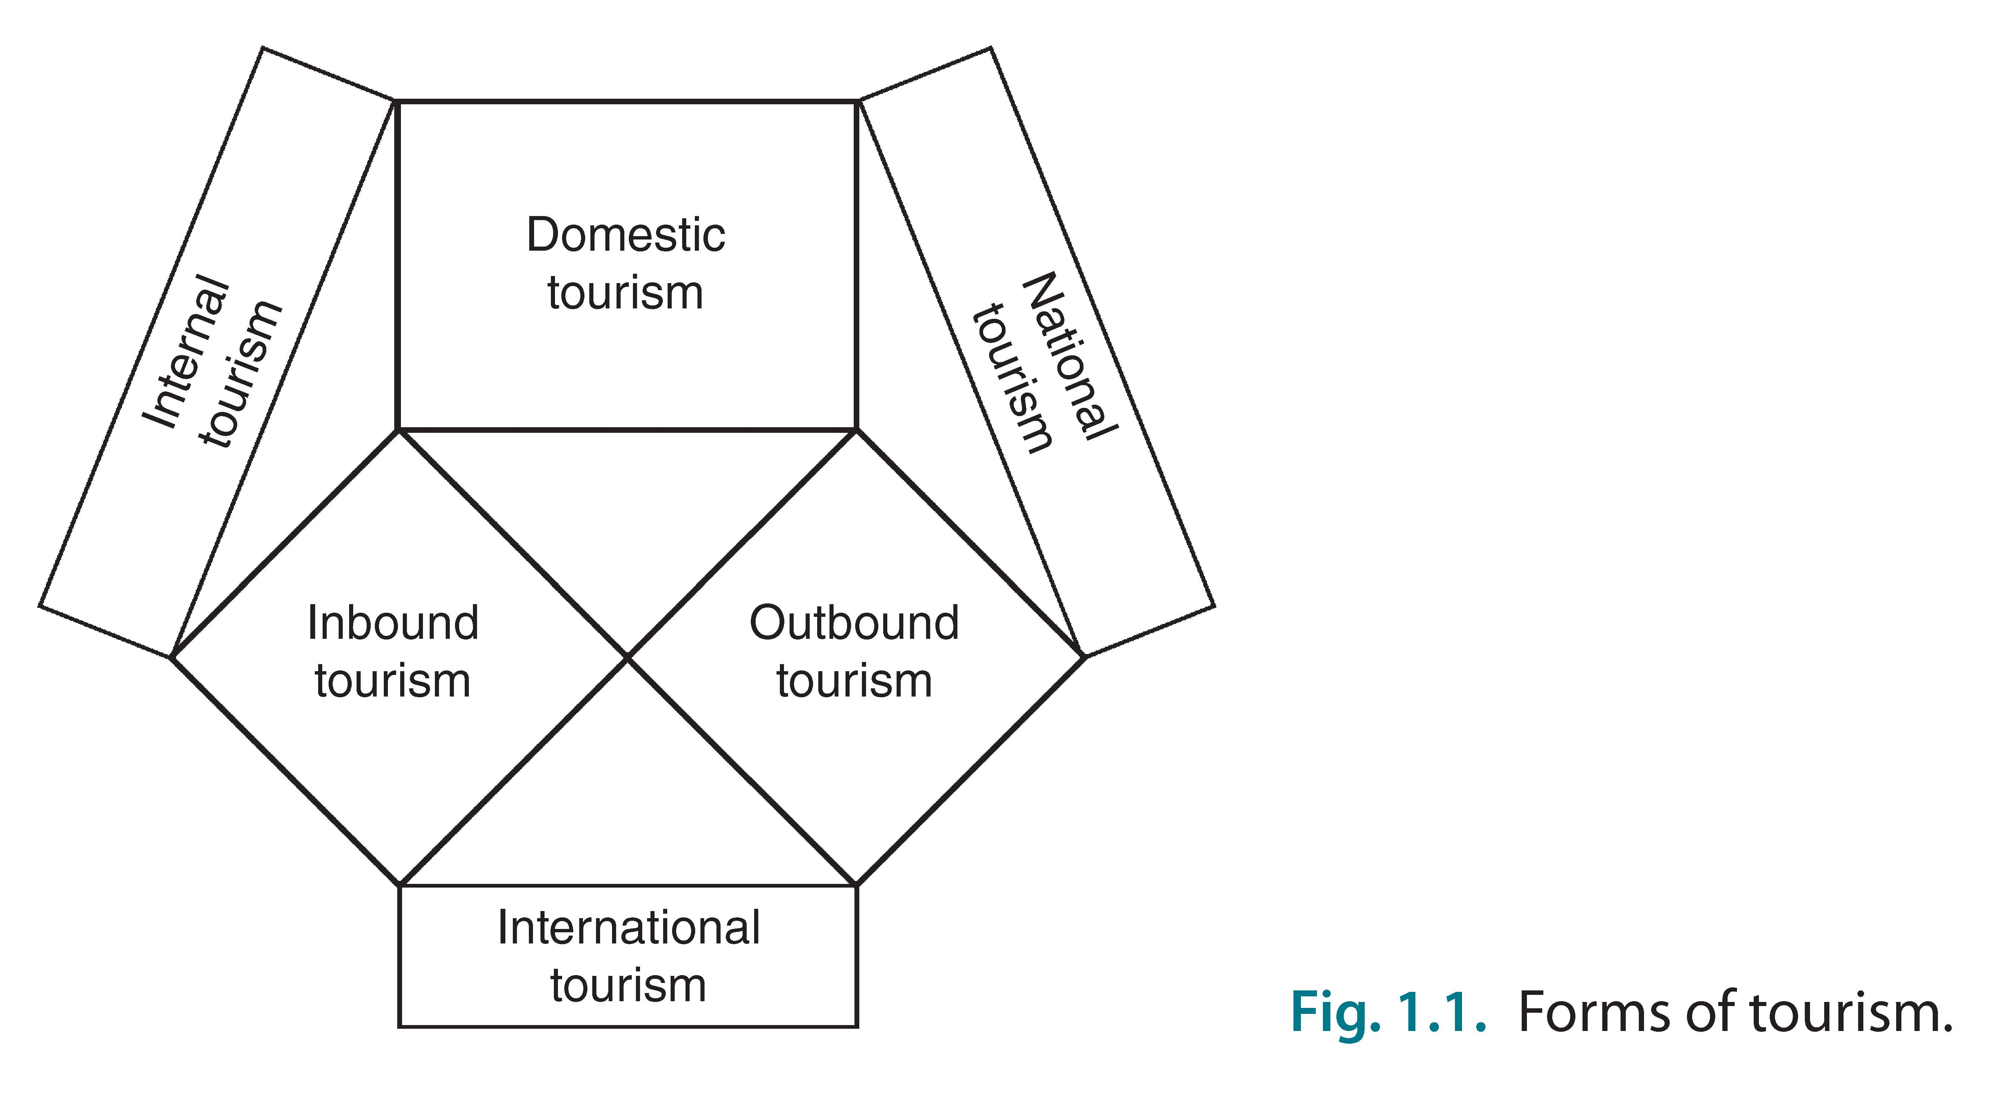
CABI TOURISM TEXTS
4

Slide 8
CABI TOURISM TEXTS
5
OTHER KEY CONCEPTS
Industry
Tourism is not an industry but there are tourism industries
Commodities
Examples of tourism commodities
Statistical challenges in measuring magnitude of tourism
Visitors and non-visitors consume tourism commodities
Tourism and non-tourism businesses produce tourism commodities
Tourism Satellite Account
Tourism ratio

Slide 9
CABI TOURISM TEXTS
6
TOURISM RESEARCH
Research questions versus management questions
Research questions must be answerable
Management questions may not be answerable, at least not by research (may require new funds, reorganization, political courage, etc.)

Slide 10
CABI TOURISM TEXTS
7
TOURISM RESEARCH – SOME CLASSIFICATIONS
Who initiates and manages
Pure
Action
Consultancy
Workplace
‘Delay’
Functions
Description
Explanation
Prediction

Slide 11
CABI TOURISM TEXTS
8
TOURISM RESEARCH – SOME CLASSIFICATIONS
‘Platforms’ of research
Advocacy
Cautionary
Adaptancy
Science or knowledge-based

Slide 12
CABI TOURISM TEXTS
9
THINKING ABOUT THINKING – 1
Deduction versus induction
Models
Hypotheses
Hypothesis testing
Type I error – false positive
Type II error – false negative

Slide 13
CABI TOURISM TEXTS
10
THEORIES
Type 1: natural sciences; only one theory usually accepted at a time after substantial testing
Type 2: social science; similar to Type 1 but multiple theories may exist simultaneously
Type 3: theory is equated with statistical analysis
Type 4: untested/untestable verbal or graphic models
Type 5: epistemology as theory
Type 6: ‘grounded theory’
Type 7: ungrounded label or metaphor

Slide 14
CABI TOURISM TEXTS
11
THINKING ABOUT THINKING – 2
Paradigms: ways of looking at world that shape research
The drawing on the next slide illustrates, graphically, the power of an epistemology
Your perspective allows you to view the image as a rabbit or a duck
You can switch between perspectives, but you cannot see a rabbit and a duck simultaneously

Slide 15
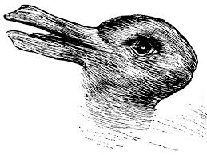
CABI TOURISM TEXTS
12
THE POWER OF AN EPISTEMOLOGY
‘Kaninchen und Ente’ (‘Rabbit and Duck’) from Fliegende Blätter, 1892

Slide 16
CABI TOURISM TEXTS
13
THINKING ABOUT THINKING – 3
Paradigms: ways of looking at world that shape research
The drawing on the previous slide illustrates, graphically, the power of an epistemology
Includes three elements
Epistemology: how we come to know things or gather information
Ontology: the nature of reality
Methodology: tools used by a researcher to study a subject

Slide 17
CABI TOURISM TEXTS
14
THINKING ABOUT THINKING – 4
Empirical research
Also called positivism or post-positivism
Reality exists independently of observer
Characterized by falsifiable observations and methods such as statistical analysis
Focus is on outcome and repeatable answers
Ultimately, it is asymmetric knowledge
You can be proved wrong but you can never be proved absolutely right – there is a risk that a future test will prove you wrong

Slide 18
CABI TOURISM TEXTS
15
THINKING ABOUT THINKING – 5
Subjective research
No objective reality
Researcher as a person is an integral part of research logic and data collection
Approach is holistic, process-oriented
Focus is on process, gaining personal insights
Many different epistemologies and research approaches

Slide 19
CABI TOURISM TEXTS
16
THINKING ABOUT THINKING – 6
Examples of subjective research approaches
Grounded theory
Interpretism/constructivism/constructionism
Critical theory
Feminist theory
Conflict theory
Marxist theory
etc.

Slide 20
CABI TOURISM TEXTS
17
TWO SPECIAL RISKS IN SUBJECTIVE RESEARCH
Narrative fallacy
Inferring a plausible but invalid story from observations
Confirmation error
Selecting only evidence that confirms expectations or interpreting evidence in a way that supports expectations

