Slide 1
Stewarding America’s Antiquities at Mesa Verde
Managing Outdoor Recreation: Case Studies in the National Parks, 2nd Edition

Slide 2
Mesa Verde National Park
Established in 1906
Southwest Colorado – Four Corners region
52,00 acres
≈ 5,000 archaeological sites
Including ≈ 600 cliff dwellings
Ancestral Puebloan people
550 to 1300 AD

Slide 3
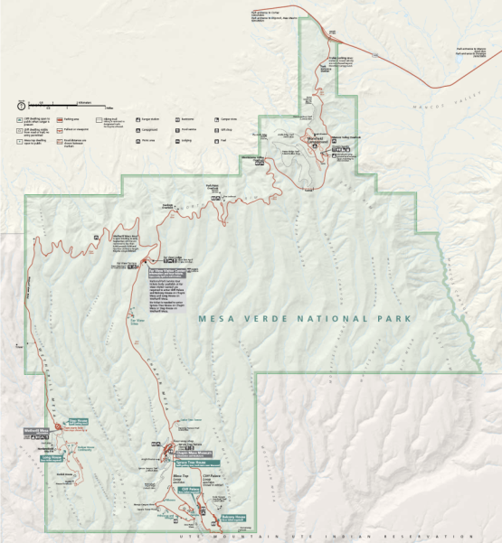

Slide 4
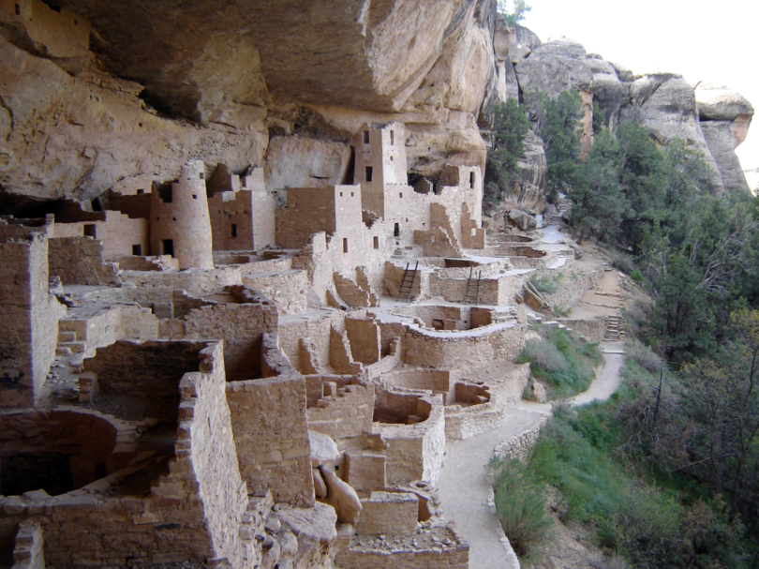
Notes:
https://www.nps.gov/media/photo/gallery.htm?id=02675736-155D-4519-3E004E99D001DA1C

Slide 5
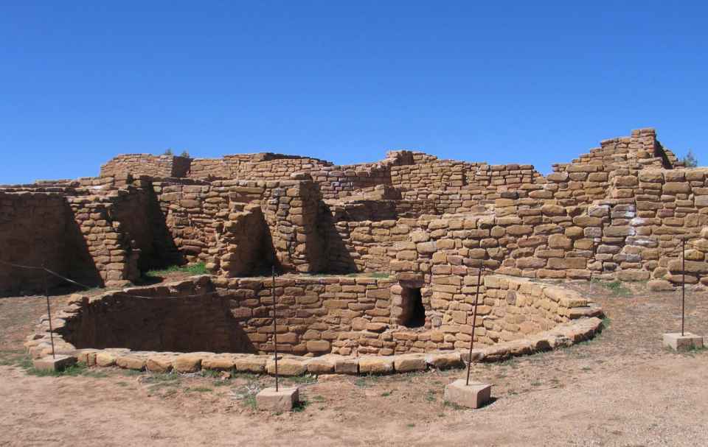
Notes:
https://www.nps.gov/media/photo/gallery.htm?id=5722133E-155D-4519-3EA5161441B51B2E

Slide 6
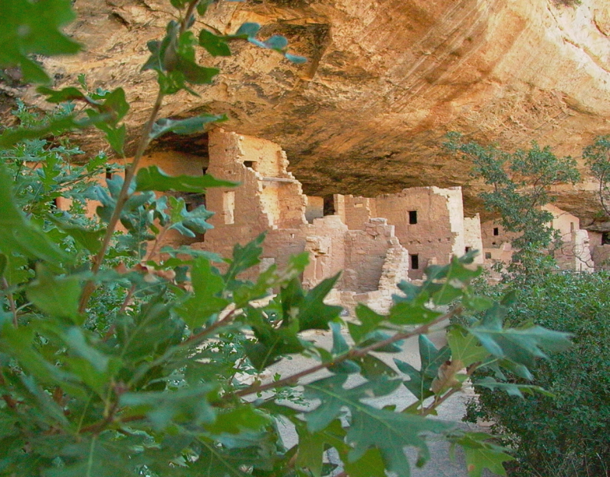
Notes:
https://www.nps.gov/media/photo/gallery.htm?id=5722133E-155D-4519-3EA5161441B51B2E

Slide 7
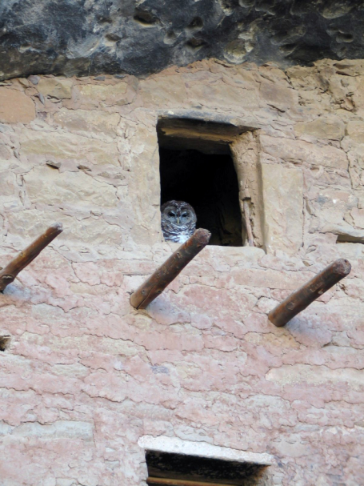
Notes:
https://www.nps.gov/media/photo/gallery.htm?id=02675736-155D-4519-3E004E99D001DA1C

Slide 8
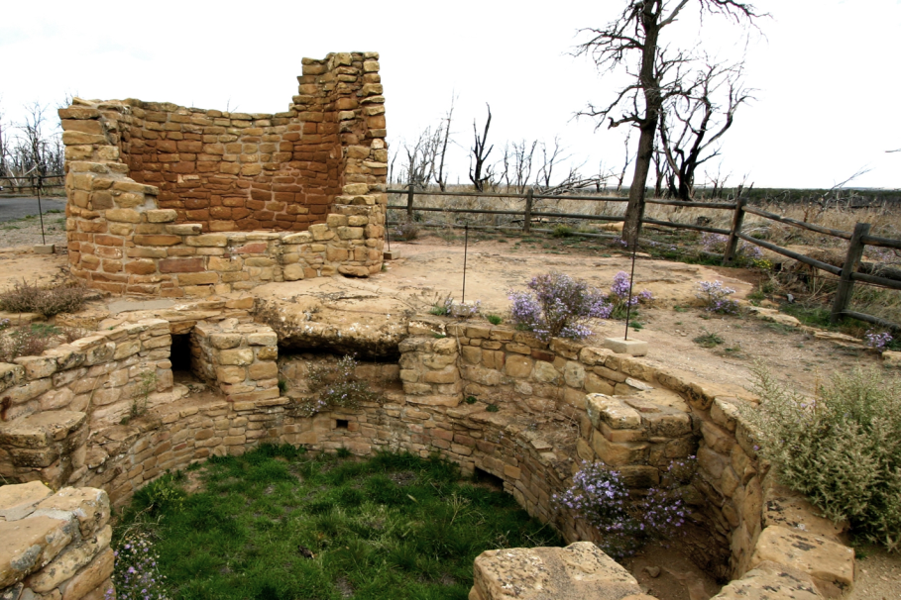

Slide 9
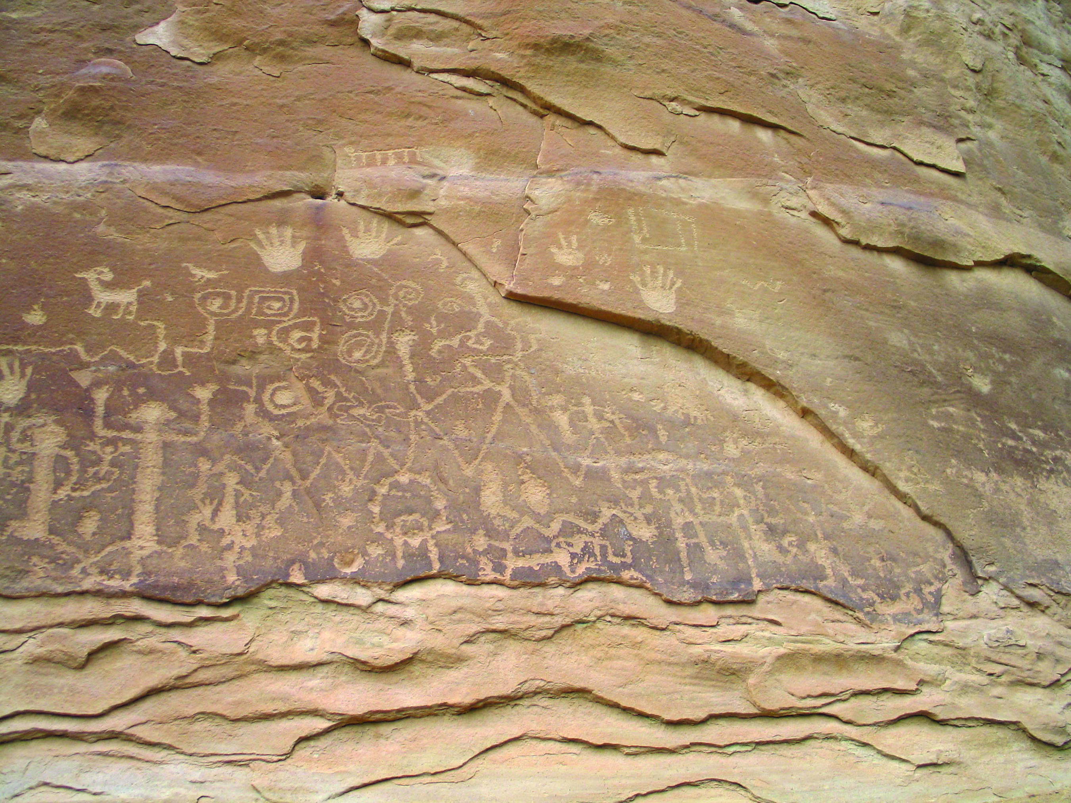
Notes:
https://www.nps.gov/media/photo/gallery.htm?id=575BB48F-155D-4519-3E40BFEF9424DCD1
https://www.nps.gov/media/photo/gallery.htm?id=575BB48F-155D-4519-3E40BFEF9424DCD1

Slide 10

Mesa Verde National Park
https://www.nps.gov/meve/index.htm

Slide 11
Problems
Impacts to resources: Historic/cultural
Depreciative behaviour: Inappropriate use
Impacts to facilities: Interpretive facilities/programs

Slide 12
Strategies and Practices
Management strategies: Limit use, reduce the impact of use, harden the resource
Management practices: Rules/regulations, law enforcement, facility development/site design/maintenance, rationing/allocation, zoning, information/education

Slide 13
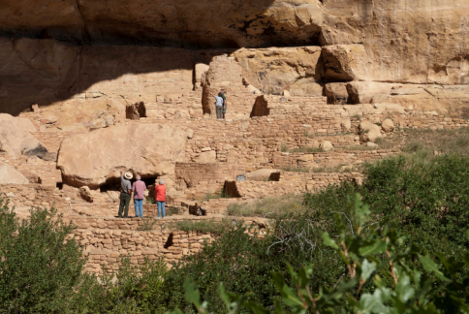
Rules/Regulations and Law Enforcement
Access to sites only in presence of uniformed ranger
Site closures

Slide 14
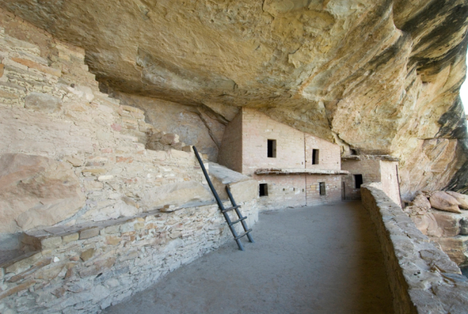
Facility Development/Site Design/Maintenance
Stabilization of ruins

Slide 15
Rationing / Allocation and Information / Education
Limits on the number of visitors allowed on ranger led tours
Education about significance of the area in the form of interpretive programs

Slide 16
Zoning
Park divided into two primary use zones
Provides alternative types of visitor experiences

Slide 17
Video
Spruce Tree House Closure (3:39)
Tour of Balcony House (2:20)
https://www.nps.gov/meve/learn/photosmultimedia/multimedia.htm
https://www.nps.gov/meve/learn/photosmultimedia/multimedia.htm

