Slide 1
Saving Bats at Mammoth Cave
Managing Outdoor Recreation: Case Studies in the National Parks, 2nd Edition

Slide 2
Mammoth Cave National Park
Established in 1941
South central Kentucky
World’s longest known cave (400+ miles)
World Heritage Site (1981)
International Biosphere Reserve (1990)
Karst topography, caverns and mineral formations, cave wildlife

Slide 3
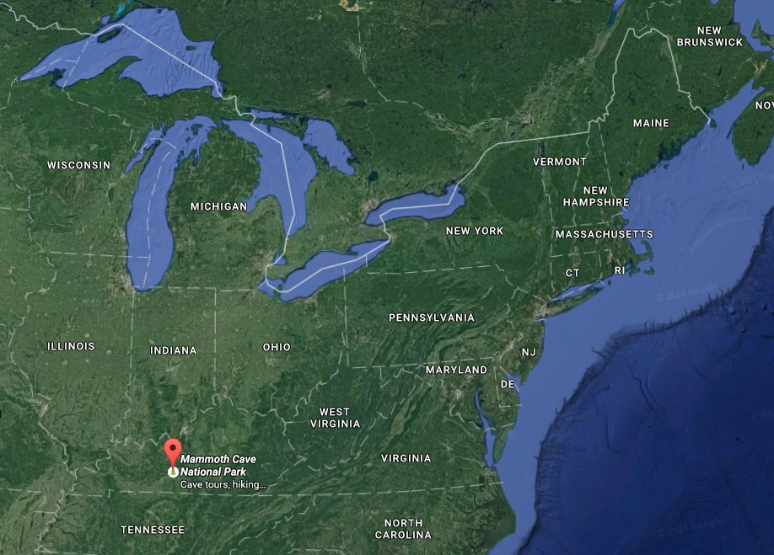
Notes:
Google maps

Slide 4
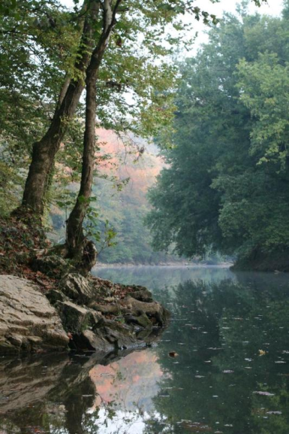
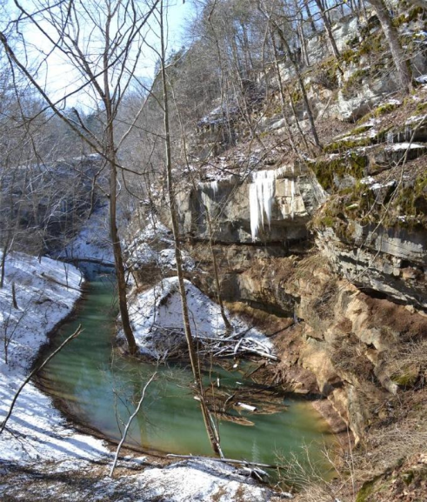
Notes:
Green River; Cedar Sink

Slide 5
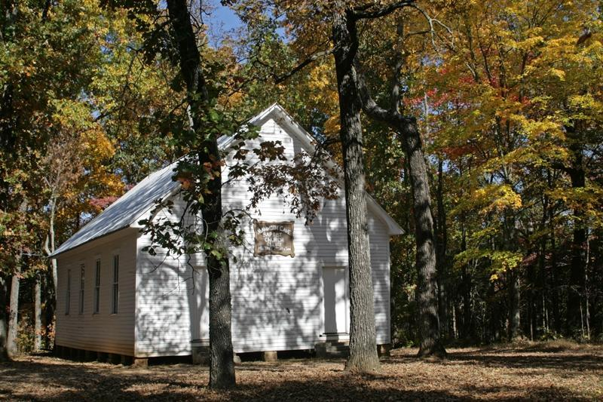
Notes:
Mammoth Cave Baptist Church

Slide 6
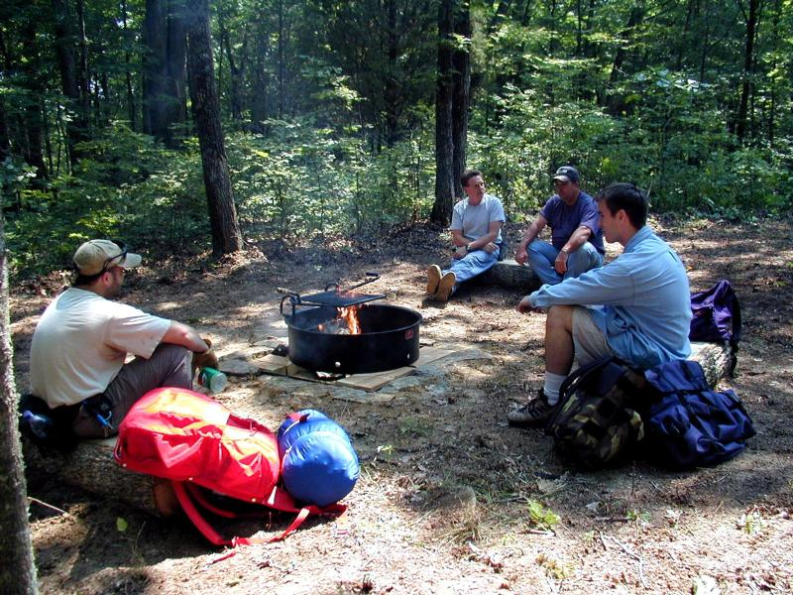

Slide 7
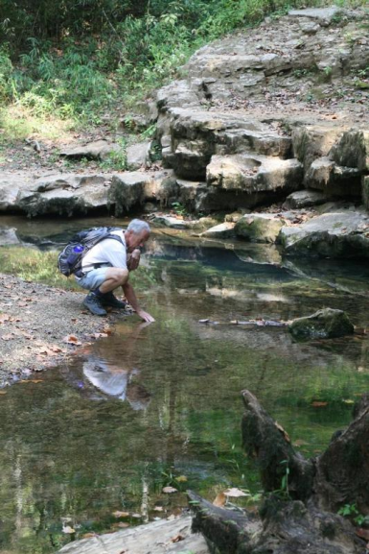
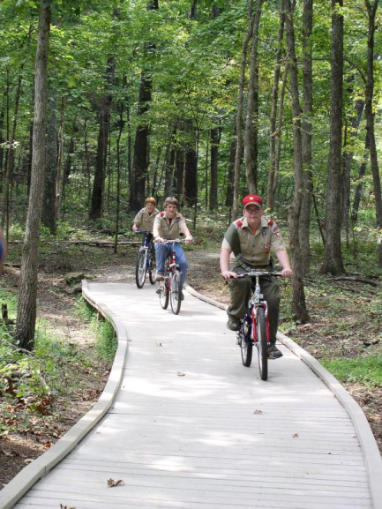

Slide 8
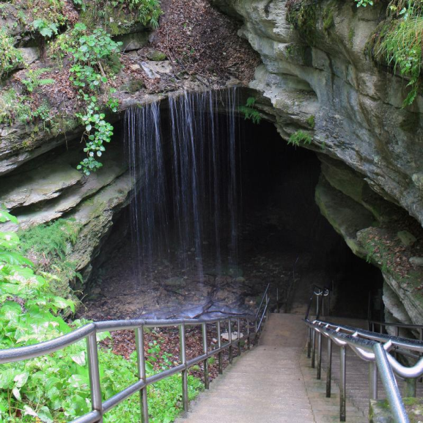

Slide 9
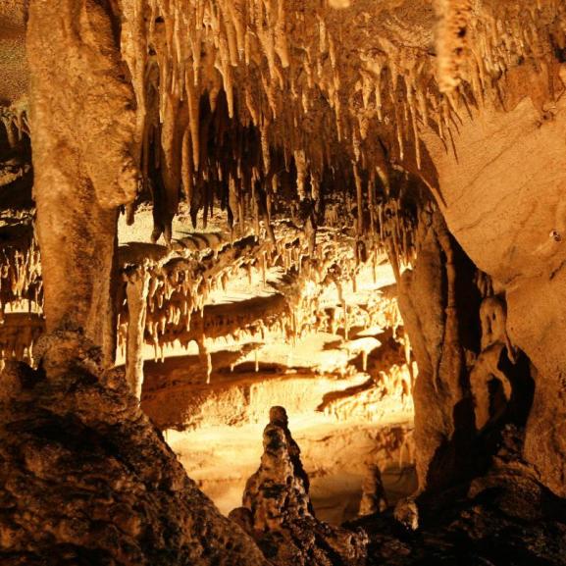

Slide 10
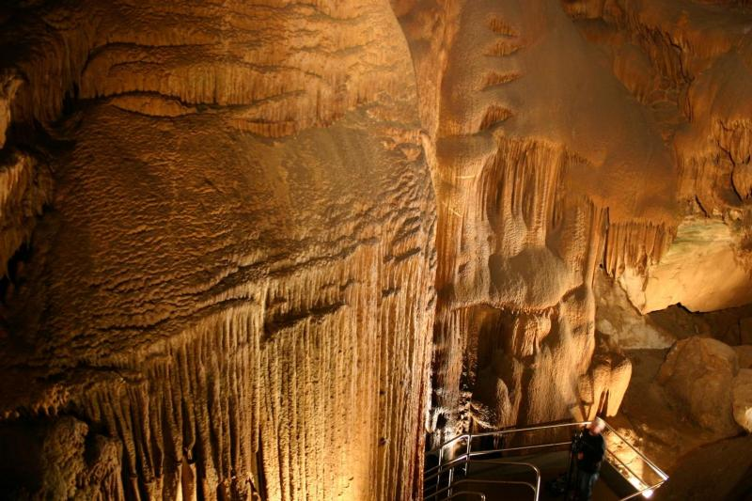

Slide 11
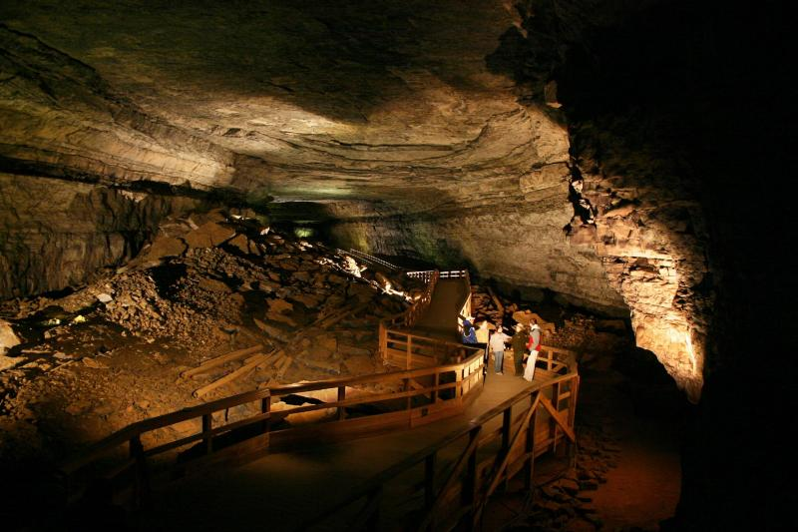

Slide 12
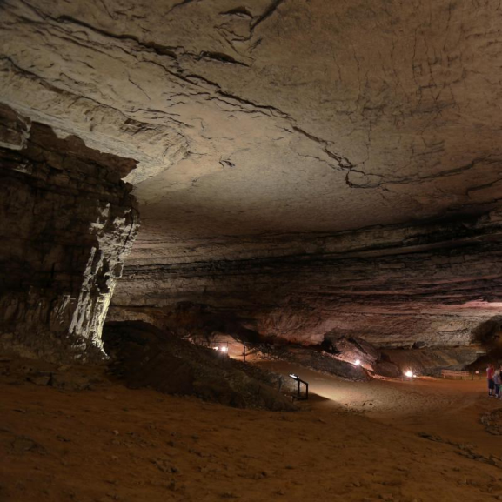

Slide 13
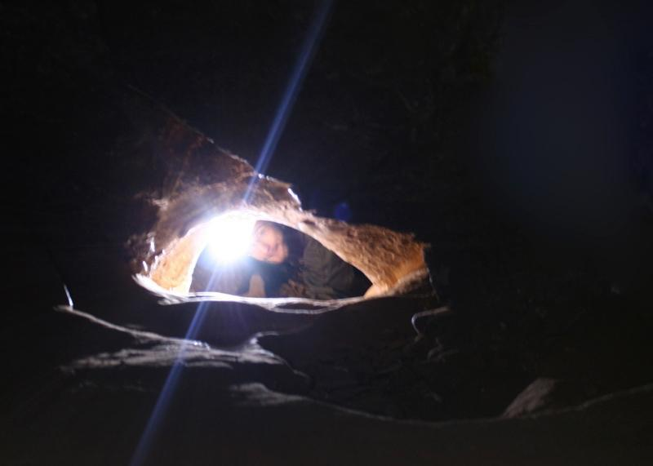

Slide 14
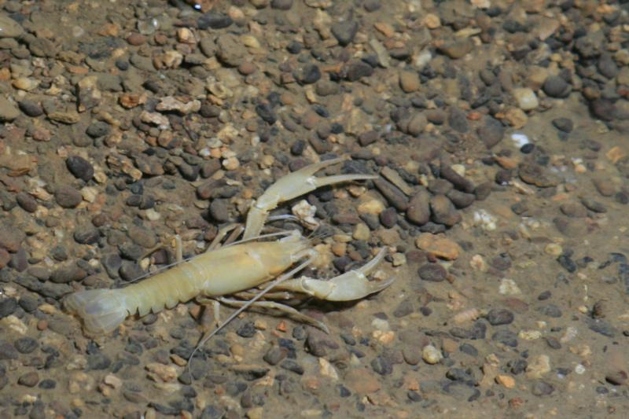
Notes:
Cave crayfish

Slide 15
Notes:
Indiana bat

Slide 16
Mammoth Cave National Park
https://www.nps.gov/maca/index.htm

Slide 17
Bats of Mammoth Cave
Nine species of cave-associated bats
Two federally endangered
White-nose syndrome (WNS)
Cold-loving fungus, deadly to bats
Visitors can carry on clothing and gear
Detected in park in 2013

Slide 18
Problems
Impacts to resources: Wildlife

Slide 19
Strategies and Practices
Management strategies: Limit use, reduce the impact of use
Management practices: Facility development/site design/maintenance, rules/regulations, law enforcement

Slide 20
Facility Development/Site Design/Maintenance
Gated closure of colonial bat roosting sites
White-Nose Syndrome Station
Bioremediation mats

Slide 21
Rules/Regulations
Independent recreational caving prohibited
Clothing worn in other caves after 2005 not permitted
Wild cavers must wear gear provided by park
Bioremediation mat walk following tour required

Slide 22
Law Enforcement
Monitor and enforce cave closures
Intercept visitors carrying private caving gear

Slide 23
Video
Bats in Crisis: Introduction (4:24)
Bats in Crisis: Response (6:18)
https://www.youtube.com/watch?v=BzA2b92cWg4
https://www.youtube.com/watch?v=QtqoR8anAA0

