Slide 1
Protecting Biscayne’s Underwater Treasures
Managing Outdoor Recreation: Case Studies in the National Parks, 2nd Edition

Slide 2
Biscayne National Park
Biscayne National Monument (1968)
Biscayne National Park (1980)
173,000 acres; 95% underwater
Biologically rich coral reefs and seagrass meadows
Boating, swimming, snorkelling, fishing
½ million visitors per year

Slide 3
Notes:
Google maps

Slide 12
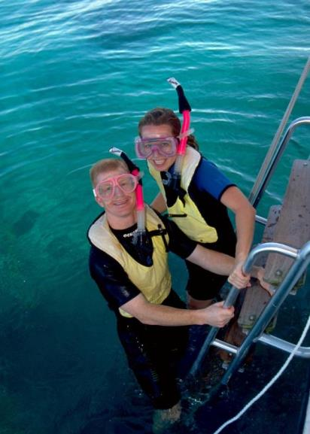

Slide 15
Biscayne National Park
https://www.nps.gov/bisc/index.htm

Slide 16
Recreational Boating
Shallow waters and vulnerable habitat
Visitors spread over vast area
Unlimited entry points
Propeller scars and groundings

Slide 17
Problems
Impacts to resources: Soil, vegetation, water, wildlife
Impacts to experience: Conflict, crowding, depreciative behaviour
Impacts to facilities/services: Attraction sites

Slide 23
Strategies and Practices
Management strategies: Reduce the impact of use, harden resource/experience
Management practices: Facility development/site design/maintenance, rules/regulations, information/education, law enforcement, zoning

Slide 24
Facility Development/Site Design/Maintenance
Markers and mooring buoys

Slide 25
Rules/Regulations
Columbus Day Weekend
Mandatory anchorage area
No more than five boats rafted together
100 feet between vessels or groups

Slide 26
Information/Education
Park website, docks, press releases
Polarized sunglasses
“Brown, brown, run aground!”
“Blue, blue, cruise on through.”

Slide 27
Law Enforcement
Fines for boat groundings
Park System Resource Protection Act
Damage Recovery Team

Slide 28
Zoning
Marine reserve zone
Anchoring prohibited
Fishing prohibited

Slide 29
Video
Spectrum of Life (10:55)
Reef Revival (3:17)
https://www.nps.gov/bisc/learn/photosmultimedia/nowplaying.htm
https://www.youtube.com/watch?v=EeT5_pe4INk

