Slide 1
No Bad Trip in Glacier
Managing Outdoor Recreation: Case Studies in the National Parks, 2nd Edition

Slide 2
Glacier National Park
“Crown of the Continent”
Established in 1910
First International Peace Park (1932)
International Biosphere Reserve (1974)
World Heritage Site (1995)
25 glaciers remain

Slide 3
Notes:
Google maps

Slide 4
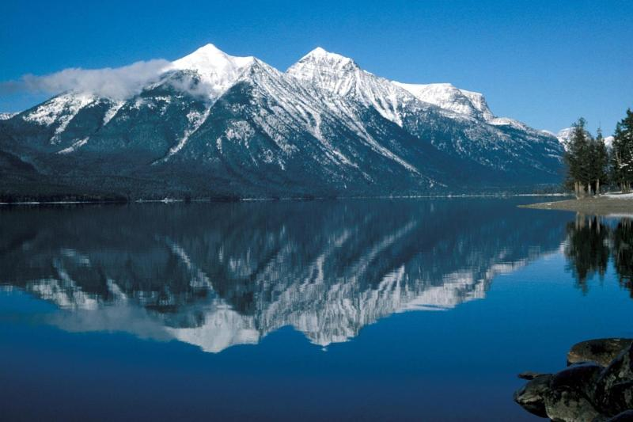

Slide 5
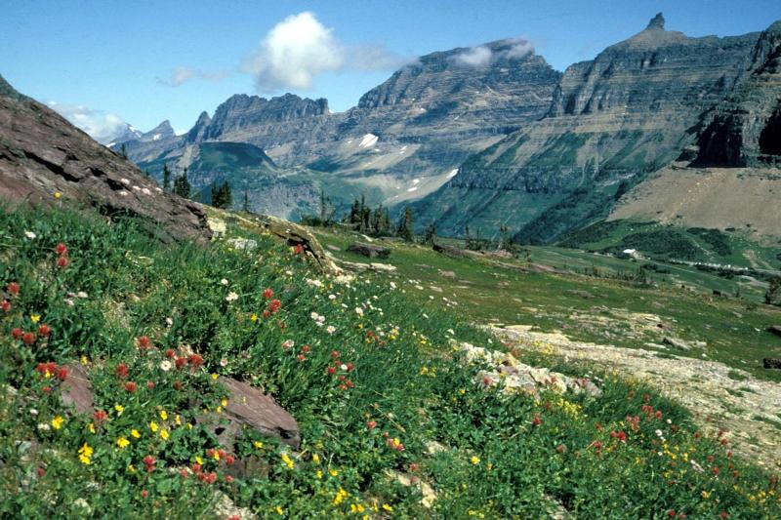

Slide 6
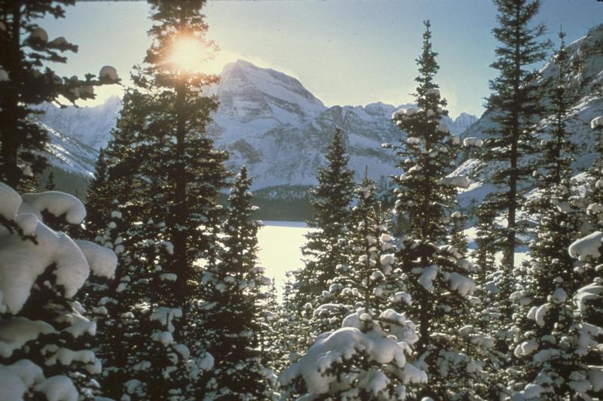

Slide 7
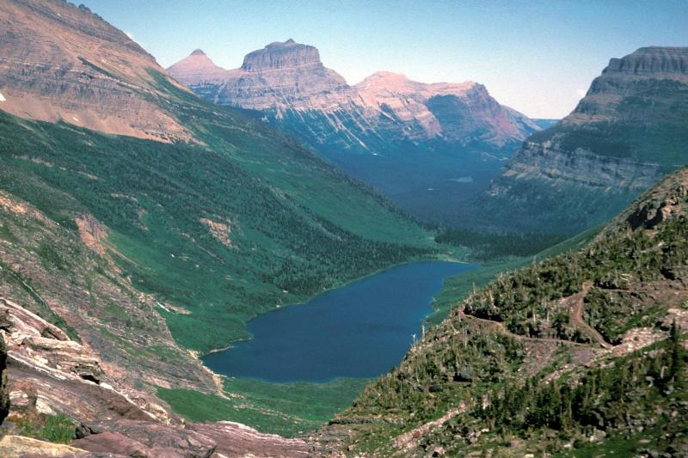

Slide 8
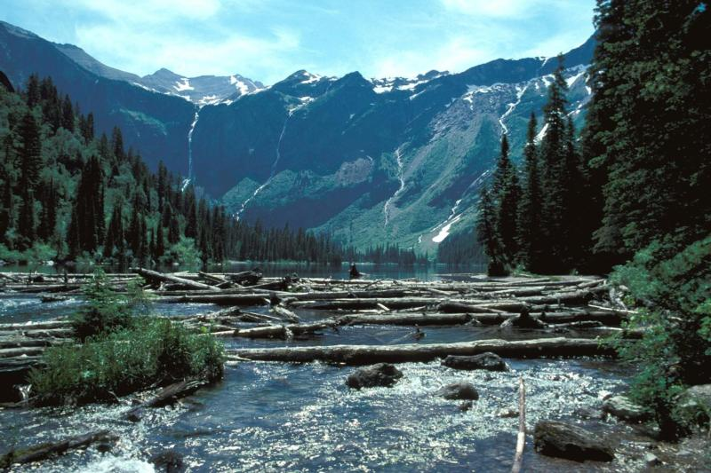

Slide 9
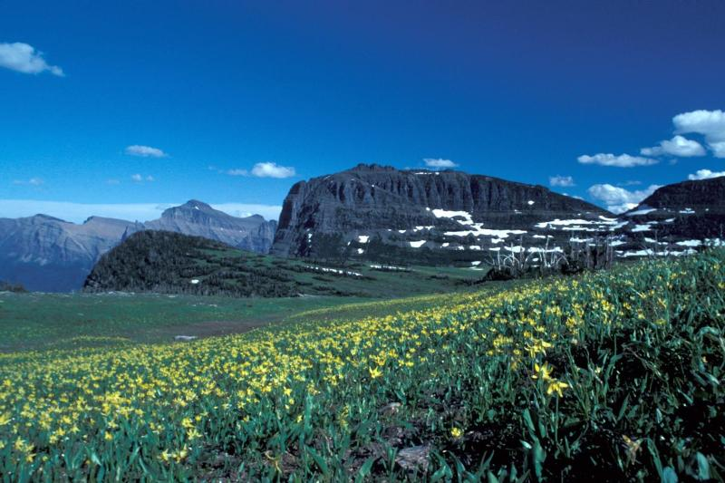

Slide 10
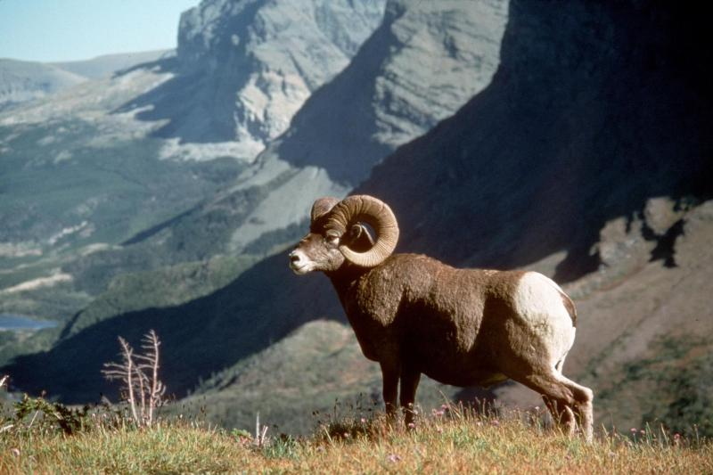

Slide 11
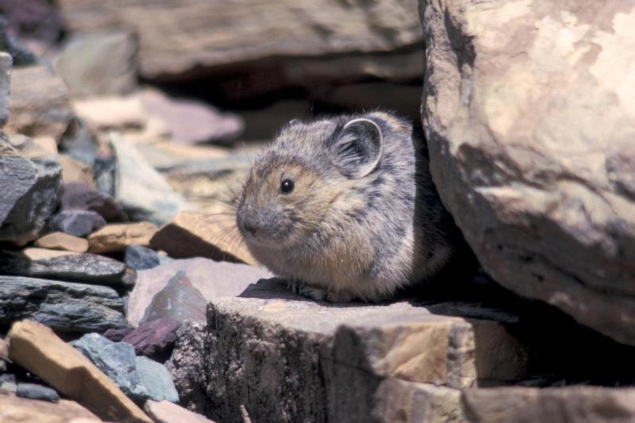

Slide 12
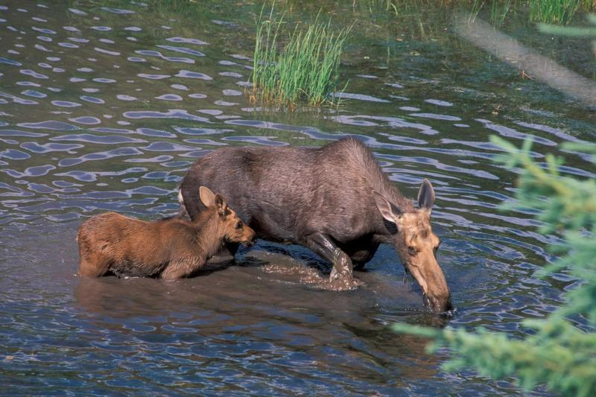

Slide 13
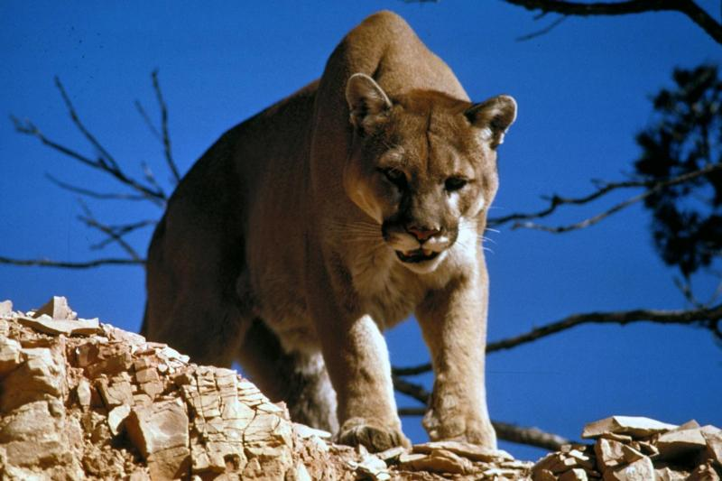

Slide 14
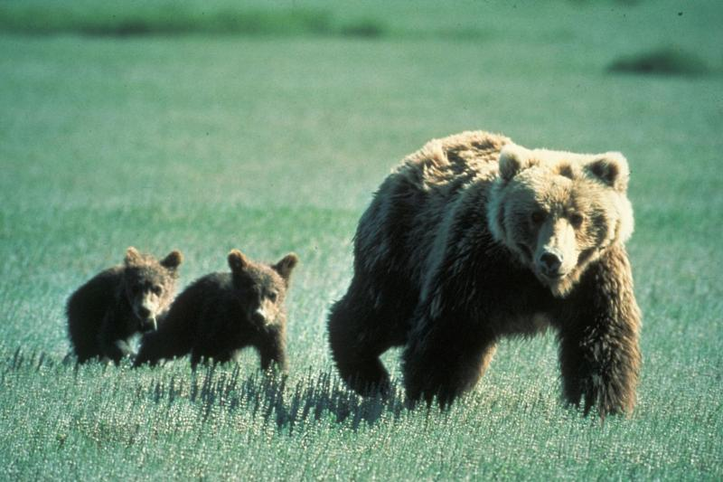

Slide 15
Glacier National Park
https://www.nps.gov/glac/index.htm

Slide 16
Backcountry Visitation
High demand for overnight use
Short backpacking season
Variable campsite opening dates
“Night of the grizzlies”

Slide 17
Problems
Impacts to resources: Vegetation, soil, wildlife, water

Slide 18
Strategies and Practices
Management strategies: Limit use, reduce the impact of use, harden resource/experience
Management practices: Facility development/site design/maintenance, rules/regulations, information/education, law enforcement, zoning

Slide 19
Facility Development/Site Design/ Maintenance
65 primitive campgrounds
208 designated campsites
Separate cooking areas
Primitive toilets

Slide 20
Rules/Regulations
Permit for designated campsites
Length of stay limits at popular sites
Leave No Trace
12 person group maximum
2 tents and 4 people per site
No dogs (except guide)
No food at tent sites
Food storage in bins or hanging bag

Slide 21
Information/Education
Park website
Advance reservation system
Backcountry office
Walk-in permits
Backcountry blog
15 minute video
“There is no bad trip in Glacier!”

Slide 22
Law Enforcement
Enforce permits and campsite rules
Alert visitors to changes in trail conditions

Slide 23
Zoning
Designated campsites
Nyack/Coal Creek Camping Zone
Hike-in mountain chalets

Slide 24
Video
Backcountry Video (14:19)
Bear Safety (7:51)
https://www.nps.gov/media/video/view.htm?id=870E3A26-155D-451F-67A8788C9EF6EE11
https://www.nps.gov/media/video/view.htm?id=BDACC427-155D-451F-6772BD00883C1C96

