Slide 1
“Alternative Transportation” at Grand Teton
Managing Outdoor Recreation: Case Studies in the National Parks, 2nd Edition

Slide 2
Grand Teton National Park
Established in 1929
Enlarged in 1950
310,000 acres
Northwestern Wyoming
Surrounded by Winegar Hole, Jedidiah Smith, and Teton Wildernesses
Iconic Teton Range with eight peaks that exceed 12,000 feet

Slide 3
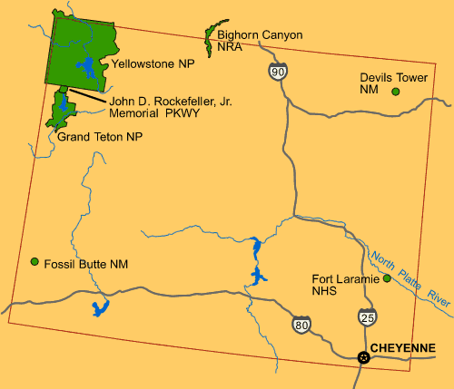

Slide 4
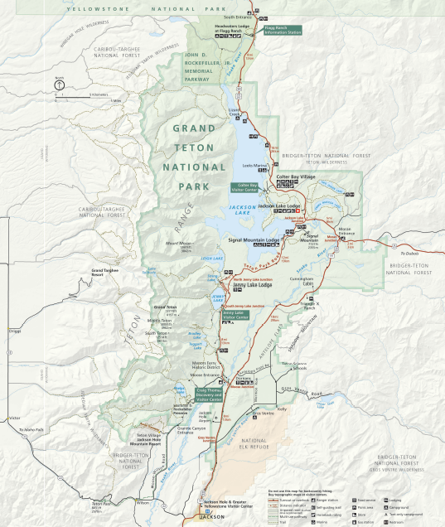

Slide 5
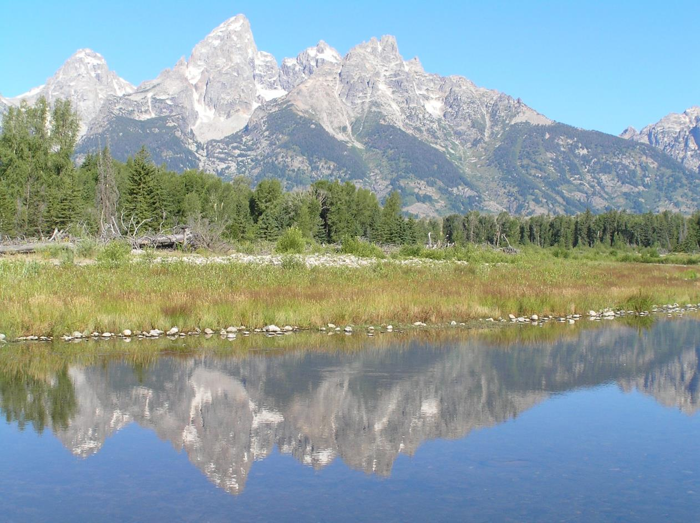
Notes:
https://www.nps.gov/media/photo/gallery.htm?id=02675736-155D-4519-3E004E99D001DA1C

Slide 6
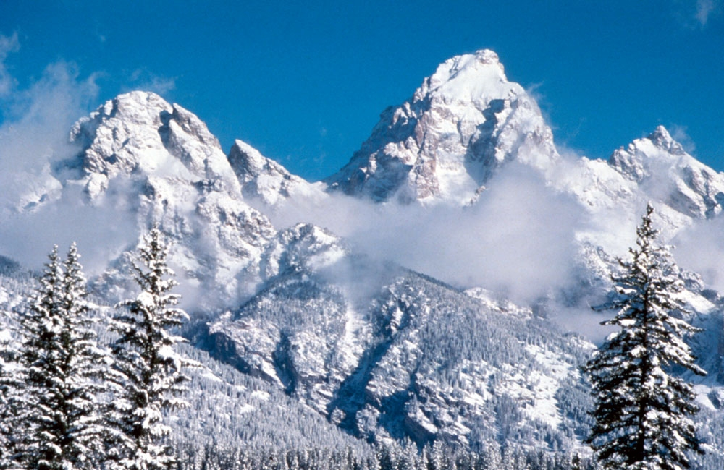
Notes:
https://www.nps.gov/media/photo/gallery.htm?id=5722133E-155D-4519-3EA5161441B51B2E

Slide 7
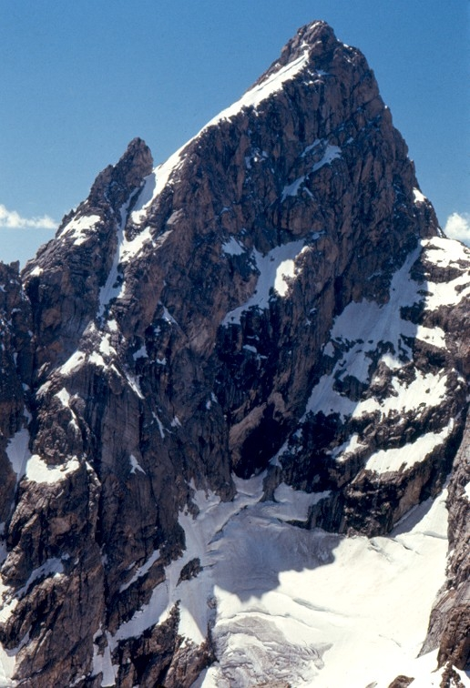
Notes:
https://www.nps.gov/media/photo/gallery.htm?id=5722133E-155D-4519-3EA5161441B51B2E

Slide 8
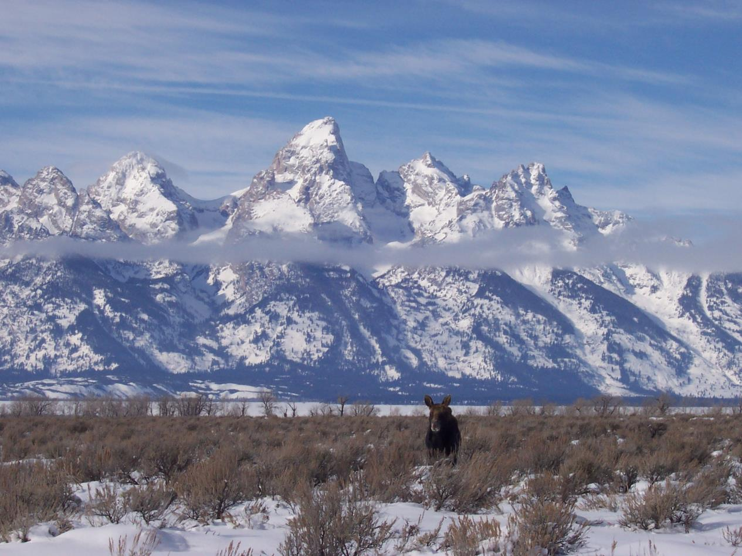
Notes:
https://www.nps.gov/media/photo/gallery.htm?id=02675736-155D-4519-3E004E99D001DA1C

Slide 9
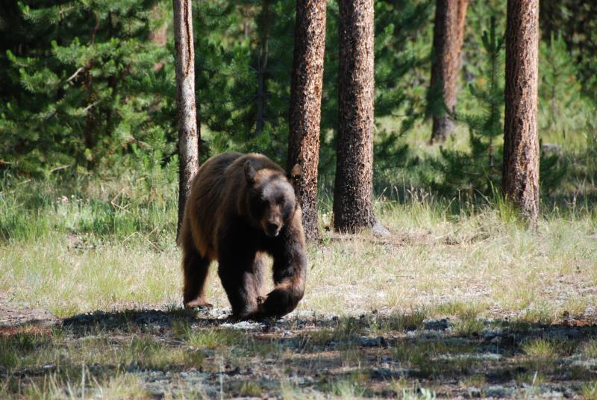

Slide 10
Notes:
https://www.nps.gov/media/photo/gallery.htm?id=575BB48F-155D-4519-3E40BFEF9424DCD1
https://www.nps.gov/media/photo/gallery.htm?id=575BB48F-155D-4519-3E40BFEF9424DCD1

Slide 11
Grand Teton National Park
https://www.nps.gov/grte/index.htm

Slide 12
Problems
Impacts to resources: Vegetation, soil, air, wildlife
Impacts to experience: Conflict, crowding
Impacts to facilities/services: Roads

Slide 13
Strategies and Practices
Management strategies: Increase supply, reduce impact of use, harden the resource
Management practices: Facility development/site design/maintenance, rules/regulations, information/education

Slide 14
Facility Development/Site Design/Maintenance
Transportation plan completed in 2007
Calls for system of multi-use pathways
Suggests transit system feasibility study
Calls for improved road signs, visitor information of traffic conditions and transportation options

Slide 15
Rules/Regulations
Pathways restricted to daylight hours
Pets prohibited
Visitors must stay at least 300 ft. from large animals and may not harass them
Food and backpacks must be attended at all times

Slide 16
Information/Education
Bicyclists and skaters are encouraged to travel at an appropriate speed for number of other users on the pathway
Helmets, bright-colored clothing, and reflectors are recommended to enhance visibility
Info regarding the park’s pathway is provided to visitors on signs, at visitor centers, and on the park website

Slide 17
Video
Wildlife Viewing in Grand Teton National Park (2:27)
Bears in the Moose-Wilson Corridor (4:22)
https://www.nps.gov/media/video/view.htm?id=0006E8AF-155D-451F-67F3336EE8F38E08
https://www.nps.gov/media/video/view.htm?id=E791CB47-155D-451F-67C246697364B06F

