Slide 1
The Winter Wonderland of Yellowstone
Managing Outdoor Recreation: Case Studies in the National Parks, 2nd Edition

Slide 2
Yellowstone National Park
First national park in the world
Established in 1872
2 million acres
Geothermal features
60% of world’s geysers
Greater Yellowstone Ecosystem
Abundant wildlife

Slide 3
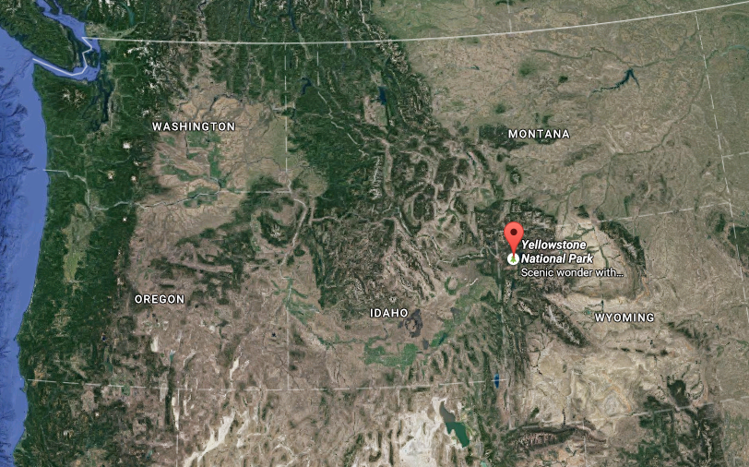

Slide 4
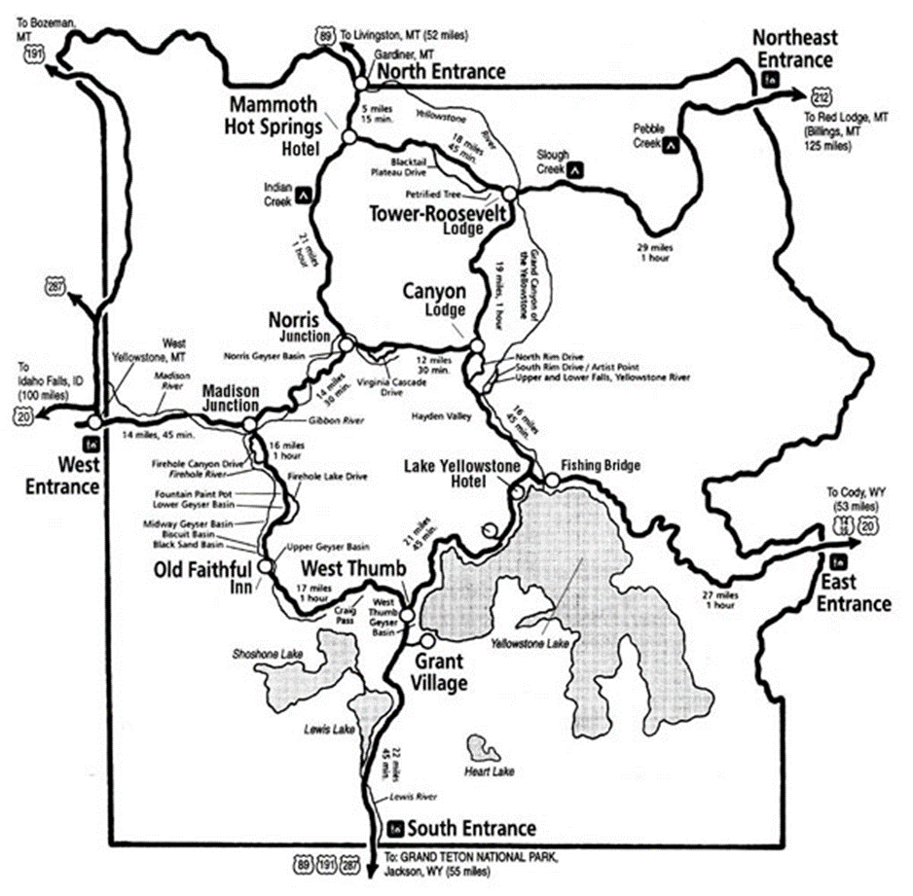

Slide 5
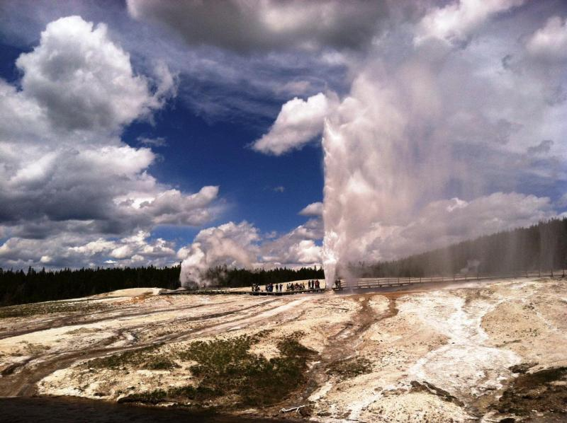

Slide 6
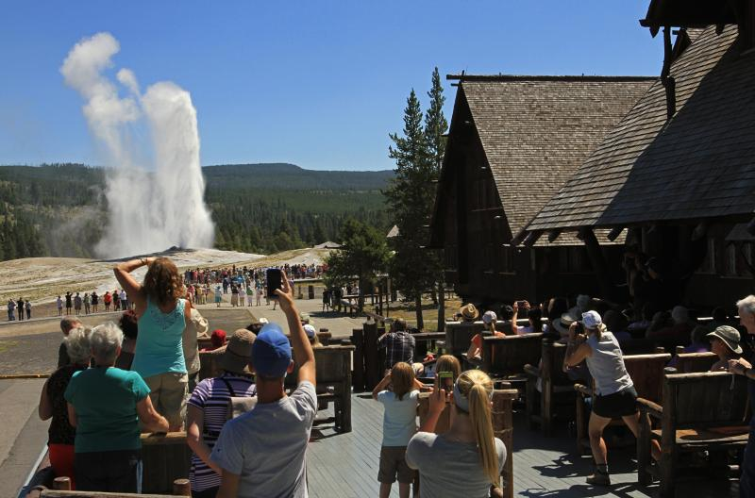

Slide 7
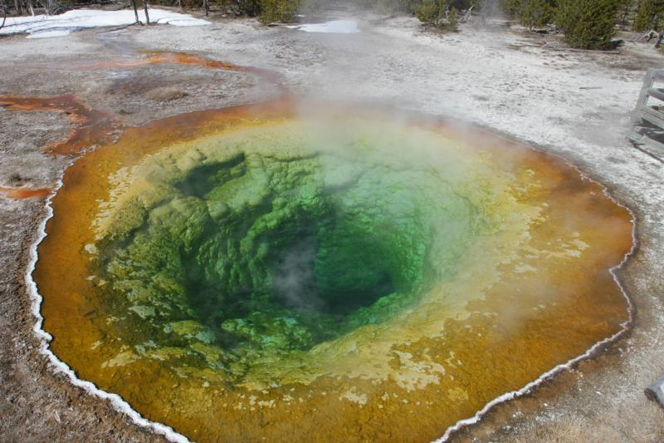

Slide 8
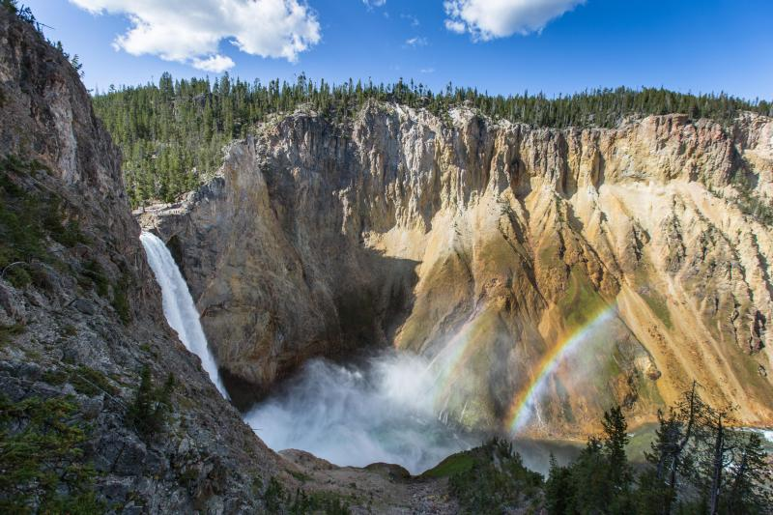

Slide 9
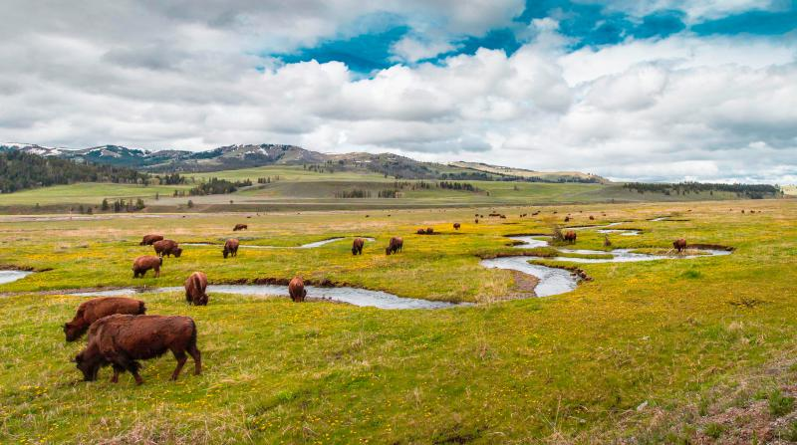

Slide 10
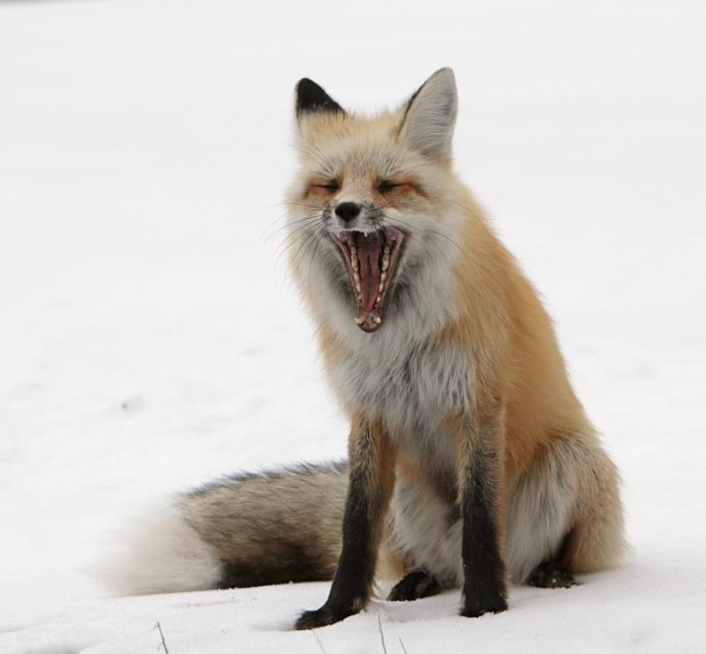

Slide 11
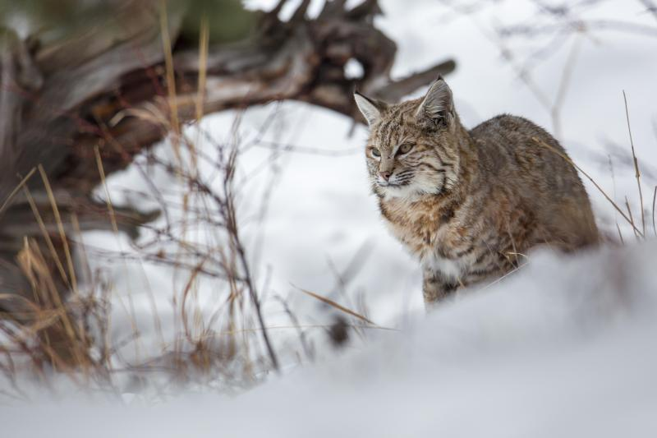

Slide 12
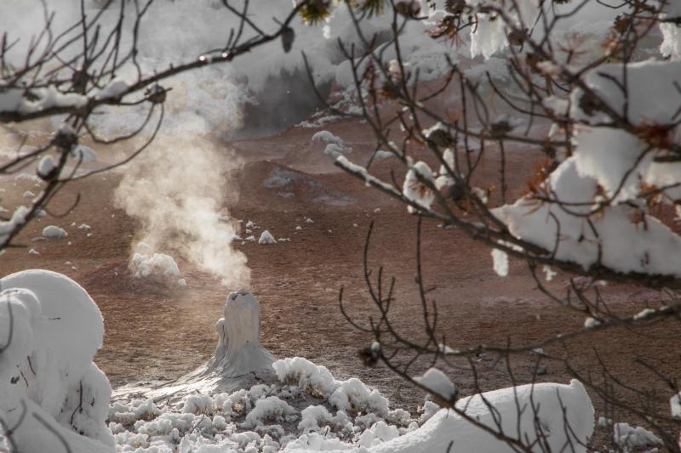

Slide 13
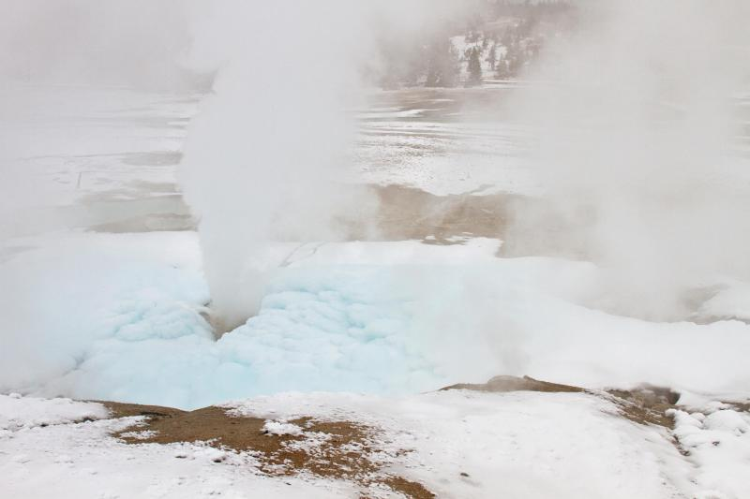

Slide 14
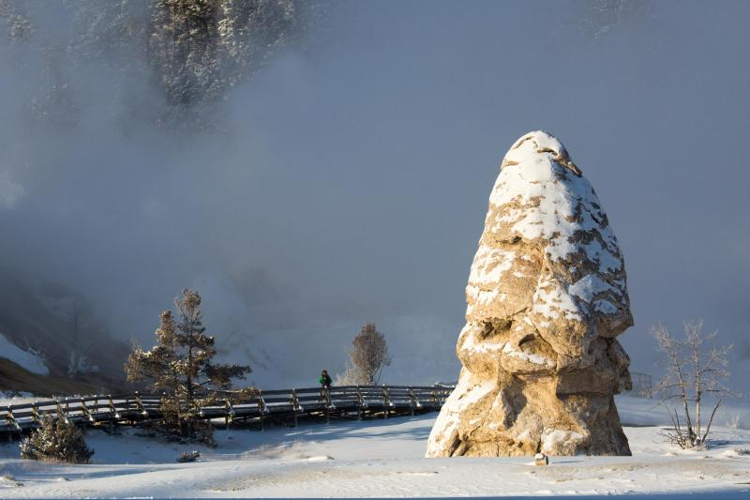

Slide 15
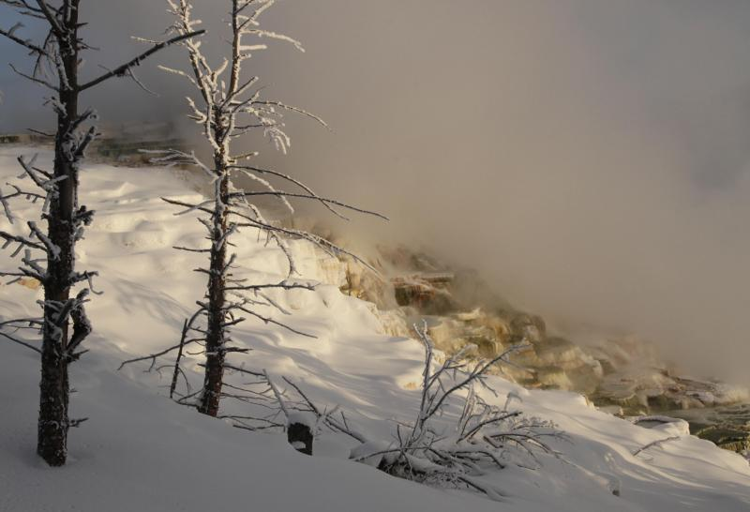

Slide 16
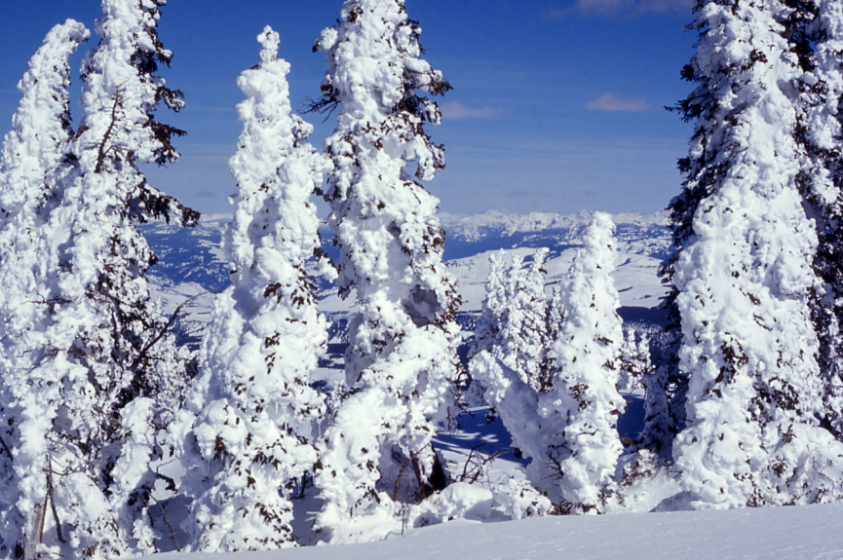

Slide 17
Yellowstone National Park
https://www.nps.gov/yell/index.htm

Slide 18
Winter Visitation
Snow planes (1949)
First modern snowmobiles (1963)
Growing visitation, noise and air pollution, stress on winter wildlife
Lawsuits, extended planning, and public comment
Long-term winter use plan (2013)
Collaborative adaptive management

Slide 19
Problems
Impacts to resources: Air, wildlife, soundscape
Impacts to experience: Conflict, crowding, depreciative behavior
Impacts to facilities/services: Attraction sites, trails

Slide 20
Strategies and Practices
Management strategies: Limit use, reduce the impact of use
Management practices: Facility development/site design/maintenance, rules/regulations, rationing/allocation, law enforcement

Slide 21
Facility Development/Site Design/ Maintenance
Trail grooming for oversnow travel

Slide 22
Rules/Regulations
Required guide certification course
Travel single file and stay on designated trails
Vehicles allowed from 7am to 9pm
Snowmobiles | Snowcoaches
15 g/KW-hr hydrocarbons, 90 g/kW-hr carbon monoxide | EPA Tier 2 vehicle standards
67 decibels | 75 decibels
35 mph speed limit | 25 mph speed limit

Slide 23
Rationing/Allocation
“Transportation events”
110 per day
Up to 50 snowmobile groups
Can exchange allocated events

Slide 24
Rationing/Allocation
1 transportation event =
Snowmobiles | Snowcoaches
Group of 10 maximum | 1 (or 2)
Seasonal average of 7 | Seasonal average of 1
Seasonal average of 8 with higher technology standards | Seasonal average of 1.5 with higher technology standards

Slide 25
Law Enforcement
$5,000 fine for travel off established routes

Slide 26
Video
Yellowstone in Winter (8:35)
https://www.youtube.com/watch?v=UV10Wt30IGE

