Slide 1
Climbing Towards Common Ground at Devils Tower
Managing Outdoor Recreation: Case Studies in the National Parks, 2nd Edition

Slide 2
Devils Tower National Monument
Inaugural use of the Antiquities Act – 1906
World’s first National Monument
Northeastern Wyoming
Sacred to many American Indians
Traditional ceremonial activities practiced at the sacred site
History of rock climbing at the tower extends over a century

Slide 3
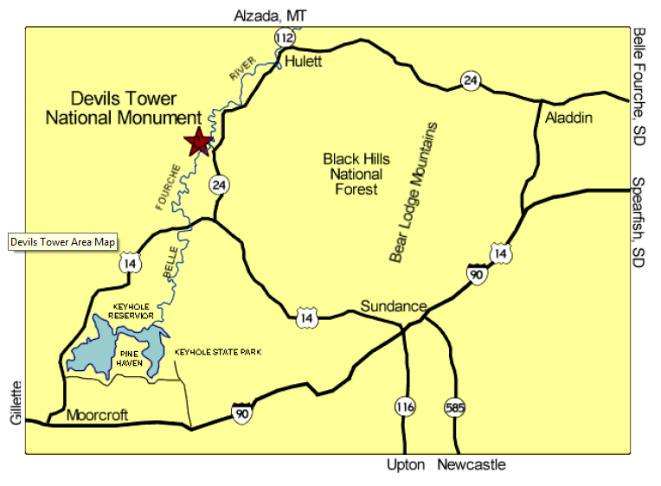

Slide 4
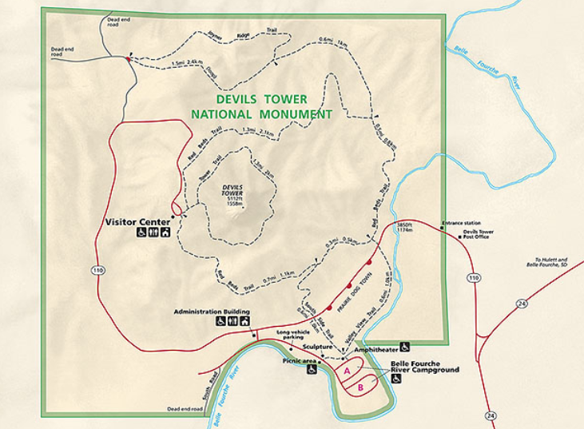

Slide 5
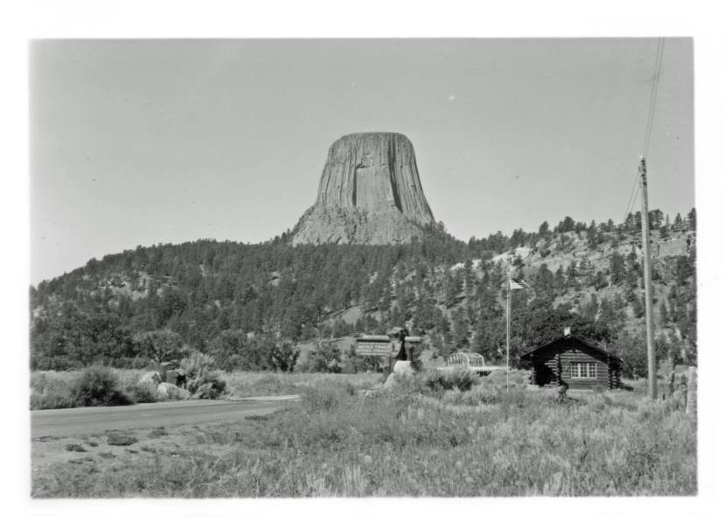
Notes:
https://www.nps.gov/media/photo/gallery.htm?id=02675736-155D-4519-3E004E99D001DA1C

Slide 6
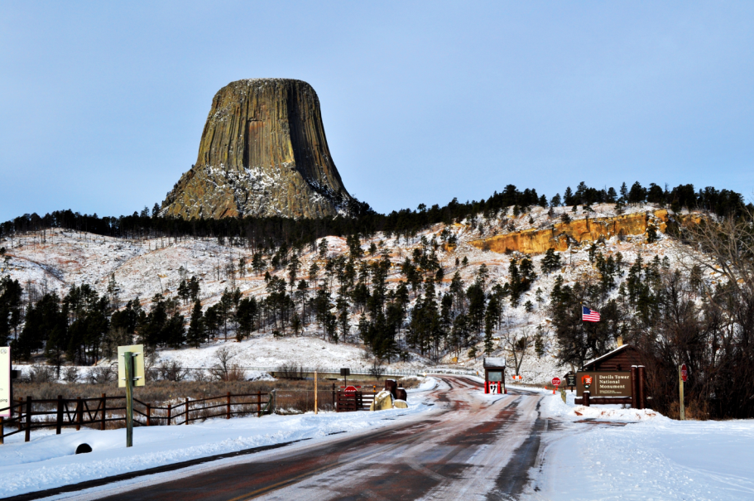
Notes:
https://www.nps.gov/media/photo/gallery.htm?id=5722133E-155D-4519-3EA5161441B51B2E

Slide 7
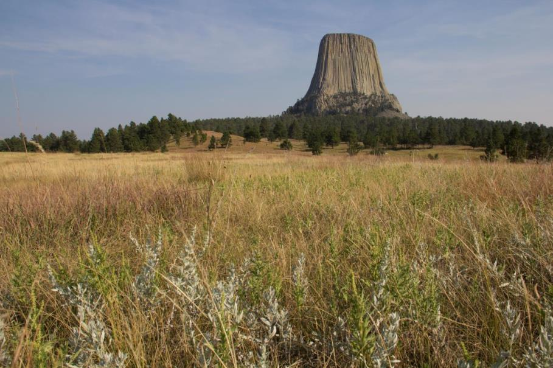

Slide 8
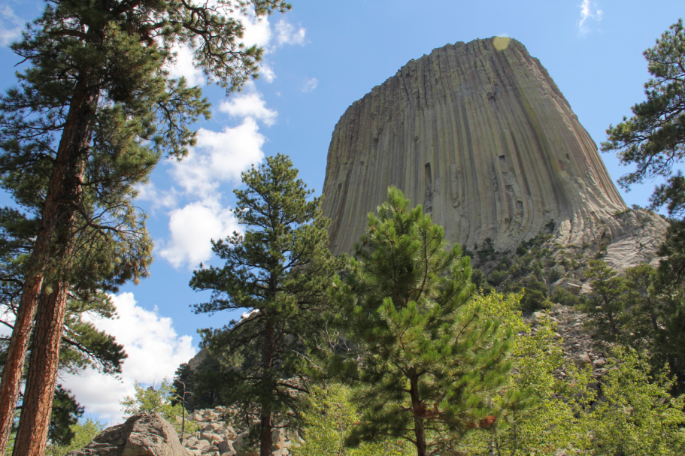
Notes:
https://www.nps.gov/media/photo/gallery.htm?id=5722133E-155D-4519-3EA5161441B51B2E

Slide 9
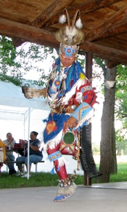
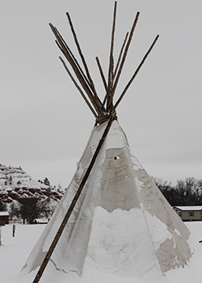
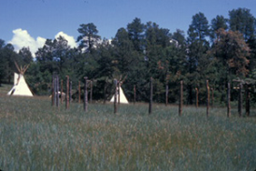
Notes:
https://www.nps.gov/media/photo/gallery.htm?id=5722133E-155D-4519-3EA5161441B51B2E

Slide 10
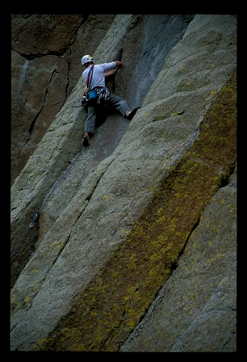
Notes:
https://www.nps.gov/media/photo/gallery.htm?id=02675736-155D-4519-3E004E99D001DA1C

Slide 11
Devils Tower National Monument
https://www.nps.gov/deto/index.htm

Slide 12
Problems
Impacts to resources: Historic/cultural
Depreciative behaviour: Inappropriate use
Impacts to experience: Conflict

Slide 13
Strategies and Practices
Management strategies: Reduce impact of use
Management practices: Zoning, information/education, rules/regulations, facility development/site design/maintenance

Slide 14
Zoning
Temporal – voluntary climbing closure

Slide 15
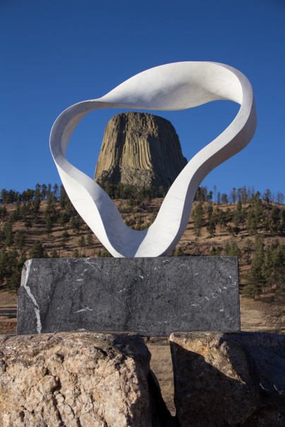
Information/Education
Cross-cultural education program designed to enhance knowledge of significance to American Indians

Slide 16
Rules/Regulations and Facility Development/Site Design/Maintenance
Climbers must register with a ranger before and after climbs
A dedicated climber registration office has been developed to provide visitors more contacts with climbing rangers

Slide 17
Video
The Sacred Tower (5:32)
Climbing Devils Tower (6:46)
Climbing Management (10:29)
https://www.nps.gov/media/video/view.htm?id=8919909D-1DD8-B71B-0B35982BF53F49DA
https://www.nps.gov/media/video/view.htm?id=CA03F2ED-1DD8-B71B-0B5E93D361E81605
https://www.nps.gov/media/video/view.htm?id=852FCF3A-1DD8-B71B-0BF58309DE60C967

