Slide 1
Managing Monuments and Memorials at the National Mall
Managing Outdoor Recreation: Case Studies in the National Parks, 2nd Edition

Slide 2
National Mall and Memorial Parks
1,000 acres of green spaces and cultural sites in Washington D.C.
City planner Pierre L’Enfant (1791)
McMillan plan, US Bicentennial, Extending the Legacy plan

Slide 3
National Mall
US Capitol, Lincoln Memorial, Washington Monument, White House
Smithsonian Institute museums
Lawns, gardens, thousands of trees

Slide 4
Notes:
Google maps

Slide 11
Notes:
March for Women’s Lives - 2015

Slide 12
National Mall and Memorial Parks
https://www.nps.gov/nama/index.htm

Slide 13
Intensive Use
25 million + visits per year
Visits to monuments and memorials
Festival attendance
Recreation and exercise
Rallies, demonstrations, and protests

Slide 14
Problems
Impacts to resources: Soil, vegetation, historical/cultural
Impacts to experience: Crowding, conflict
Impacts to facilities/services: Attraction sites, trails, roads/parking, interpretive facilities/programs

Slide 15
Strategies and Practices
Management strategies: Limit use, increase supply, reduce the impact of use, harden resource
Management practices: Facility development/site design/maintenance, information/education, rules/regulations, rationing/allocation, law enforcement

Slide 16
Facility Development/Site Design/Maintenance
Multipurpose facilities
High capacity restrooms
Separated bicycle, pedestrian, vehicle paths
Wider, paved walkways

Slide 17
Facility Development/Site Design/maintenance
Turf grass restoration
Durable grass species
Compaction-resistant, engineered soils
Drainage system
Underground cisterns

Slide 18
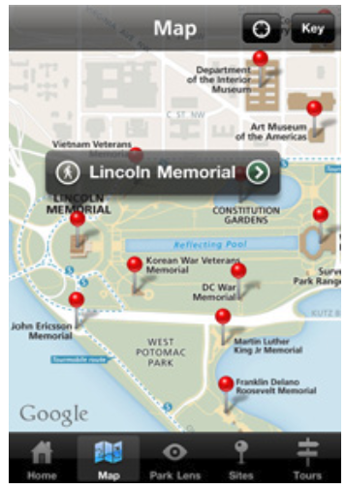
Information/Education
Park website
Mobile apps
Interpretive programs and exhibits
Roving docents

Slide 19
Rules/Regulations
NO tree climbing, remote model airplanes, kites with non-biodegradable string
NO jogging, picnicking, rollerblading, skating, skateboarding, bicycling, scooters at certain memorials

Slide 20
Rationing/Allocation
Permits for organized events
First-come, first-served
4,000 to 6,000 permits per year

Slide 21
Law Enforcement
National Park Service, US Capitol Police, Metropolitan Police, Secret Service
Monetary bond for expenses
Cost Recovery Program for damages

Slide 22
Video
Washington Monument EarthCam
Turf Restoration - Phase I
Turf Restoration - Phase II
http://www.earthcam.com/usa/dc/washingtonmonument/?cam=wamo
http://nationalmall.org/building/restore-improve/progress/completed-projects/turf-restoration-phase-i
http://nationalmall.org/turf-phaseii

