Slide 1
The Buzz from Above at Grand Canyon
Managing Outdoor Recreation: Case Studies in the National Parks, 2nd Edition

Slide 2
Grand Canyon National Park
Established as National Park in 1919
Over 1.2 million acres
Northern Arizona
Includes over 1.1 million acres of proposed Wilderness
First recorded air tour occurred prior to park designation
Complex relationship between FAA and NPS

Slide 3
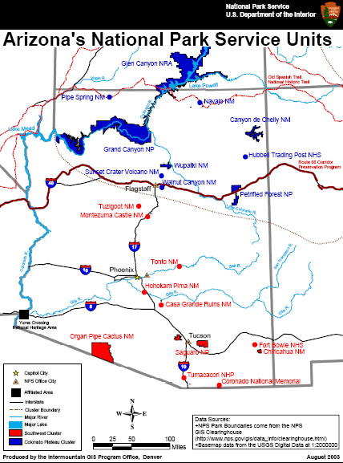

Slide 4
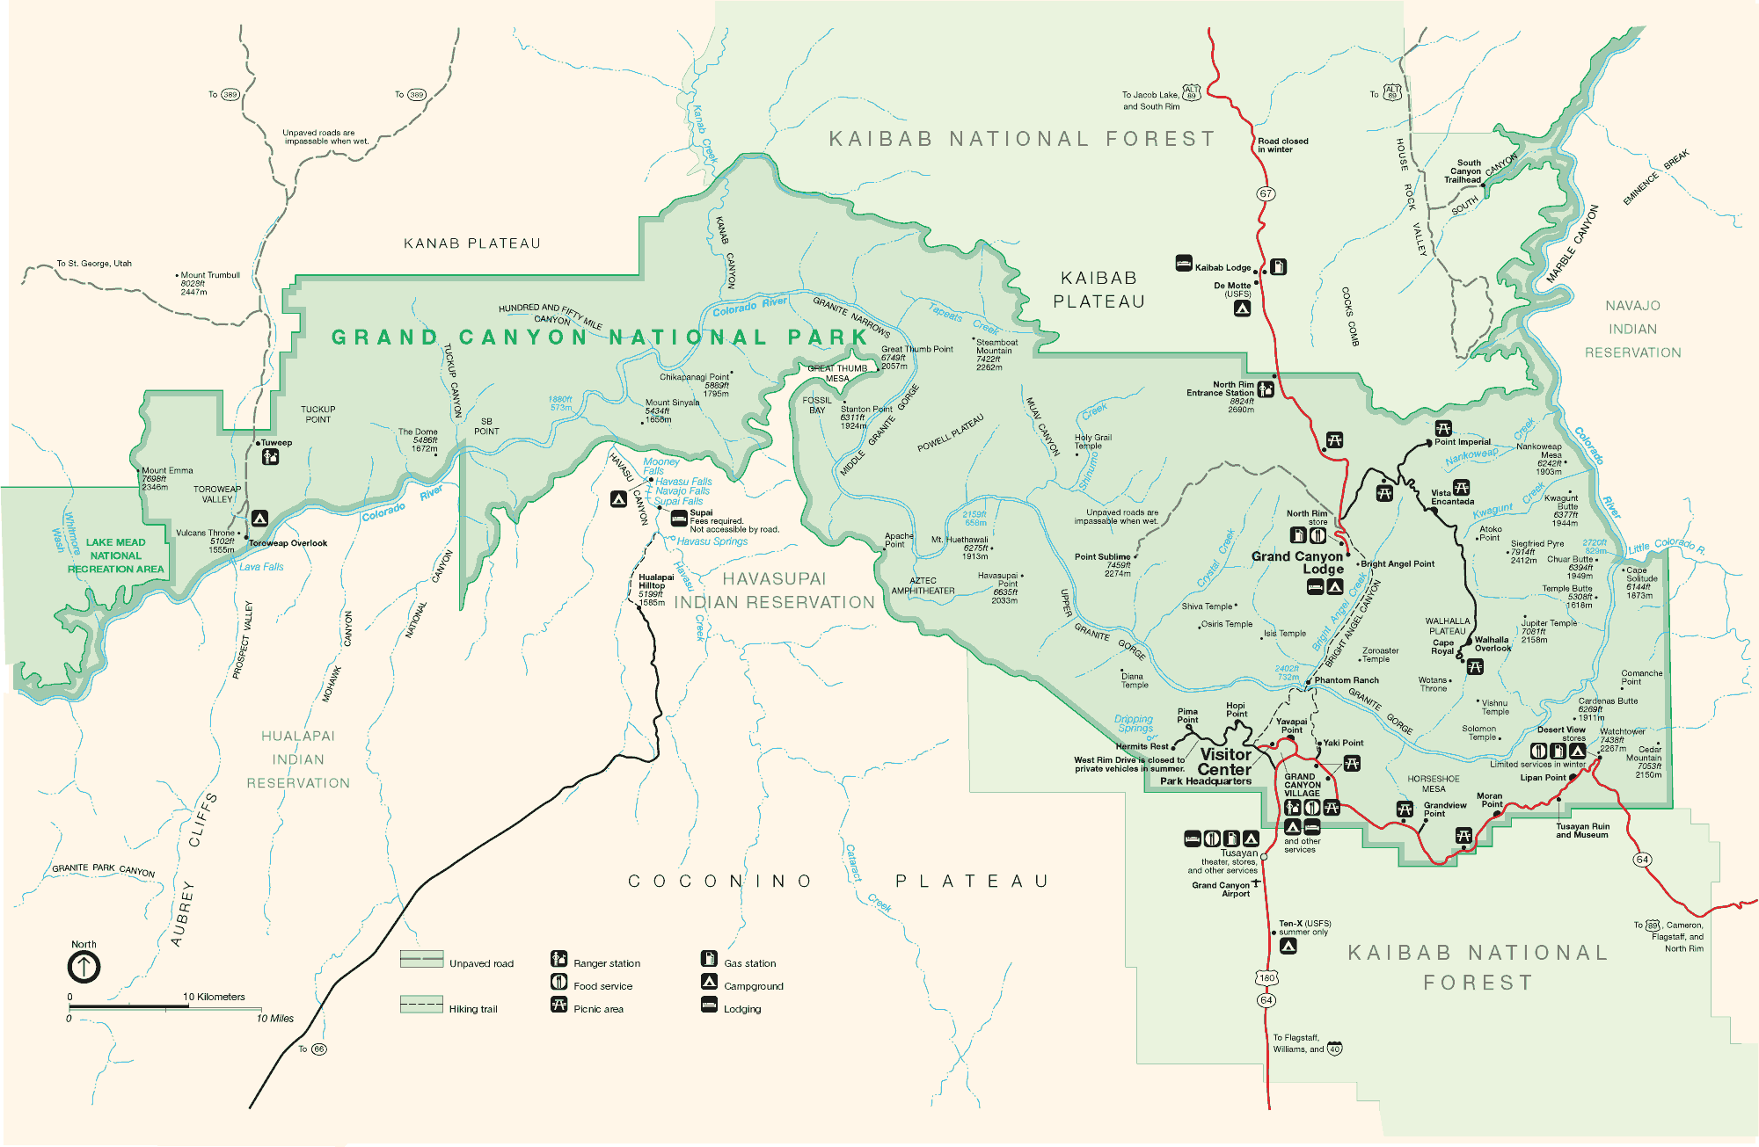

Slide 5
Notes:
https://www.nps.gov/media/photo/gallery.htm?id=02675736-155D-4519-3E004E99D001DA1C

Slide 6
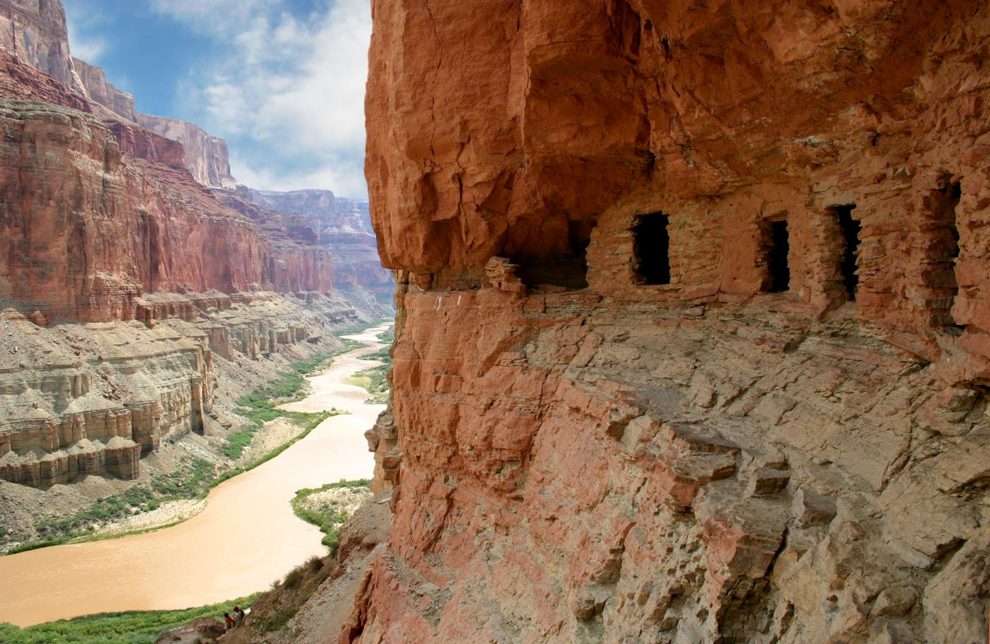

Slide 7
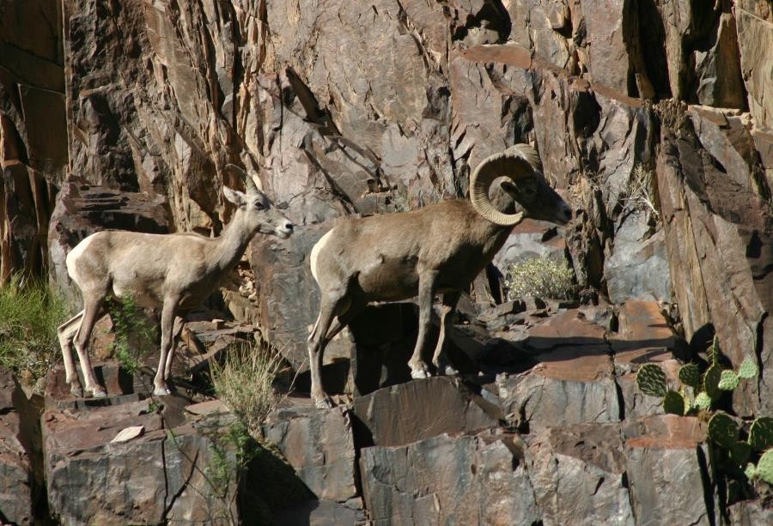
Notes:
https://www.nps.gov/media/photo/gallery.htm?id=5722133E-155D-4519-3EA5161441B51B2E

Slide 8
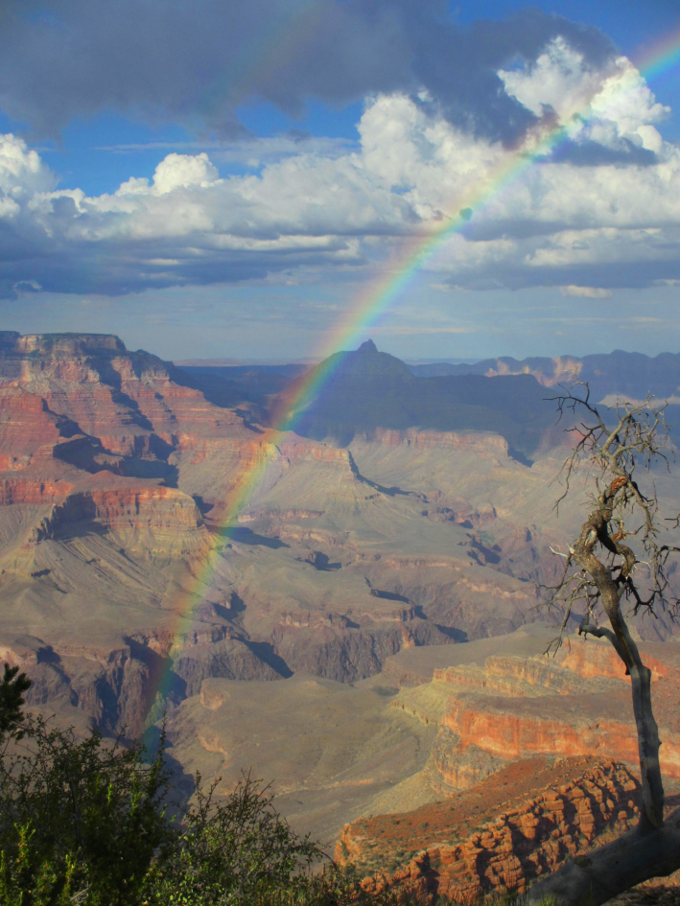
Notes:
https://www.nps.gov/media/photo/gallery.htm?id=5722133E-155D-4519-3EA5161441B51B2E

Slide 9
Notes:
https://www.nps.gov/media/photo/gallery.htm?id=02675736-155D-4519-3E004E99D001DA1C

Slide 10
Grand Canyon National Park
https://www.nps.gov/grca/index.htm

Slide 11
Problems
Impacts to resources: Soundscape, wildlife
Impacts to experience: Conflict
Impacts to facilities/services: Attraction sites, trails, campgrounds, interpretive facilities/programs

Slide 12
Strategies and Practices
Management strategies: Limit use, reduce impact of use
Management practices: Rationing/allocation, rules/regulations, zoning

Slide 13
Rationing/Allocation
Number of air tours allowed to operate each year is limited
An annual allocation of 93,971 flights is permitted; this number reflects the total number of flights that occurred over a one year period in 1997–1998

Slide 14
Rules/Regulations and Zoning
Special Flights Rules Area established
Designated routes for tour aircraft
Four Flight Free Zones prohibit flights below certain altitudes
Within travel corridors on the park’s east end, operations are limited from 8 a.m. to 6 p.m. from May to September, and from 9 a.m. to 5 p.m. from October through April

Slide 15
Video
Grand Canyon’s very own YouTube Channel (multiple videos)
https://www.youtube.com/channel/UC8jf0seie_pM_rsPp27aBgA

