Slide 1
Doing the Zion Shuttle
Managing Outdoor Recreation: Case Studies in the National Parks, 2nd Edition

Slide 2
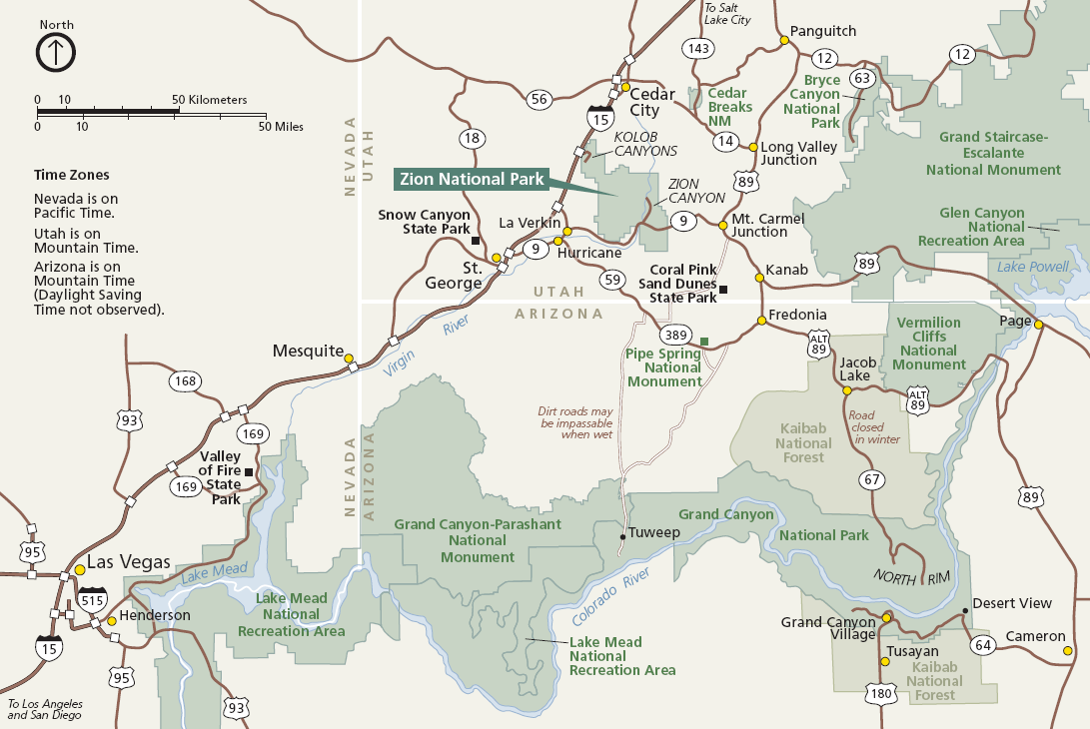

Slide 3
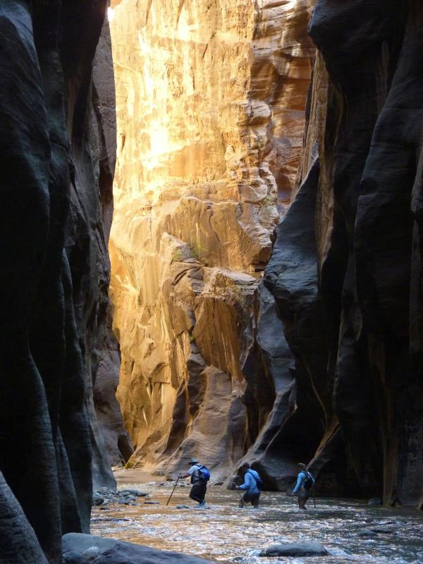

Slide 4
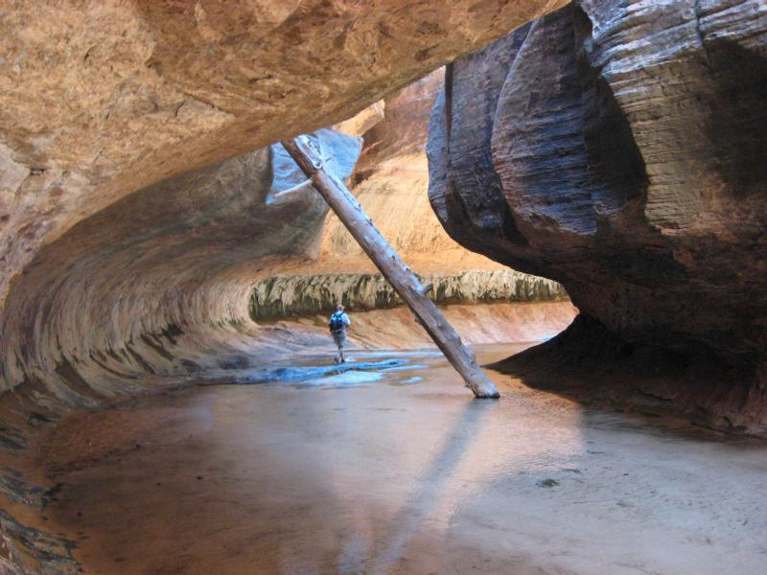

Slide 5
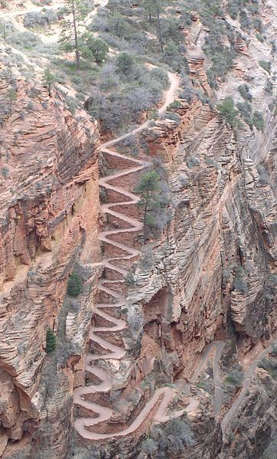
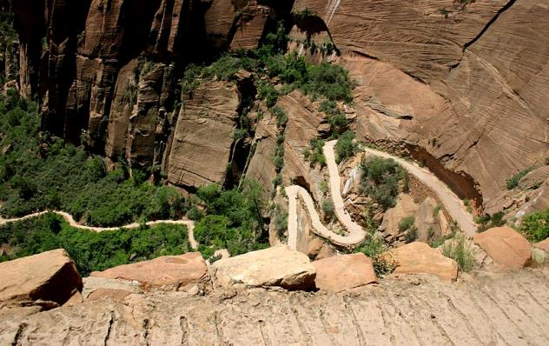
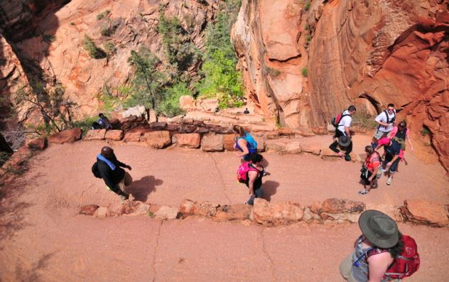
Photo Credit: Jeff Turner
Photo Credit: Jay Johnson

Slide 6
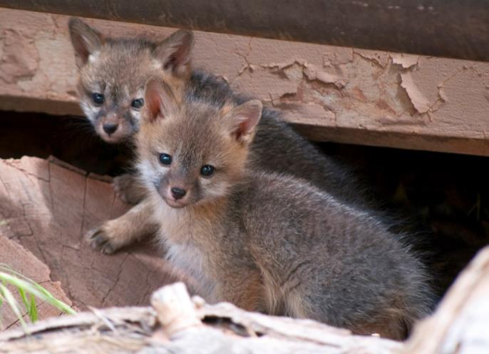
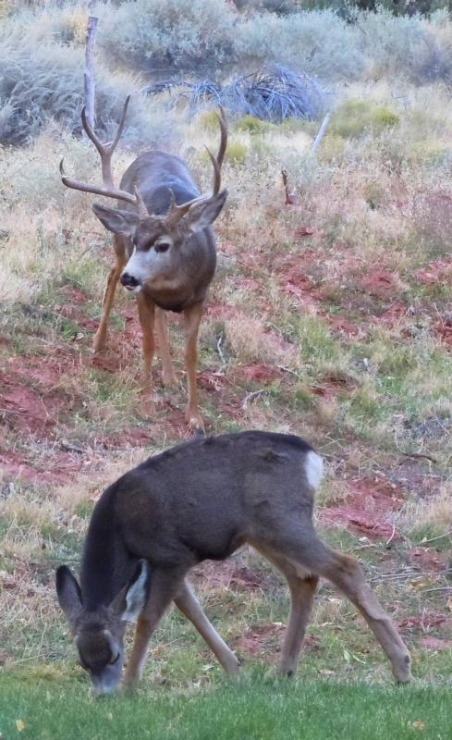


Slide 7
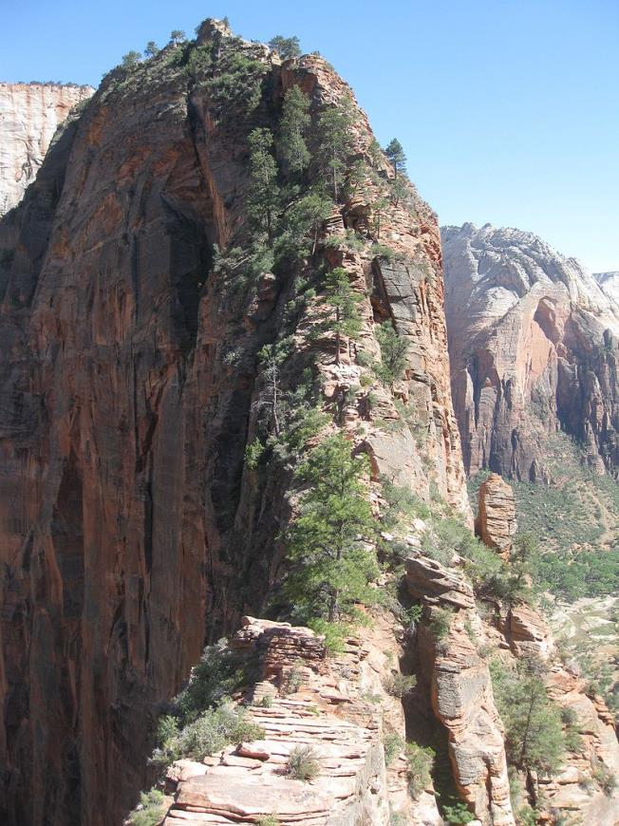
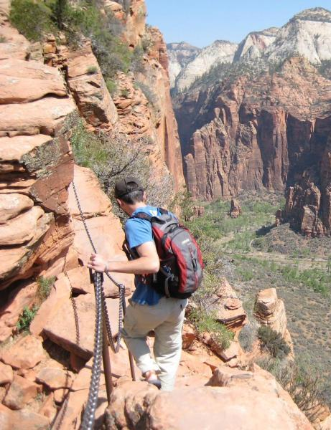
Photo Credit: Roman Fuchs

Slide 8
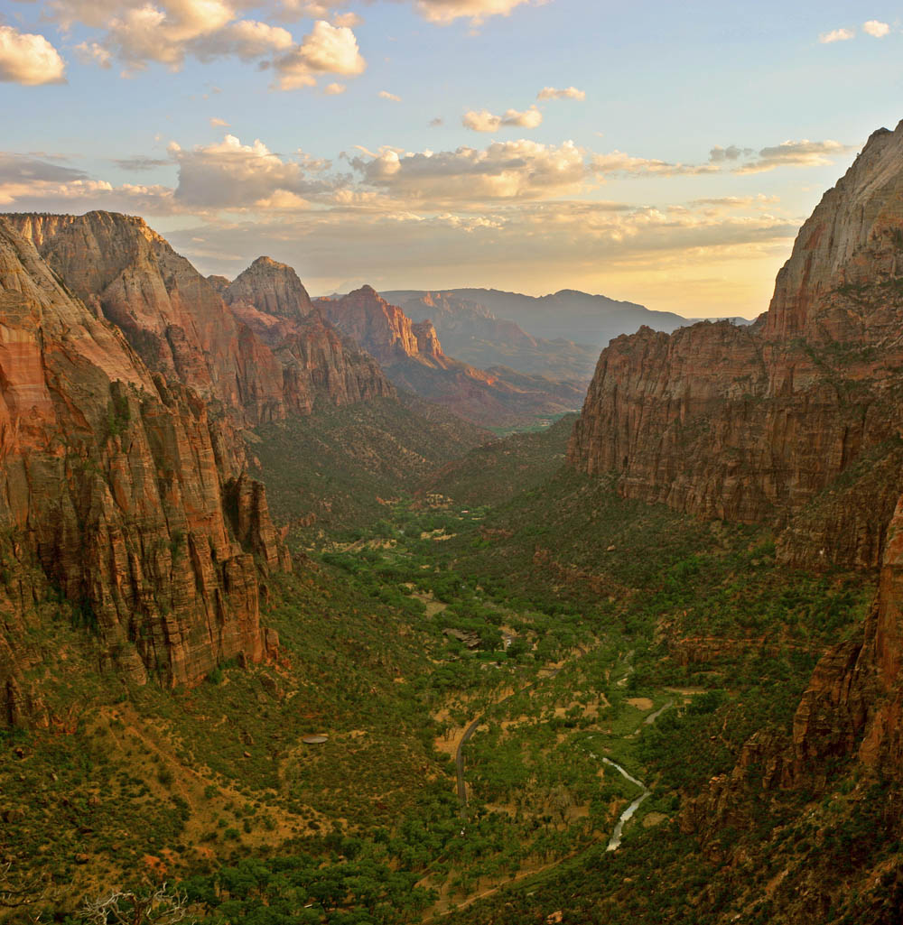
Photo Credit: Diliff

Slide 9
Zion National Park
Culturally significant dating back 700 ad
Mormon influence beginning in 1858
Zion National Monument – 1909
Zion National Park – 1919
CCC construction 1930s
Kolob Canyon expansion in 1956
229 square miles of park land
Zion – “the promised land”

Slide 10

Zion National Park
http://www.nps.gov/zion/index.htm

Slide 11
Zion National Park Traffic
In the late 1990s as many as 5,000 cars entered the Canyon each day, competing for the area’s 450 parking spaces
Road congestion
Unauthorized parking
Noise from high volume traffic

Slide 12
Problem
Impacts to resources: Impacts to soundscape, wildlife, soil and vegetation, air.
Impacts to experience: Crowding, conflict
Impacts to facilities/service: roads, parking lots, attraction sites.

Slide 13
Strategies and Practices
Management strategies: Reduce the impact of use; harden the resource
Management Practices: Facility development/ site design/maintenance; rules and regulations; spatial and temporal zoning

Slide 14
Facility Development/Site Design/Maintenance
In 2000, 30 propane-powered “double” shuttle buses, each holding 66 people (or the equivalent of about 25 cars)

Slide 15
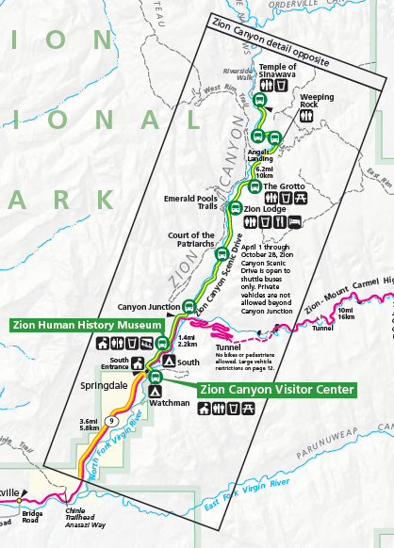
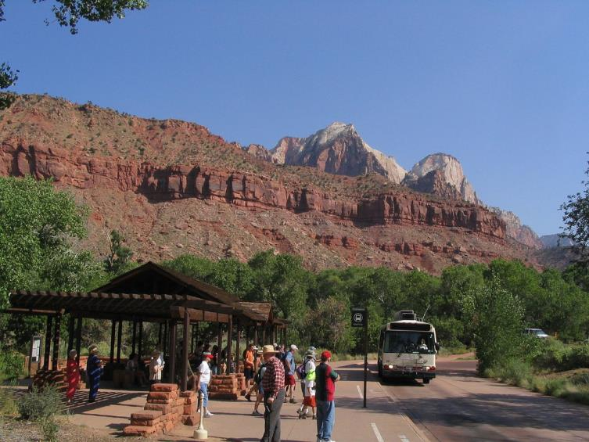
Photo Credit: Ken Lund

Slide 16
Rules and Regulations
The Zion Canyon Scenic Drive is accessible only by shuttle bus from March 12 through the end of October and on weekends in November.

Slide 17
Zoning
Spatial
Temporal

Slide 18
Videos
Zion Shuttle System (4:00)
Hiking the Subway (10:00)
Flash flood (:40)
Hiking the Narrows (2:50)
https://www.nps.gov/zion/planyourvisit/shuttle-system.htm
http://www.youtube.com/watch?v=rgNSrE0BJ8g&feature=fvwp&NR=1
http://www.youtube.com/watch?v=ThMz7S9-co4
http://www.youtube.com/watch?v=Dx_YfUKyvEU

