Slide 1
A Mountain with Handrails at Yosemite
Managing Outdoor Recreation: Case Studies in the National Parks, 2nd Edition

Slide 2
A Mountain with Handrails at Yosemite
Yosemite National Park
1890
A “crown jewel” park
John Muir
1,200 square miles
Sierra Nevada Mountains
Half Dome is legendary in the climbing community
First technical ascent of the vertical north face was in 1957 via a route pioneered by Royal Robbins and others

Slide 3
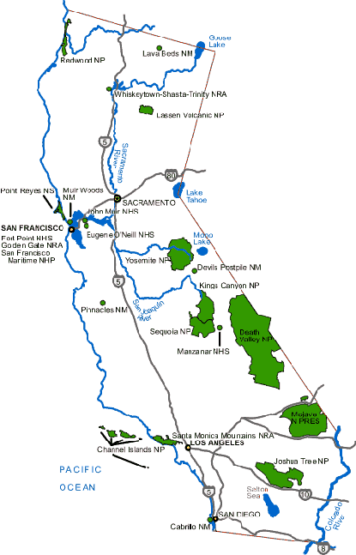

Slide 4
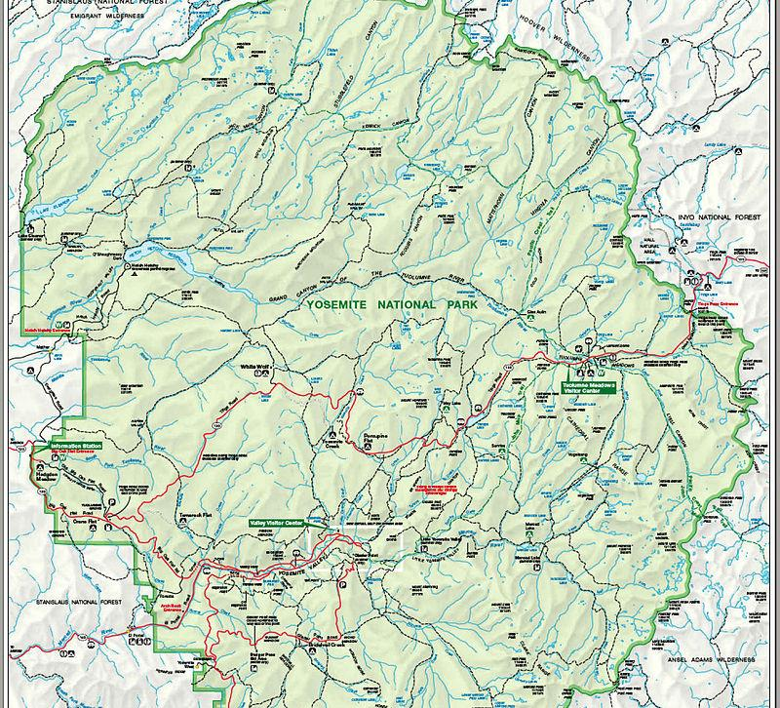

Slide 5
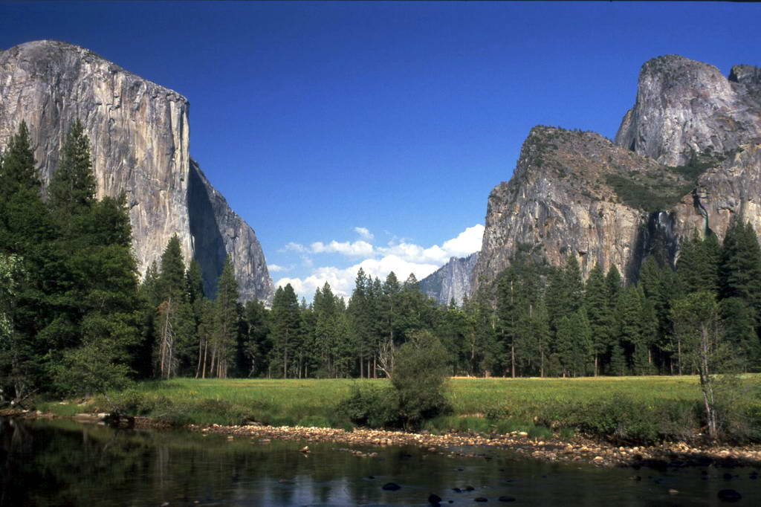
Photo Credit: Rainer Marks
Notes:
https://www.nps.gov/media/photo/gallery.htm?id=02675736-155D-4519-3E004E99D001DA1C

Slide 6
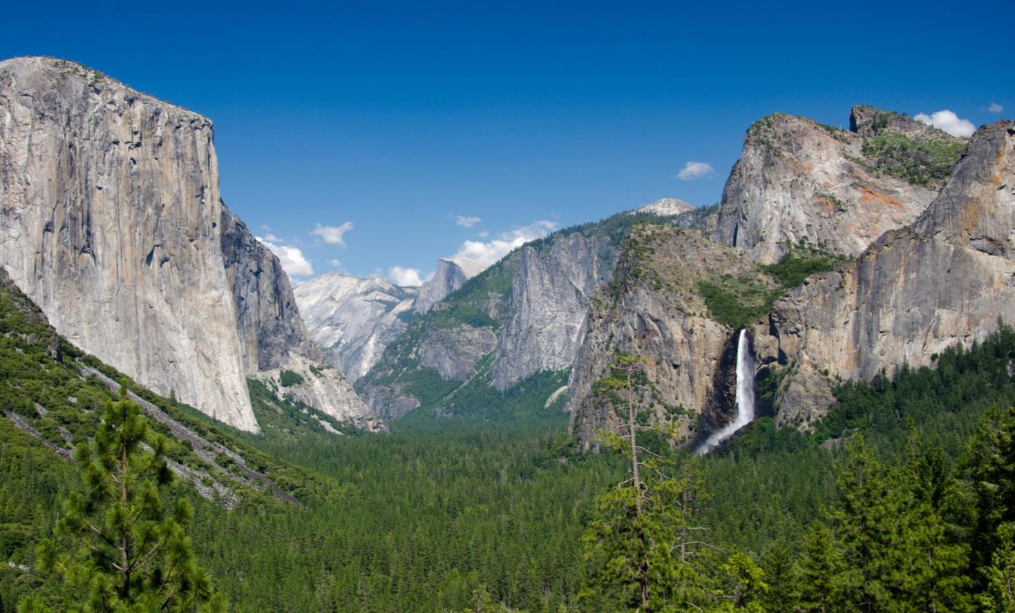
Photo Credit: John Viirok
Notes:
https://www.nps.gov/media/photo/gallery.htm?id=5722133E-155D-4519-3EA5161441B51B2E

Slide 7
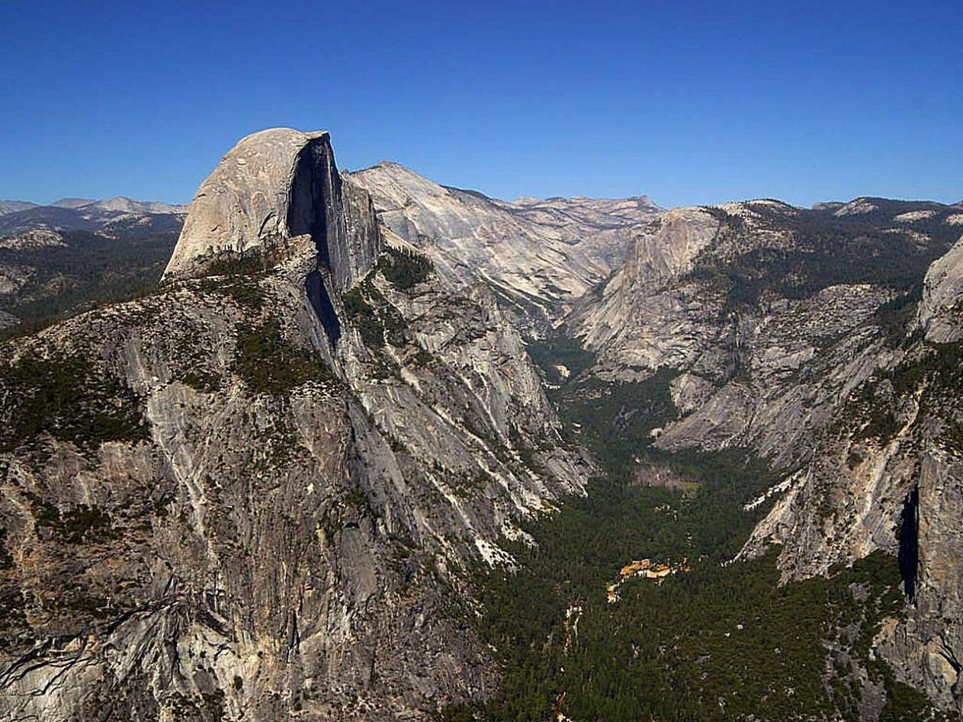
Notes:
https://www.nps.gov/media/photo/gallery.htm?id=5722133E-155D-4519-3EA5161441B51B2E

Slide 8
Yosemite National Park
http://www.nps.gov/yose/index.htm
Notes:
https://www.nps.gov/media/photo/gallery.htm?id=02675736-155D-4519-3E004E99D001DA1C

Slide 9
A Mountain with Handrails at Yosemite
Nearly 50 climbing routes today
John Muir Trail to Half Dome Trail
“Cables route”
Cables were installed in 1919 to increase visitation
400 vertical feet, 100% grade, 9,000 feet above sea level, exposed on all sides
“Half Dome is the ultimate Yosemite day hike – the one you can’t die without doing, and the one you’re most likely to die while doing.”

Slide 10
A Mountain with Handrails at Yosemite
10–12 demanding hours
Route polished by hiking boots
Altitude sickness
Vertigo
“Everything in my body was shaking. I felt like I was going to vomit.”

Slide 11
A Mountain with Handrails at Yosemite
Inadequate preparation
Increasing number of accidents requiring SAR
Deaths in 1985, 2007, and 2009
Half Dome is in designated wilderness
Mandatory permit system instituted in 2010

Slide 12
Problems
Impacts to experiences: Crowding
Impacts to facilities/service: Impacts to trails; impacts to attractions

Slide 13
Strategies and Practices
Management Strategies: Limit use
Management Practices: Rationing/allocation; rules and regulations; law enforcement

Slide 14
Rationing/Allocation
A maximum of 300 hikers are allowed (about 225 day hikers and 75 backpackers) each day
Preseason lottery for hiking permits in March (225 permits/day)
Daily Lottery (50 permits/day)
Cost for permits is $8.00 (plus $4.50 per group processing fee)

Slide 15
Rules and Regulations
Mandatory permit system instituted in 2010

Slide 16
Law Enforcement
Permit must be presented to a park ranger at the cables
Fine may be applied if hikers do not have permits at the cables

Slide 17
A Mountain with Handrails at Yosemite
Permits on Craigslist for as much as $100
Research on crowding
When more than 30 people on the cables, some visitors move outside the cables
Computer simulation model
This Page Intentionally Left Blank

Slide 18
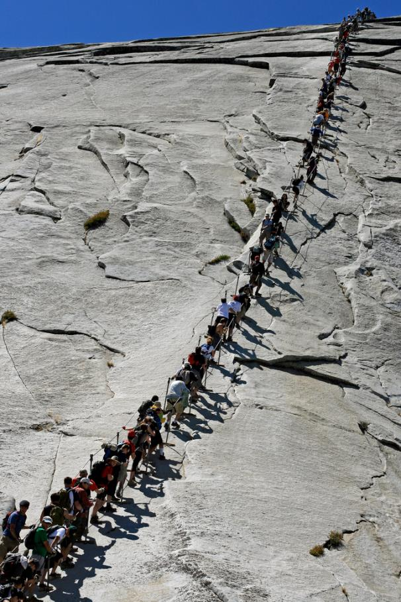
Photo Credit: Bonzo McGrue

Slide 19
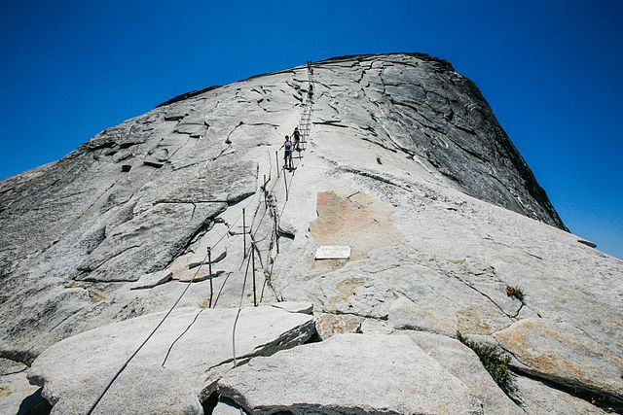
Photo Credit: Alex Proimos

Slide 20
A Mountain with Handrails at Yosemite
Half Dome: Know Before You Go (6:04)
Hike up Half Dome (6:43)
Yosemite plan means fewer hikers on Half Dome (Associated Press)
http://www.youtube.com/watch?v=lEpjUqU_GbQ
http://www.youtube.com/watch?v=-T8GrXNA6XE
http://www.taiwannews.com.tw/etn/news_content.php?id=1828170

