Slide 1
Don’t Pick Up Aquatic Hitchhikers in Voyageurs
Managing Outdoor Recreation: Case Studies in the National Parks, 2nd Edition

Slide 2
Voyageurs National Park
Established 1975
French Canadian fur traders
218,000 acres of lakes, upland forest, and rocky shoreline
4 large lakes, 26 interior lakes

Slide 3
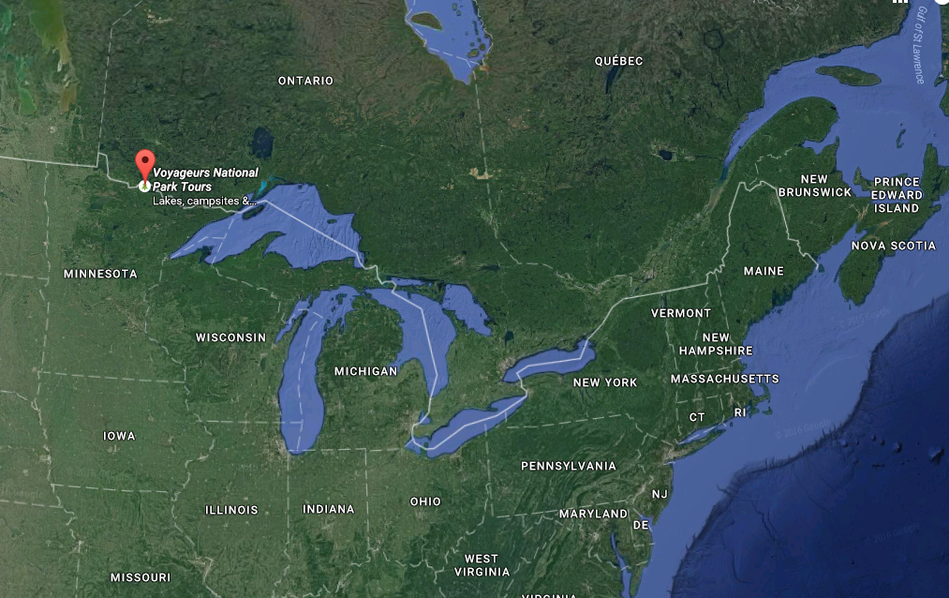
Notes:
Google maps

Slide 4
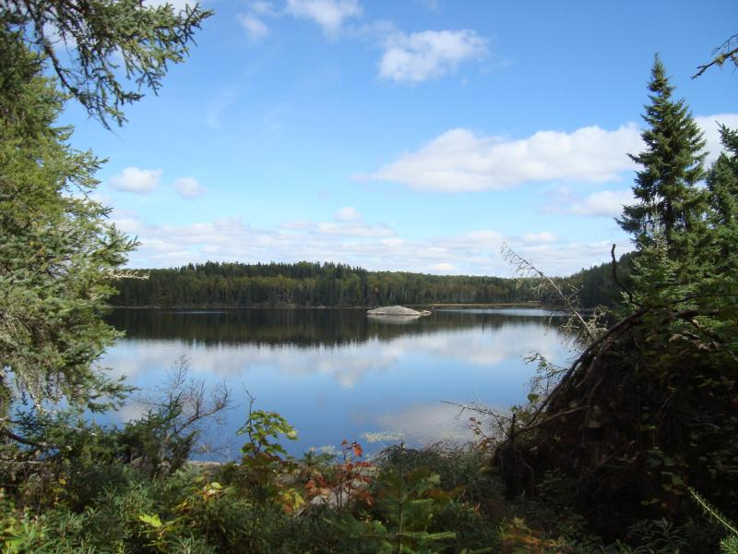

Slide 5
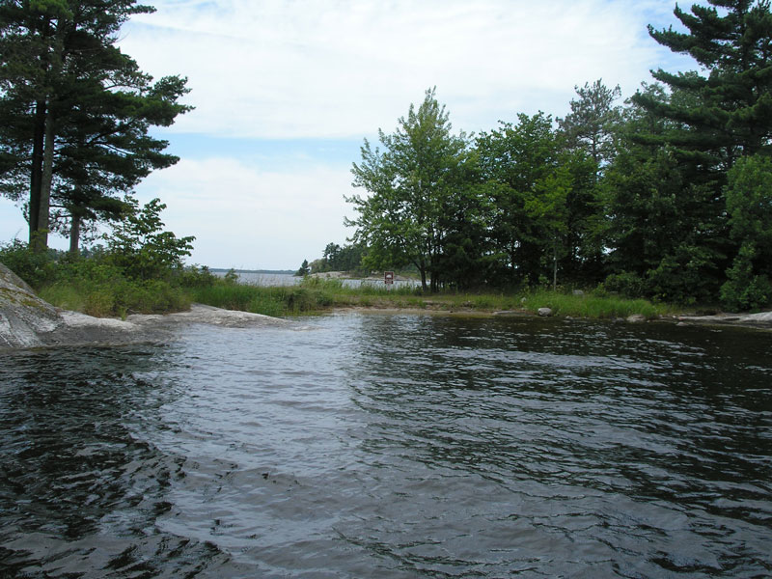

Slide 6
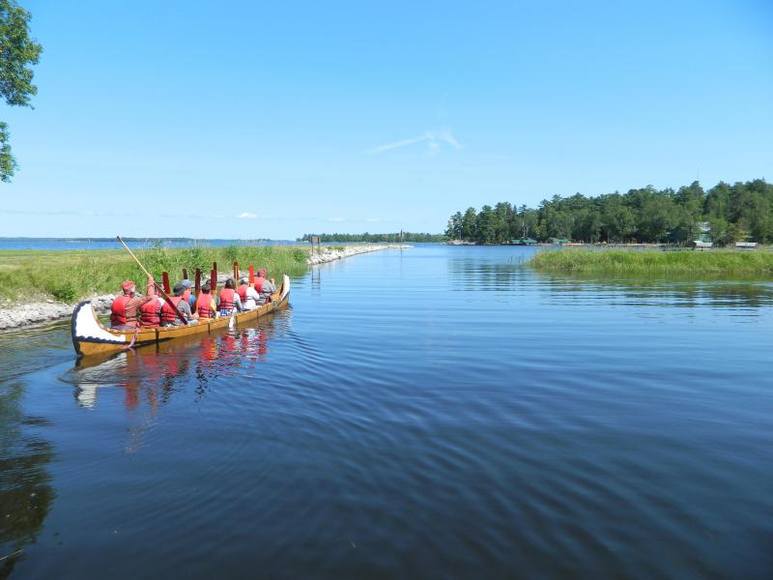

Slide 7
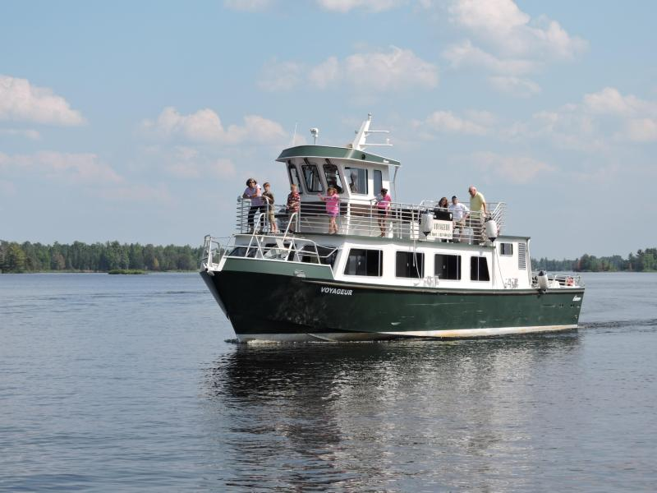

Slide 8
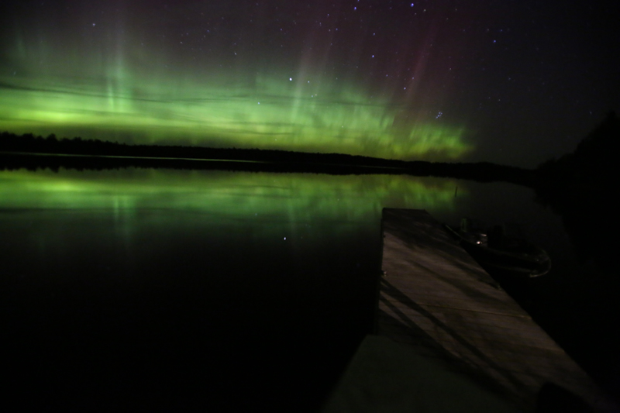

Slide 9

Voyageurs National Park
https://www.nps.gov/voya/index.htm

Slide 10
Aquatic Invasive Species
Numerous examples in Great Lakes region
Consequences: Altered ecosystems, disrupted food webs, decline in biodiversity
Removal can be challenging; focus on prevention

Slide 11
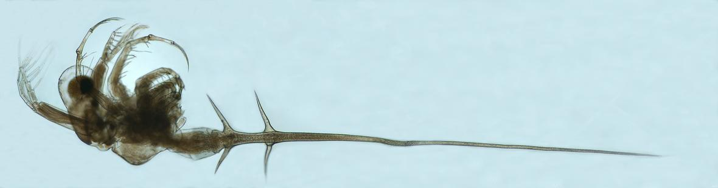
Spiny water flea
Notes:
https://www.usgs.gov/media/images/invasive-spiny-water-flea

Slide 12
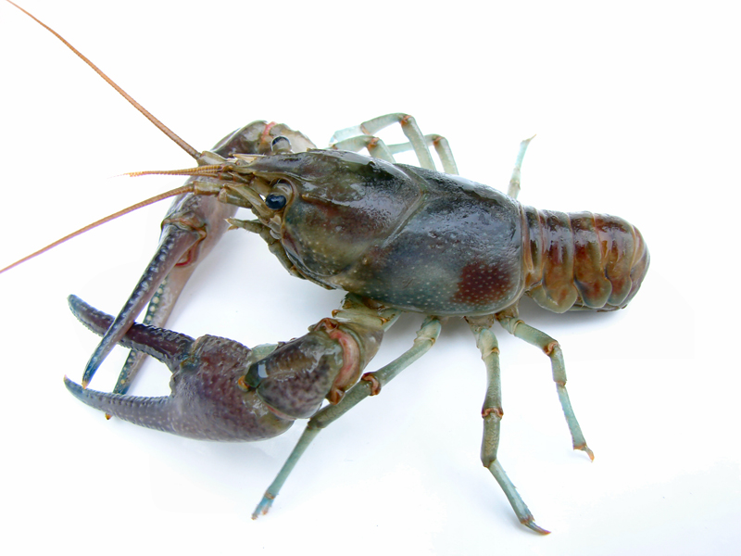
Rusty crayfish
Notes:
http://www.seagrant.umn.edu/ais/images_rustycrayfish (Jeff Gunderson)

Slide 13
Problems
Impacts to resources: Water, wildlife

Slide 14
Strategies and Practices
Management strategies: Reduce the impact of use
Management practices: Rules/regulations, information/education, law enforcement

Slide 15
Rules/Regulations
2010 Boating and Fishing Regulations
Interior lakes
Private watercraft prohibited
No float plane landings
Artificial bait only

Slide 16
Information/Education
Best Management Practices
Separate gear for interior and large lakes
Dry gear for 5+ days
Wash gear in hot water for 1 min+
Remove materials from fishing equipment
Inspect boats, drain water

Slide 17
Information/Education
Boat docks, visitor center, park website, social media, boat tours
Portable interactive kiosk
Minnesota DNR publications
EPA Great Lake’s Restoration Initiative interpreter

Slide 18
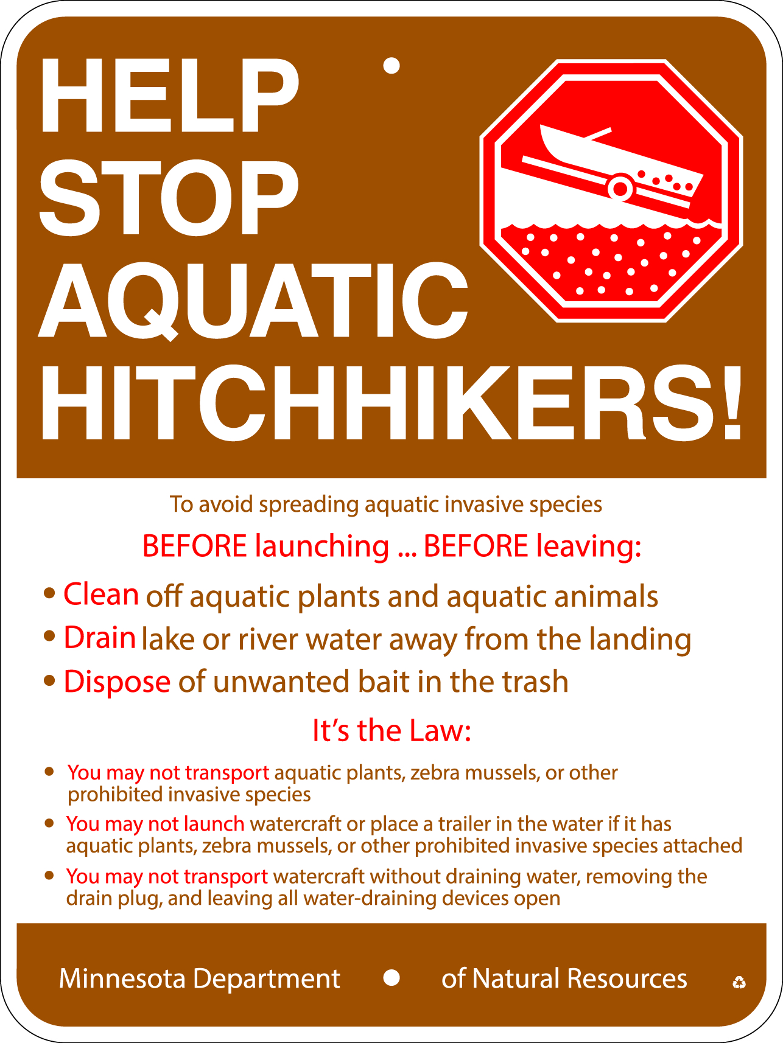

Slide 19
Law Enforcement
Fines for violating interior lakes regulations
Minnesota state invasive species law
Periodic boat inspections by MN DNR

Slide 20
Video
Spiny Water Flea (7:07)
https://www.nps.gov/media/video/view.htm?id=2912C03E-ADF8-1529-7D5DDACBAAF959B6

