Slide 1
Bear Etiquette in Katmai
Managing Outdoor Recreation: Case Studies in the National Parks, 2nd Edition

Slide 2
Katmai National Park and Preserve
Katmai National Monument (1918)
Katmai NPP (1980)
4.7 million acres
Valley of Ten Thousand Smokes
Brooks River Area – National Historic Landmark, 4,000 years of cultural history

Slide 3
Notes:
Google maps

Slide 10
Katmai National Park and Preserve
https://www.nps.gov/katm/index.htm

Slide 11
Brooks Camp
Established in 1950s
10,000 to 15,000 visitors annually
Early June through mid September
Best bear viewing in July and September

Slide 15
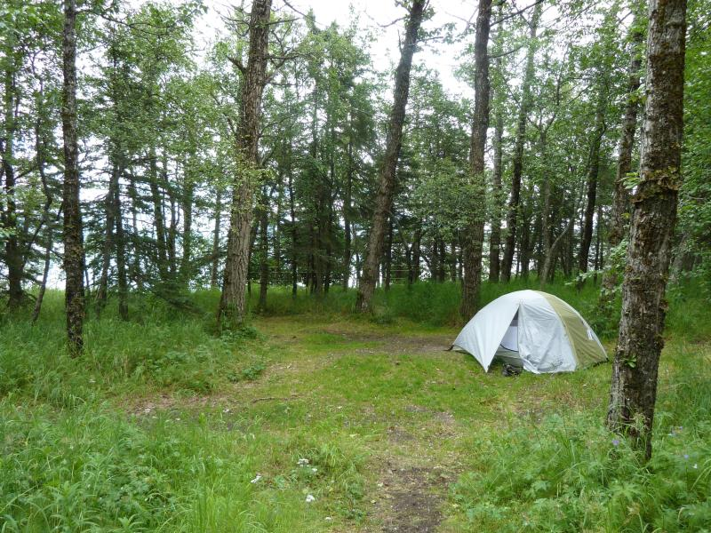

Slide 16
Problems
Impacts to resources: Wildlife
Impacts to experience: Crowding
Impacts to facilities/services: Attraction sites

Slide 17
Strategies and Practices
Management strategies: Harden resource/experience, reduce the impact of use, increase supply
Management practices: Facility development/site design/maintenance, rules/regulations, information/education, rationing/allocation

Slide 18
Facility development/Site Design/ Maintenance
Bear viewing platforms
Elevated boardwalk
Electric fence
Webcams

Slide 23
Rules/Regulations
No food or drink outside designated areas
No pets
Carry gear at all times
Stay 50 yards from bears
Food storage in central cache
Camp within electric fence
Freeze fish immediately

Slide 24
Information/Education
“Bear etiquette” training course
North American Nature Photography Association ethical guidelines

Slide 25
Rationing/Allocation
40 visitor maximum on Falls Platform
1 hour viewing time

Slide 26
Video
Bear Cams
https://www.nps.gov/katm/learn/photosmultimedia/webcams.htm

