Slide 1
Containing Contaminants at Carlsbad Caverns National Park
Managing Outdoor Recreation: Case Studies in the National Parks, 2nd Edition

Slide 2
Carlsbad Caverns National Park
National Monument in 1923
National Park in 1930
Southeastern New Mexico
Includes 33,000 acres of Wilderness
Includes ≈ 120 known caves
Caves formed by ‘sulfuric acid bath’
Diverse variety speleothems within caves

Slide 4
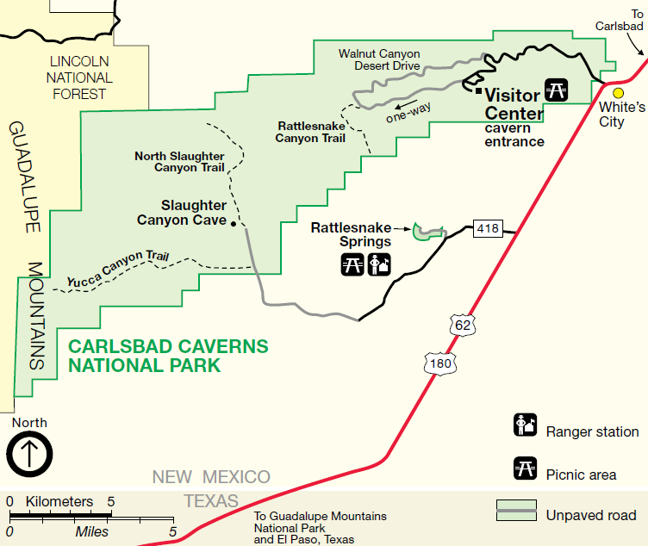

Slide 5
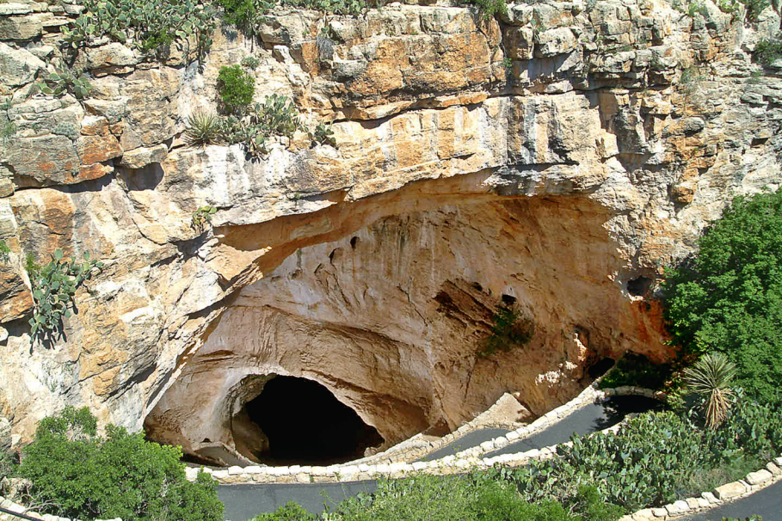
Notes:
https://www.nps.gov/media/photo/gallery.htm?id=02675736-155D-4519-3E004E99D001DA1C

Slide 6
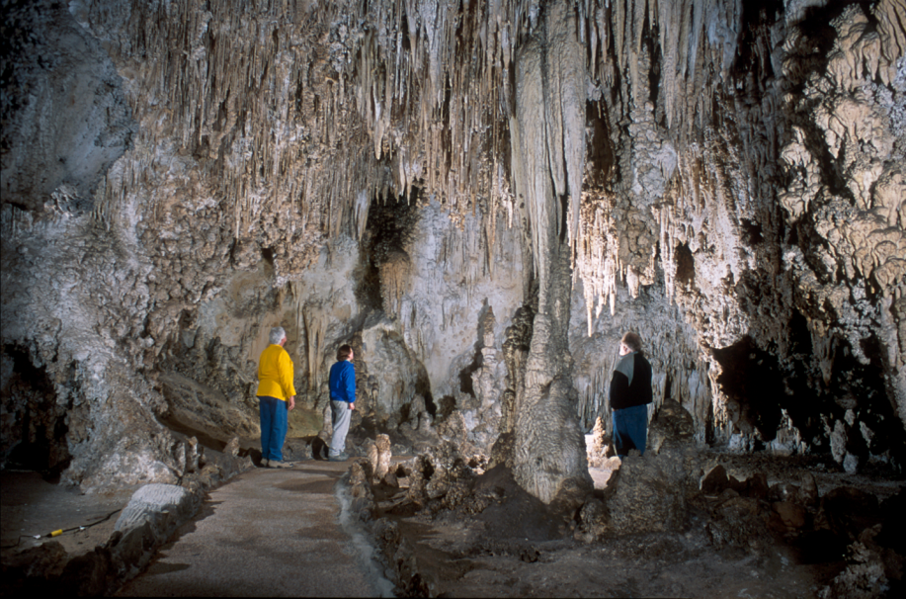

Slide 7
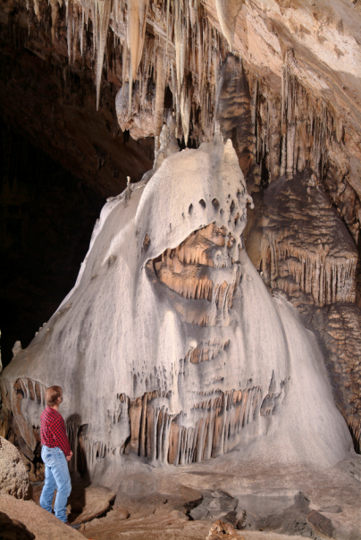
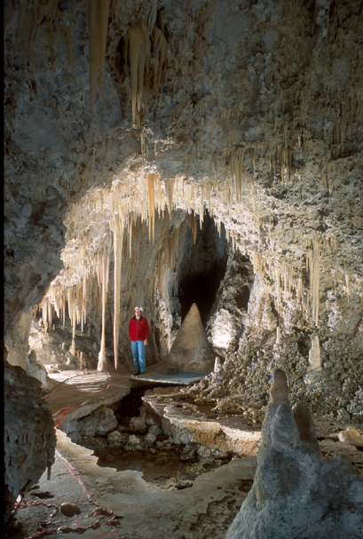
Notes:
https://www.nps.gov/media/photo/gallery.htm?id=5722133E-155D-4519-3EA5161441B51B2E

Slide 8
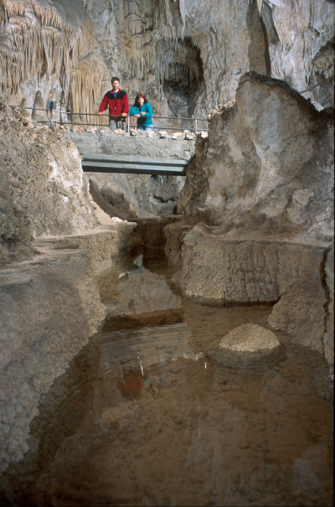
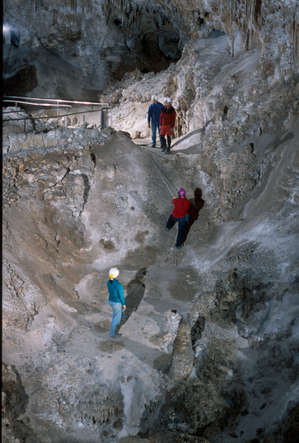
Notes:
https://www.nps.gov/media/photo/gallery.htm?id=5722133E-155D-4519-3EA5161441B51B2E

Slide 9
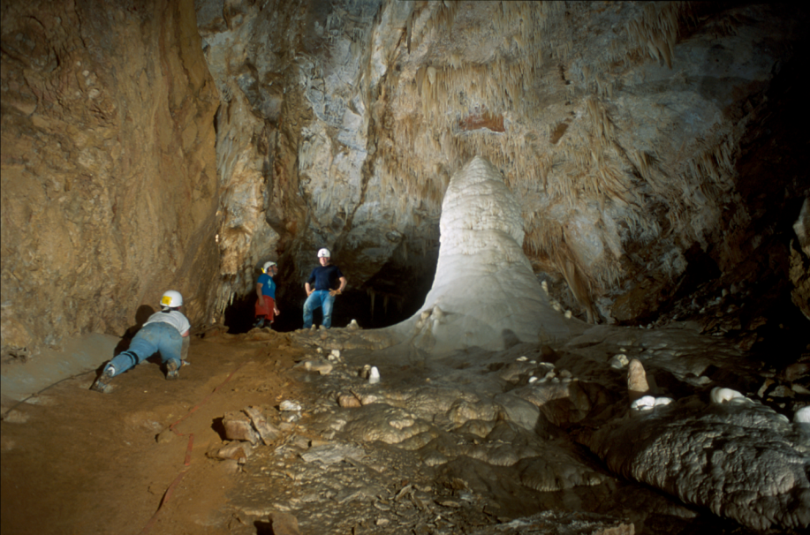
Notes:
https://www.nps.gov/media/photo/gallery.htm?id=5722133E-155D-4519-3EA5161441B51B2E

Slide 10
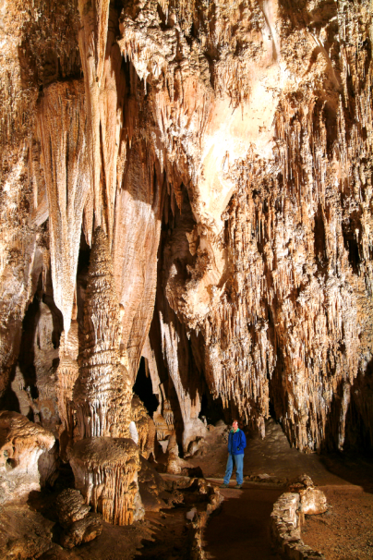
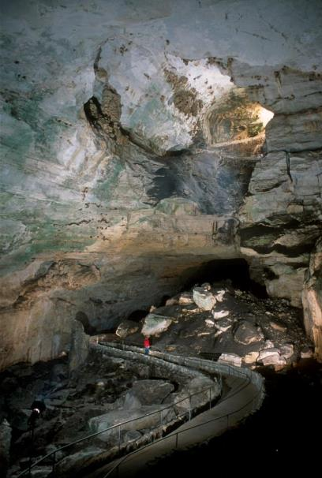
Notes:
https://www.nps.gov/media/photo/gallery.htm?id=02675736-155D-4519-3E004E99D001DA1C

Slide 11

Carlsbad Caverns National Park
https://www.nps.gov/cave/index.htm

Slide 12
Problems
Impacts to resources: Water, air
Impacts to facilities/services: Attraction sites

Slide 13
Strategies and Practices
Management strategies: Reduce impact of use, limit use
Management practices: Facility development/site design/maintenance, rules/regulations, rationing/allocation, zoning

Slide 14
Facility Development/Site Design/Maintenance
Parking removed from above cavern and revegetated with tiered beds of native plants
Leaking below ground sewer lines replaced with above ground lines
Project awarded certification for sustainable landscape design in 2013

Slide 15
Rules/Regulations, Rationing/Allocation, and Zoning
Group size limits: minimum of 3 for safety and maximum of 4–10 to minimize impact
Permits required for visiting wild caves and may require knowledge of vertical caving techniques and special equipment
Permits issue on first-come, first-served basis and visitation limits vary from 3 trips/week to 2 trips/month depending on the cave

Slide 16
Photo Gallery
Big Room Trail
Natural Entrance Trail
Ranger-guided Tours
Lechuguilla Cave
https://www.nps.gov/media/photo/gallery.htm?id=FC3F3C1D-155D-451F-678F10C79C37264B
https://www.nps.gov/media/photo/gallery.htm?id=D0D6F890-155D-451F-67AA7B66C2426F55
https://www.nps.gov/media/photo/gallery.htm?id=002834EA-155D-451F-6776BADA00BE0B71
https://www.nps.gov/media/photo/gallery.htm?id=318A0C5A-155D-451F-6771B101D8195C02

