Slide 1
Preventing the Petrified Forest from Disappearing
Managing Outdoor Recreation: Case Studies in the National Parks, 2nd Edition

Slide 2
Petrified Forest National Park
National Monument in 1906
National Park in 1962
Expanded in 2004 to > 200,000 acres
Northeastern Arizona
Includes 50,000 acres of Wilderness
≈ 800 archeological and historic sites
≈ 800,000 visitors per year

Slide 3
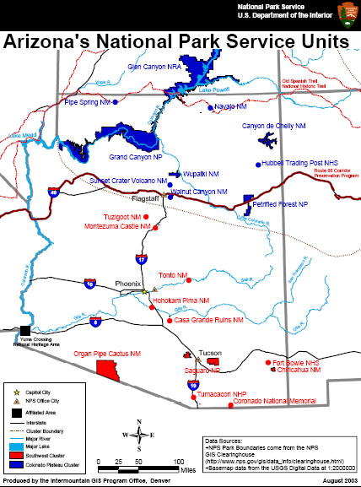

Slide 4
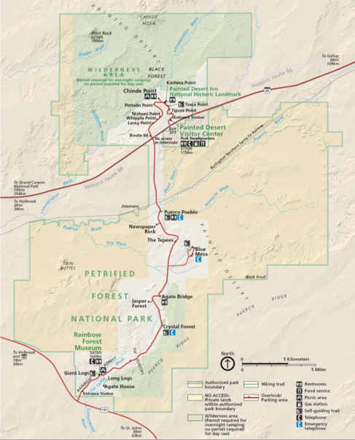

Slide 5
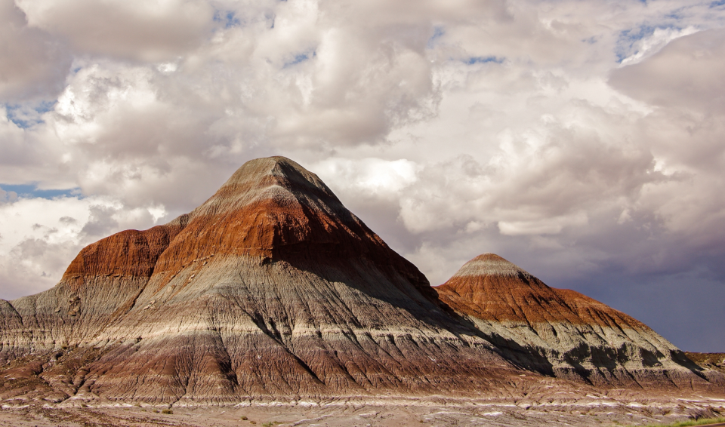
Notes:
https://www.nps.gov/media/photo/gallery.htm?id=02675736-155D-4519-3E004E99D001DA1C

Slide 6
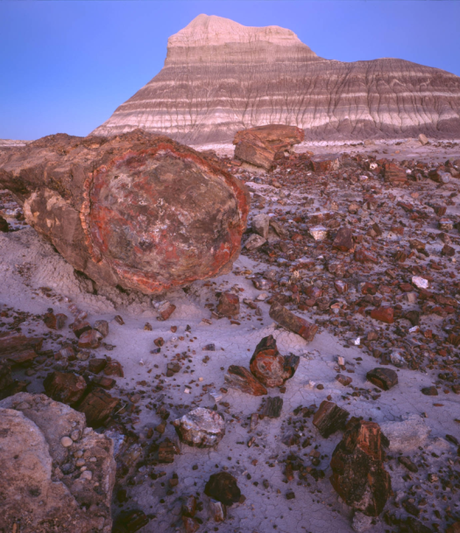

Slide 7
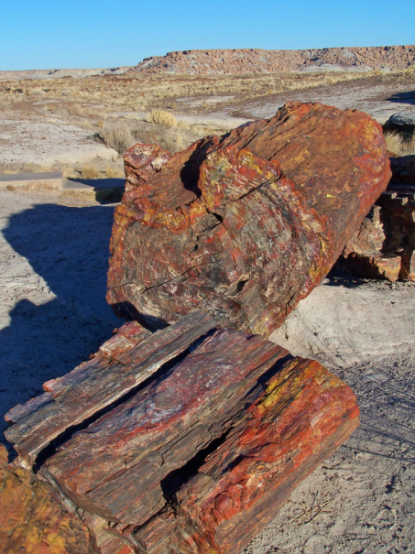
Notes:
https://www.nps.gov/media/photo/gallery.htm?id=5722133E-155D-4519-3EA5161441B51B2E

Slide 8
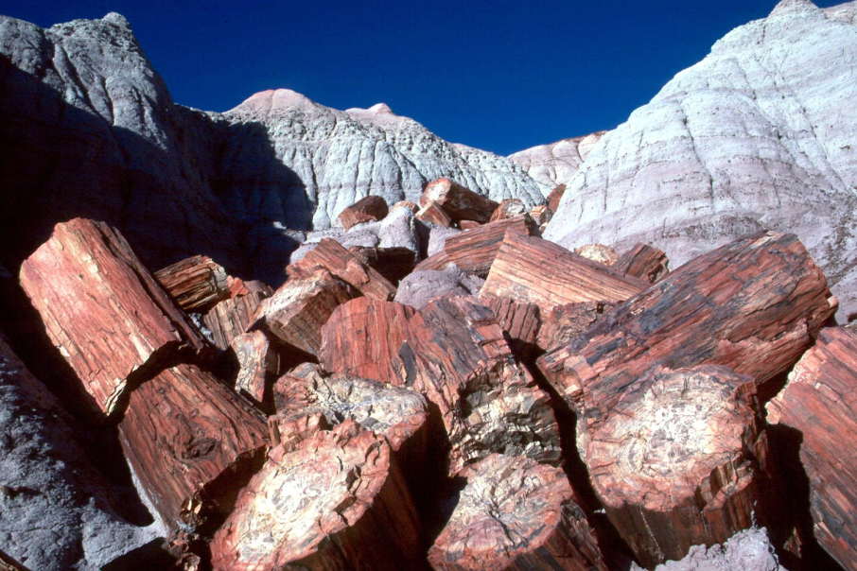
Notes:
https://www.nps.gov/media/photo/gallery.htm?id=5722133E-155D-4519-3EA5161441B51B2E

Slide 9
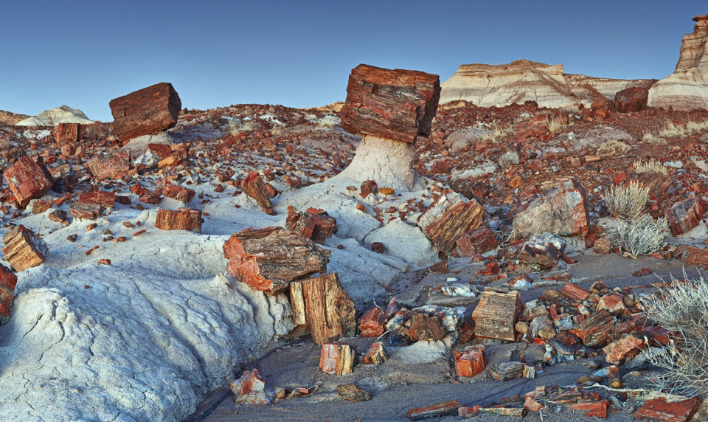
Notes:
https://www.nps.gov/media/photo/gallery.htm?id=5722133E-155D-4519-3EA5161441B51B2E

Slide 10
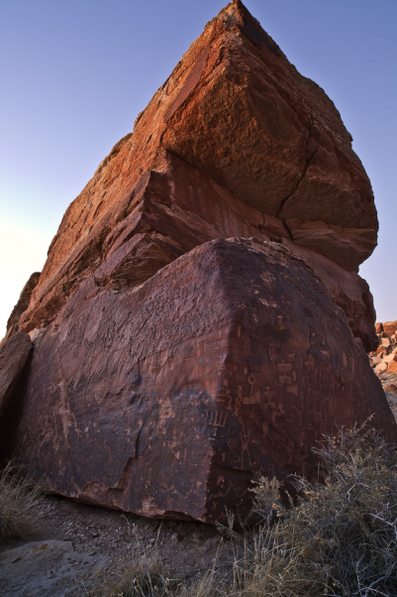
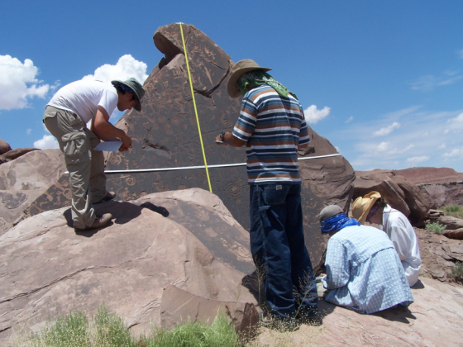
Notes:
https://www.nps.gov/media/photo/gallery.htm?id=02675736-155D-4519-3E004E99D001DA1C

Slide 11
Petrified Forest National Park
https://www.nps.gov/pefo/index.htm

Slide 12
Problems
Impacts to resources: Historical/cultural
Depreciative behavior: Theft of petrified wood

Slide 13
Strategies and Practices
Management strategies: Reduce impact of use, increase supply
Management practices: Rules/regulations, information/education, law enforcement, facility development/site design/maintenance

Slide 14
Rules/Regulations, Law Enforcement, and Information/Education
Visitors who take, move, or damage petrified wood face minimum fine of $325
Aggressive information/education program including reminder at entrance gate to not remove petrified wood
Visitor center displays and online info

Slide 15
Facility Development/Site Design/Maintenance
Signs posted ½ mile from each exit alert visitors to check stations ahead
Park rangers have collected many pieces of petrified wood along these stretches of road where visitors have pitched their cache out the window

Slide 16
Video
The Tourist, the Park Ranger, and the Petrified Forest (5:53)
Archeology in the Expansion Lands at Petrified Forest National Park (4:42)
https://www.nps.gov/media/video/view.htm?id=24B3E9AE-155D-451F-67AEC8BFE917E47D
https://www.nps.gov/media/video/view.htm?id=A181A1AF-DE13-6DAA-9FFAE7CA71A83752

