Slide 1
What Goes Up Mt. Whitney Must Come Down
Managing Outdoor Recreation: Case Studies in the National Parks, 2nd Edition

Slide 2
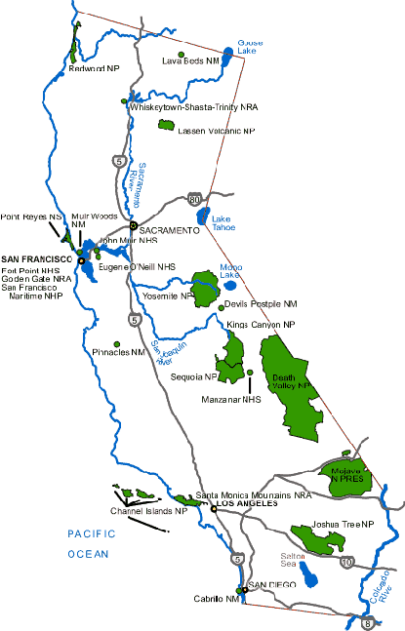

Slide 3
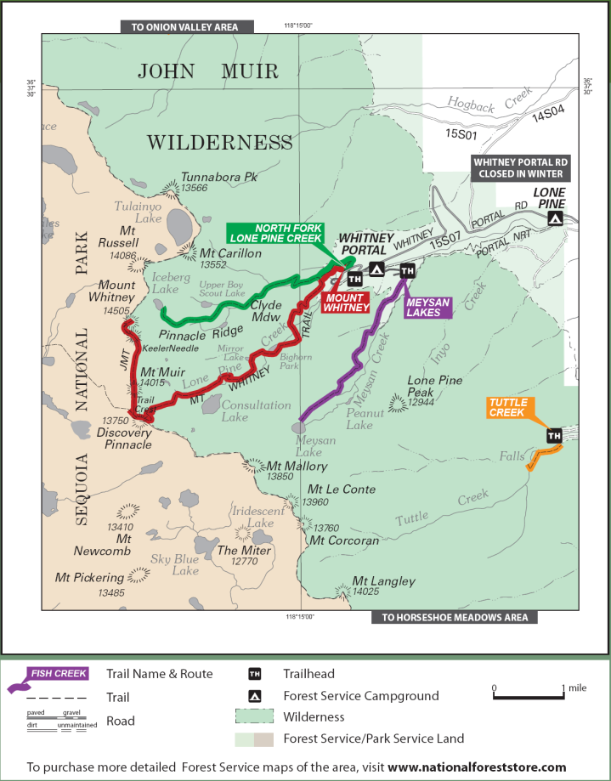

Slide 4
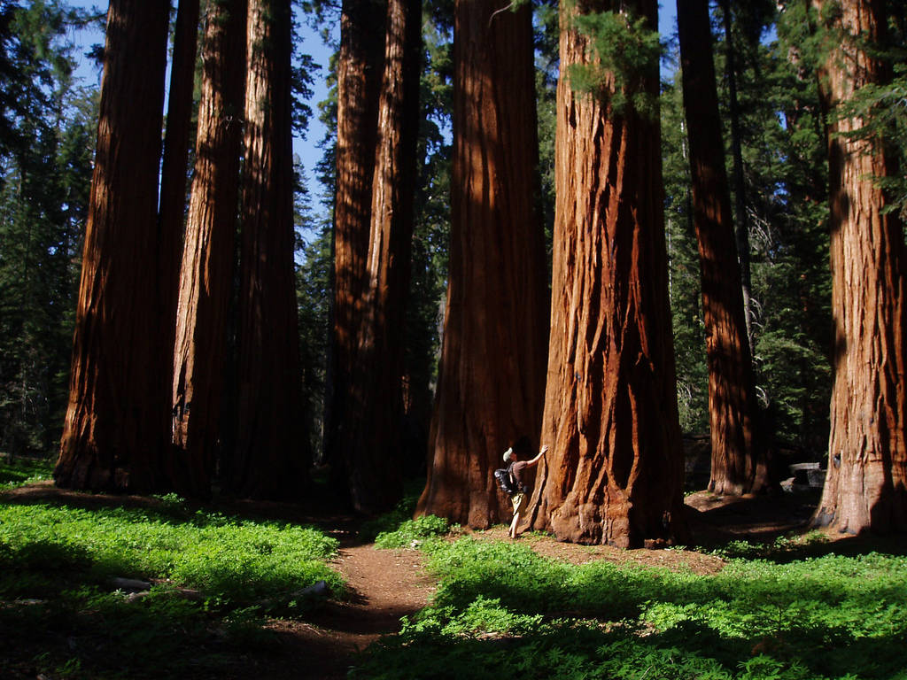

Slide 5
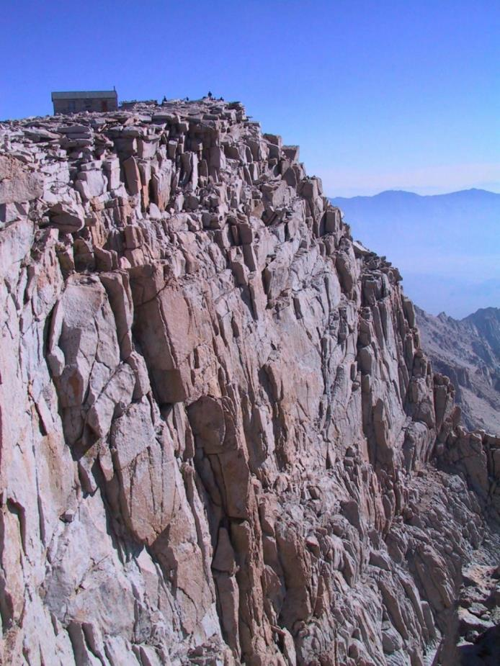

Slide 6
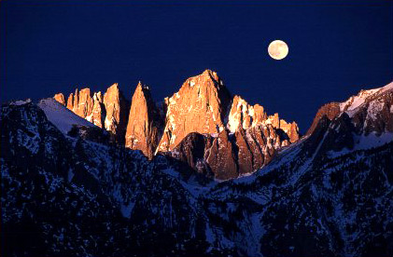

Slide 7
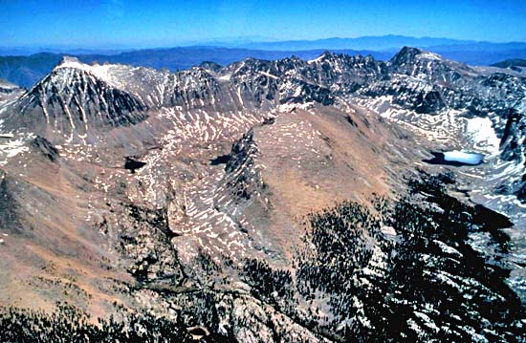

Slide 8
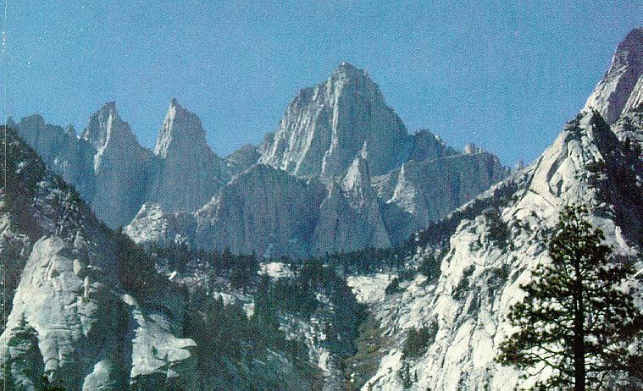

Slide 9
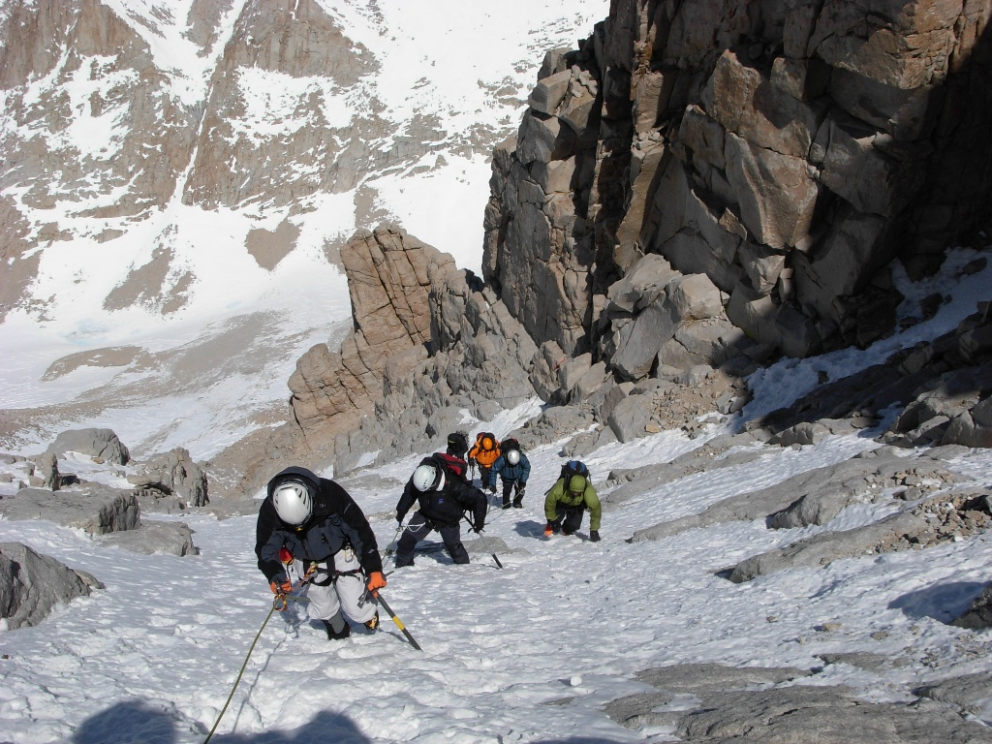

Slide 10
Mt. Whitney is the highest mountain in the “lower 48” at 14,505 feet
Mt. Whitney Trail – 22 miles and over 6,000 feet of elevation gain
Much of the trail is above tree line
Hundreds of visitors daily before current management plan was implemented

Slide 11
Lies partially in Sequoia National Park and adjacent to Inyo National Forest
Sequoia National Park (“land of the giants”)
Sequoia/Kings Canyon National Parks (856,964 acres)
Inyo National Forest (2 million acres; 9 wilderness areas)

Slide 12
Sequoia and Kings Canyon National Parks
http://www.nps.gov/seki/planyourvisit/whitney.htm

Slide 13
Eastern Sierra Interagency Visitor Center
http://www.fs.usda.gov/recarea/inyo/recarea/?recid=20698

Slide 14
Large numbers of hikers on the trails and summit
Use levels inappropriate for a wilderness setting
Improper disposal of human waste

Slide 15
Impacts to resources: Soil and vegetation.
Impacts to experience: Crowding
Impacts to facilities/service: Trails and attraction sites

Slide 16
Management Strategies: Limit use and reduce the impact of recreation
Management Practices: Zoning; rationing/ allocation; rules and regulations; information/ education; law enforcement

Slide 17
Zoning
Mt. Whitney Zone
Special management focus
Cooperative effort between the National Park Service and U.S. Forest Service
Eastern Sierra Interagency Visitor Center

Slide 18
Rationing and Allocation
Lottery system for permits
60 overnight and 100 day-use permits per day between May 1 and November 1

Slide 19
Rules and Regulations
Bear canisters
No food in cars
Visitors must pack out all solid human waste
WAG bags (waste allocation and gelling)

Slide 21
Information / Education
A program of information and education on the special character of Mt. Whitney and guidelines for use of this area
“To preserve its wilderness character, all visitors must be committed to extremely high standards of conduct”

Slide 22
Law Enforcement
Visitors who do not have permits may be fined
Visitors do not follow the regulation rules may be fined

Slide 23
More Information
Hiking Mount Whitney in a Day (3:19)
Video Trip Report – Part 1 (8:12)
Hiking the Mt. Whitney Trail Brochure
Wag Bag Website
http://www.youtube.com/watch?v=oLzUORzT6wc
http://www.youtube.com/watch?v=awD-BLPFquA
http://www.fs.usda.gov/Internet/FSE_DOCUMENTS/stelprdb5333235.pdf
http://www.cleanwaste.com/wag-bag

