Slide 1
The Sounds of Silence in Muir Woods
Managing Outdoor Recreation: Case Studies in the National Parks, 2nd Edition

Slide 2
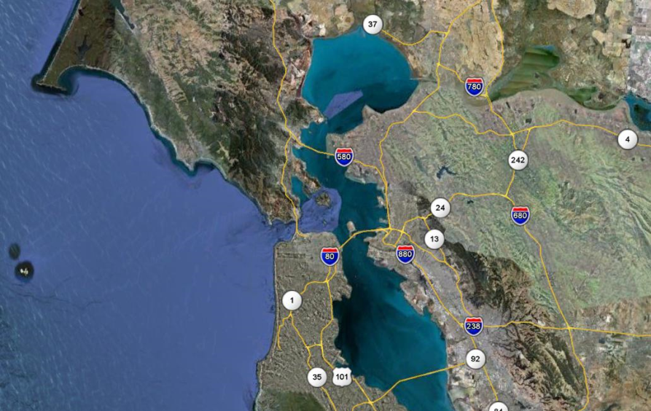

Slide 3
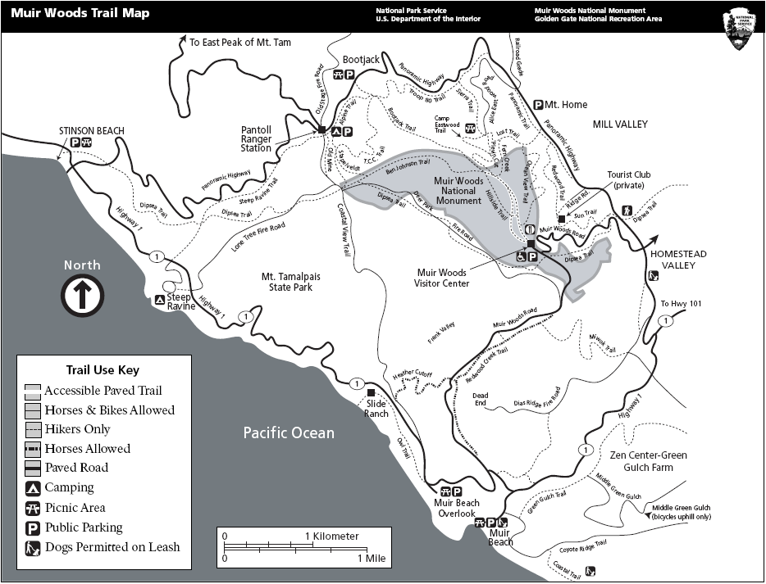

Slide 4
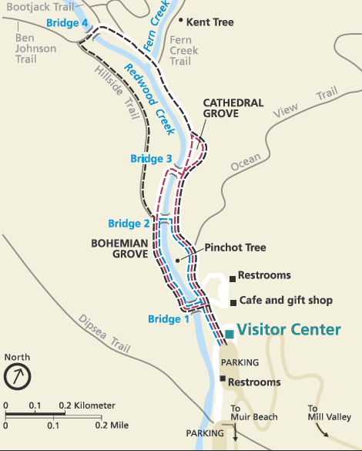

Slide 5
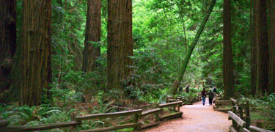

Slide 6
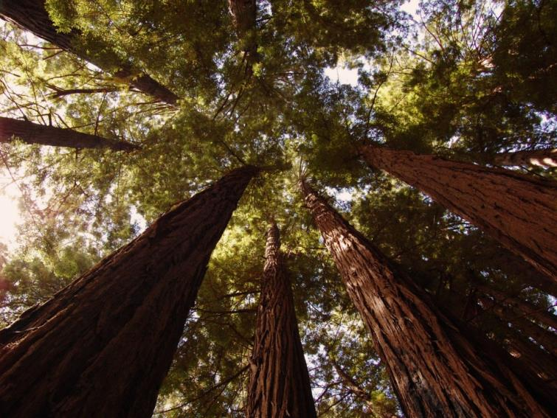

Slide 7
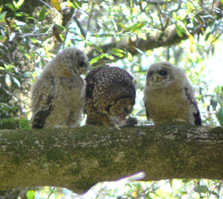
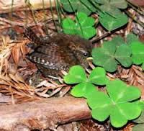

Slide 8
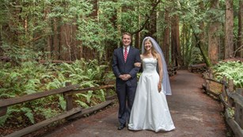
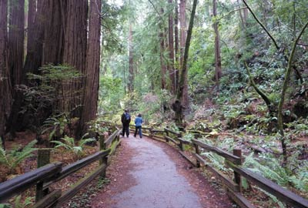

Slide 9
Muir Woods National Monument
1908 (Teddy Roosevelt)
John Muir
Nearly 600 acres of park land
750,000 visits annually
Old growth redwood forest
Spotted owls
Emergence of “soundscapes” and “natural quiet”

Slide 10
Muir Woods National Monument
http://www.nps.gov/muwo/planyourvisit/index.htm

Slide 11
Human-caused noise
Diminish “peace and quiet”
Disturbance of wildlife habitat
Interrupt interpretive programs

Slide 12
Impacts to resource: Soundscape/natural quiet, forest, wildlife
Impacts to experiences: Conflict; depreciative behavior
Impacts to facilities/service: Attractions; trails; interpretive programs

Slide 13
Management Strategies: Reduce the impact of use
Management Practices: Zoning; information/ education

Slide 14
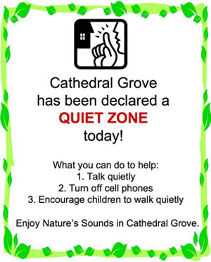
Zoning
Designation of “quiet zone” in Cathedral Grove
Sound monitoring

Slide 15
Education/Information
Signs for “quiet zone”
Turning off cell phones
Speaking in a lowered voice
Walking quietly
Visitor surveys

Slide 16
Visitor surveys
37 decibels as standard of quality
Equivalent of 30% reduction in visitor use
Strong visitor support

Slide 17
The Sounds of Silence in Muir Woods
Study Sound Clip 1
Study Sound Clip 2
Study Sound Clip 3
Study Sound Clip 4
Study Sound Clip 5

Slide 18
Social Norm Curve for Sounds at Muir Woods

Slide 19
Inside NPS
MUIR WOODS NATIONAL MONUMENT New Signs Encourage Appreciation Of Natural Sound
Rather quietly, Muir Woods recently installed five new wayside signs that encourage visitors to walk quietly and enjoy the natural soundscape of the primeval forest.
Just minutes from the Golden Gate Bridge and a major metropolitan area, the ancient forest is in sharp contrast to the busyness of the surrounding modern world.
On a weekday, in the winter or spring, early in the morning or late in the afternoon, not on a holiday, and on just about any rainy day, visitors may enjoy a few moments of quiet in Muir Woods without intrusion from mechanical or human-made sounds. But, it’s becoming more challenging as the San Francisco Bay Area’s population of seven million people continues to swell and will increase by millions over the next 50 years.
With fewer places to go without the sound of a blustery motorcycle or the rumbling airplane overhead or the constant drone of a nearby freeway, future generations will be hard-pressed to find a quiet place to listen to natural sounds for reasons of health, inspiration, and restoration. Not only does noise affect the human species, but the other species as well. Animals that depend on their sense of hearing for avoiding predators, finding mates or safe territories, finding food, and nurturing young, will be less fit to survive in urban areas.

Slide 20
Inside NPS
MUIR WOODS NATIONAL MONUMENT New Signs Encourage Appreciation Of Natural Sound (continued)
The soundscape signs are a gentle reminder that Cathedral Grove is the park’s quiet refuge for people and animals alike. The grove of mature trees, located further from the bustling parking lot and park entrance, has a history of reverence and quietude. Cathedral Grove is the site where delegates to the first United Nations in 1945 came to commemorate President Franklin Delano Roosevelt, the chief architect of the U.N.
Muir Woods offers evening programs to experience the natural sounds of an old-growth forest on a safe and leisurely walk. Though the forest and weather are less dramatic in the summer than in the winter, visitors can listen to the watery music of Redwood Creek, enjoy the forest fragrance on a still evening, and the gentle soughing of the wind through the canopy of giant trees. Contrary to what is generally observed by first-timers to Muir Woods, the forest is not silent, but quiet.
The Muir Woods soundscape signs were funded by the National Park Service Natural Sounds and Nights Skies Division. The project team includes Mia Monroe, Michael Faw, Gina Farr, Lou Sian, Tamara Williams, Karen Trevino, Erica Pilcher, and Bob Manning.
Contact Information Name: Lou Sian, Park Ranger and Media Specialist

Slide 21
Videos
Virtual Tour of Muir Woods (2:36)
When Owls Attack! (0:57)
http://www.youtube.com/watch?v=5ldc-IDfnLk
http://www.youtube.com/watch?v=sBCe08k3KqU

