Slide 1
The Ice Caves are Open, The Ice Caves are Open
Managing Outdoor Recreation: Case Studies in the National Parks, 2nd Edition

Slide 2
Apostle Islands National Lakeshore
Established in 1970
Lake Superior, northwest Wisconsin
21 islands, 12 miles of mainland
69,500-acres
Gaylord Nelson Wilderness (2004)
Sandy beaches, lighthouses, sandstone cliffs, and sea caves

Slide 5
Notes:
https://www.nps.gov/media/photo/gallery.htm?id=02675736-155D-4519-3E004E99D001DA1C

Slide 6
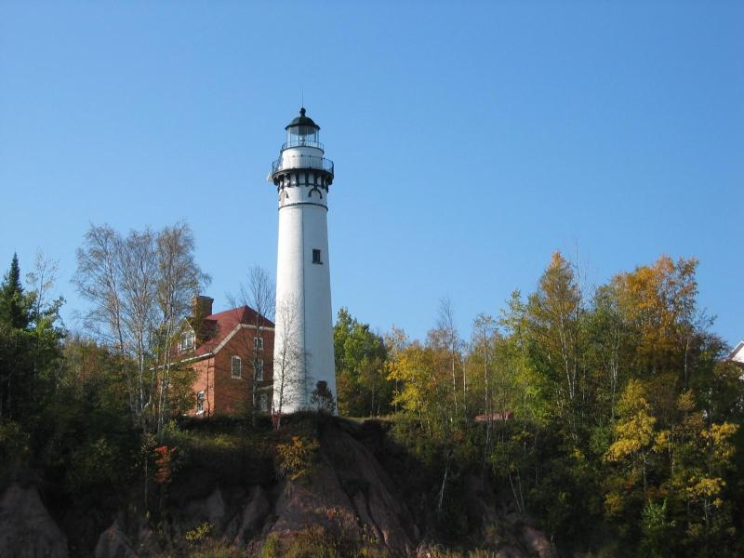
Notes:
https://www.nps.gov/media/photo/gallery.htm?id=5722133E-155D-4519-3EA5161441B51B2E

Slide 7
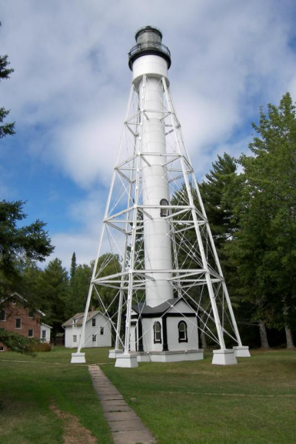
Notes:
https://www.nps.gov/media/photo/gallery.htm?id=5722133E-155D-4519-3EA5161441B51B2E

Slide 8
Notes:
https://www.nps.gov/media/photo/gallery.htm?id=02675736-155D-4519-3E004E99D001DA1C

Slide 9
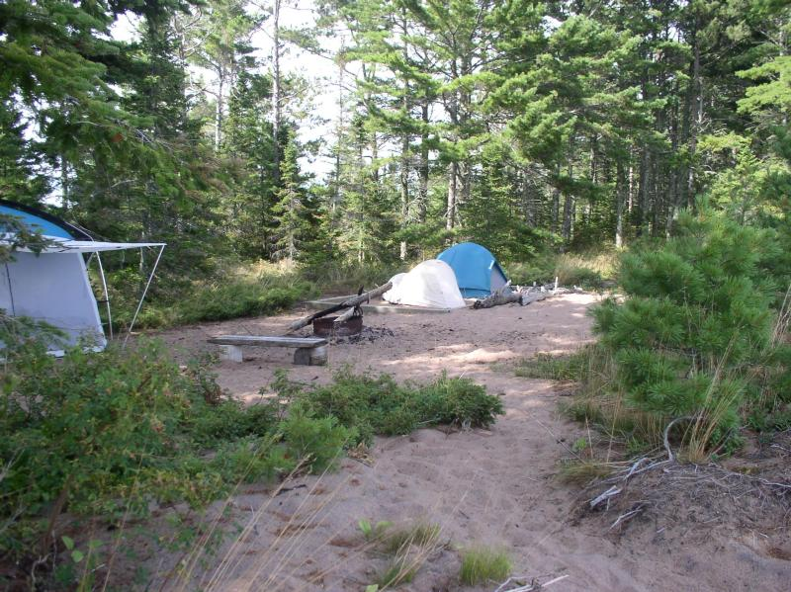

Slide 10
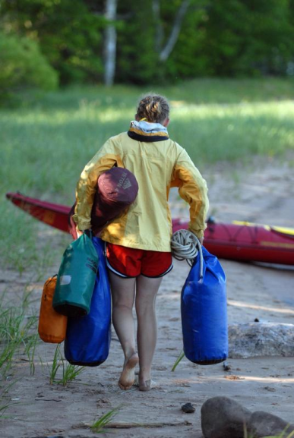
Notes:
https://www.nps.gov/media/photo/gallery.htm?id=575BB48F-155D-4519-3E40BFEF9424DCD1
https://www.nps.gov/media/photo/gallery.htm?id=575BB48F-155D-4519-3E40BFEF9424DCD1

Slide 17
Apostle Islands National Lakeshore
https://www.nps.gov/apis/index.htm

Slide 18
Ice Cave Visitation
Access depends on stable ice
Opportunities less certain in a changing climate
Record visitation in winter 2014
Accommodating visitors, promoting safety, and protecting ice structures

Slide 19
Problems
Impacts to experience: Crowding
Impacts to facilities/services: Roads/ parking, attraction sites

Slide 20
Strategies and Practices
Management strategies: Reduce the impact of use, harden experience, increase supply
Management practices: Information /education, facility development/site design/maintenance, rules/regulations

Slide 21
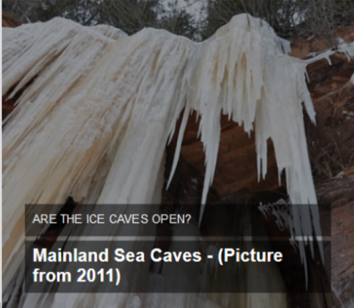
Information/Education
Website, Facebook, and “ice line”; visitor center and partners
Caves designated as open or closed

Slide 22
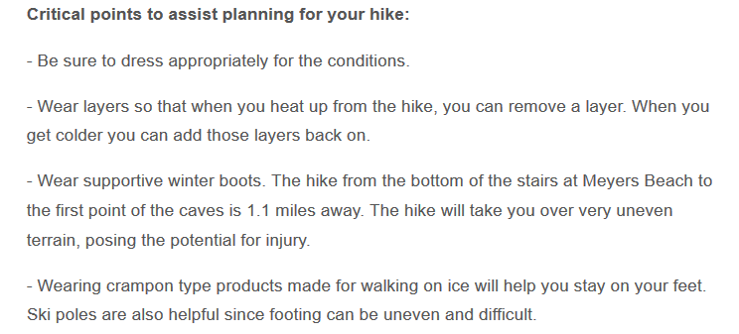
Information/Education
Managing visitor expectations

Slide 23
Facility Development/Site Design/Maintenance
Portable toilets
Roadside plowing
Shuttle service

Slide 24
Rules/Regulations
No climbing, scrambling, or rappelling on cliffs or ice

Slide 25
Video
Discover Wisconsin (1:34)
http://discoverwisconsin.com/video/ice-caves/

