Slide 1
Winning the Lottery on the Colorado River
Managing Outdoor Recreation: Case Studies in the National Parks, 2nd Edition

Slide 2
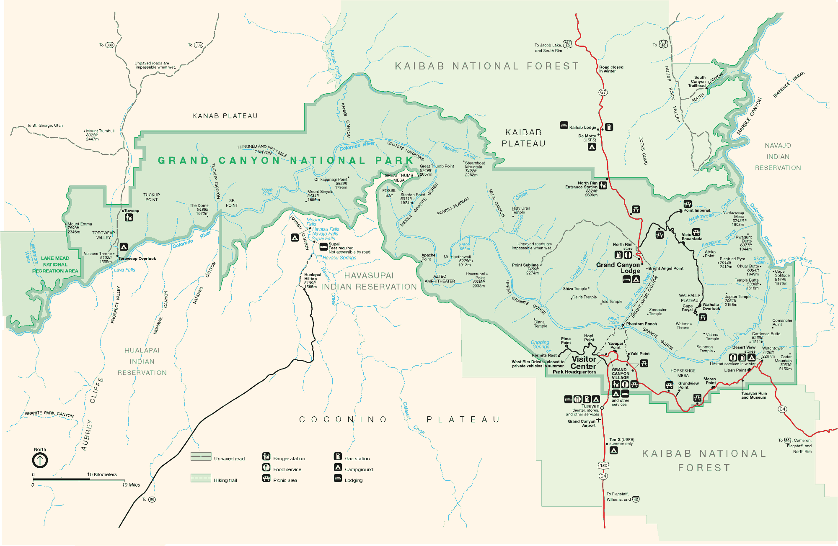

Slide 3
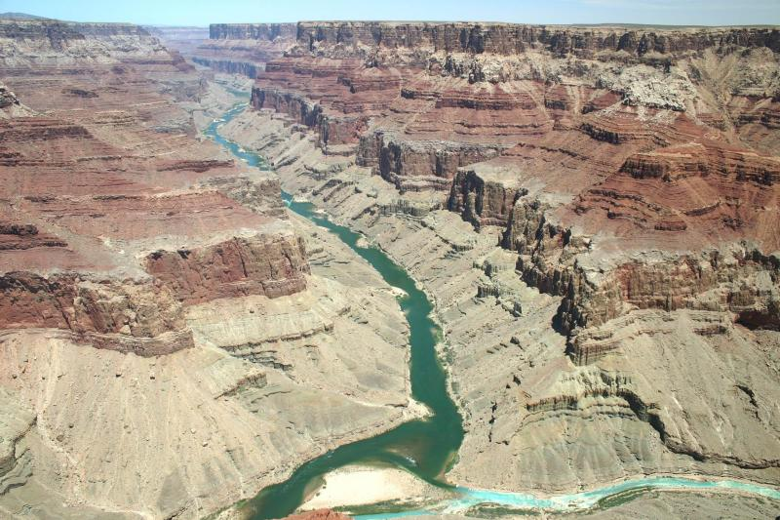

Slide 4
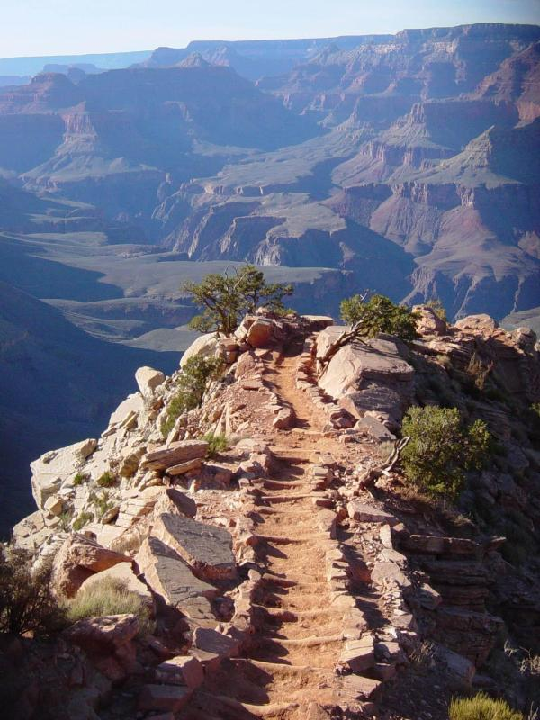

Slide 5
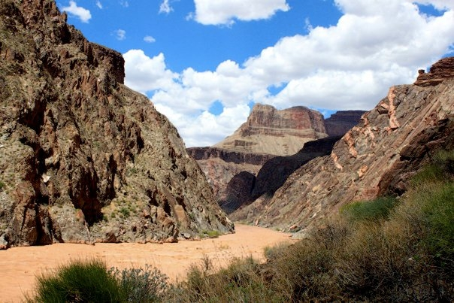

Slide 6
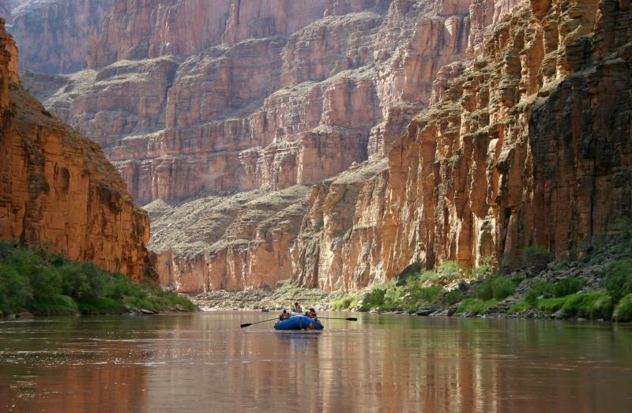

Slide 7
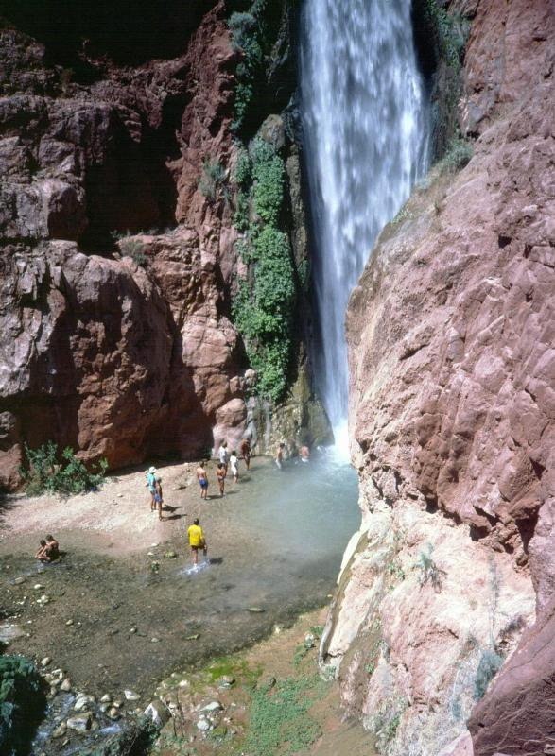
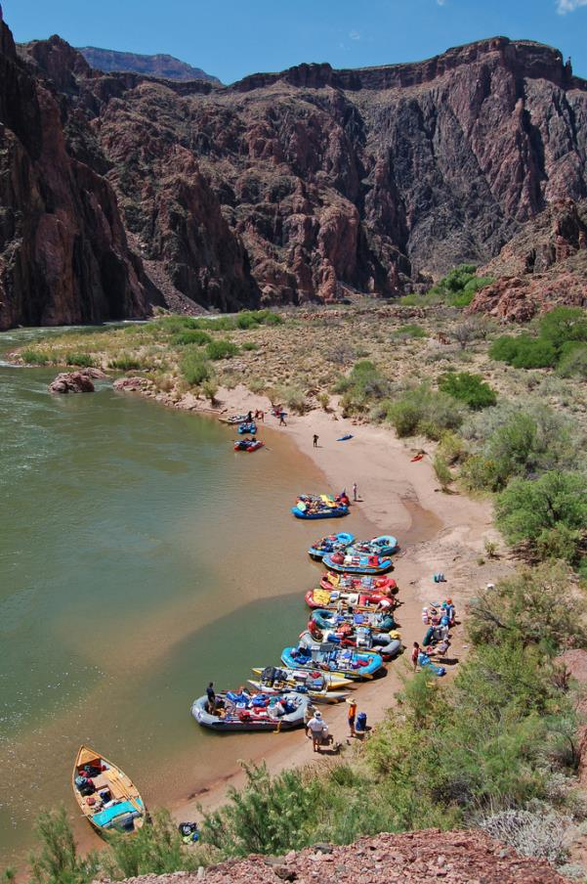

Slide 8
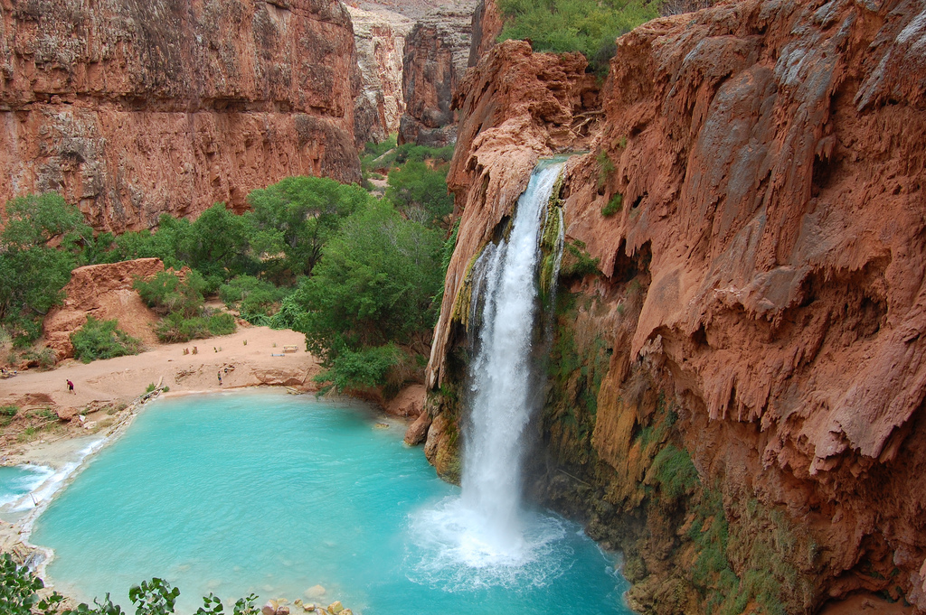
Photo Credit: Jon Roig

Slide 9
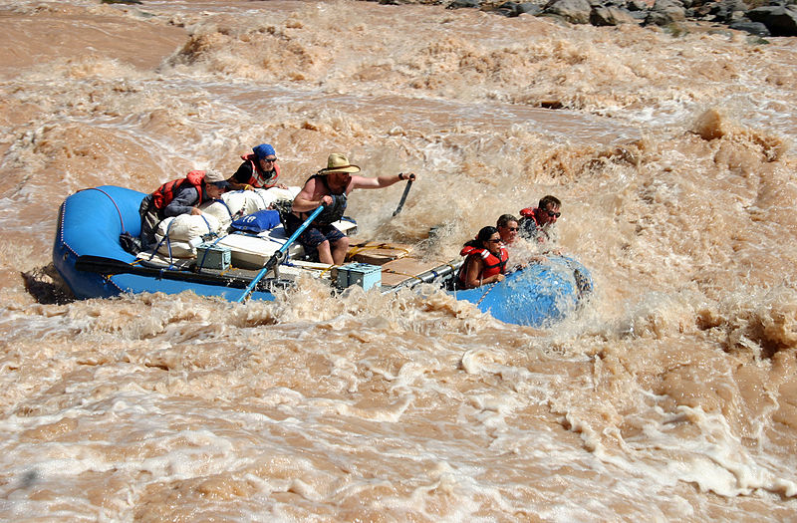

Slide 10
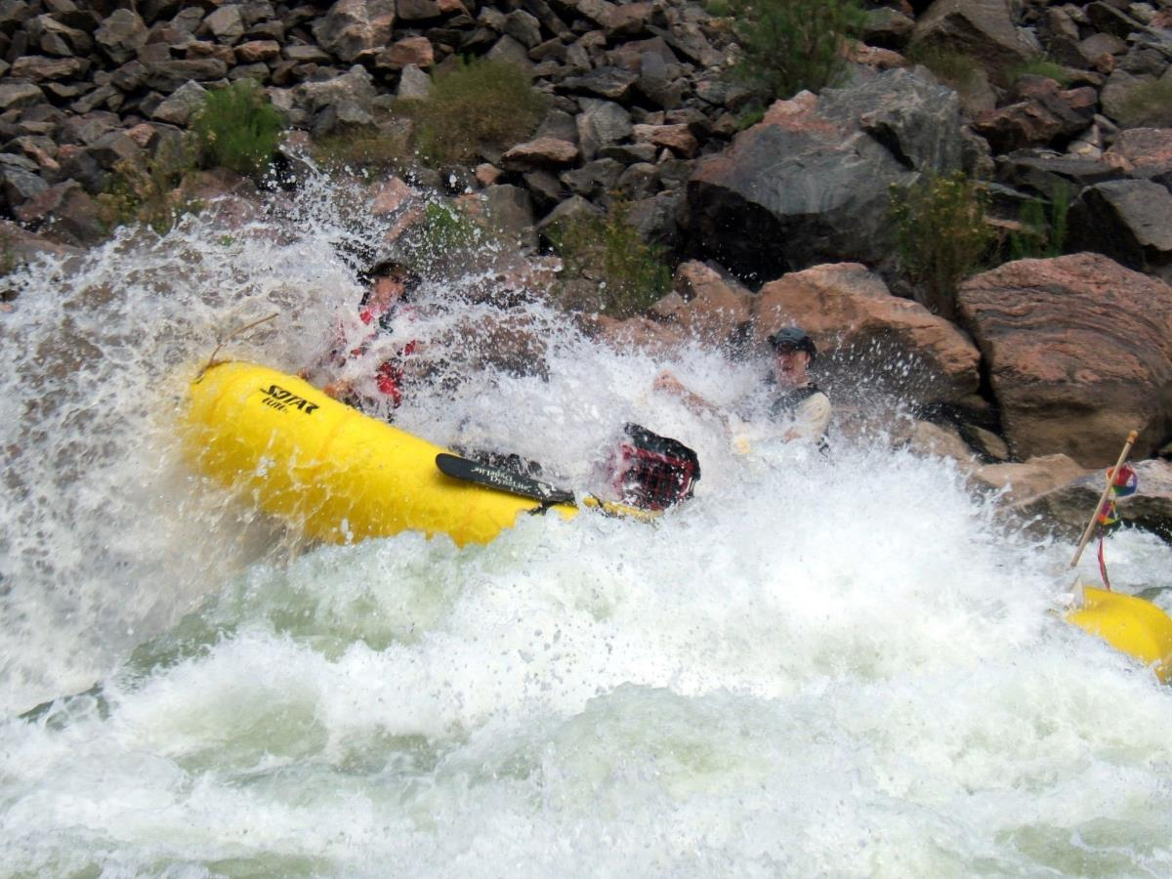

Slide 11
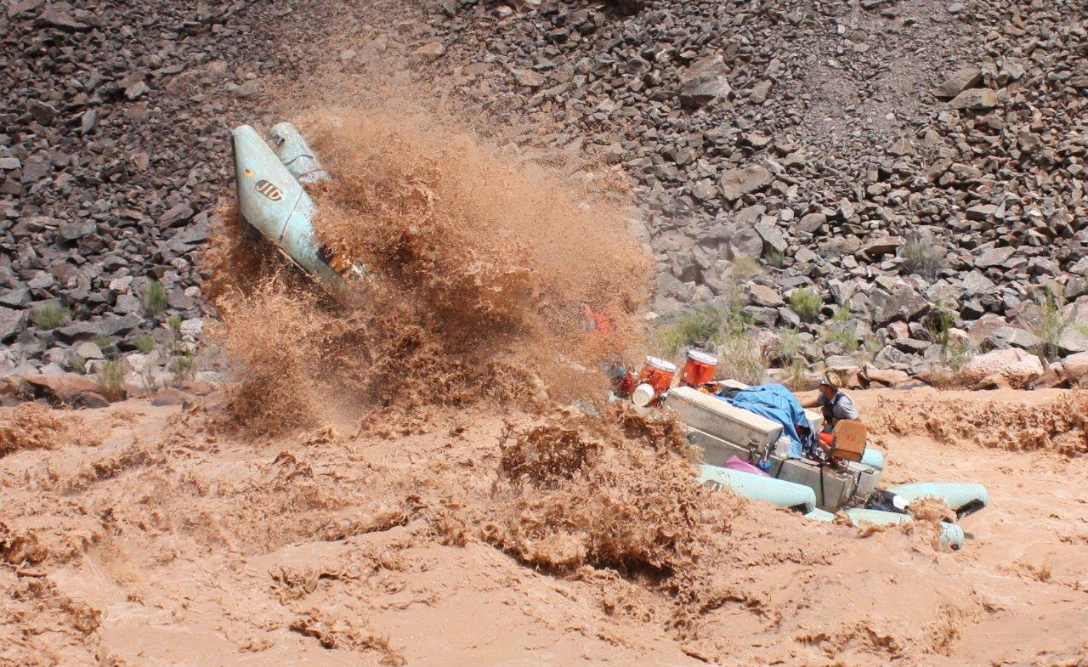
Photo Credit: Tom Martin

Slide 12
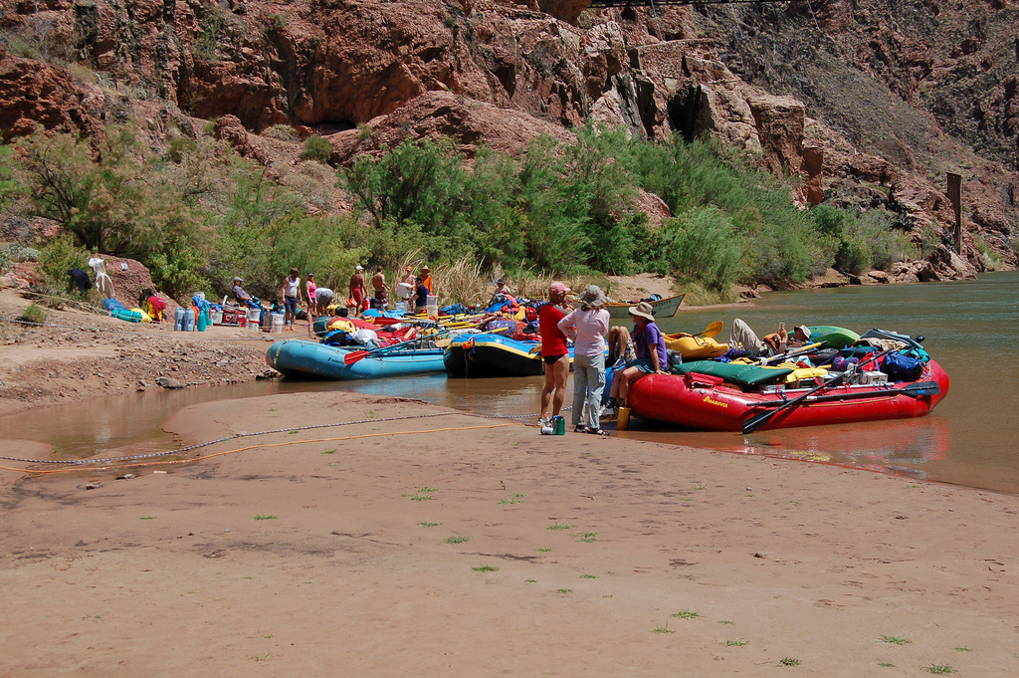

Slide 13
Grand Canyon National Park
Colorado River
Native American presence
John Wesley Powell (1869)
Geology
Source of water to Native American tribes for 12,000 years
Inspiration for artists and writers
Some of the most intensive environmental controversies in American history

Slide 14
Rapidly expanding use of the river in the 1960s and 1970s
2006 management plan
Commercial and non-commercial/private trips/motorized and non-motorized trips

Slide 15
Grand Canyon National Park
http://www.nps.gov/grca/index.htm

Slide 16
Impacts to resources: Impacts to soil and vegetation, historical/cultural sites.
Impacts to experience: Crowding, conflicts
Impacts to facilities/service: Campsites; attraction sites; impacts to historical/cultural sites.

Slide 17
Management strategies: Limit use; reduce the impact of recreation
Management practices: Zoning; rules/ regulations; rationing/allocation; law enforcement; information/education

Slide 18
Zoning
Spatial
Temporal

Slide 19
Rules/Regulations
Group size
Only one trip per year per person
Must hike with a guide on commercial trips
Commercial guides must be trained by NPS
No disturbance of artifacts
Area closures

Slide 20
Rationing/Allocation
Carrying capacity/indicators and standards (e.g. encounters on river, number of groups at campsites, disturbance of artifacts)
Launch calendar (1 to 6 launches per day for a total about 1,100 launches in 2015, [24,885 people/215,885 user days])
Allocation between private and commercial trips
Weighted lottery for private trips

Slide 21
Law Enforcement
Patrols by uniformed rangers
Uniformed rangers at launch site

Slide 22
Information/Education
Park website
Orientation video
Audio and video podcasts
Training of commercial guides
DVD for non-commercial boaters

Slide 23
River Trip Orientation Video

Slide 24
More Videos
Rafting Lava Falls – 25,000 CFS (7:01)
Flipping in Lava (2:35)
Running Hermit Rapid (0:49)
http://www.youtube.com/watch?v=G0ZoyLDAgFg&feature=related
http://www.youtube.com/watch?v=qhxB0WD8UUQ&feature=related
http://www.youtube.com/watch?v=XmDqggwrxjQ

