Slide 1
Busing Among the Grizzlies at Denali
Managing Outdoor Recreation: Case Studies in the National Parks, 2nd Edition

Slide 2
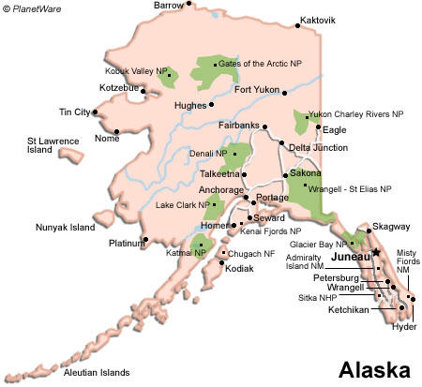

Slide 3
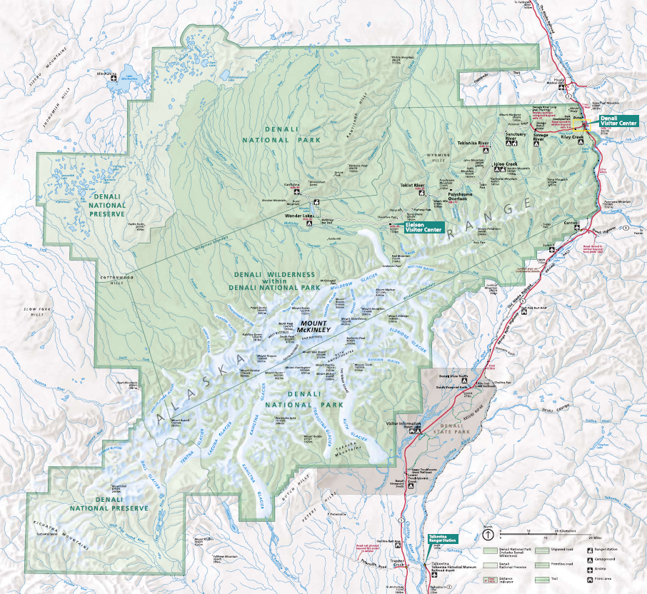

Slide 4
Denali National Park and Preserve
“Crown Jewel” park
Six million acres
Established in 1917
Completion of George Parks Highway in 1972
Serengeti of North America (grizzly and black bears, caribou, moose, wolves, Dall’s sheep)
Mt. McKinley/Denali (“the high one”)(20,320 feet)

Slide 5
Expanded and re-named in 1980 (ANILCA)
400,000 visits a year
91-mile Denali Park Road
First 15 miles open to cars, but the rest is accessible only by bus (sightseeing buses and VTS buses)

Slide 6
Denali National Park and Preserve
http://www.nps.gov/dena/index.htm

Slide 7
Problems
Impacts to resources: Wildlife
Impacts to experience: Crowding
Impacts to facilities/services: Attraction sites, campgrounds/campsites, road/parking

Slide 8
Strategies and Practices
Management Strategies: Limit use; reduce the impact of use
Management Practices: Rationing/allocation; zoning; facility development/site design/ maintenance; rules/regulations; information/ education

Slide 9
Rationing/allocation
Permits are required for overnight wilderness hiking
Tickets are required to ride the bus

Slide 10
Zoning
Different wilderness zones
Different use level of wilderness zones based on wildlife and other resource conditions, and degree of solitude

Slide 11
Facility Development/Site Design/Maintenance
Bus system implemented
Conventional sightseeing buses
Visitor Transportation System

Slide 12
Information/Education
Park website
Wilderness Access Center
Bear etiquette

Slide 13
Rules/Regulations
Bear canisters
No pets
Area closures
After first 15 miles, only buses are allowed to access wilderness hiking trails and campsites

Slide 14
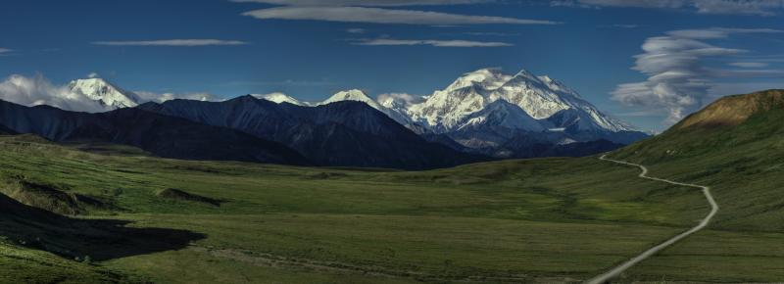

Slide 15
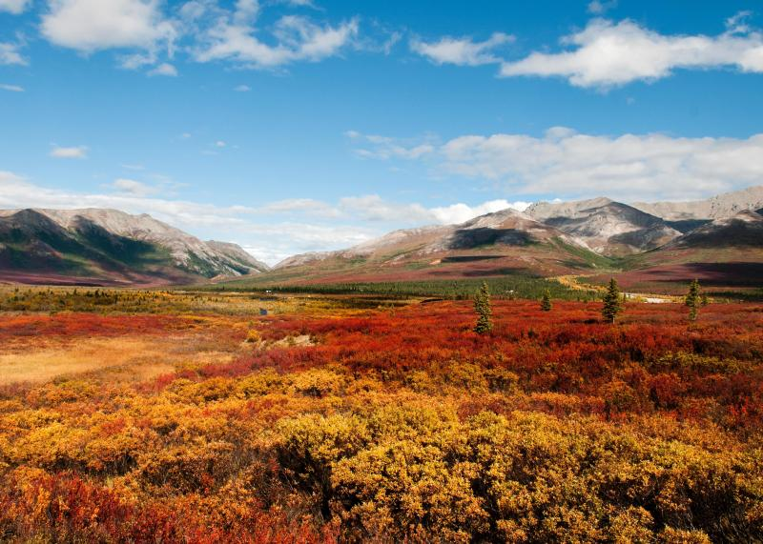

Slide 16
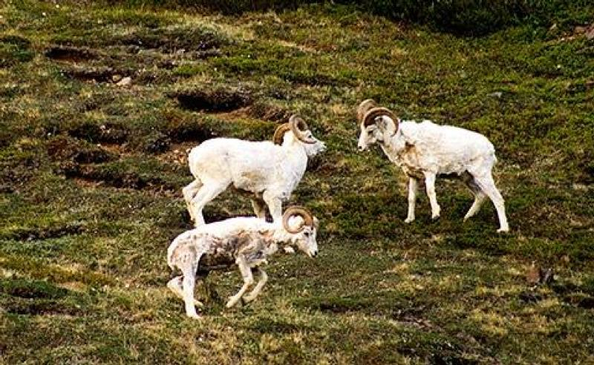

Slide 17
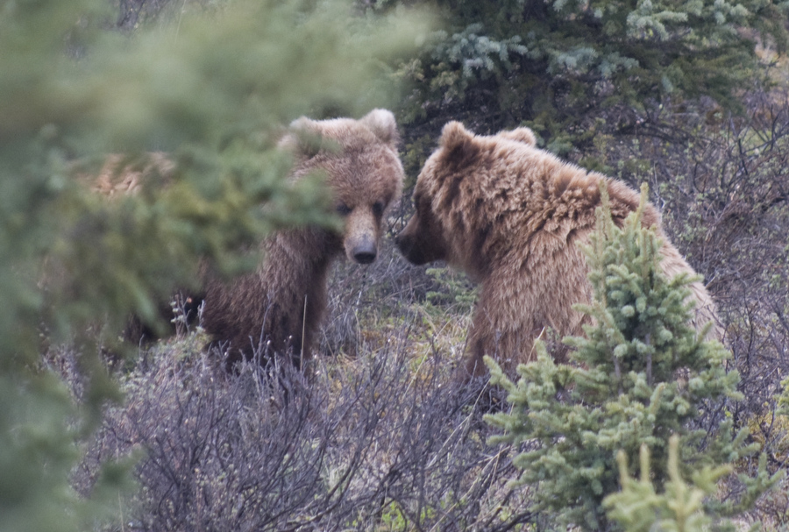

Slide 18
Indicators and Standards of Quality

Slide 19
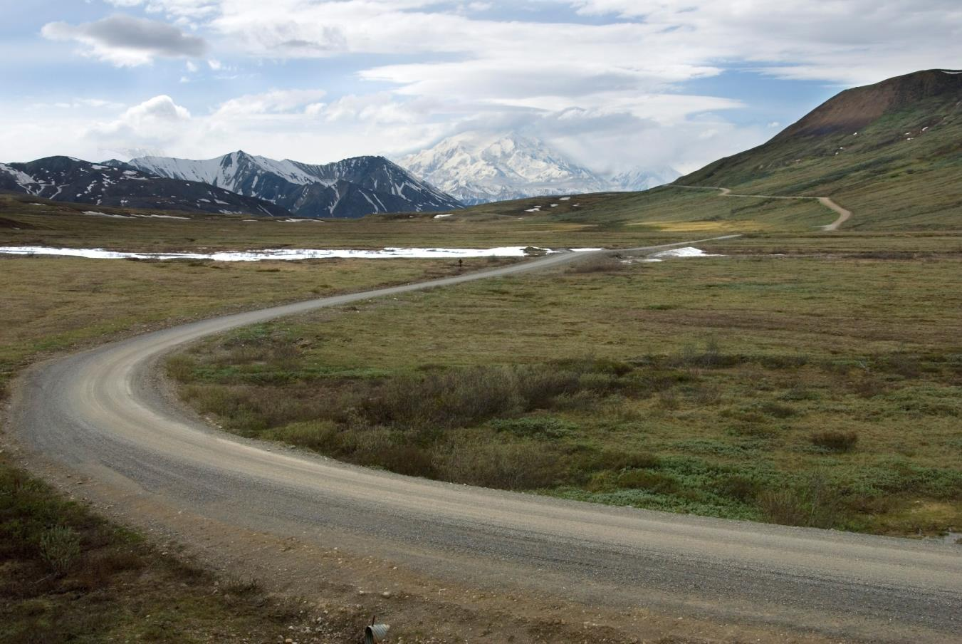

Slide 22
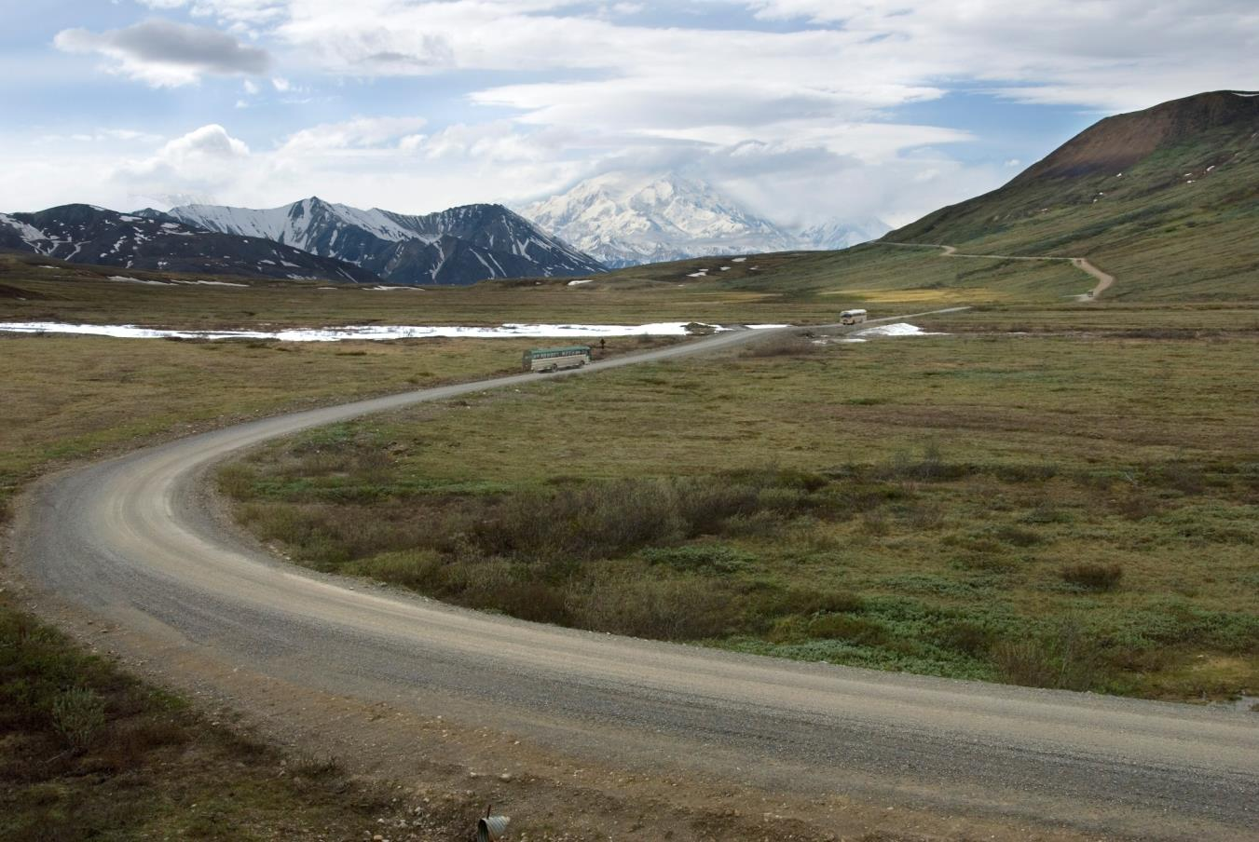

Slide 25
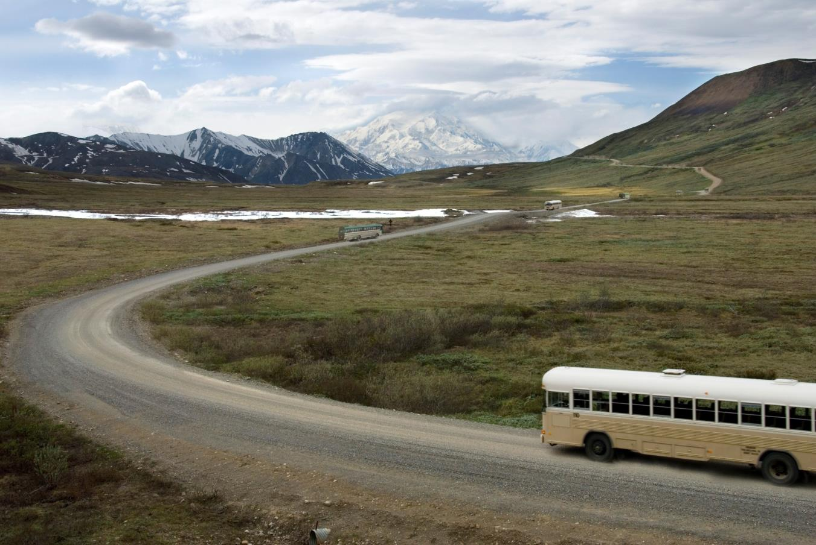

Slide 27
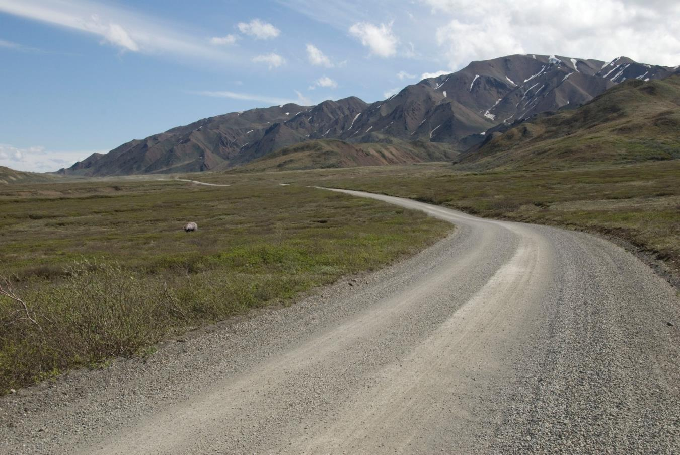

Slide 28
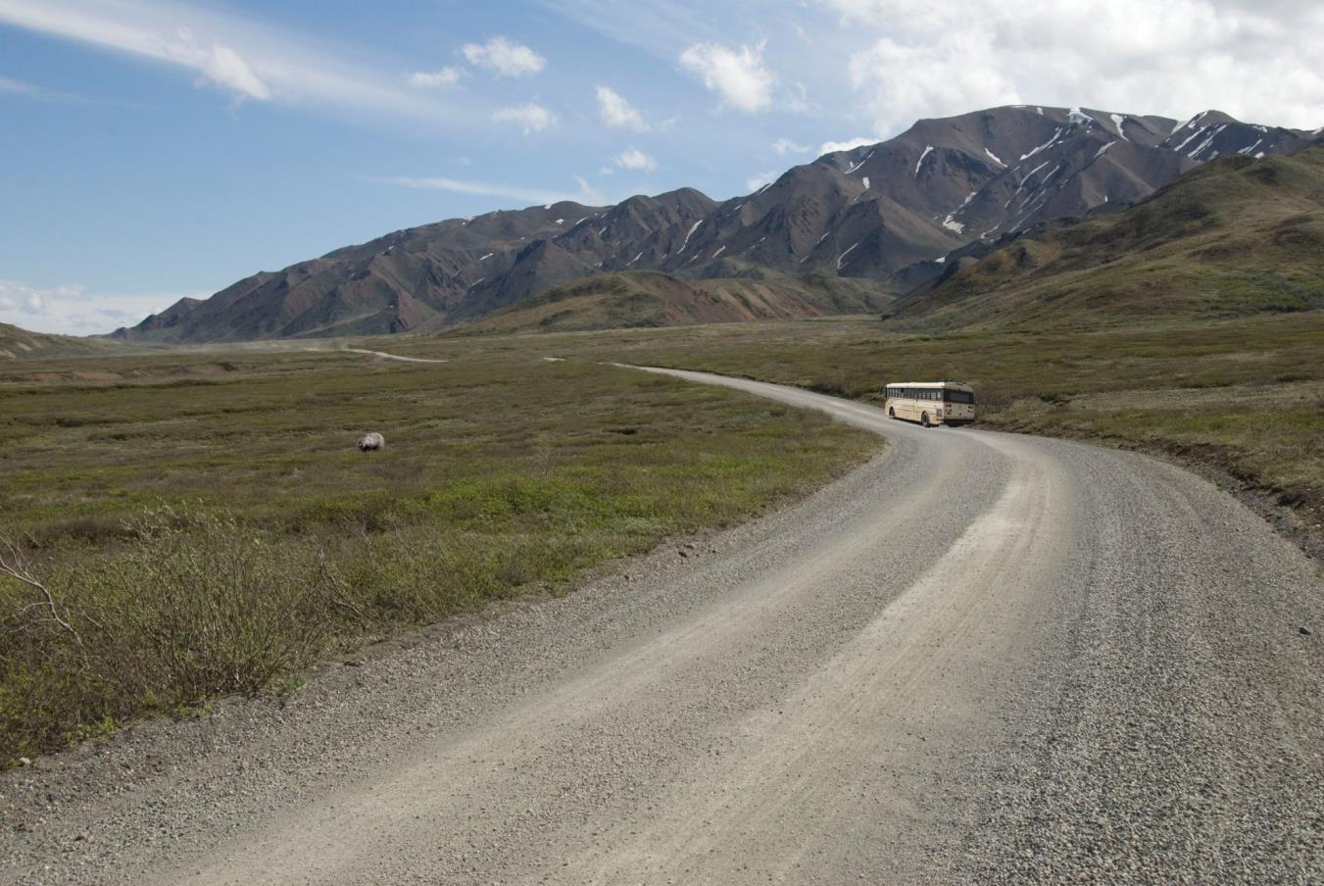

Slide 29
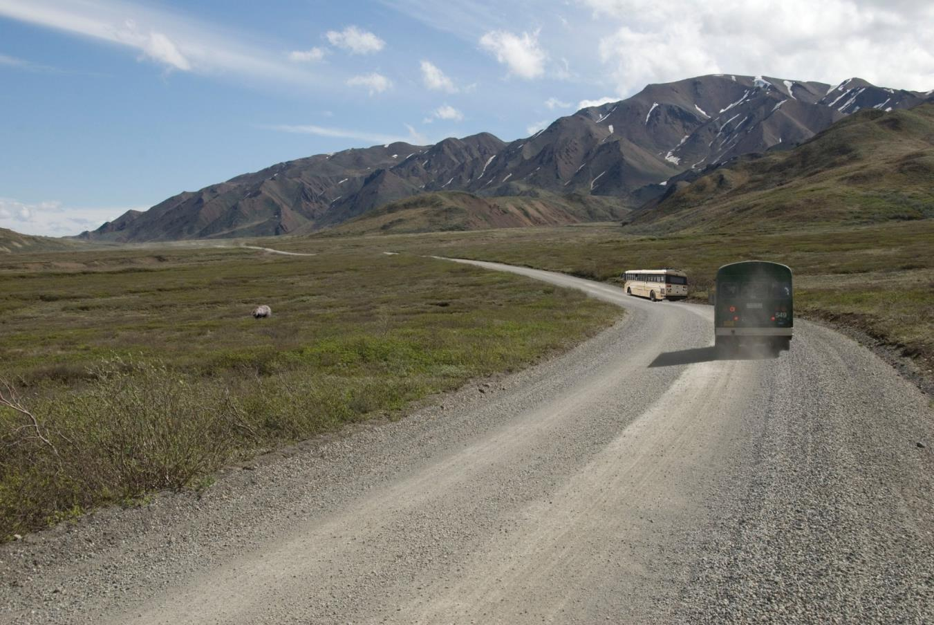

Slide 30
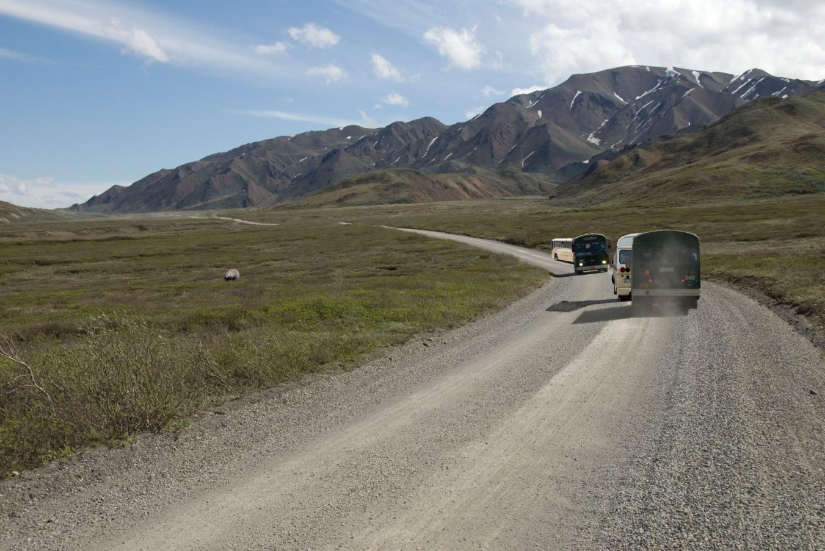

Slide 31
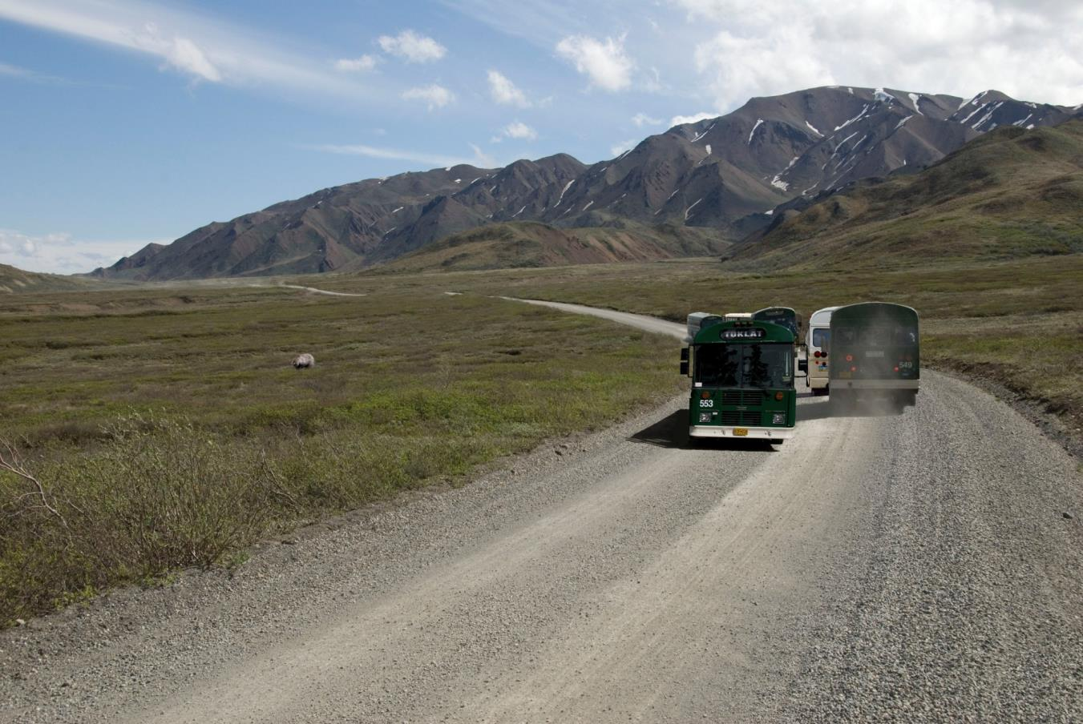

Slide 32
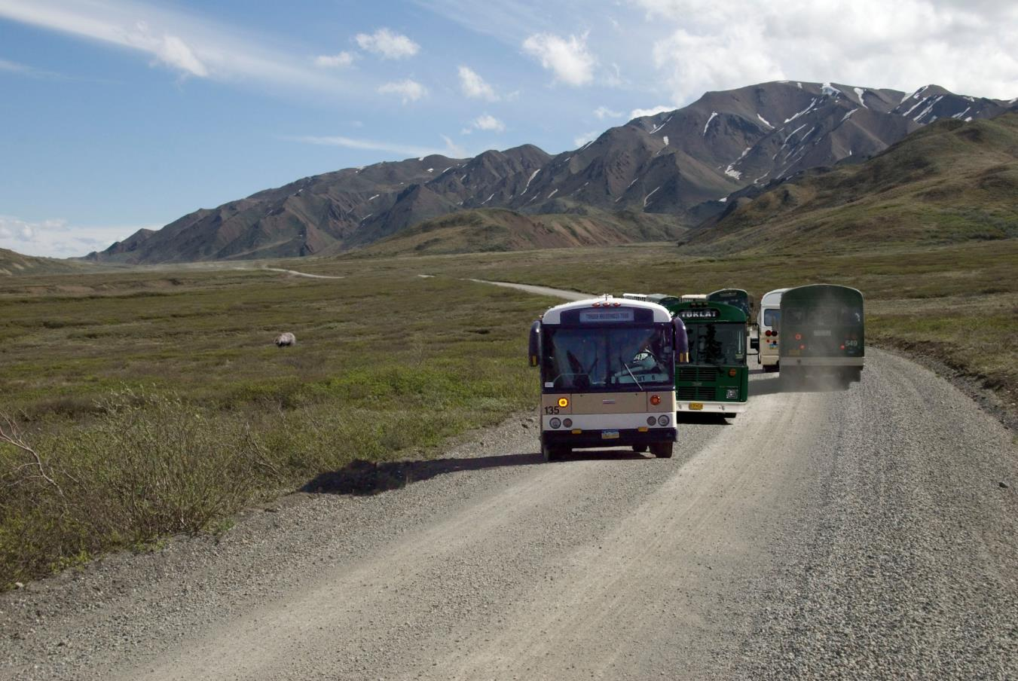

Slide 33
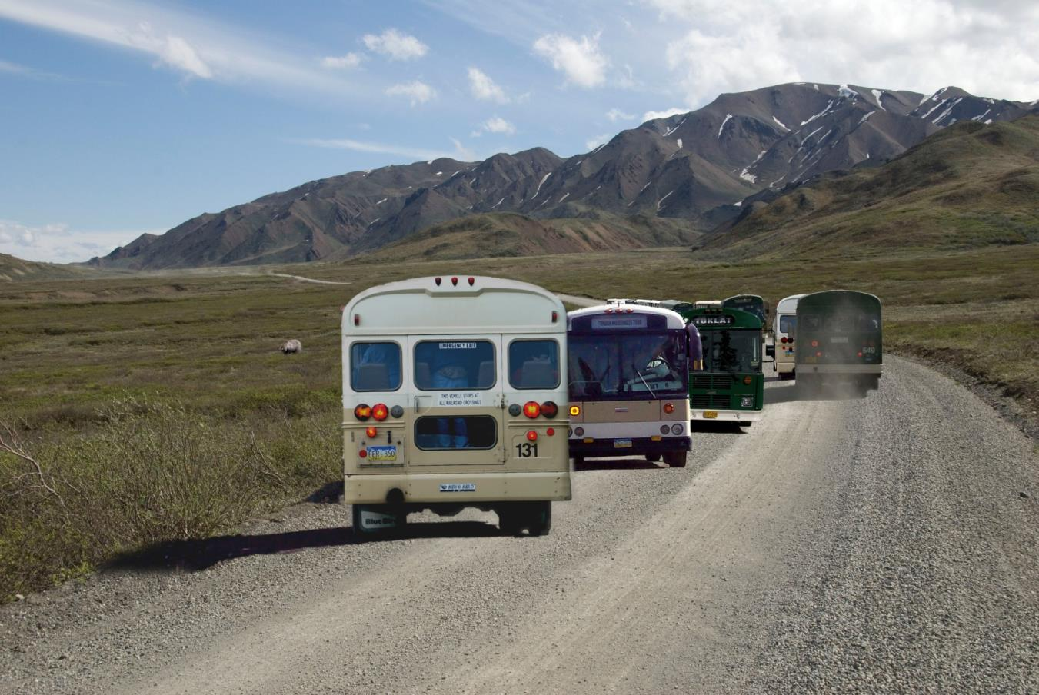

Slide 34
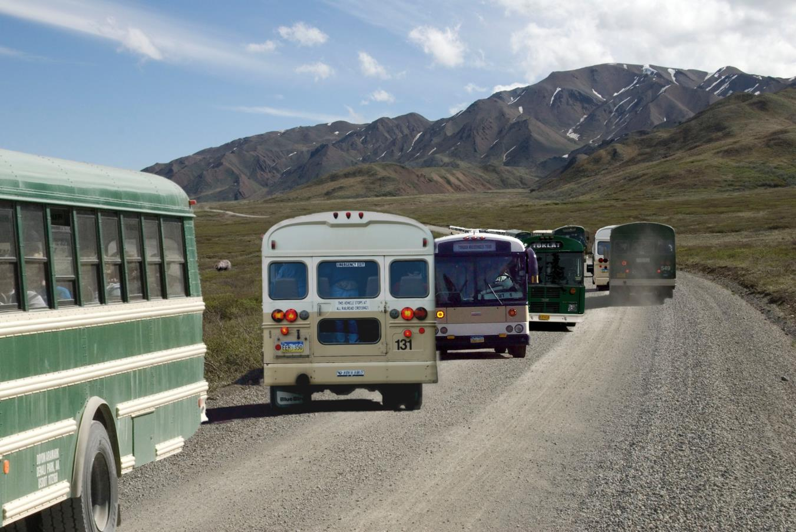

Slide 36
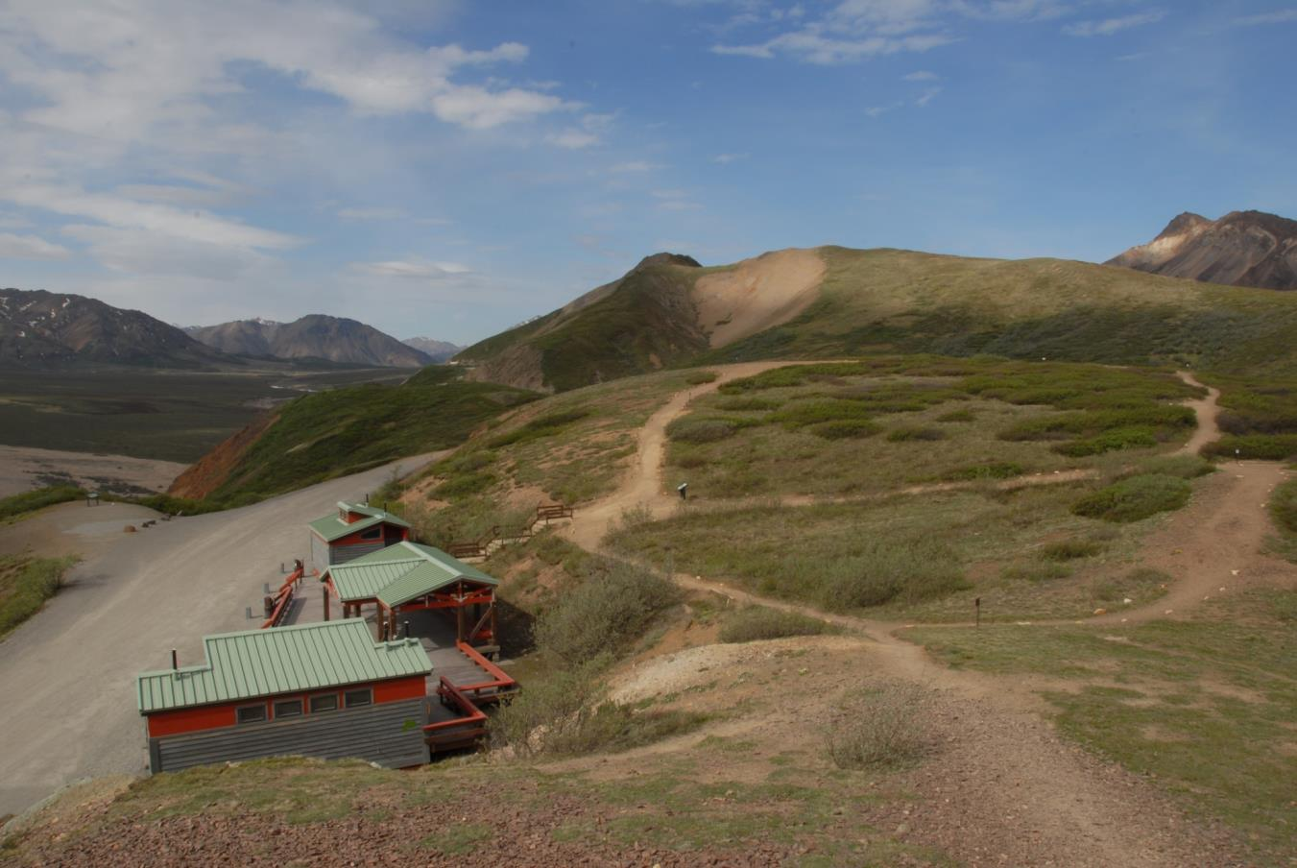

Slide 37
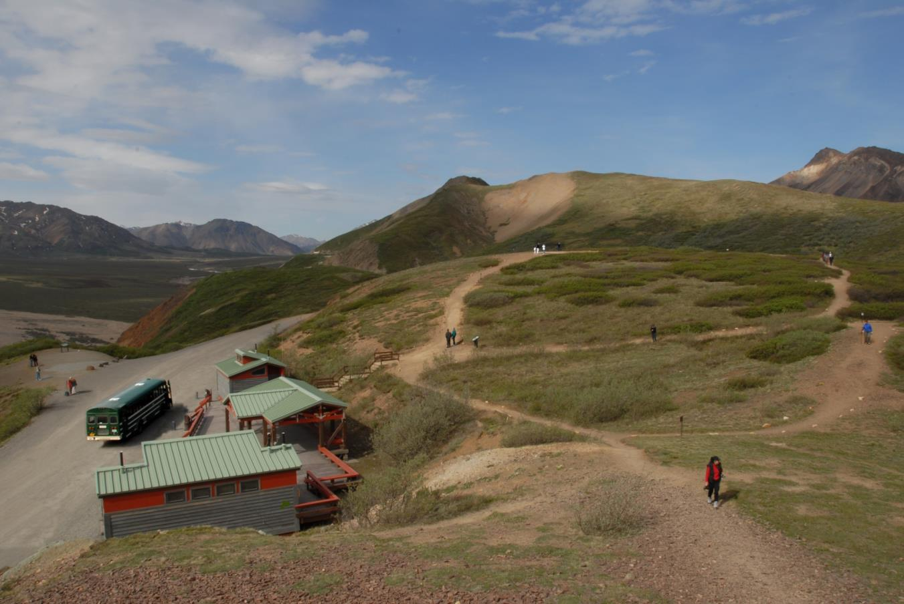

Slide 38
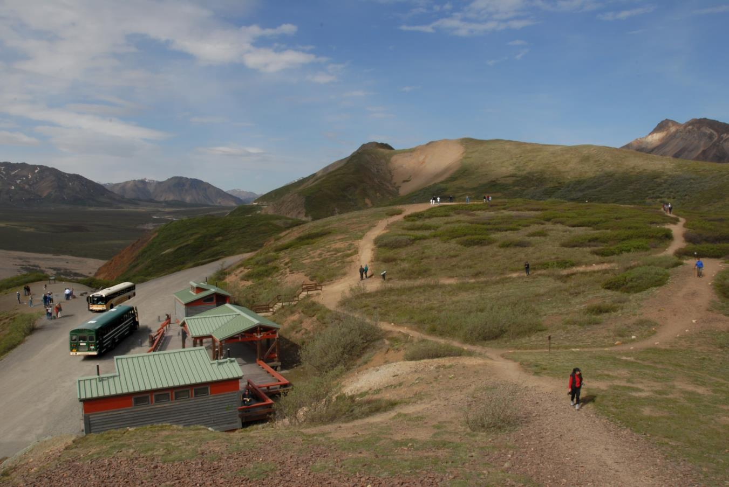

Slide 39
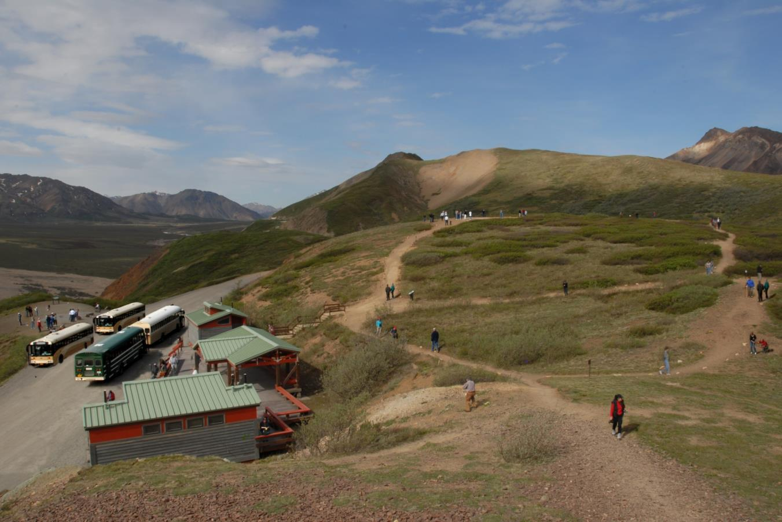

Slide 40
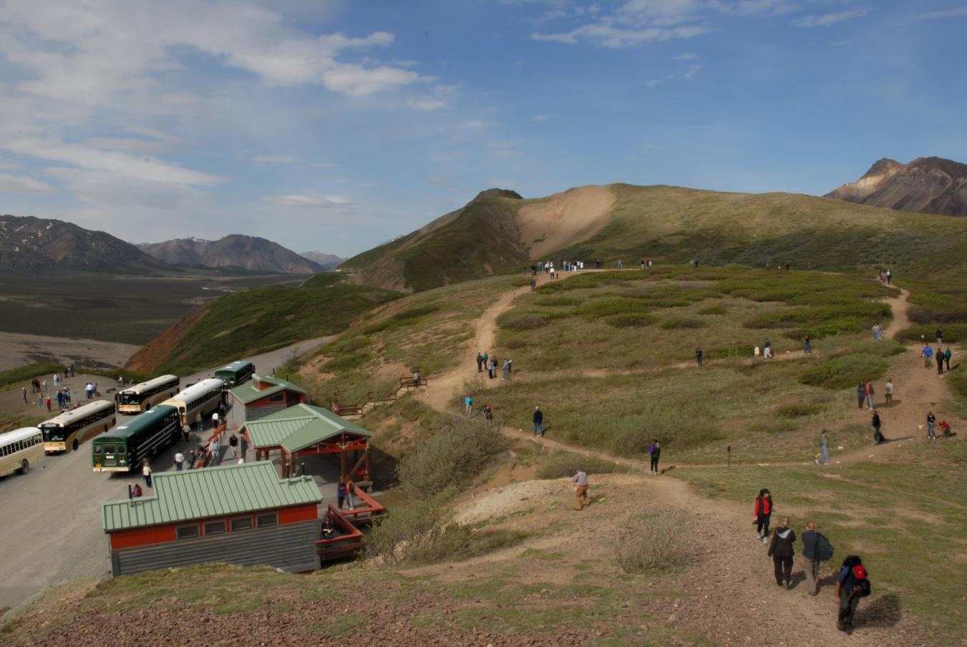

Slide 42
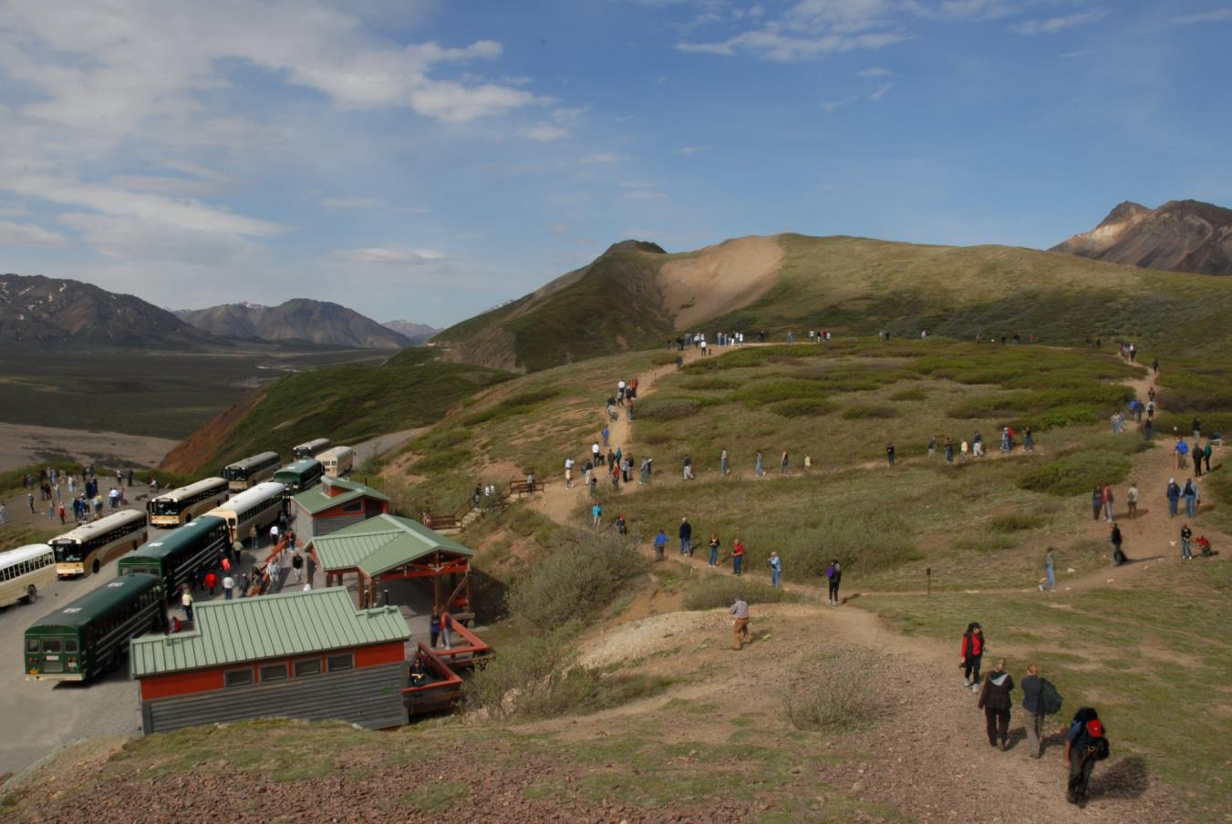

Slide 43
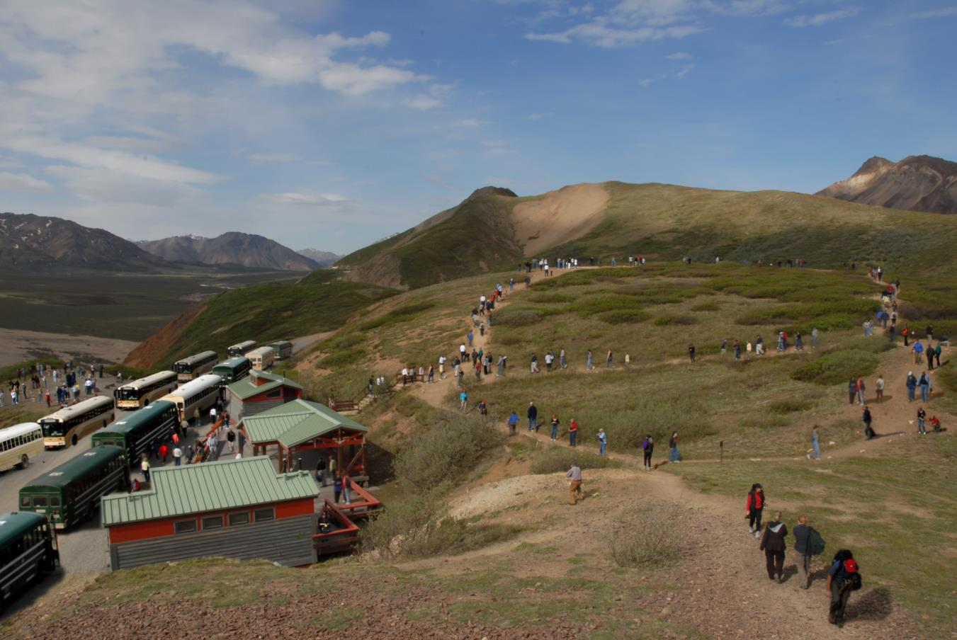

Slide 45
Busing Among the Grizzlies at Denali
Virtual Bus Trip in Denali (8:51)
Denali Bear (1:31)
Denali Backcountry (2:59)
http://www.youtube.com/watch?v=fxG6Di9-enU&feature=related
http://www.youtube.com/watch?v=IOSE_Ux46_E
https://www.nps.gov/dena/planyourvisit/bicvid.htm

