Slide 1
Turning Off the Lights at Chaco
Managing Outdoor Recreation: Case Studies in the National Parks, 2nd Edition

Slide 2
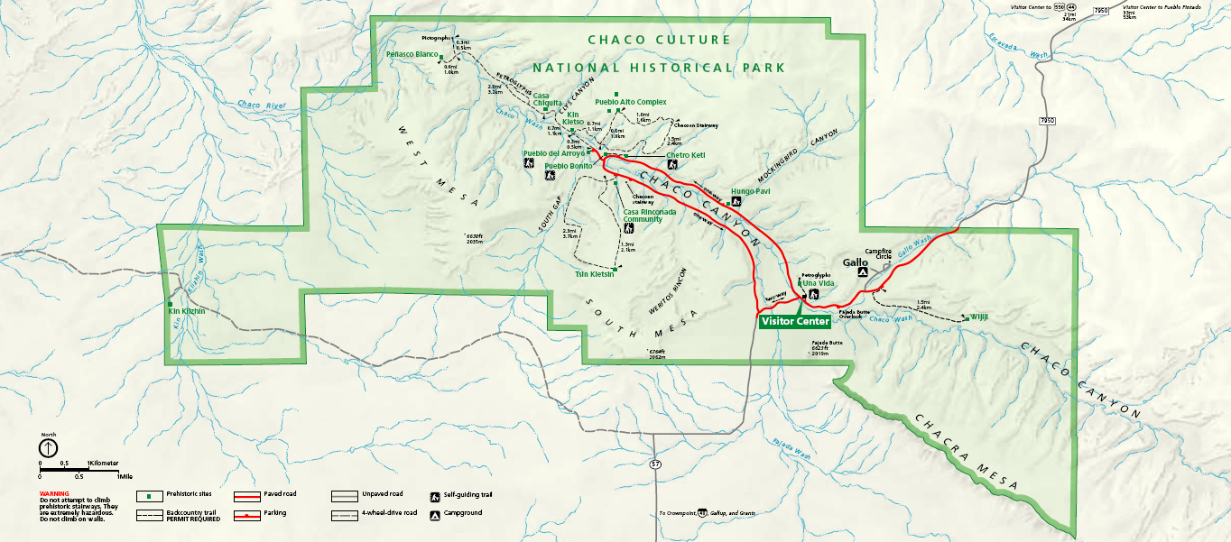

Slide 3
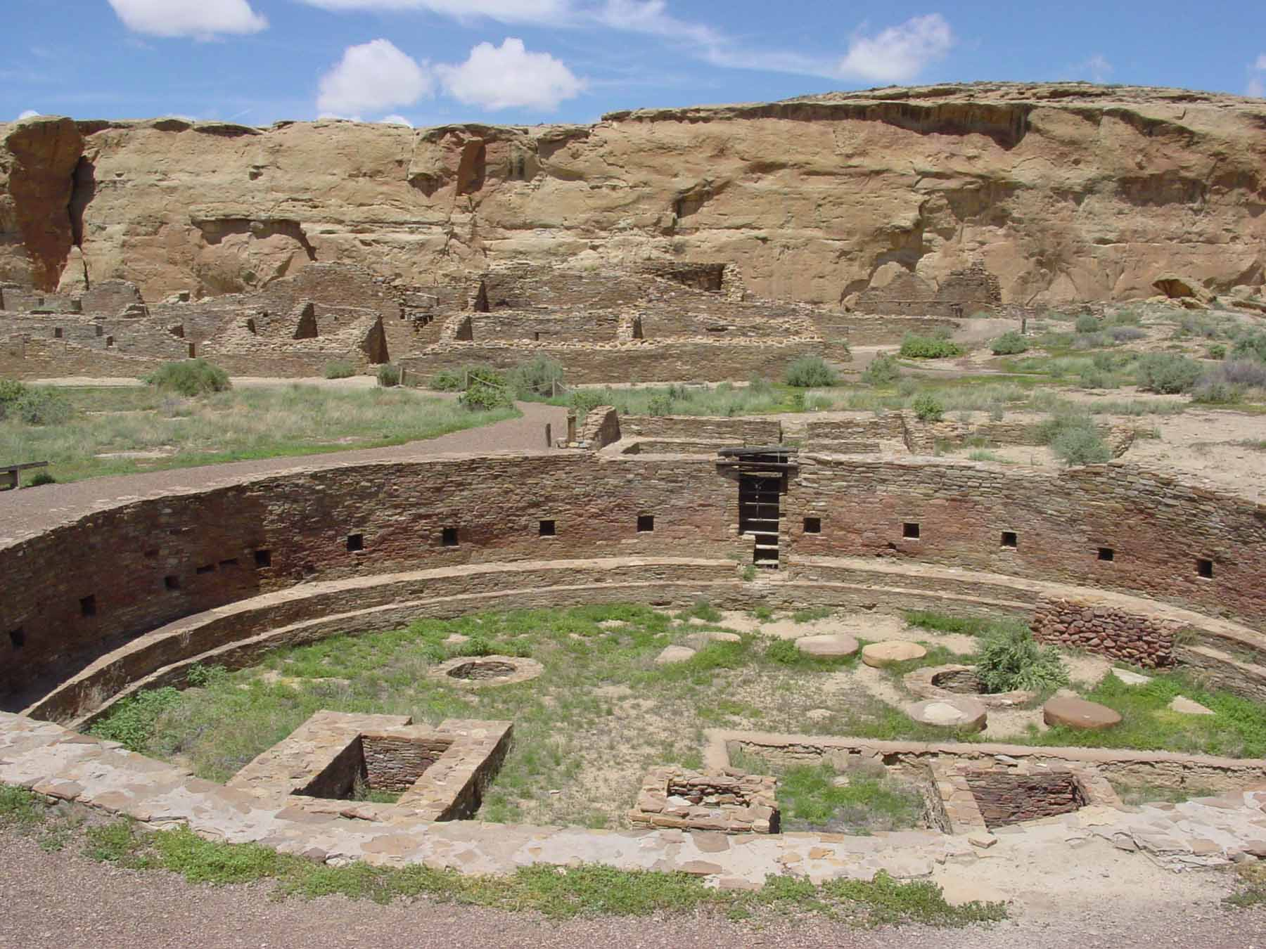

Slide 4
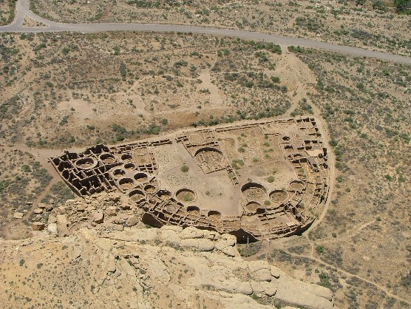

Slide 5
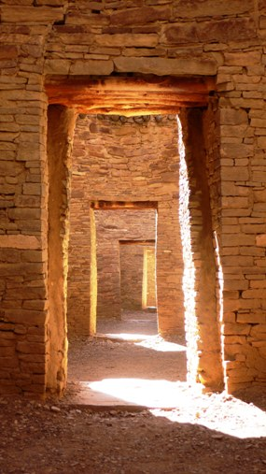

Slide 6
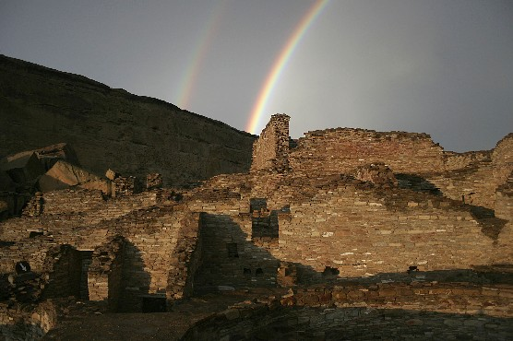

Slide 7
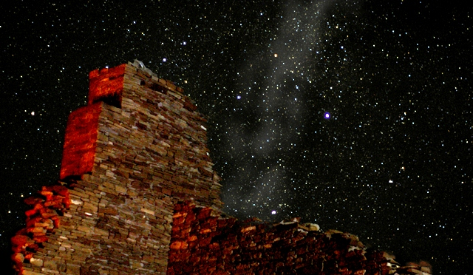

Slide 8
National Monument (1907)
National Historical Park (1980)
World Heritage Site (1987)
33,960 acres of park land
Prehistoric buildings and architecture
Importance of “natural darkness”
Astronomy programs
International Dark Sky Park (2013)

Slide 9
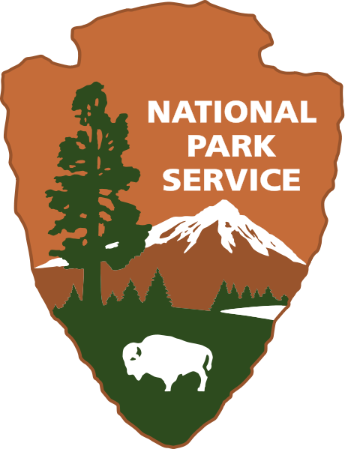
Chaco Culture National Historical Park
http://www.nps.gov/chcu/index.htm

Slide 10
Internal and external threats of lighting
Increasing demand for night sky programs
Nearly 39,000 annual visits in 2015
More than 3,000 visitors attend astronomy programs annually

Slide 11
Impacts to resources: Night skies, wildlife, and vegetation
Impacts to facilities/services: Attraction sites

Slide 12
Management strategies: Increase supply; reduce the impact of use
Management Practices: Facility development/ site design/maintenance; information/ education

Slide 13
Facility Development/Site Design/Maintenance
Replace the mercury vapor lights with shielded incandescent bulbs
Motion sensor
Remove unnecessary lighting
Interpretive programs, “star parties”, observatory
Partnership: The Albuquerque Astronomical Society (TAAS), International Dark-Sky Association

Slide 14
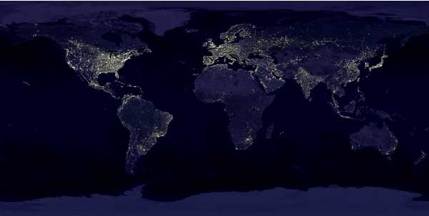

Slide 15
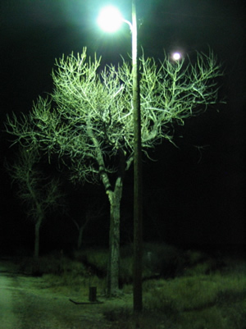
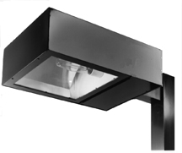
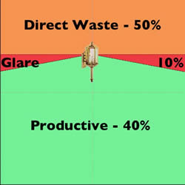
From
To

Slide 16
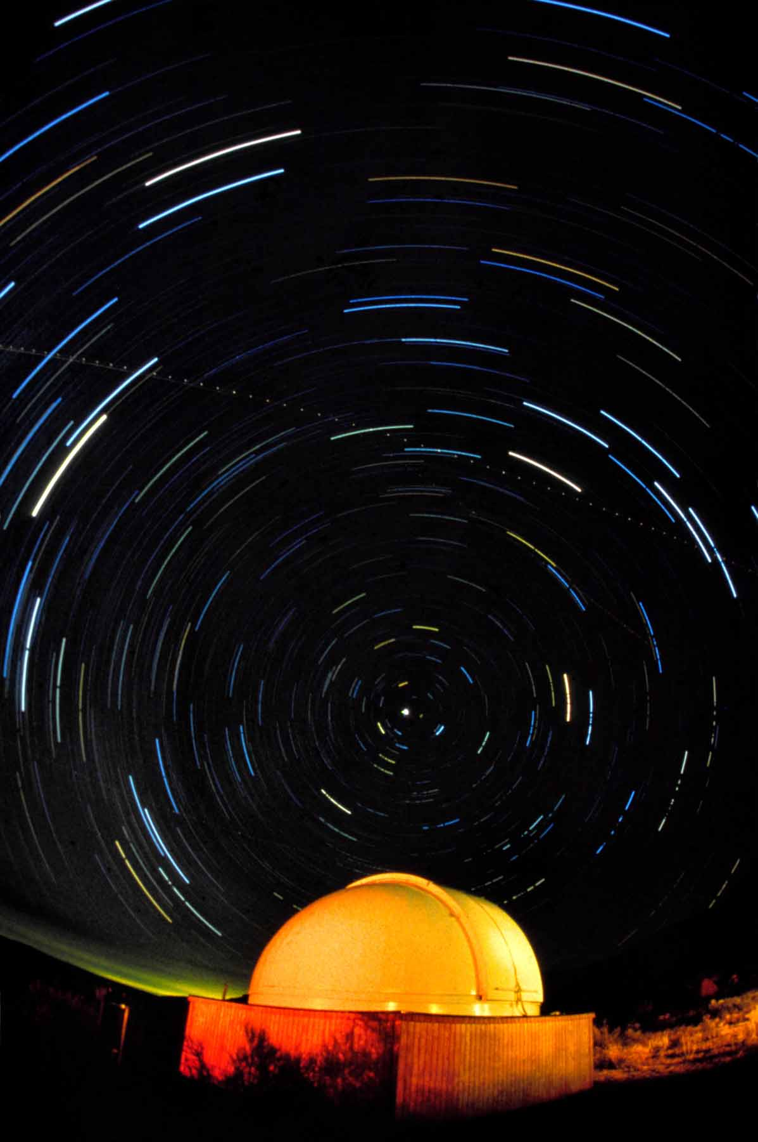

Slide 17
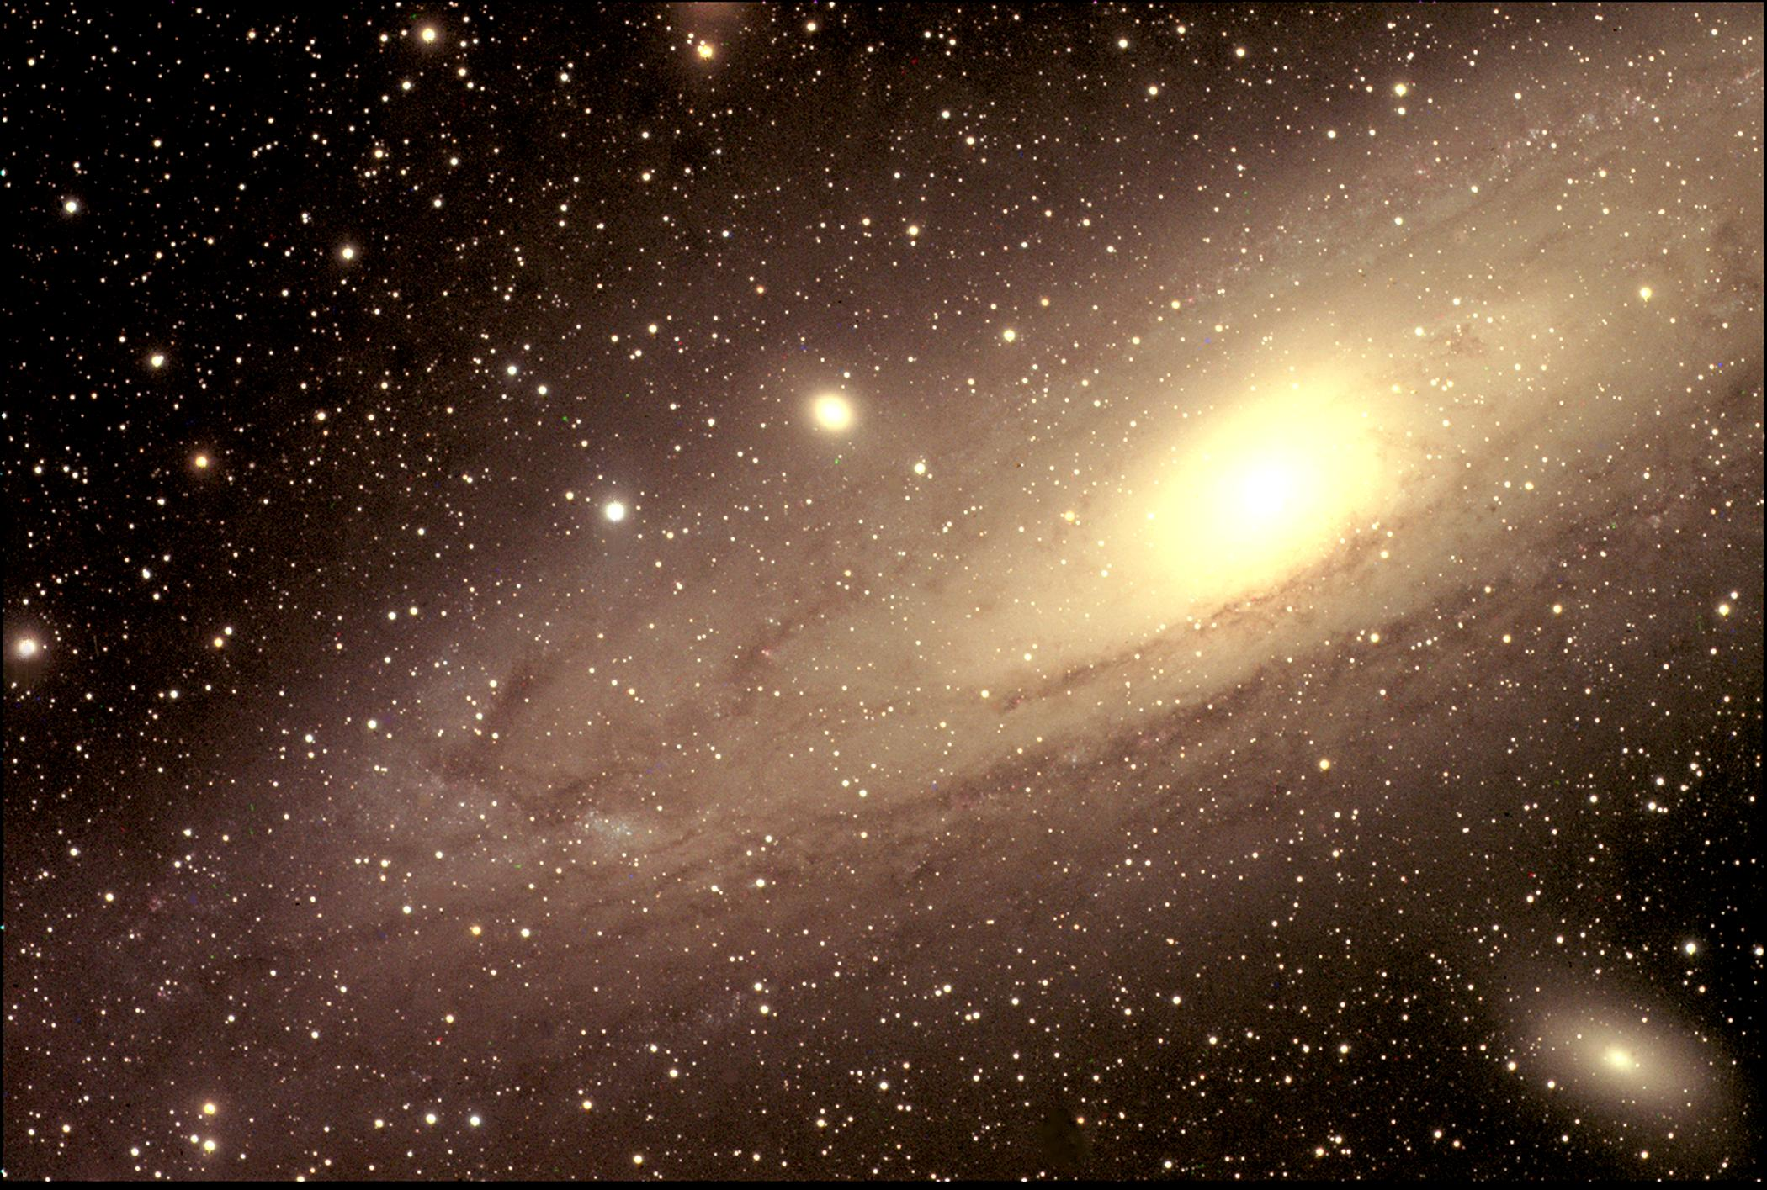
Andromeda Galaxy taken from Chaco Observatory

Slide 18
Education/Information
Interpretive programs, “star parties”, observatory
Partnership: The Albuquerque Astronomical Society (TAAS), International Dark-Sky Association

Slide 19
More Information
New Mexico Night Sky Protection Act
NPS Night Sky Team
National Parks Milky Way Posters
International Dark-Sky Association
George Wright Forum Article
http://www.nature.nps.gov/air/lightscapes/team.cfm
http://www.tylernordgren.com/milky-way-posters/
http://www.darksky.org/
http://www.georgewright.org/184shattuck.pdf

