Slide 1
How Many Visitors is Too Many at Arches?
Managing Outdoor Recreation: Case Studies in the National Parks, 2nd Edition

Slide 2
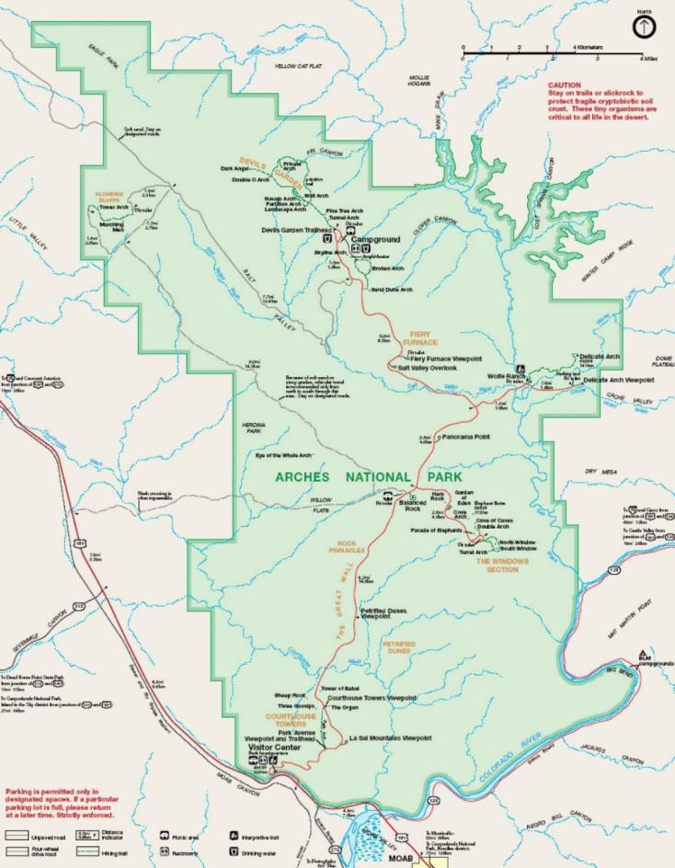

Slide 3
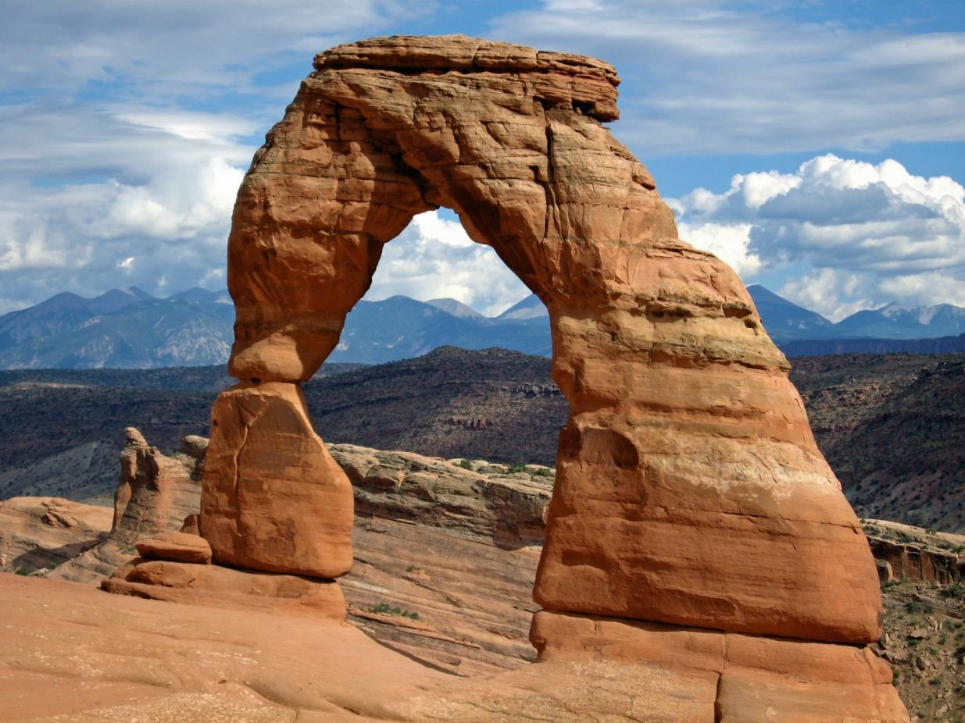

Slide 4
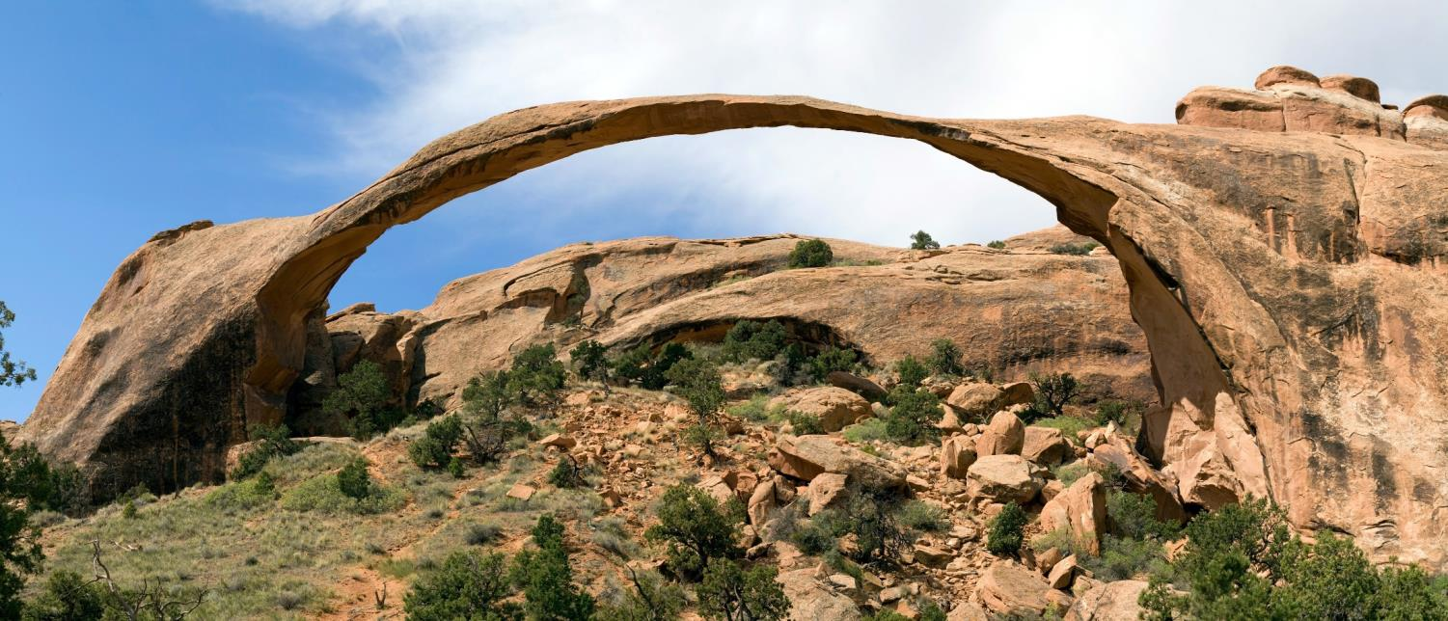

Slide 5
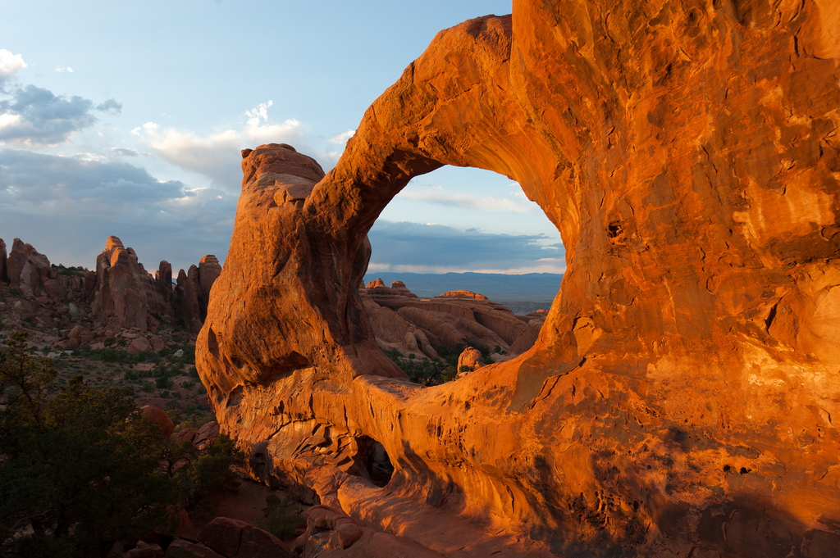

Slide 6
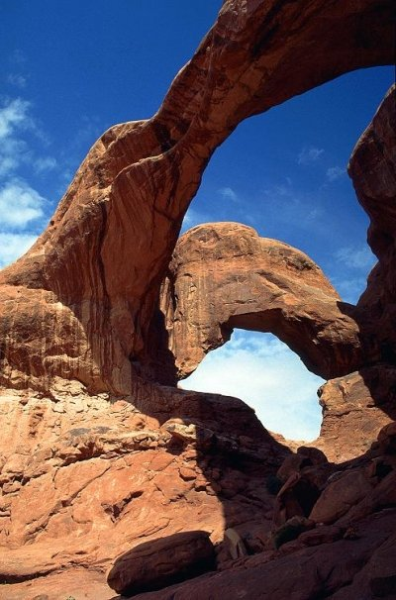

Slide 7
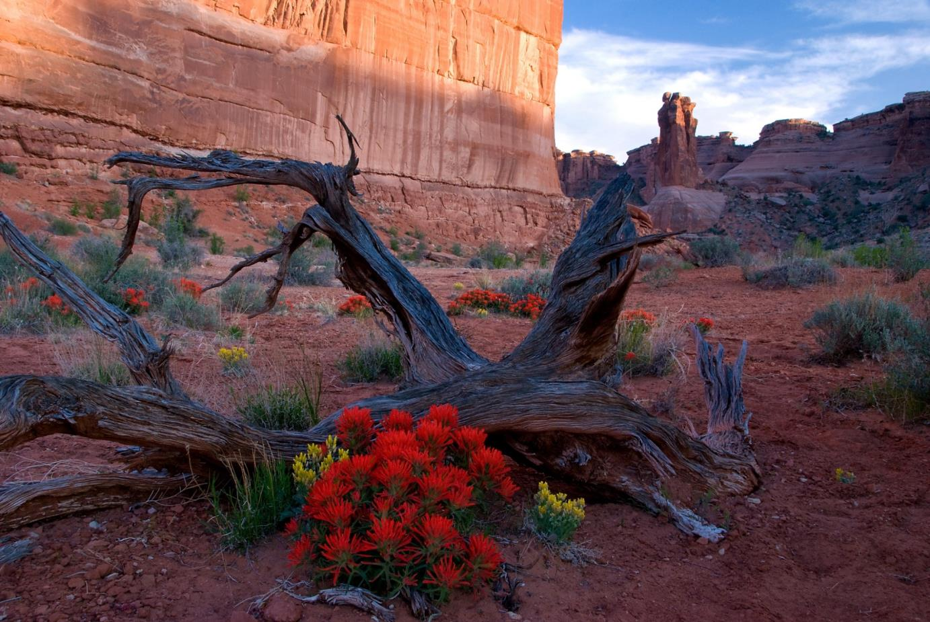

Slide 8
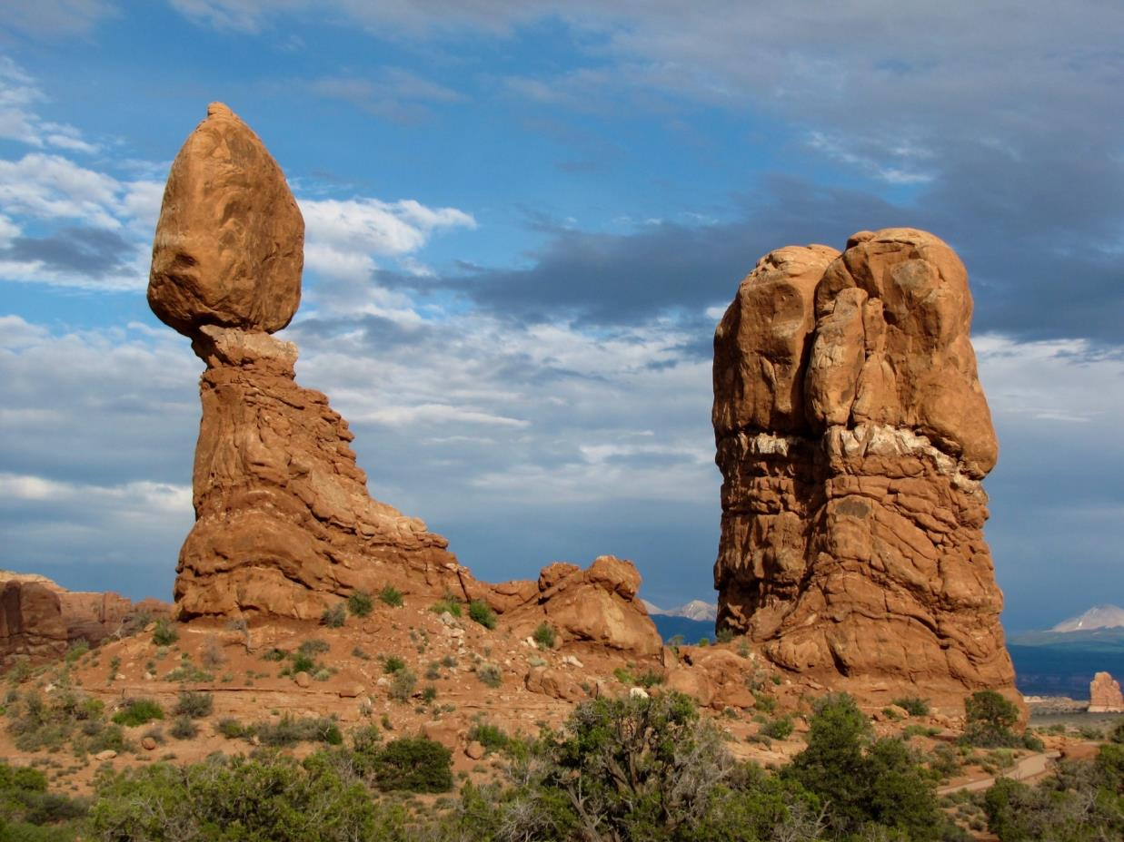

Slide 9
Established in 1929
77,000 acres of park land
More than 2,000 distinctive stone arches
The highest density of these geologic features in the world
1.4 million annual visits in 2015

Slide 10
Ed Abbey
Program of research
Indicator of quality: Crowding
Standard of quality: Maximum acceptable level of use (people at one time (PAOT))

Slide 11
Arches National Park

Slide 12
Trampling and degradation of fragile soil (microbiotic soil crust) and vegetation
Crowding on trails and at attraction sites

Slide 13
Impacts to resources: Impacts to soil and vegetation
Impacts to experience: Crowding; depreciative behavior
Impacts to facilities/service: Trails, attraction sites

Slide 14
Management Strategies: Limit use; reduce the impact of use
Management Practices: Zoning; information/education; facility development/site design/maintenance; law enforcement; rationing/allocation

Slide 15
Sizing of parking lots/parking regulations
Permit systems for some areas
Information/education: Web site; park newspaper; film; signs; visitor center; interpretive programs; Facebook and Twitter
Signs and fencing along trails
Monitoring

Slide 17
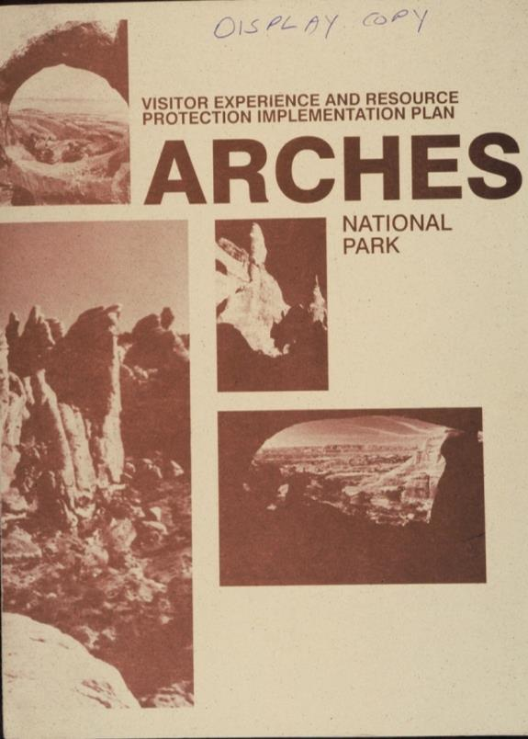

Slide 18
Management-by-Objectives Framework
1. Formulate management objectives and associated
indicators and standards of quality.
2. Monitor indicators of quality.
3. Implement management practices to maintain
standards of quality.

Slide 19
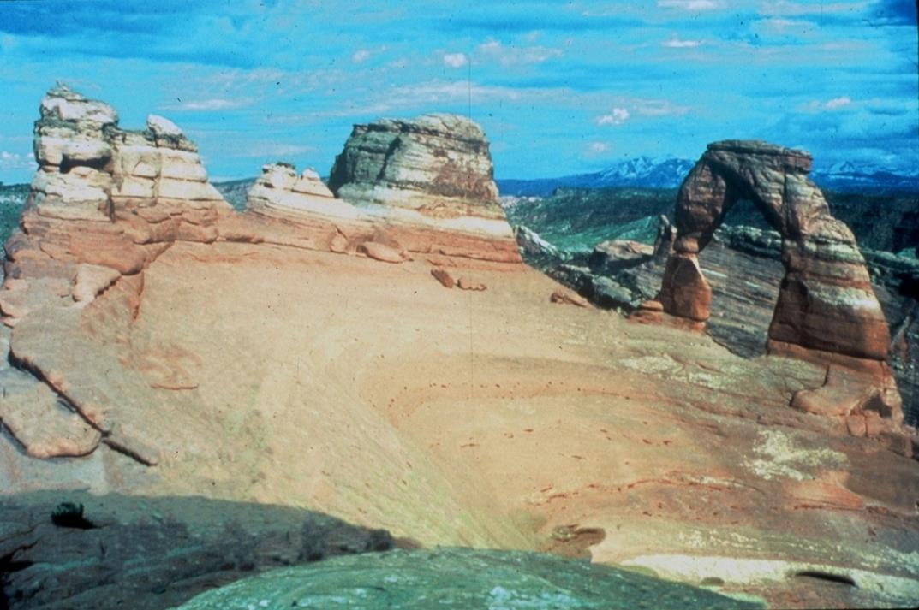

Slide 20
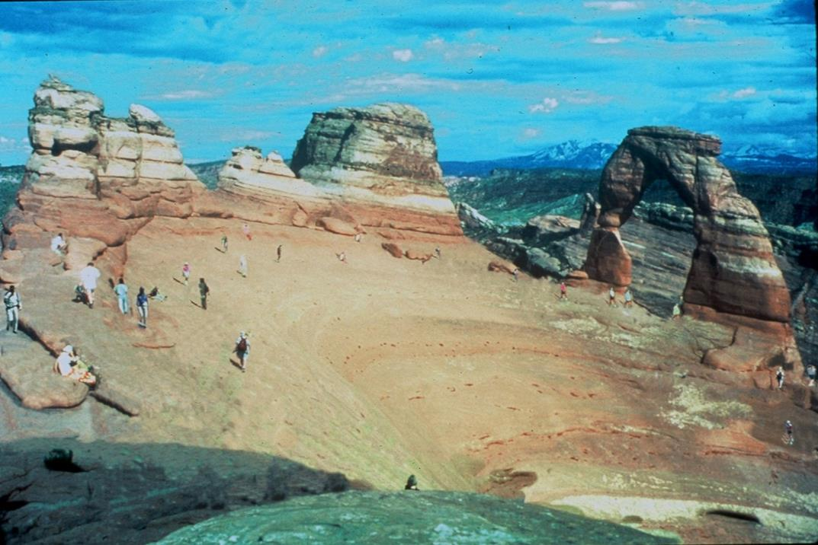

Slide 21
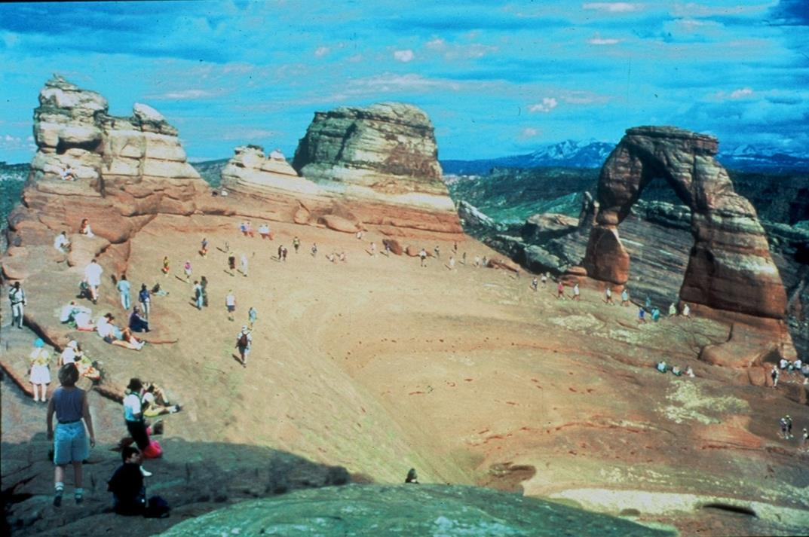

Slide 22
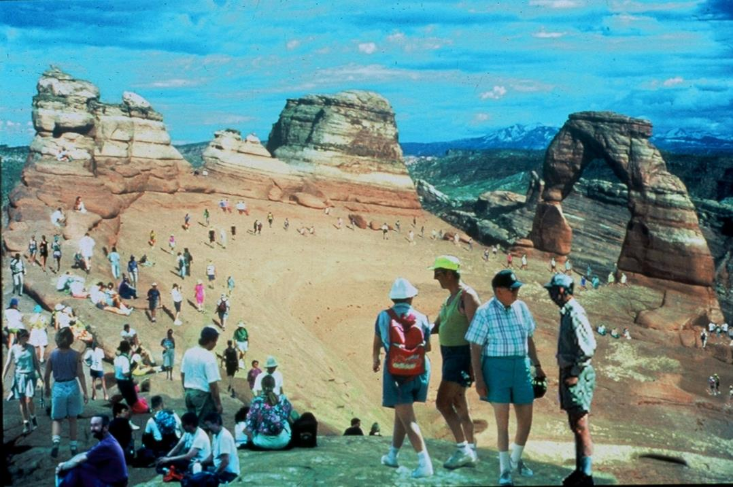

Slide 23
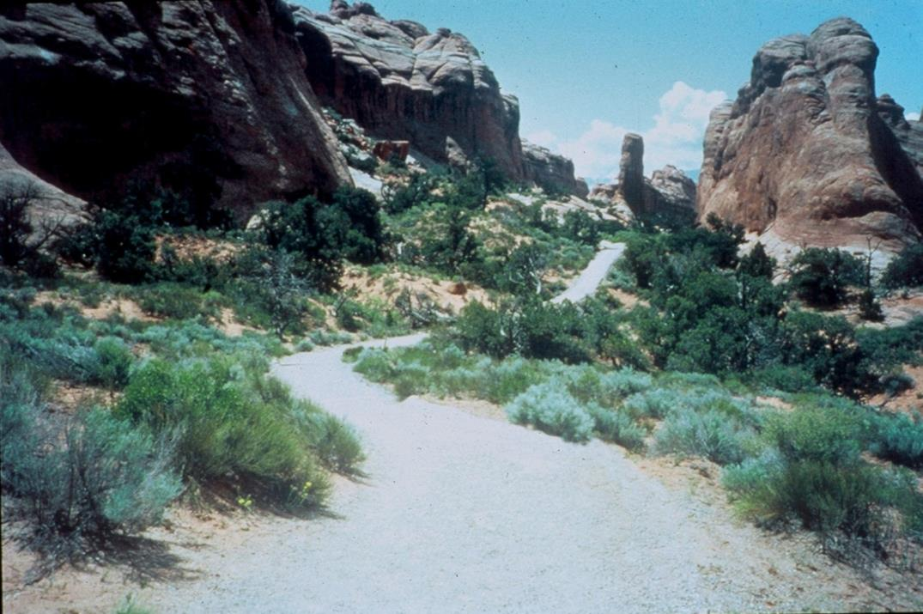

Slide 24
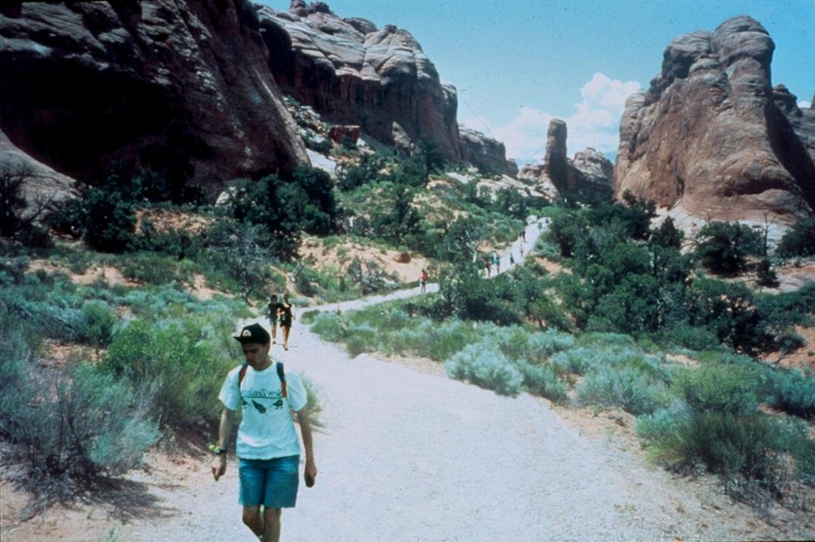

Slide 25
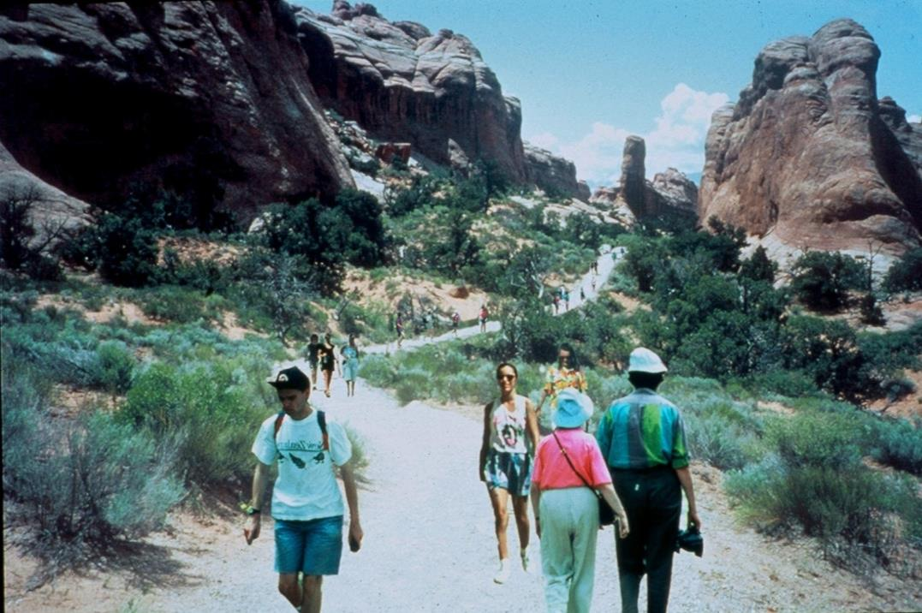

Slide 26
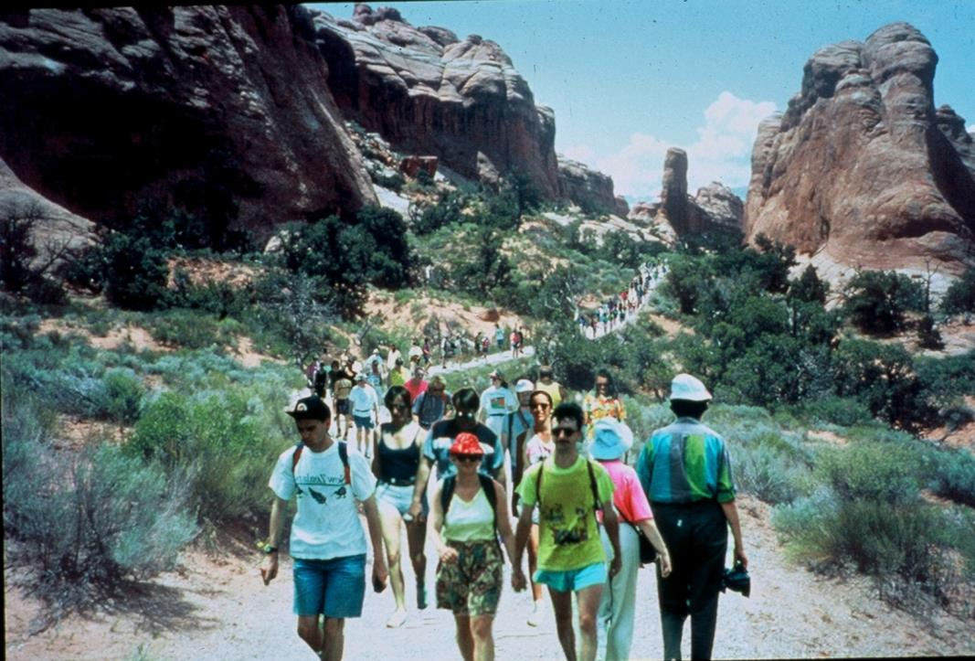

Slide 27
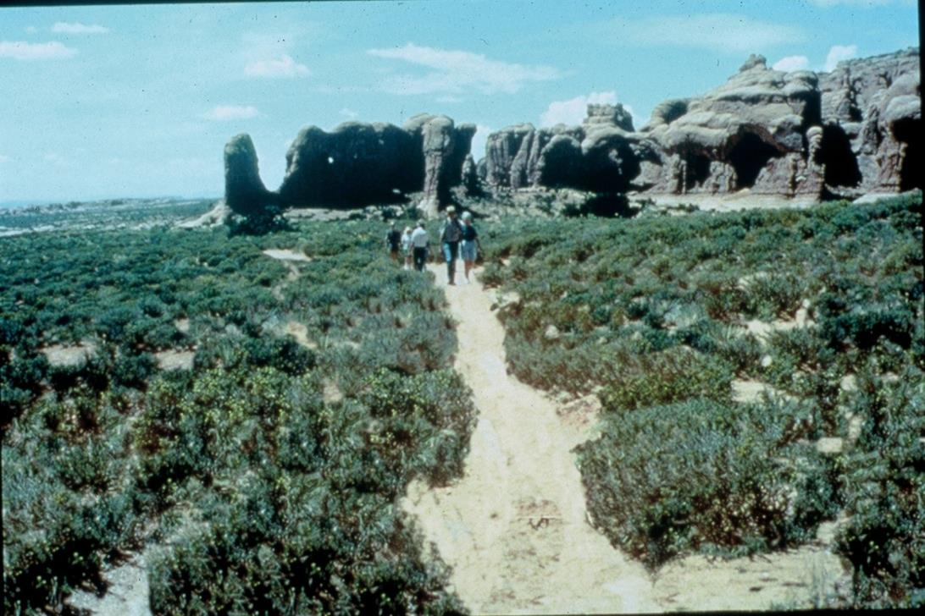

Slide 28
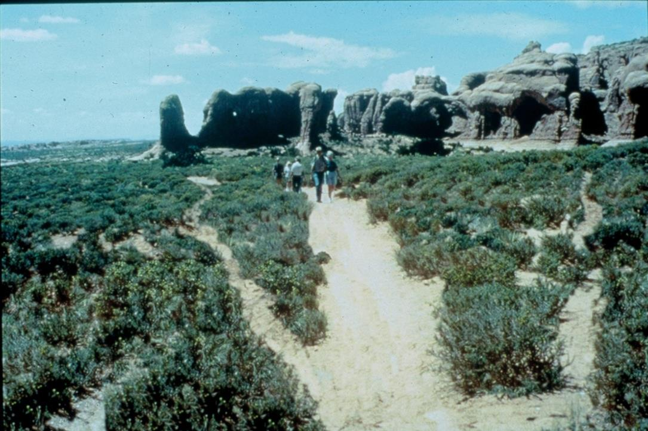

Slide 29
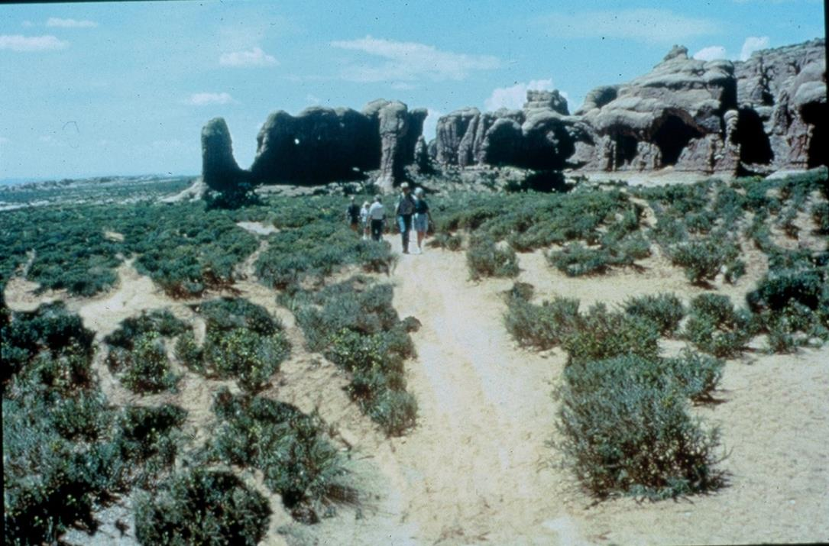

Slide 30
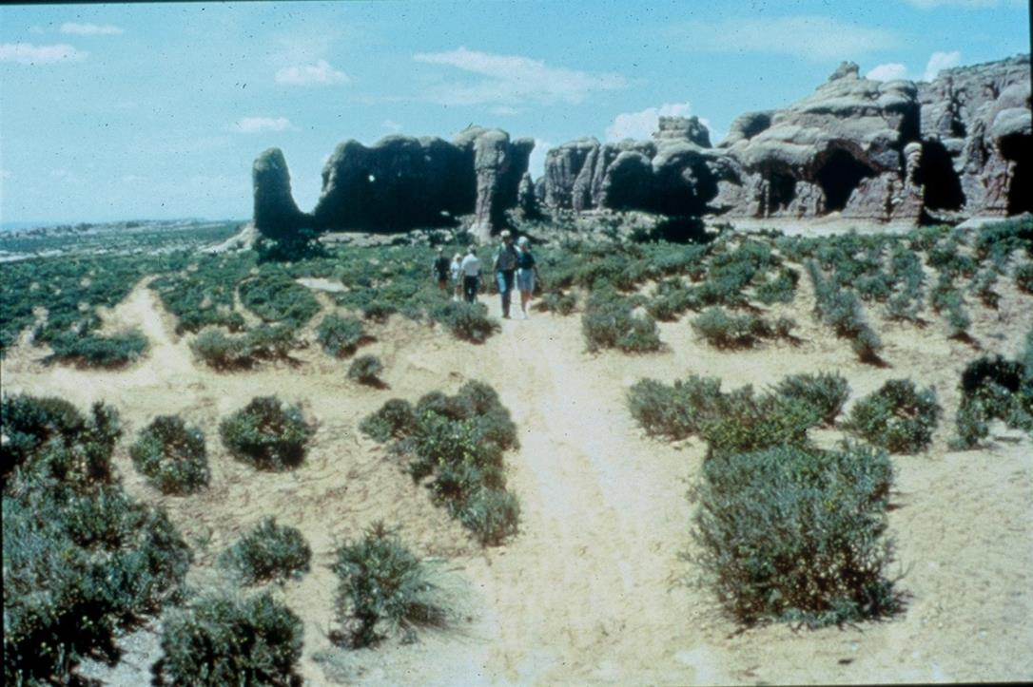

Slide 31
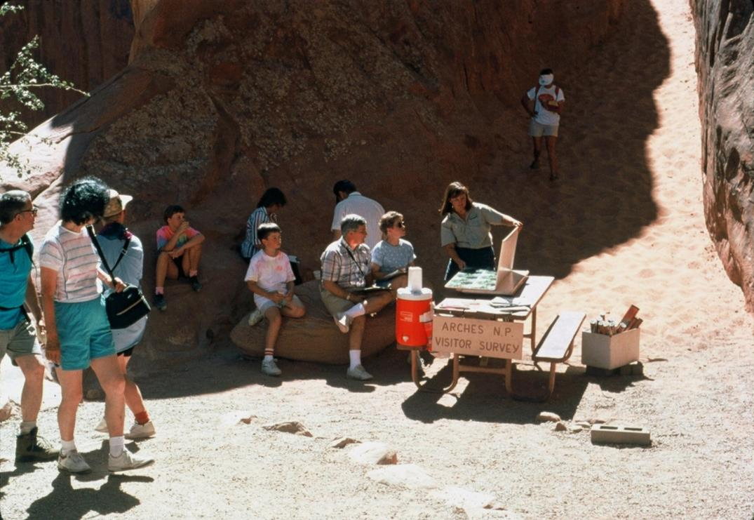

Slide 32
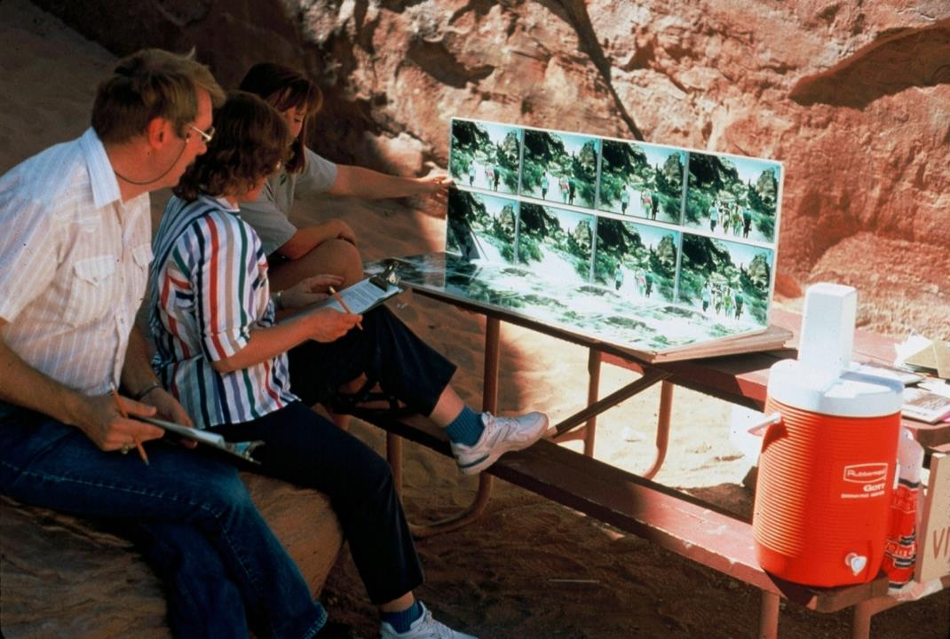

Slide 33
Optimal or Preferred Condition
4
3
2
1
Minimum Acceptable Condition
Range of Acceptable Conditions
Norm Intensity or Salience
Acceptability
0
-1
-2
Crystallization (Dispersion
around points defining the
norm curve)
-3
-4
0
2
4
6
8
10
12
14
16
18
20
Number of Groups Encountered Along A Trail Per Day

Slide 34
Social Norm Curve for Delicate Arch

Slide 35
Videos
Geology of Arches (3:33)
Arches National Park Ranger Talk (4:09)
https://www.nps.gov/arch/learn/photosmultimedia/geologyvideo.htm
https://www.youtube.com/watch?v=9nRjNuTRZoE

