Slide 1
Let There Be Light in Great Smoky Mountains National Park
Managing Outdoor Recreation: Case Studies in the National Parks, 2nd Edition

Slide 4
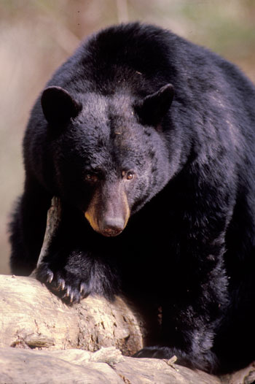
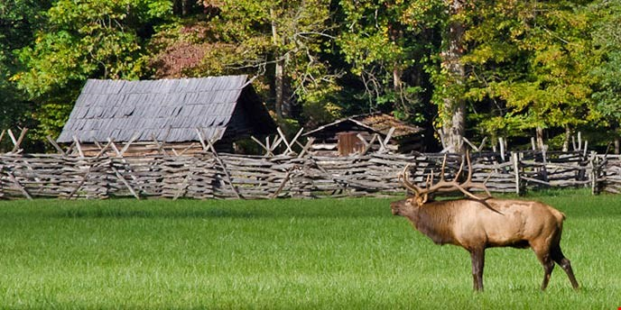
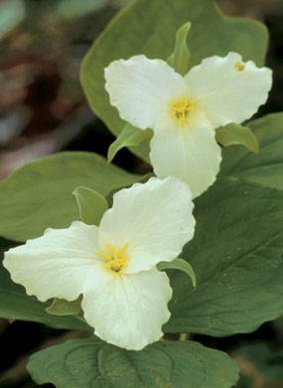

Slide 5
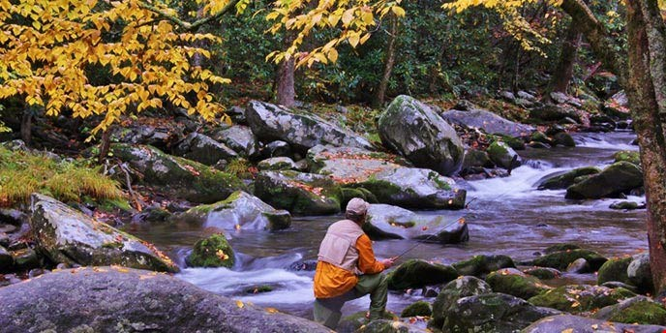

Slide 6
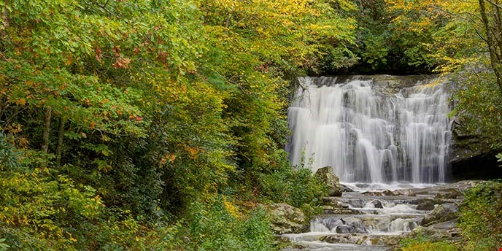

Slide 7
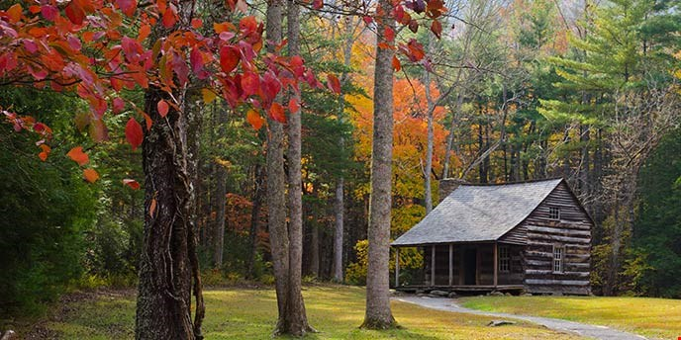

Slide 8
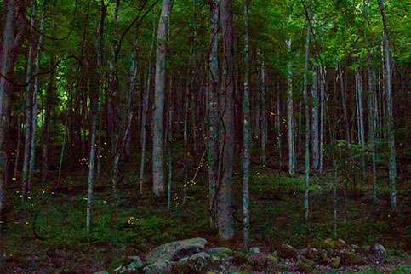

Slide 9
Horace Kephart
George Masa
John D. Rockefeller Jr.
Congress authorized the park (1926)
Great Smoky National Park (1934)
522,419 acres of park land
International Biosphere Reserve (1976)
UNESCO World Heritage Site (1983)
Well-known for its biodiversity

Slide 10

Great Smoky Mountains National Park
https://www.nps.gov/grsm/index.htm

Slide 11
More than 10 million visits in 2015
Popularity of synchronous firefly (Photinus carolinus) event (late May to early June)
Vulnerability of bioluminescence
Transportation congestion
Unauthorized parking

Slide 12
Impacts to resources: Impacts to soil, vegetation, and wildlife
Impacts to experience: Crowding
Impacts to facilities/service: Attraction sites, trails, roads/parking, interpretative facilities/programs

Slide 13
Management Strategies: Limit use and reduce impact of recreation
Management practices: Rationing/allocation; rules/regulations; facility development/site design/maintenance; information/education

Slide 14
Rules/Regulations
  Only shuttle buses are allowed to access firefly viewing area
  Cars should be parked at Sugarlands Visitor Center
  Visitors are not allowed to catch fireflies
  Visitors are required to stay on maintained trails
  Visitors are required to pack out trash

Slide 15
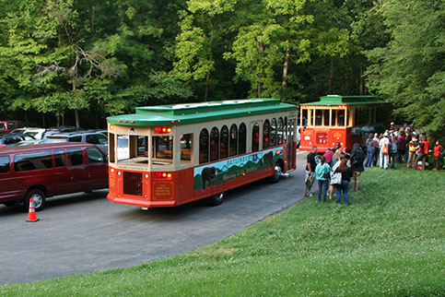
Facility Development/Site Design/Maintenance
  Shuttle bus to access firefly viewing area
  Provided in partnership with the city of Gatlinburg

Slide 16
Rationing/Allocation
  Only 225 parking passes are allowed each day
  Lottery system used to allocate parking passes
  Cost for permit is $1.50/pass, fee for shuttle is $1.00/person

Slide 17
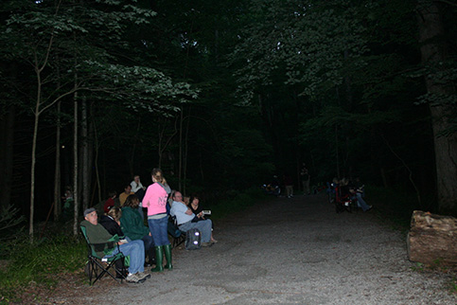
Information/Education
  Park website
  Rangers
  Viewing site
  Light show etiquette (e.g. covering flashlights, using flashlights only when walking to the viewing site, turning off flashlights after reaching the viewing site, pointing flashlights when walking)

Slide 18
Video
Day Hiking and Wildlife (6:22)
https://www.youtube.com/watch?v=qZ9GzIMGRMw&feature=youtu.be

