Slide 1
Building a Better Campsite Along the Appalachian Trail
Managing Outdoor Recreation: Case Studies in the National Parks, 2nd Edition

Slide 2
Appalachian National Scenic Trail
Envisioned in 1920s by Benton MacKaye
Completed in 1937
2,175 miles from Springer Mountain in Georgia to Mount Katahdin in Maine
Crosses through 14 states
Maintained through partnerships between public agencies and private organizations

Slide 3
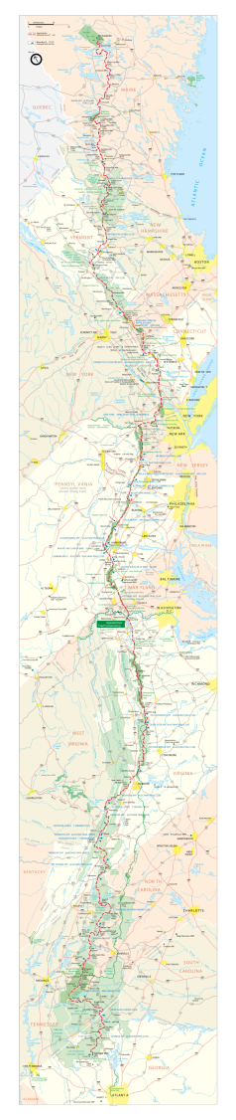

Slide 4
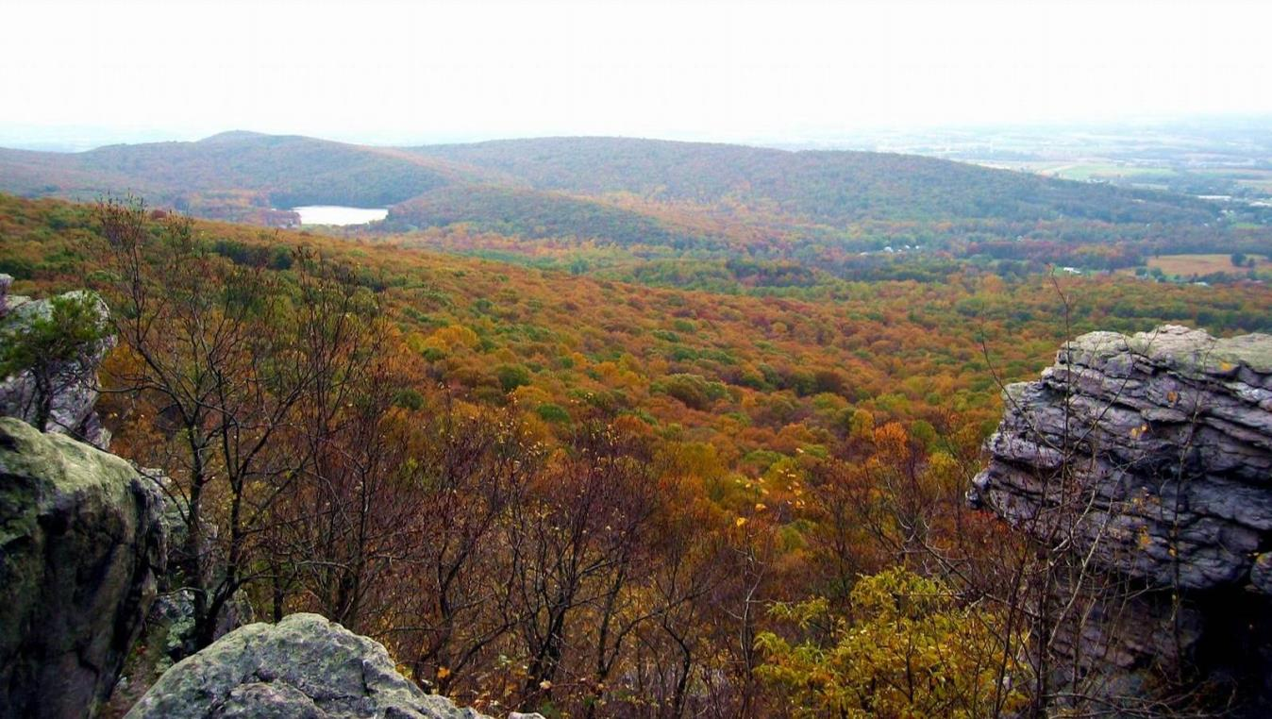
Notes:
https://www.nps.gov/media/photo/gallery.htm?id=5722133E-155D-4519-3EA5161441B51B2E

Slide 5
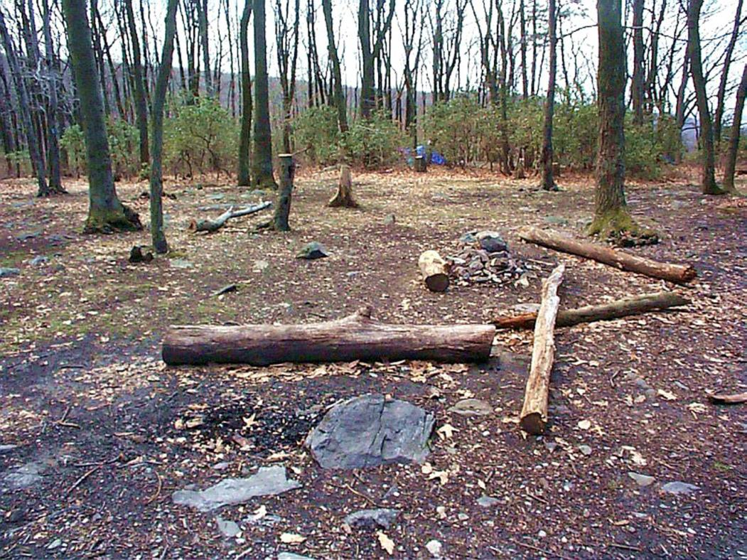
Notes:
https://www.nps.gov/media/photo/gallery.htm?id=5722133E-155D-4519-3EA5161441B51B2E

Slide 6
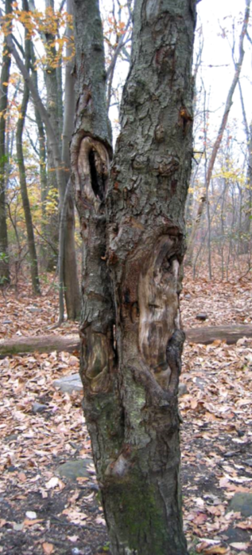
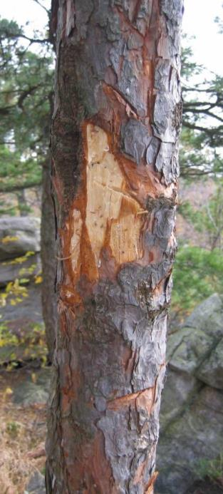
Notes:
https://www.nps.gov/media/photo/gallery.htm?id=5722133E-155D-4519-3EA5161441B51B2E

Slide 7
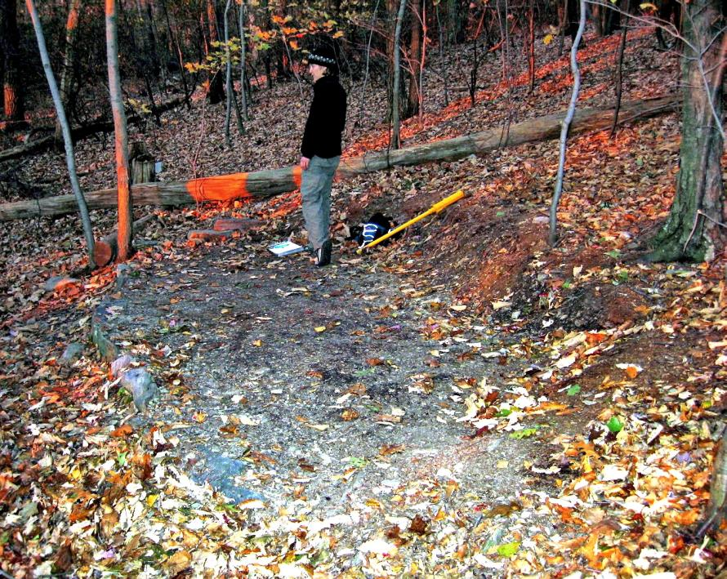

Slide 8
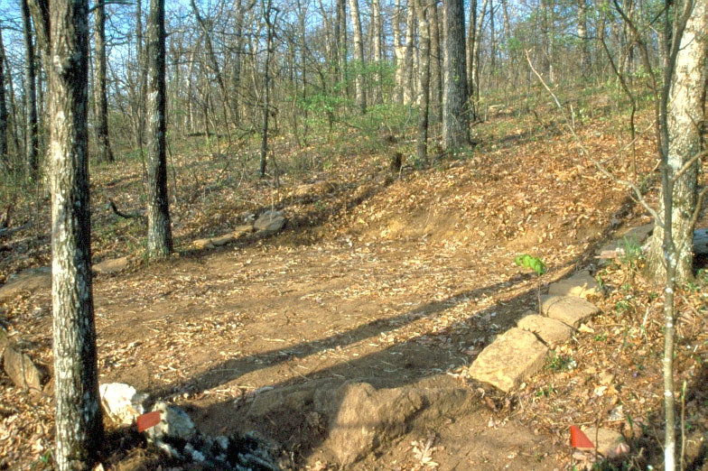

Slide 9
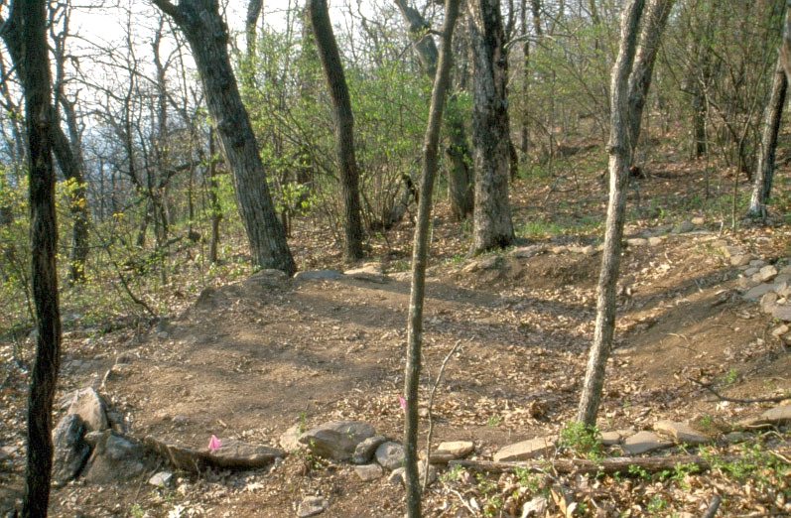

Slide 10
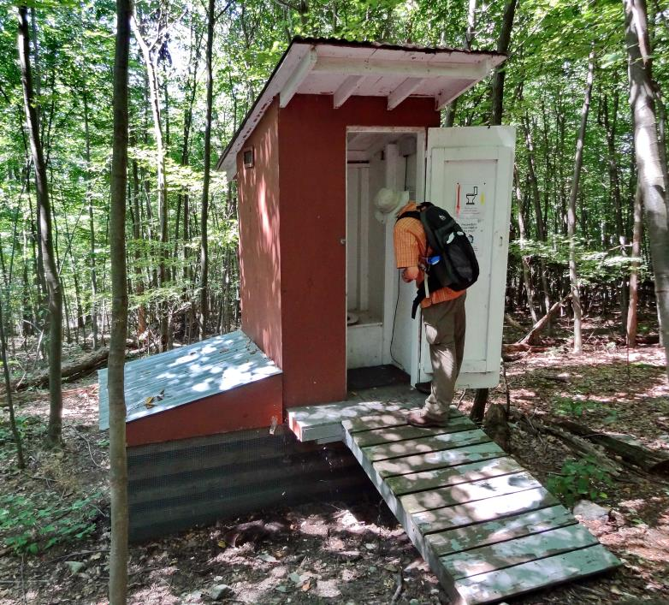

Slide 11
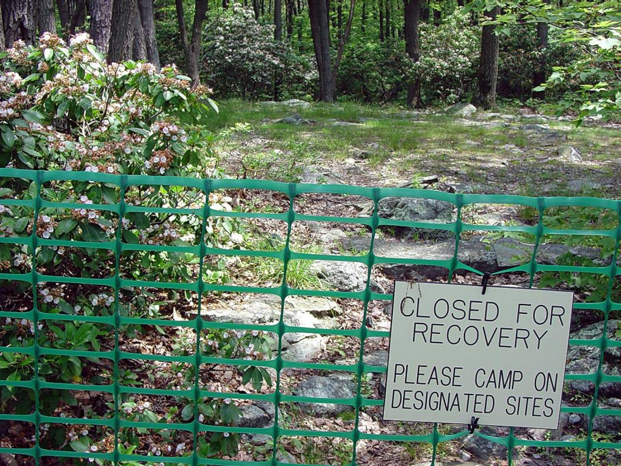

Slide 12
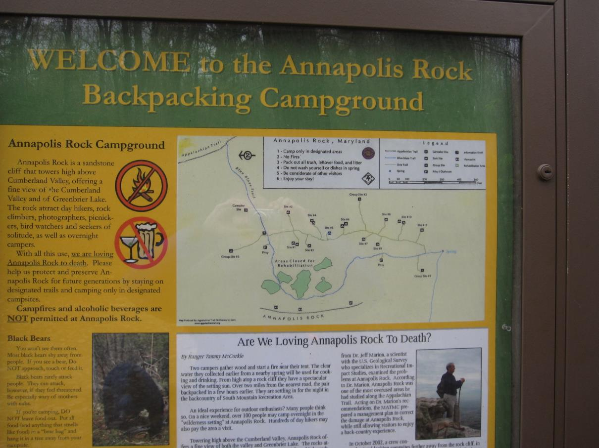
Notes:
https://www.nps.gov/media/photo/gallery.htm?id=02675736-155D-4519-3E004E99D001DA1C

Slide 13
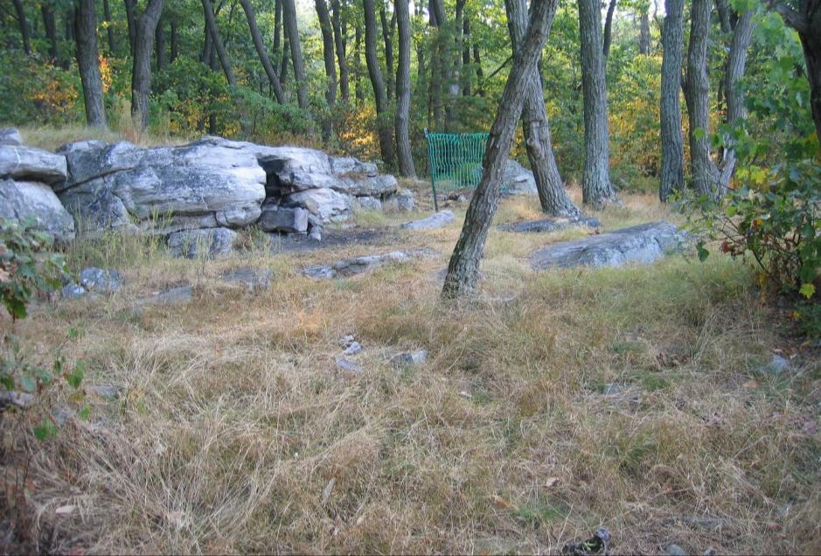
Notes:
https://www.nps.gov/media/photo/gallery.htm?id=02675736-155D-4519-3E004E99D001DA1C

Slide 14

Appalachian National Scenic Trail
https://www.nps.gov/appa/index.htm

Slide 15
Problems
Impacts to resources: Soil, vegetation
Impacts to experience: Crowding, conflict, depreciative behavior
Impacts to facilities/services: Campsites

Slide 16
Strategies and Practices
Management strategies: Harden the resource, limit use, reduce impact of use
Management practices: Facility development/site design/maintenance, rationing/allocation, rules/regulations, information/education

Slide 17
Facility Development/Site Design/Maintenance
Annapolis Rocks once called “the worst campground along the AT”
“Side-hill” campsite construction use to prevent spread of vegetation and soil disturbance
Two self-composting toilets installed

Slide 18
Rationing /Allocation and Rules/Regulations
Group size limits of ten people
Total number of campers per night capped at 75
Alcohol and campfires prohibited

Slide 19
Information/Education
Old camping area closed for rehabilitation was fenced and signs reminded visitors of closure
New rules and regulations were posted by a map of the camping area at two kiosks
Two ridge runners were hired to supervise the campsite and surrounding area during peak visitation season

Slide 20
Website
Leave No Trace
https://lnt.org/

