Slide 1
Treading Lightly on Acadia
Managing Outdoor Recreation: Case Studies in the National Parks, 2nd Edition

Slide 2
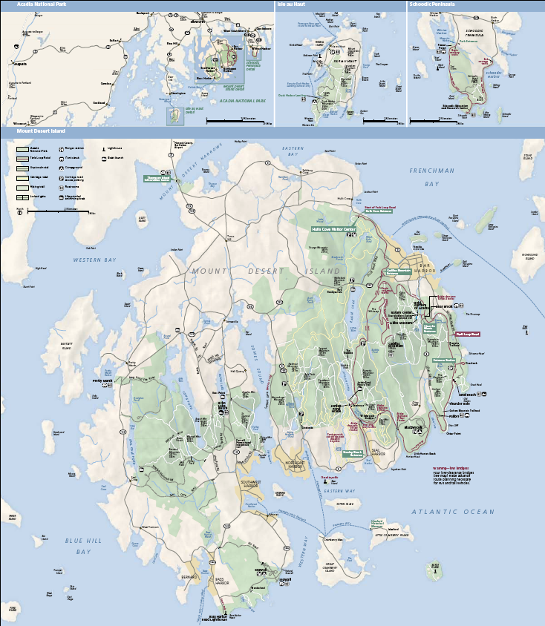

Slide 3
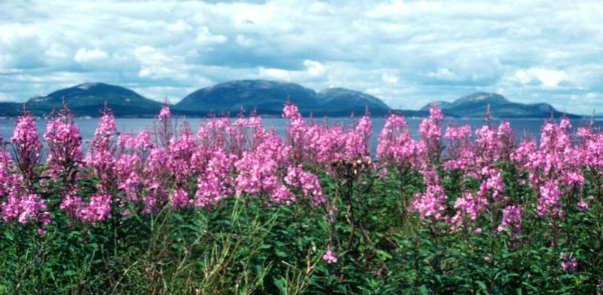

Slide 4
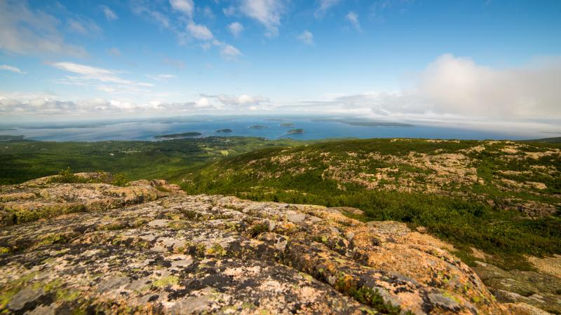

Slide 5
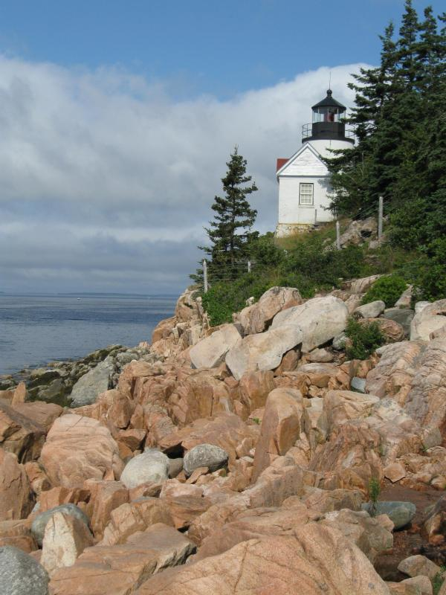

Slide 6
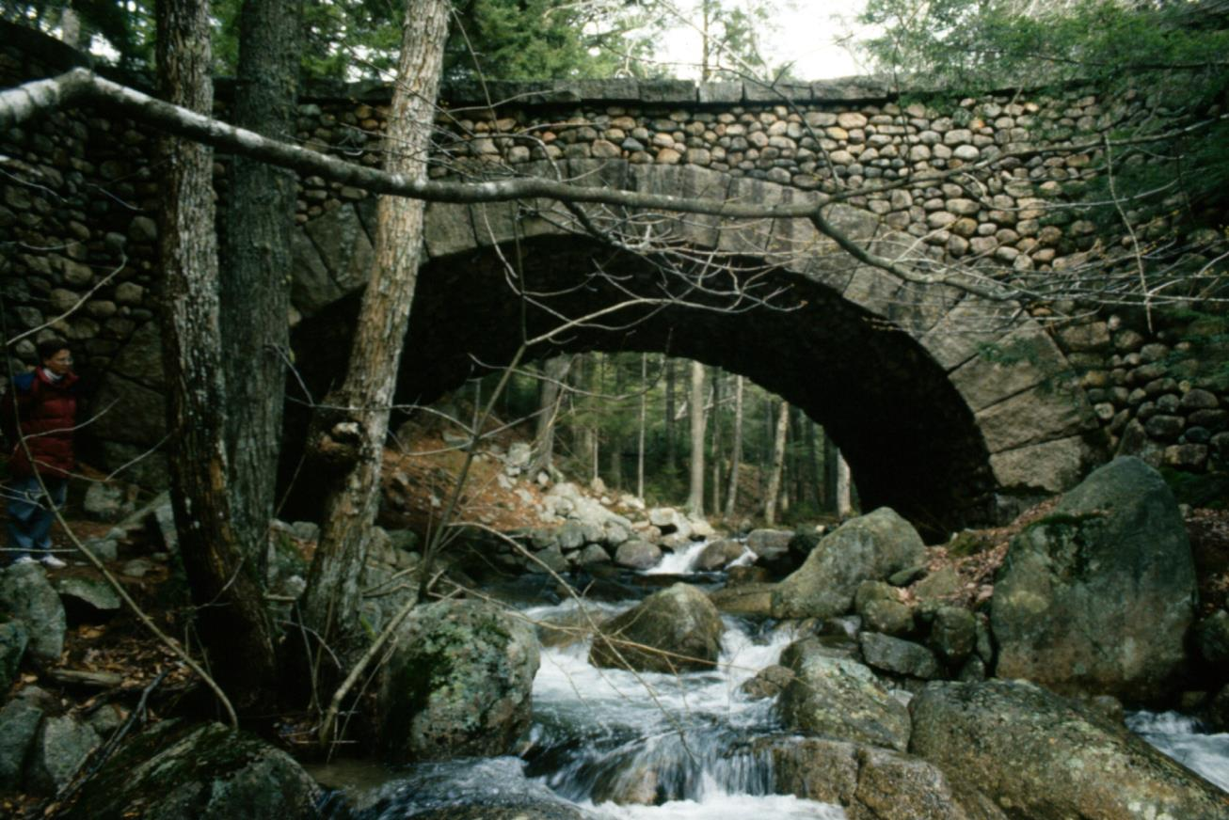

Slide 7
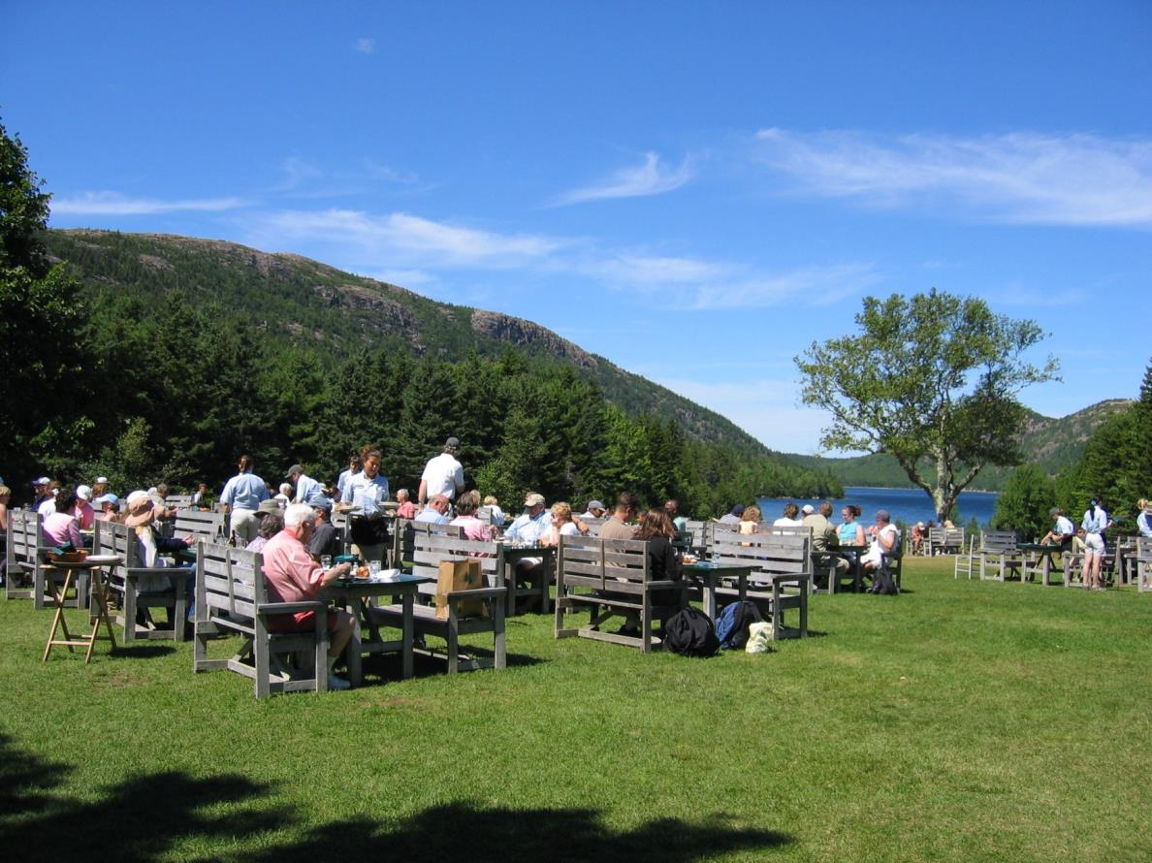

Slide 8
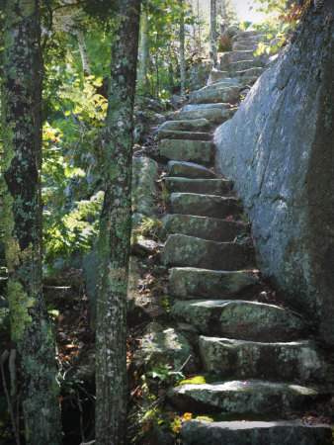
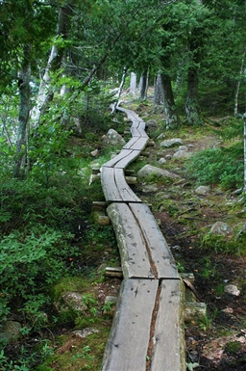
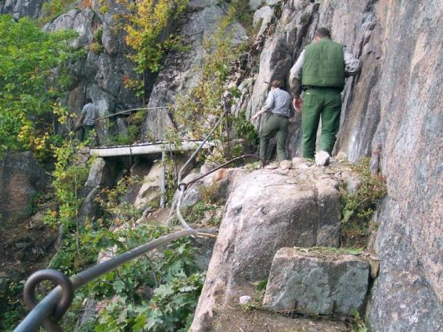

Slide 9
Sieur de Monts National Monument (1916)
Acadia National Park (1929)
47,000 acres of park land
140 miles of trails
50 miles of Carriage Road
2.8 million annual visits (2015)

Slide 10
Acadia National Park
https://www.nps.gov/acad/index.htm

Slide 11
Maybe the most intensively used national park
Thousands of hikers each day
As many as 5,000 visitors to the summit of Cadillac Mountain each day
Soil compaction and erosion
Trampling of vegetation
Altering/building cairns
Walking off trails
Unleashed dogs

Slide 12
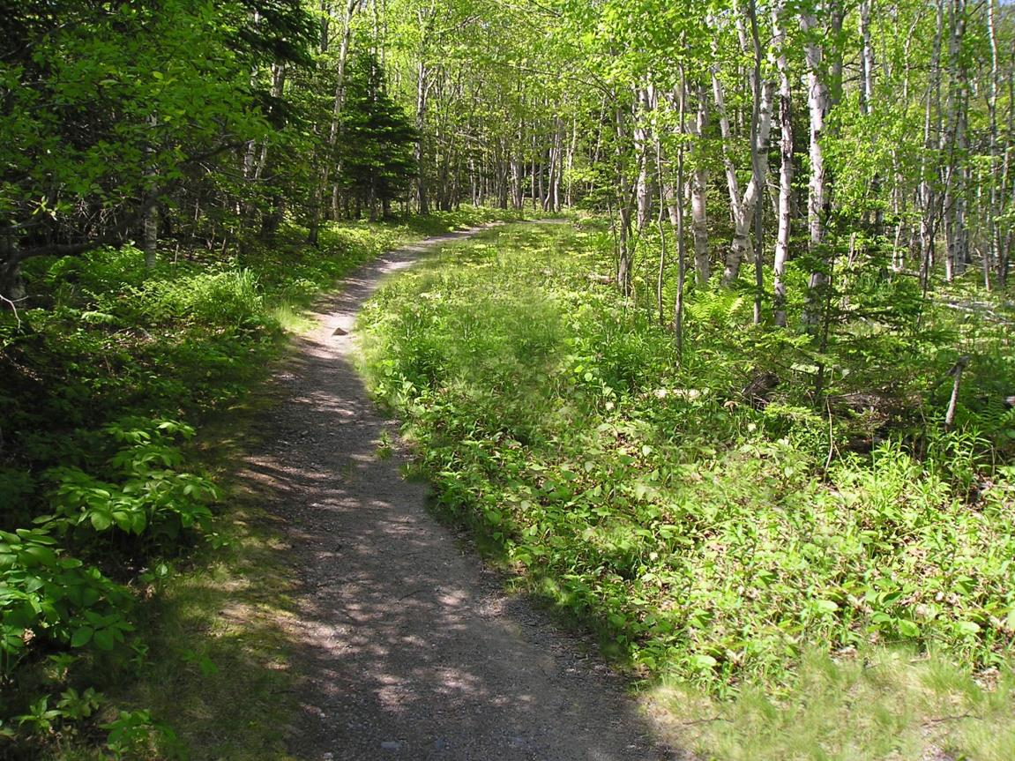

Slide 13
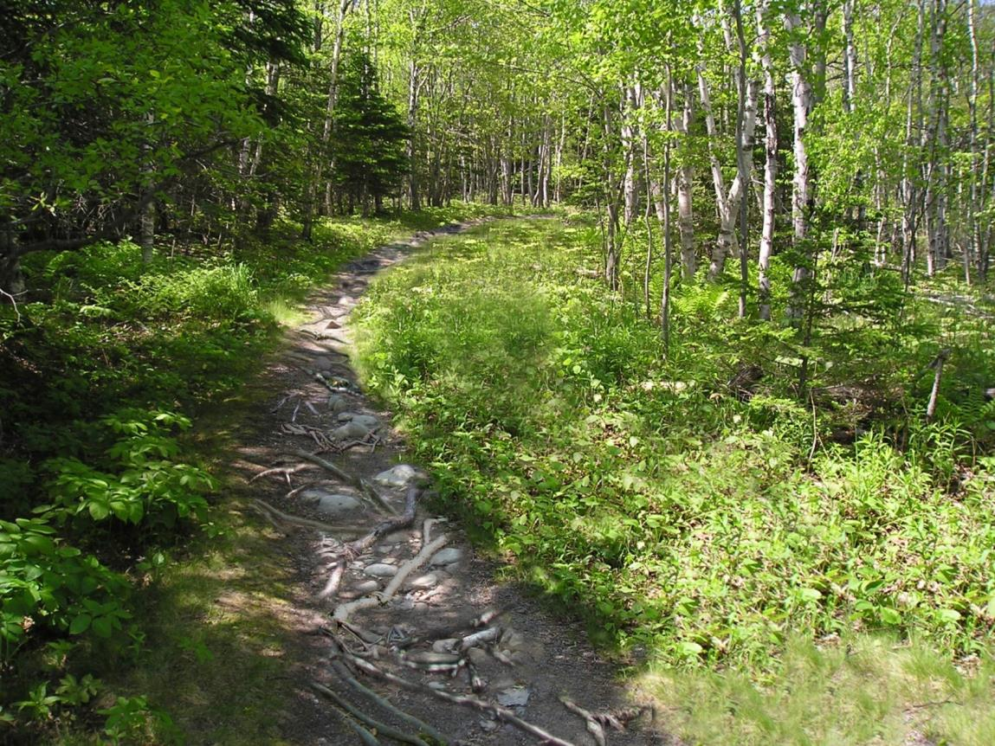

Slide 14
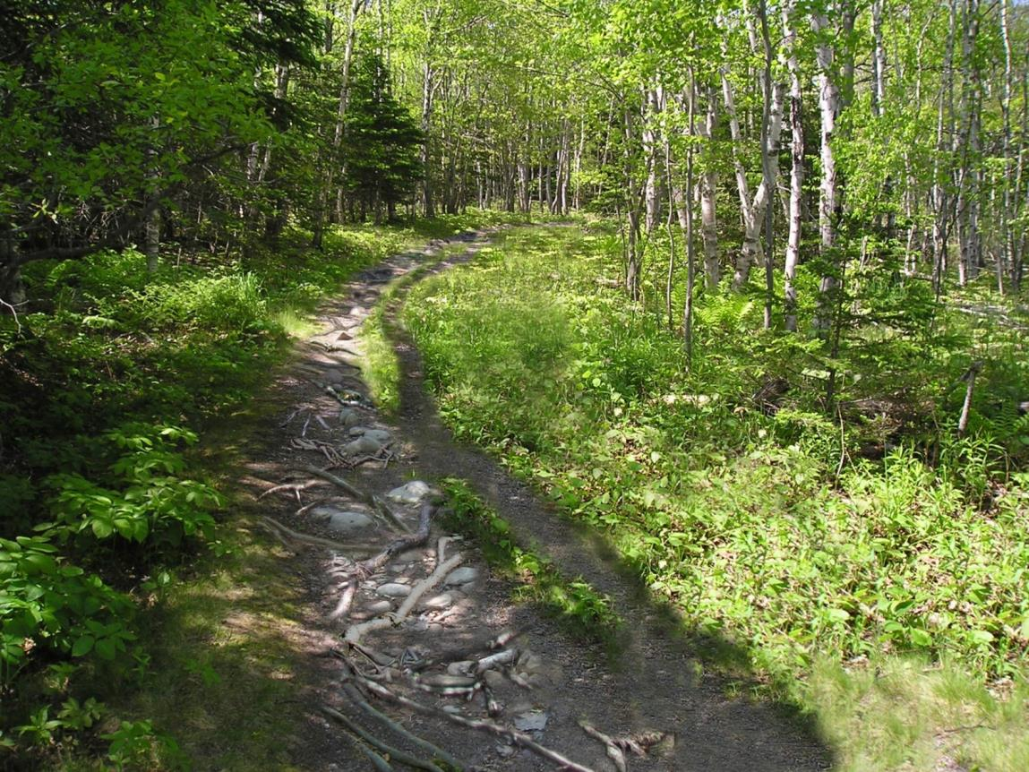

Slide 15
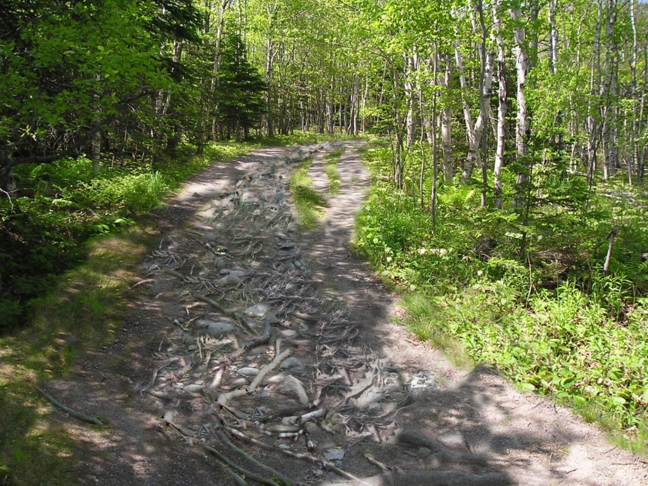

Slide 16
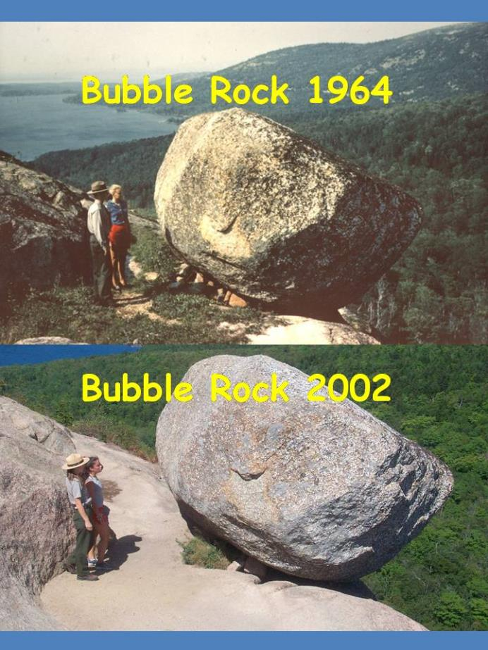

Slide 17
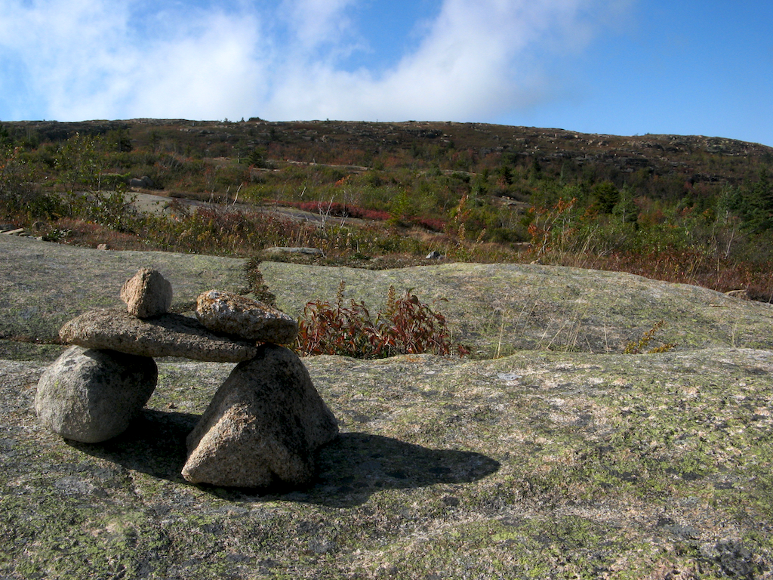
Bates Cairn

Slide 18
Impacts to resources: Impacts to soil, vegetation, rocks, wildlife
Impacts to experience: Crowding; depreciative behavior
Impacts to facilities/service: Trails, cairns, attraction sites

Slide 19
Management strategy: Reduce the impact of recreation
Practice: Information/education; facility development/site design/maintenance

Slide 20
Information/Education
Partners: Leave No Trace; Friends of Acadia
Ridge runners: educating hikers in “Leave No Trace” principles
Signs and videos

Slide 21
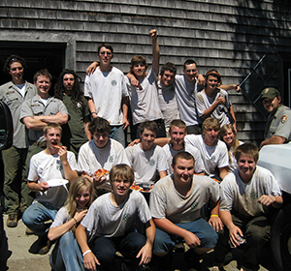
Facility Development/Site Design/Maintenance
Partners: Friends of Acadia, Acadia Youth Conservation Corps (AYCC)
Maintain trails, cairns, campgrounds and attraction sites

Slide 23
Acadia Pet Policy
https://www.nps.gov/acad/planyourvisit/pets.htm

Slide 24
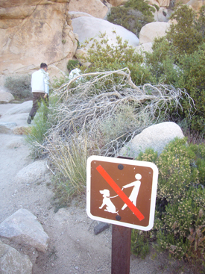

Slide 25
Leave No Trace
http://www.lnt.org/

Slide 26
NPS Leave No Trace video
http://www.nps.gov/features/wilderness/leavenotrace/popup.html

Slide 27
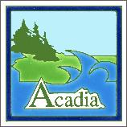
Acadia Leave No Trace video
https://www.youtube.com/watch?v=8x0xnKb55Ek

Slide 28
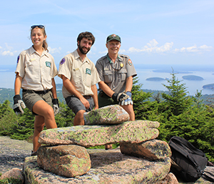
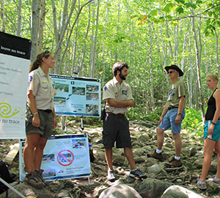

Slide 29
