Slide 1

CABI TOURISM TEXTS
4th Edition
Leisure, Sport and
Tourism, Politics,
Policy and Planning
A. J. Veal
COMPLEMENTARY TEACHING MATERIALS

Slide 2

CHAPTER 12
Leisure, Sport and Tourism, Politics, Policy and Planning, 4th Edition
Planning Tool 3: Facility/Service Audit – Facility Use and Its Measurement
Leisure, Sport and Tourism, Politics, Policy and Planning, 4th edition, Veal, 2017, CABI Tourism Texts

Slide 3
Outline
Introduction
Data collection methods
Tourists
User characteristics
Putting capacity and use together
Greenfield sites
Natural and heritage resource assessment
Programmes and events
Leisure, Sport and Tourism, Politics, Policy and Planning, 4th edition, Veal, 2017, CABI Tourism Texts

Slide 4
Facility use and its measurement
Methods:
  Administrative
  Interview surveys
  On-site visitor counts
  Visual/manual counts
Leisure, Sport and Tourism, Politics, Policy and Planning, 4th edition, Veal, 2017, CABI Tourism Texts

Slide 5
a) Administrative
Method | Data available | Additional data | Visits per week (N)
1. Individual ticket sales | Ticket sales/wk (T) | - | N=T
2. Bookings data | Facility bookings/wk (B) | Group size (by observation) (G) | N= BxG
3. Season ticket/annual pass sales | Annual season ticket sales (T) | No. of trips per week per ticket (by survey) (S) | N = T x S/ 52
4. Membership records/ surveys | a. If members visits auto-matically recorded: weekly average (Vm) b. If not: weekly avge visits from member survey (Vm) | No. of members (M) | N = Mx(Vm)
5. Parking ticket sales data | Parking ticket sales/week (P) | Vehicle occupancy (by sample observ-ation) (O) | N=PxO
Leisure, Sport and Tourism, Politics, Policy and Planning, 4th edition, Veal, 2017, CABI Tourism Texts

Slide 6
b) Interview surveys
Method | Data available | Additional data | Visits per week (N)
Resident interview survey | % visiting facility (Vr) Average frequency/wk (Fr) | Population (from census) (P) | Nr = (Vr x Fr x P)/100
7. Tourist survey | % visiting facility (Vt) No. of visits during stay (Ft) | No. of tourists (from tourism body or local research) (T) | Nt = (Vt x Ft x P)/100
8. On-site visitor interview survey | % of commuters, neighbours (C)* | - | Nc = C x Nr
Total visits |  |  | N = Nr + Nt + Nc
* i.e. not residents and not tourists
Leisure, Sport and Tourism, Politics, Policy and Planning, 4th edition, Veal, 2017, CABI Tourism Texts

Slide 7
c) On-site visitor counts
Method | Data available | Additional data | Visits per week (N)
Automatic counts
9. Automatic vehicle counters | No. of vehicles/wk (A) | Vehicle occupancy (by sample obser- vations) (O) | Nv= A x O
10. Automatic pedestrian counters | No. of persons/wk (Vp) | - | Np= Vp
11. Video/time-lapse cameras/aerial photography | No. of persons/vehicles/ craft present: sampled times, gives person-vehicle/craft- hours (Y) | For vehicles/craft: occupancy (O) For all: av’ge length of stay (by survey) (L) | N=(O x Y)/L
Visual/manual counts
12. Entrance or exit flows | No. of visitors/wk (N) | - | N
13. Spot counts of numbers present | No. of persons present: sampled times, gives person-hours (Y) | Average length of stay (L) | N=Y/L

Slide 8
Counting tourist numbers (Table 12.5)
Data that can be collected about tourists (in addition to head counts) include:
  Origin
  Socio-demographic information
  Purpose of visit
  Destination
  Length of stay
Leisure, Sport and Tourism, Politics, Policy and Planning, 4th edition, Veal, 2017, CABI Tourism Texts

Slide 9
Counting tourist numbers (Table 12.5)
Method | Visitors covered
Administrative
Ports of entry: short-term arrival/departure | All international
Public transport data | All (arriving by public transport)
Interview/questionnaire-based surveys
Road cordon survey: interview | All arriving via major road
Road cordon survey + mail return questionnaire | As above
International visitors survey (at airports/ports) | Sample of visitors departing by air/sea
Domestic tourism survey | Sample of residents/domestic tourists
On-site tourist survey | All/sample of visitors to site
Accommodation survey | Tourists staying in commercial accommodation
Direct counts
Road cordon survey: automatic (registration nos) | All arriving via major road
Leisure, Sport and Tourism, Politics, Policy and Planning, 4th edition, Veal, 2017, CABI Tourism Texts

Slide 10
F. Putting capacity and use together
This is done in the Supply Module of U-Plan (Ch. 9)
Leisure, Sport and Tourism, Politics, Policy and Planning, 4th edition, Veal, 2017, CABI Tourism Texts

Slide 11
G. Spatial dimensions
The catchment area idea
Measuring catchment areas
Visit rates
Social groups
Catchment areas in a rural residential areas
Catchment areas and countryside recreation
Modelling
Hierarchies of facilities
Priority social area analysis
Leisure, Sport and Tourism, Politics, Policy and Planning, 4th edition, Veal, 2017, CABI Tourism Texts

Slide 12
The catchment area idea
Facility catchment (or ‘market’) area:
  the area from which the majority of visitors travel to use a facility – e.g. 75%
Leisure, Sport and Tourism, Politics, Policy and Planning, 4th edition, Veal, 2017, CABI Tourism Texts

Slide 13
Facility catchment areas (Fig. 12.1)
N.B. Catchment area will not always be circular: affected by transport routes, population density, etc.
Leisure, Sport and Tourism, Politics, Policy and Planning, 4th edition, Veal, 2017, CABI Tourism Texts

Slide 14
Catchment area size affects required provision level (Fig. 12.2)
Halving the radius increased the no. of facilities required four-fold
Leisure, Sport and Tourism, Politics, Policy and Planning, 4th edition, Veal, 2017, CABI Tourism Texts

Slide 15
Measuring catchment areas
The idea of visit rate = visits per 1000 of population
See examples from:
  Harlow Leisure Centre, Essex, UK (Fig. 10.8) – in map form
  Centennial Park, Sydney, Australia (Fig. 10.9) – in graph form
Leisure, Sport and Tourism, Politics, Policy and Planning, 4th edition, Veal, 2017, CABI Tourism Texts

Slide 16
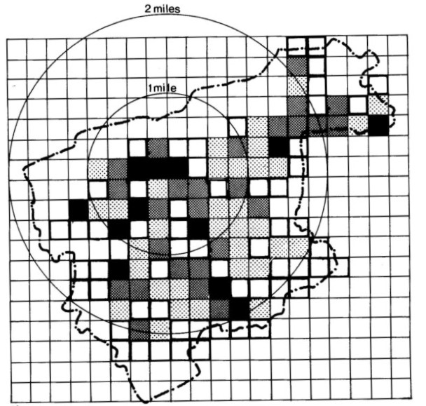
Leisure centre visit rates
(Fig. 12.3)
Visits per week per 1000 of population
51 and over
26–50
11–25
0.1–10
Council boundary
Leisure centre
Source: Harlow Leisure Centre survey (BERG, 1973)
Leisure, Sport and Tourism, Politics, Policy and Planning, 4th edition, Veal, 2017, CABI Tourism Texts

Slide 17
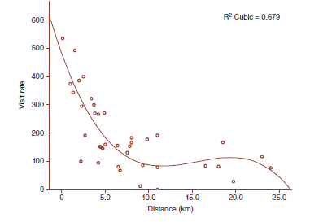
Declining visit rates with distance: Centennial Park, Sydney (Fig. 12.4)
Leisure, Sport and Tourism, Politics, Policy and Planning, 4th edition, Veal, 2017, CABI Tourism Texts

Slide 18
An example of catchment area planning
(Box 12.2)
Three existing swimming pools (based on real data)
V = number of visits per week
P = population levels
VR = visit rates (V/P)
Leisure, Sport and Tourism, Politics, Policy and Planning, 4th edition, Veal, 2017, CABI Tourism Texts

Slide 19
Fig. 12.5
V= 800 P=23,200
VR= 34
V= 550
P= 33,000
VR= 17
V= 400
P= 32,000 VR= 37
V= 1150
P= 31,500 VR=37
V= 1200
P= 13,300
VR= 91
V= 1100
P= 8,000
VR= 135
V= 1150
P= 26,500
VR=43
V= 600
P= 39,000
VR= 15
V= 1300
P= 7,500
VR= 174
1 Mile
Facility
Local council boundary

Slide 20
Fig. 12.6
V= 800
V= 1300
V= 1200
V= 1200
V= 1100
V= 400
V= 1150
V= 350
V= 1125
V= 200
V= 1275
V= 500
New facility
1 Mile
Facility
Local council boundary

Slide 21
Other spatial topics
Catchment areas and countryside recreation
  principles still apply but population distributed in villages/towns/cities (see Figure 1.3)
Modelling
  relationships/prediction can be mathematically modelled (see Ch. 13)
Hierarchies of facilities
  e.g. Greater London Council (GLC) parks hierarchy
Leisure, Sport and Tourism, Politics, Policy and Planning, 4th edition, Veal, 2017, CABI Tourism Texts

Slide 22
GLC parks hierarchy
Park type | Max. distance from residence (mls) | Size (approx. minimum, ha) | Main function
Metropolitan | 2.0 | 61 | Weekend and occasional visits by car or public transport
District | 0.75 | 20 | Weekend and occasional visits – mainly pedestrian
Local | 0.25 | 2 | Short-duration pedestrian visits (including from workplace)
Small local | <0.25 | <2 | Shorter pedestrian visits by less mobile groups and workers
Leisure, Sport and Tourism, Politics, Policy and Planning, 4th edition, Veal, 2017, CABI Tourism Texts

Slide 23
Priority social area analysis
Census-based data used to classify residential areas
e.g. ACORN system (A Classification Of Residential Neighbourhoods) (CACI Ltd consultancy company – www.CACI.co.uk)
Used in marketing (segmentation) but can also be used to determine priority areas for public provision (see DCMS ‘Taking Part’ survey)
Leisure, Sport and Tourism, Politics, Policy and Planning, 4th edition, Veal, 2017, CABI Tourism Texts

Slide 24
ACORN system
ACORN category | Groups | UK pop’n (%)
Wealthy achievers | A. wealthy executives B. affluent greys (older people) C. flourishing (well-off) families | 8.6 7.9 9.0
Urban prosperity | D. prosperous professionals E. educated urbanites (young urban professionals) F. aspiring singles (mainly urban students) | 2.1 5.5 3.8
Comfortably off | G. starting out (young couples) H. secure families I. settled suburbia (older suburban couples) J. prudent pensioners | 3.1 15.5 6.1 2.7
Moderate means | K. Asian communities L. post-industrial families (older-skilled) M. blue-collar roots (manual workers) | 1.5 4.7 7.5
Hard-pressed | N. struggling (low-income) families, O. burdened singles (elderly + single parents) P. high-rise hardship Q. inner city adversity | 13.3 4.2 1.6 2.1

Slide 25
H. Greenfield sites
Greenfield sites: areas with no existing population
Discussed in general terms in Chapter 9
Leisure, Sport and Tourism, Politics, Policy and Planning, 4th edition, Veal, 2017, CABI Tourism Texts

Slide 26
I. Natural and heritage resource assessment
Situations:
environmental impact assessment: seeking development approval: environmental conservation is often a constraint on development
site appraisal: as above, but individual site
tourism/cultural planning: environmental/heritage resources may be a constraint but also an opportunity – may be the whole basis for leisure/tourism (e.g. lakes, mountains, historic buildings)
Leisure, Sport and Tourism, Politics, Policy and Planning, 4th edition, Veal, 2017, CABI Tourism Texts

Slide 27
J. Programmes and events
Most take place in facilities, so may be included in facility audit, but:
May need to be treated separately when:
  taking place in multiple facilities
  taking place in non-formal facilities – e.g. street-based carnivals
Leisure, Sport and Tourism, Politics, Policy and Planning, 4th edition, Veal, 2017, CABI Tourism Texts

