Slide 2
Chapter 9
Passenger Lines and Ferries

Slide 3
Passenger Lines and Ferries
liner: vessel advertising sailings on a specified trade route on a regular basis. It is not necessary that every named port be called on every voyage (US Department of Transportation, 2008).
ferry: ship designed with one or more decks specifically for the carriage of passengers, and where there is either no cabin accommodation for the passengers (un-berthed) or not all of the passengers are accommodated in cabins where cabins are provided (Glossary of Transport Statistics, 2009).
  passenger ferries
  ro-pax: vessels built for freight vehicle transport along with passenger accommodation
  fast ferries: catamaran, monohull, hydrofoil
  cable ferries

Slide 4
Institutional Framework
same regulation framework as cruises in North America and Canada
Europe: Regulation EU No. 1177/2010
prevent refusal of boarding and to offer free assistance to disabled persons
give rights to passengers in case of cancellation or delay
  - significant delays: compensation of 25%, 50% for long delays
  - overnight stay due to delay: ferry operator pays for hotel and meals
  - cancellation: right to be re-routed at no extra cost, or full refund

Slide 5
Demand
Hierarchy of Ferry Demands
Source: Adapted from Wergeland, 2012

Slide 6
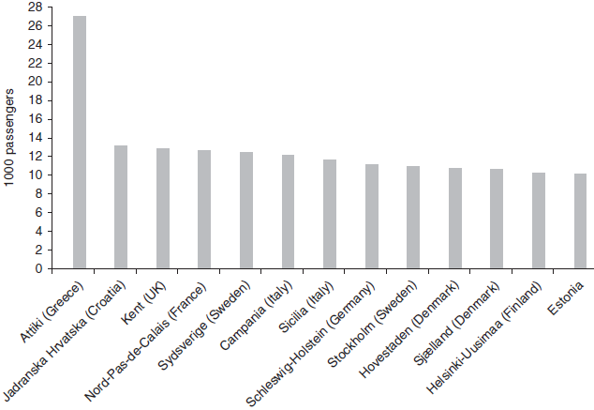
Demand
Number of passengers transported in Europe in 2011
overall decline in passenger transport numbers in the past years
growth in Italy, Denmark, Finland and the Netherlands
Source: Adapted from Eurostat, 2013c

Slide 7
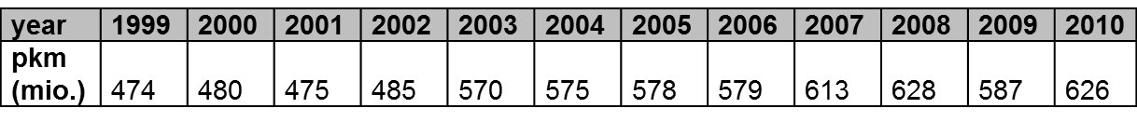
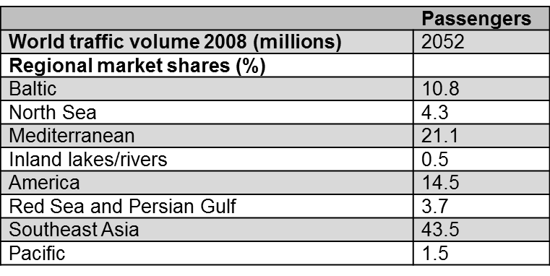
Demand
US ferry passenger kilometres
increase of 32.5% in the last 10 years
2008: 82 million passengers
Distribution of world ferry traffic in 2008
Source: Adapted from ShipPax, 2009

Slide 8
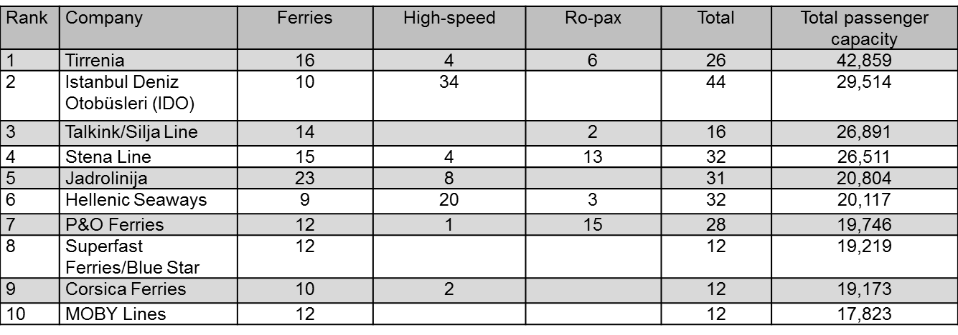
Supply
Ranking of European ferry operators by passenger capacity in 2008
Source: Adapted from ShipPax, 2008

Slide 9
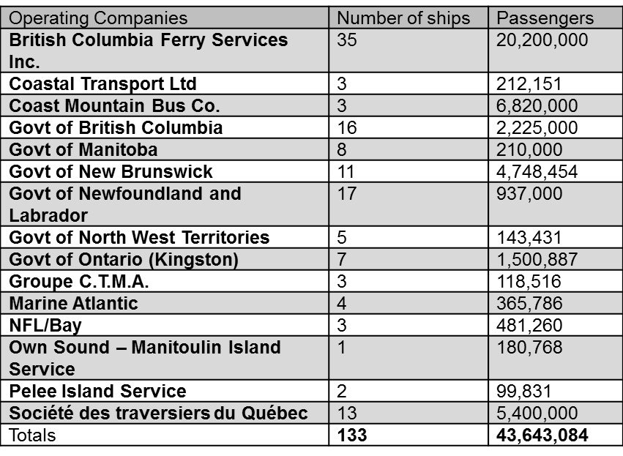
Supply
US: - largest operator Washington State Ferries (26 vessels and a passenger capacity of 36.110)
- second largest operator NY Waterways (16 fast ferries and a passenger capacity of 2.631)
Operating companies in Canada in 2011/2012
Source: Adapted from CFOA, 2012b

