Slide 2
Chapter 2
Airplanes

Slide 3
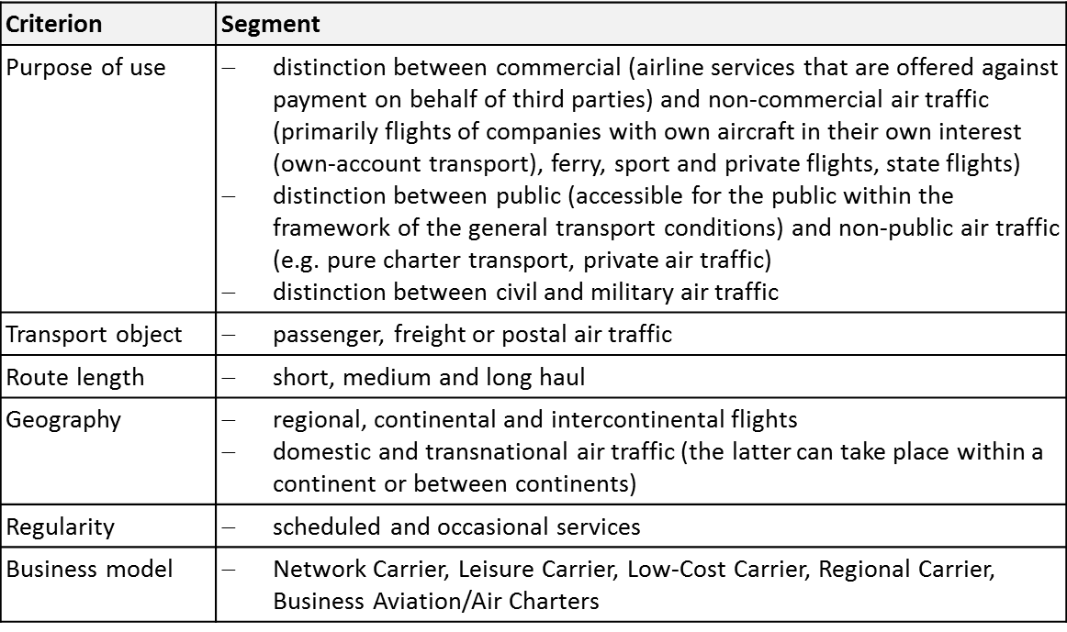
Selected Criterions of Air Traffic Classification
Source: Adapted from Conrady, Fichert & Sterzenbach, 2013

Slide 4
Business Models
Network Carriers: fundamental type of an airline business model
aspects: global player, fleet, hub-and-spoke network, target group, product/ service offer, multi-channel distribution, frequent flyer programme, yield management
Leisure Carriers: founded specifically for the holiday air traffic and the package holiday business
Low-Cost Carriers: no single business model
typical aspects: strategic flight planning, fleet, service concept, human resource management, administration, simple branding, simple pricing system, little competition, ancillary services & revenues
Regional Carriers:
conduct scheduled flights in a point-to-point system between peripheral locations with low traffic density
provide feeder flights between peripheral locations with low traffic density and the hubs of the Network Carriers
Business Avi­ation: any use of an aircraft by a corporation, a company, or another organization for the pur­pose of transporting its em­ployees and/or property not for compensation or hire and employ­ing professional pilots for the op­eration of their aircraft
Air Taxi: single seats are sold for flights that are operated according to the client needs

Slide 5
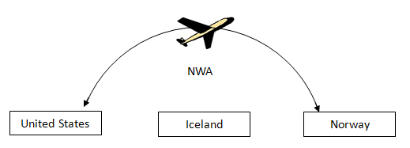
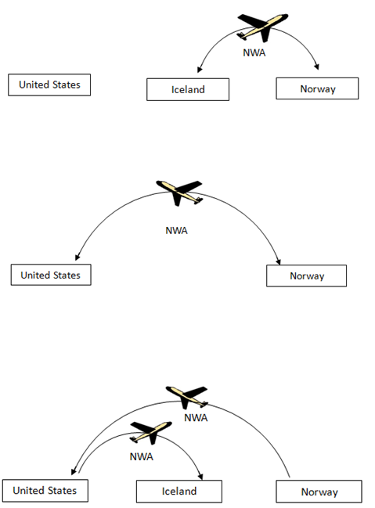
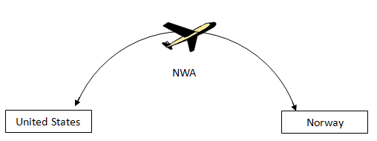
Institutional Framework
Nine Freedoms of the Air

Slide 6
Institutional Framework
Multi- & bilateral Agreements
Open-Skies-Agreement: e.g. between the US and Europe
airlines can fly from any point in the EU to any point in the US
before the agreement: only possible from the respective homelands
bilateral agreements:
contracting states grant each other certain air traffic rights, mostly the 3rd to 5th freedom of the air
more than 4,900 agreements
the following questions must principally be re­solved:
Which airlines are allowed to carry out air traffic between the two states?
Which airports are allowed to be approached in international traffic?
How often are the individual routes allowed to be operated and which capacities are allowed to be offered in international traffic?
Which tariffs are allowed to be applied in international traffic?

Slide 7
Worldwide Demand in 2011
Source: DLR, 2012

Slide 8
Demand
Development of the Passenger Volumes in the EU27
Source: Adapted from DLR, 2012

Slide 9
Demand
Top 10 Domestic Air Transport Markets in 2011, measured in source-destination pas­sengers (million)
Source: Adapted from DLR, 2012

Slide 10
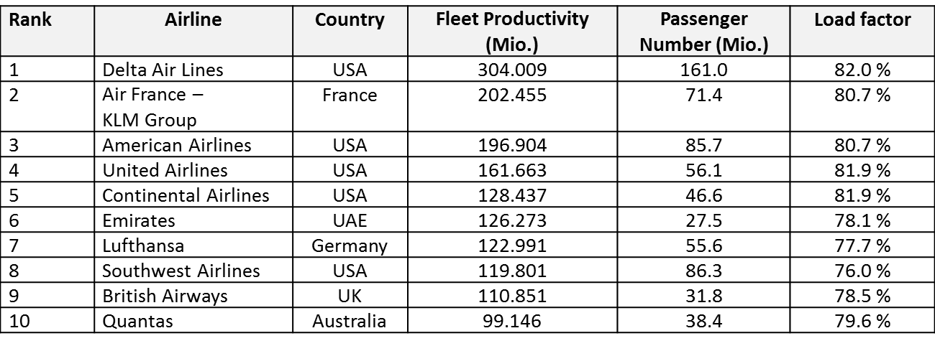
Supply
The 10 Largest Airlines Worldwide
Source: Airline Business, 2010

