Slide 1


CABI TOURISM TEXTS
2nd Edition
Food and Wine
Tourism
ERICA CROCE AND
GIOVANNI PERRI
COMPLIMENTARY TEACHING MATERIALS

Slide 2

CHAPTER 8
CABI TOURISM TEXTS
Designing a Life Experience:
Itinerary Planning and Organization

Slide 3
CABI TOURISM TEXTS
LEARNING OBJECTIVES
To be knowledgeable about complexity: to plan and organize an itinerary and a tour; to build a travel catalogue.
To learn how to analyse and select potential providers (food companies, hospitality, catering and other services).
To focus on structuring and designing a coherent and appealing itinerary: the best format, step by step.

Slide 4
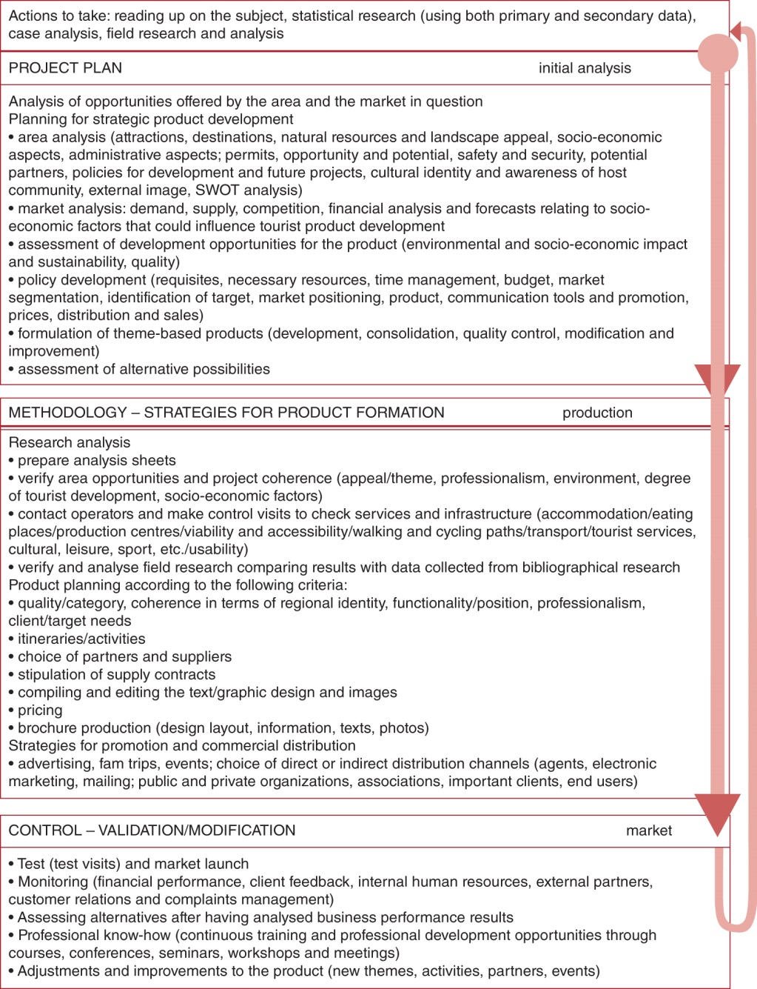
Figure 8.1. Guidelines for brochure planning.
CABI TOURISM TEXTS

Slide 5
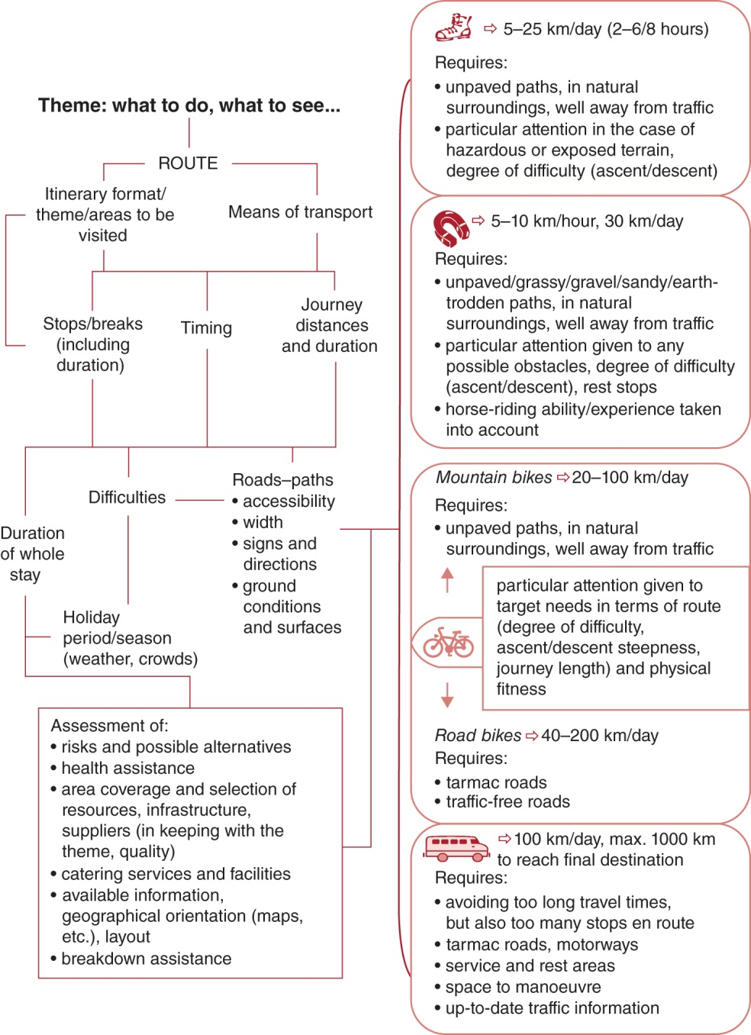
Figure 8.8. Structuring an itinerary: principal factors.
CABI TOURISM TEXTS

Slide 6
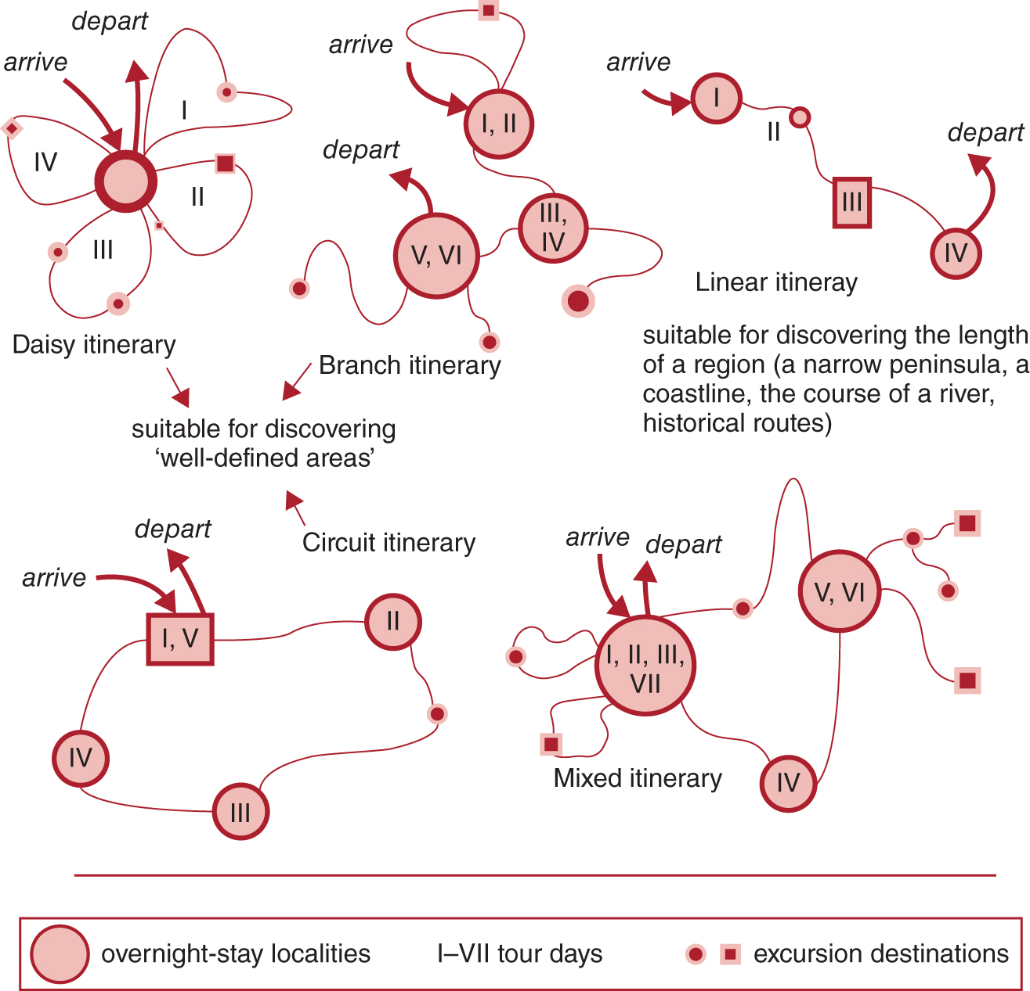
Figure 8.9. Different regions: choosing the best format.
CABI TOURISM TEXTS

Slide 7
CABI TOURISM TEXTS
Review Questions and Tasks
Visiting a winery and a hotel to be included as providers of services in a travel package: list at least ten elements for each kind of structure that should be taken into account in the analysis sheet for the on-site visit and for the selection.
Illustrate the main steps when structuring an itinerary.
Explain how the route format of a tour may be shaped, taking into account the theme of the holiday, geomorphological and cultural features of the area, location of resources, distribution of tourist facilities and services, technical aspects. Focus on ‘daisy itinerary’ and ‘linear itinerary’, giving two real examples of tourist regions suitable for these two models.

