Slide 1
CABI TOURISM TEXTS
2nd Edition Food and Wine Tourism
ERICA CROCE AND
GIOVANNI PERRI
COMPLIMENTARY TEACHING MATERIALS

Slide 2
CHAPTER 5
CABI TOURISM TEXTS
The Supply Side: the Actors Involved in Food and Wine Production

Slide 3
CABI TOURISM TEXTS
LEARNING OBJECTIVES
To organize food and wine tours in producing establishments and companies (guidelines, tips and clues).
To lead a tasting session in a professional way.
To welcome and involve kids in food and drink visits.

Slide 4
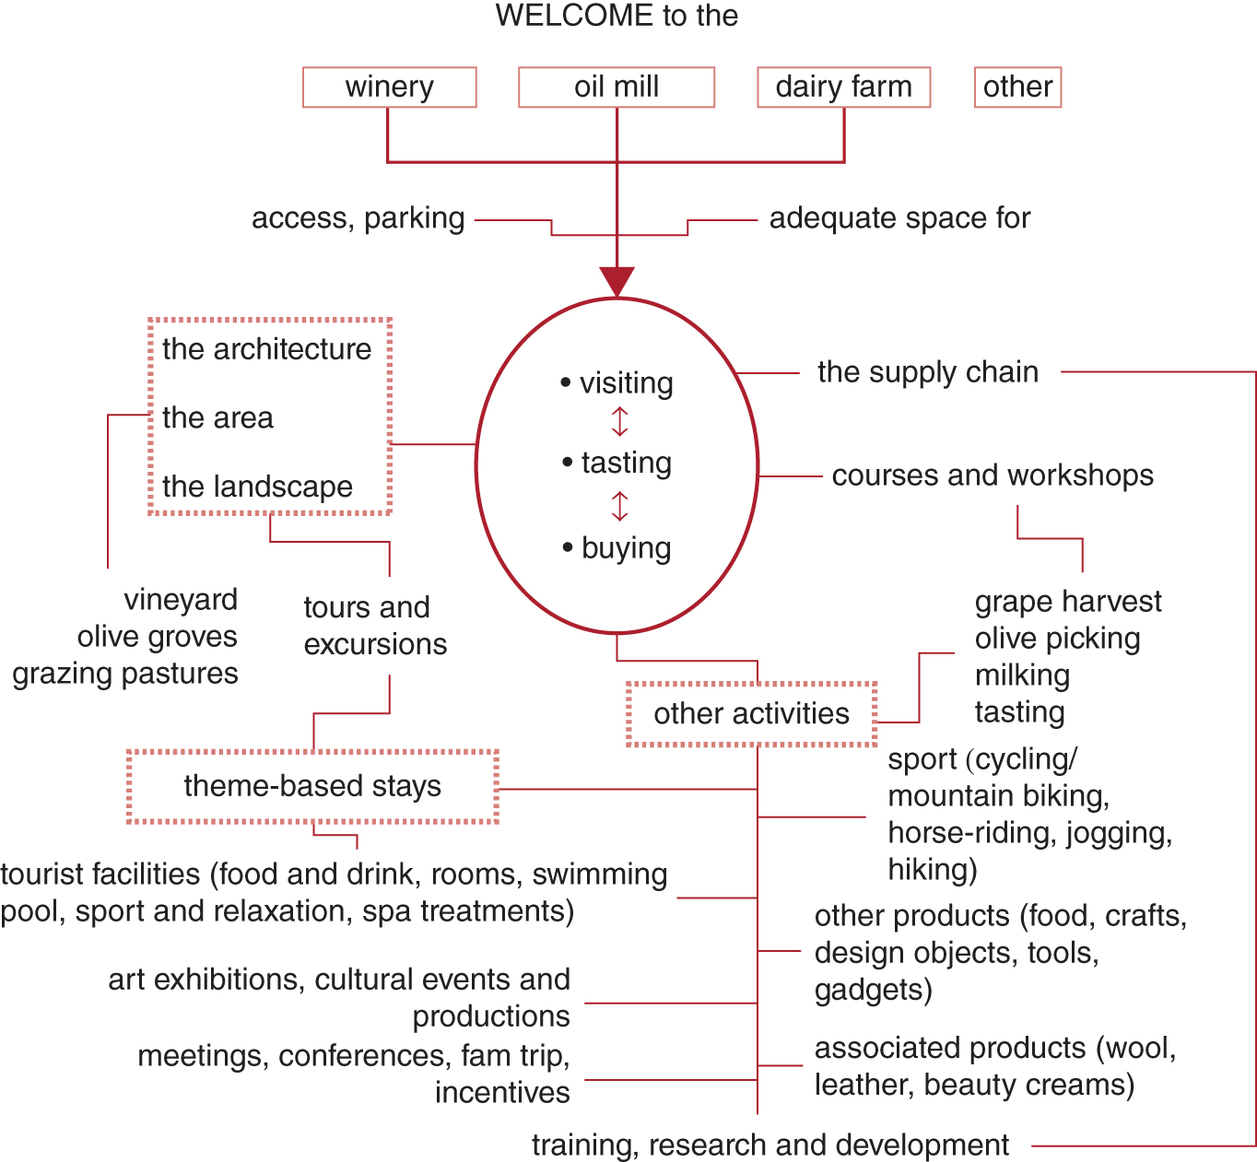
Figure 5.9. Example of a potential oenogastronomic tourist product.
CABI TOURISM TEXTS

Slide 5
CABI TOURISM TEXTS
Review Questions and Tasks
Write a ‘decalogue’ for producing establishments, summarizing the ten most important suggestions to welcome tourists in a proper way.
Organizing a visit with tasting session in a farm producing a kind of food you like: imagine going for an inspection on site and give a list of technical prerequisites the establishment and the tour guided by proprietors should have to be promoted by your travel catalogue.
Organizing a tasting session: choose a food product and imagine leading the ‘class’ for a group of primary school children on a school trip. What considerations should you make if comparing this kind of public to adults?

