Slide 1
CABI TOURISM TEXTS
2nd Edition Food and Wine Tourism
ERICA CROCE AND
GIOVANNI PERRI
COMPLIMENTARY TEACHING MATERIALS

Slide 2
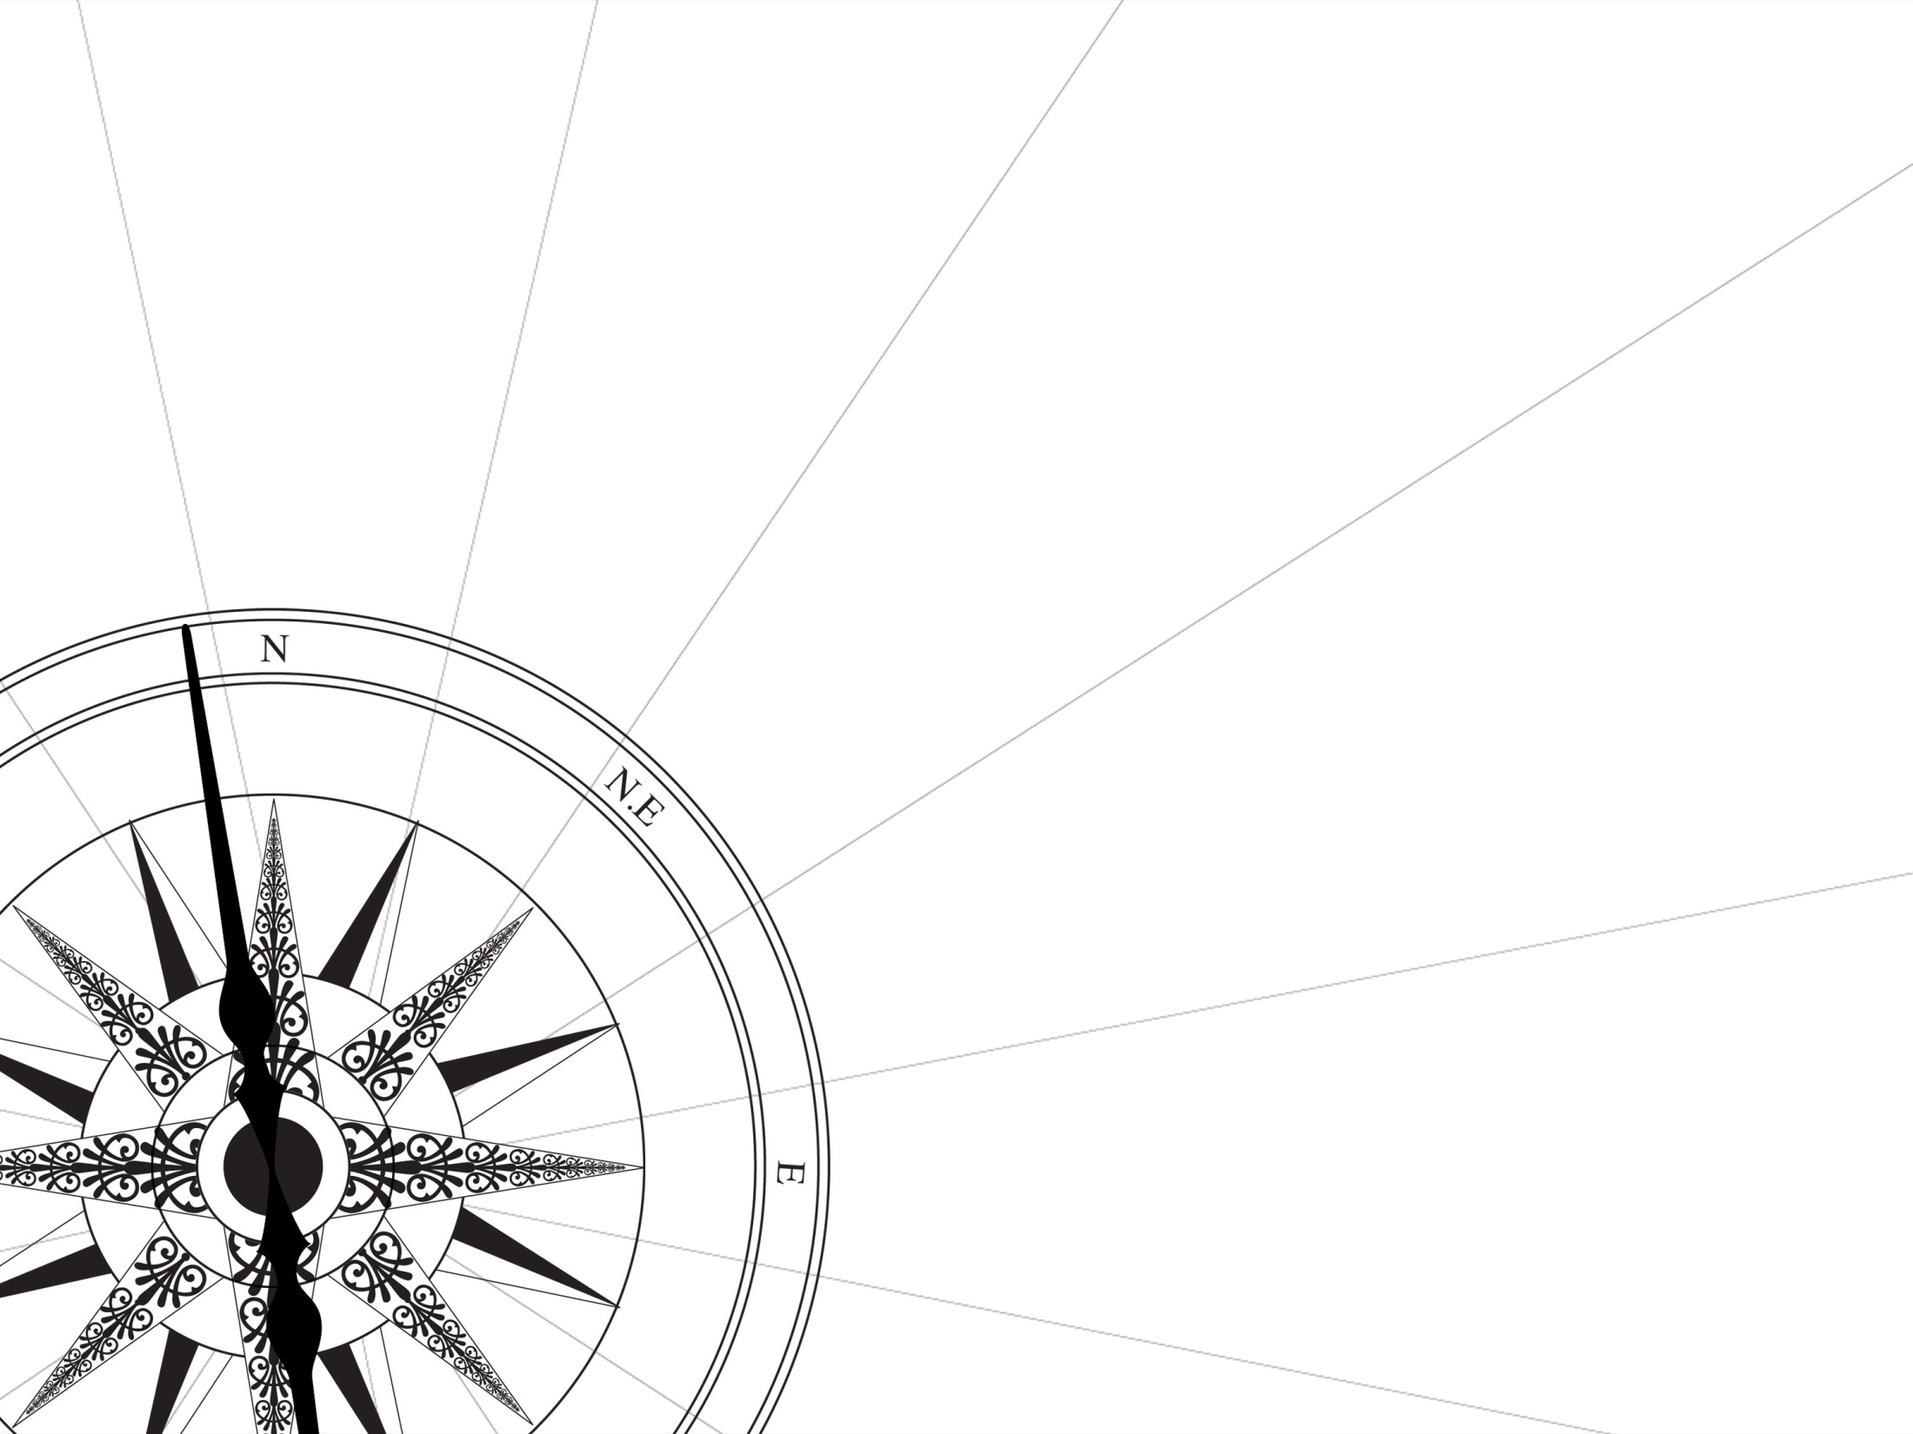
CHAPTER 4
CABI TOURISM TEXTS
Transforming a Terroir into a
Tourist Destination

Slide 3
CABI TOURISM TEXTS
LEARNING OBJECTIVES
To identify differences and points of connection between ‘global tourist product’ and ‘specific tourist product’.
To learn how to build the right tourist product in the right place.
To discuss how to communicate the identity of a tourist terroir.

Slide 4
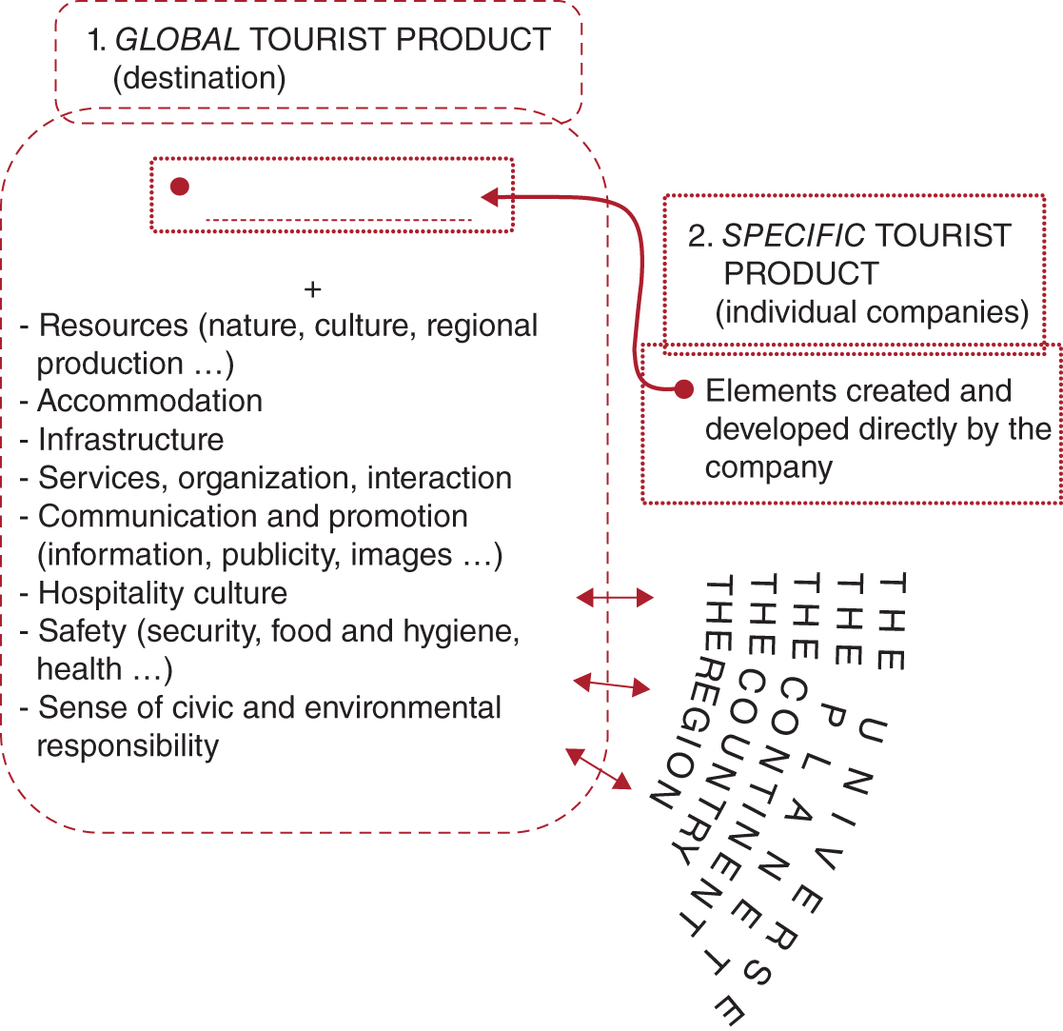
Figure 4.2. The tourist product: essential elements.
CABI TOURISM TEXTS

Slide 5
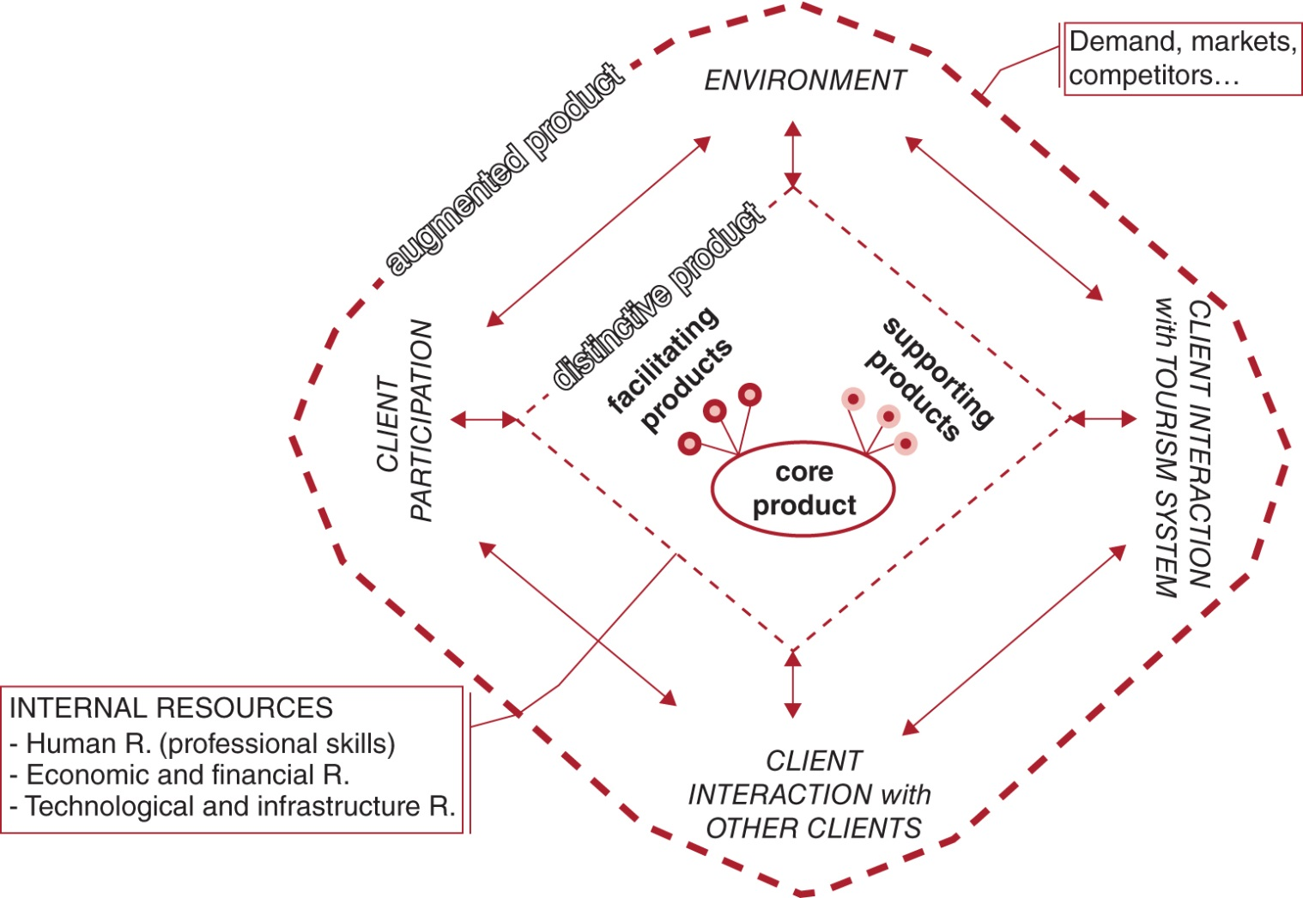
Figure 4.4. The augmented tourist product (source: the authors’ own adaptation from Kotler et al., 2009).
CABI TOURISM TEXTS

Slide 6
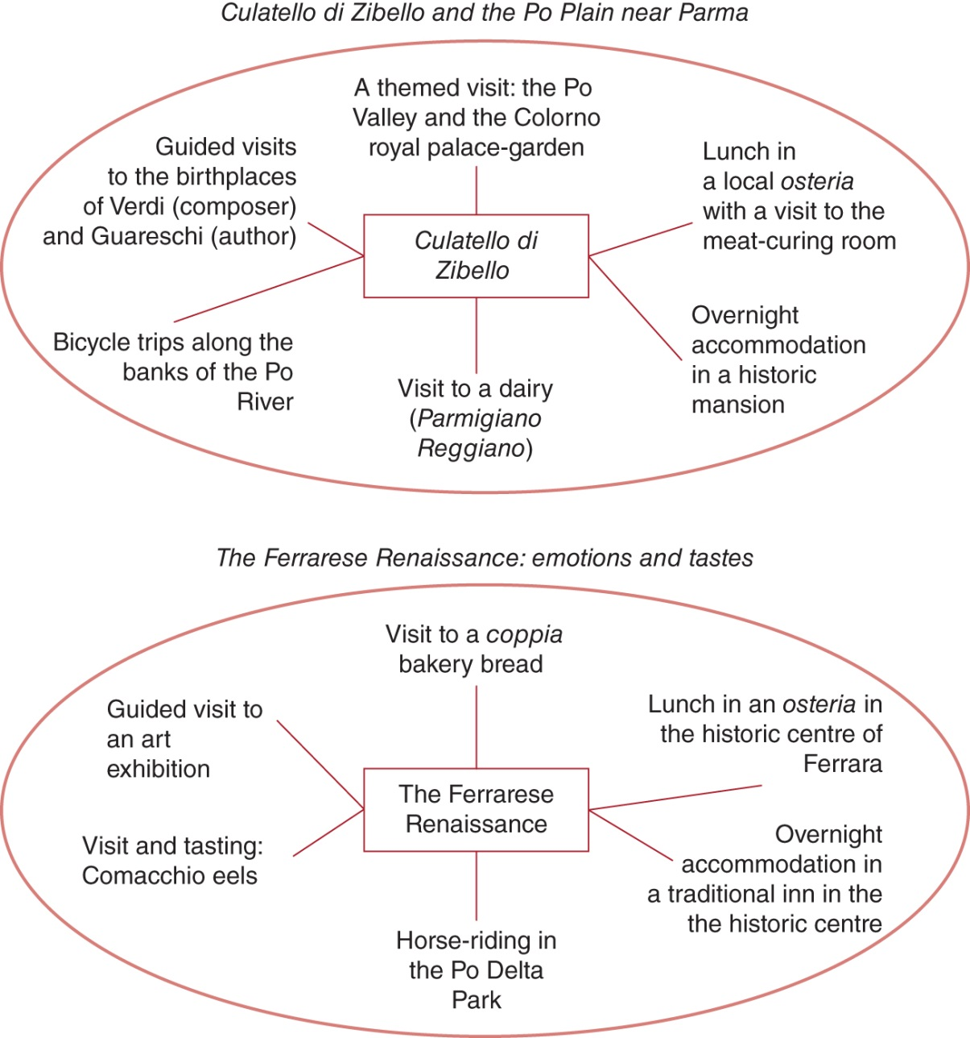
Figure 4.6. Examples of tourist products: gastronomy as a core product or as an ancillary component.
CABI TOURISM TEXTS

Slide 7
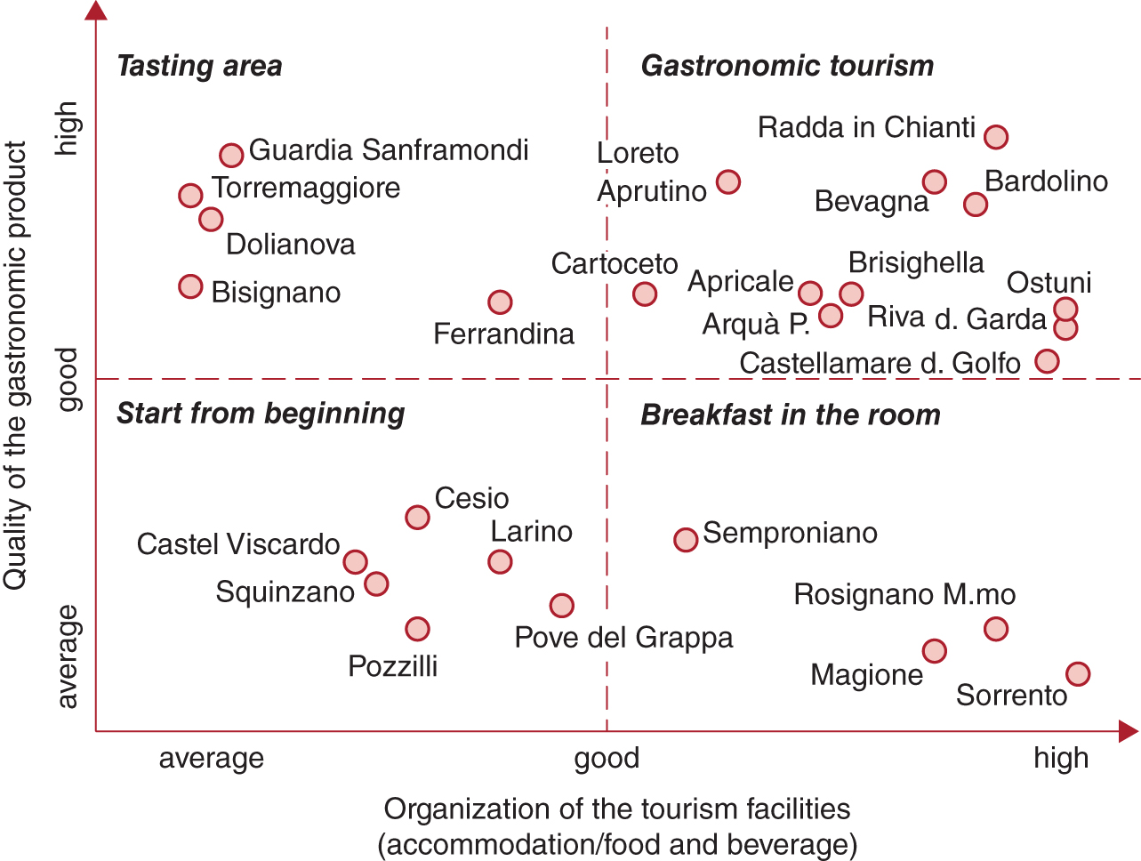
Figure 4.8. Tourism positioning: a possible approach to mapping Italian extra-virgin olive oil production areas (source: the authors’ own adaptation of field research and analyses of reviews in tourism and gastronomy publications, e.g. Slow Food, Michelin, Gambero Rosso, 2005–2007).
CABI TOURISM TEXTS

Slide 8
CABI TOURISM TEXTS
Review Questions and Tasks
What are differences and points of connection between ‘global tourist product’ and ‘specific tourist product’?
Draw a diagram to plan in a coherent way your own ‘augmented tourist product’. Start from a core that identifies an agro-food producing activity that should develop into a tourism business.
List at least five possible ways to communicate and promote the identity of a tourist terroir.

