Slide 1
CABI TOURISM TEXTS
2nd Edition Food and Wine Tourism
ERICA CROCE AND
GIOVANNI PERRI
COMPLIMENTARY TEACHING MATERIALS

Slide 2
CHAPTER 3
CABI TOURISM TEXTS
Tourists on the Food and Wine Trail:
Who Are They?

Slide 3
CABI TOURISM TEXTS
LEARNING OBJECTIVES
To examine food and wine tourists’ behaviour.
To define and describe food and wine tourism target groups in order to deal with them meeting their expectations.
To provide useful guidelines to follow for tourists before, during and after the visit.

Slide 4
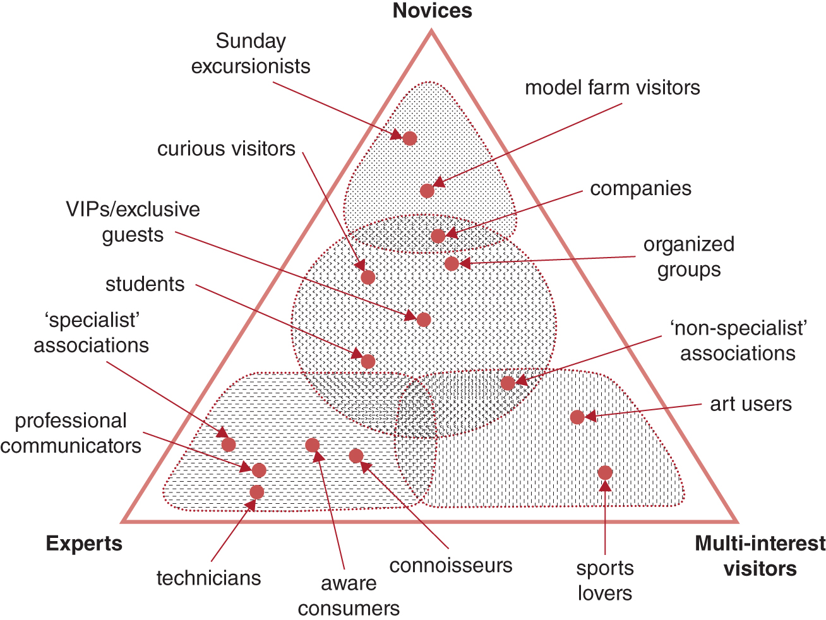
Figure 3.2. Food and wine tourists: a pyramid of different types.
CABI TOURISM TEXTS

Slide 5
CABI TOURISM TEXTS
Review Questions and Tasks
Describe common food and wine tourists’ behaviour.
Imagine welcoming, during the same tour and in the same group, tourists belonging to different target groups. Choose from Fig. 3.2 three different ‘profiles’; briefly describe their main characteristics and explain how you would deal with each of them in order to let everyone feel comfortable with each other and with the tour.
Write a very short document containing at most ten sustainable ‘rules’ that an aware tourist should follow when visiting a food- and wine-producing region.

