Slide 1
CABI TOURISM TEXTS
2nd Edition Food and Wine Tourism
ERICA CROCE AND
GIOVANNI PERRI
COMPLIMENTARY TEACHING MATERIALS

Slide 2
CHAPTER 2
CABI TOURISM TEXTS
The Environment: Tools of the Trade

Slide 3
CABI TOURISM TEXTS
LEARNING OBJECTIVES
To discover the importance of terroir as a key point to plan valuable tourism experiences in food- and wine-producing regions.
To understand geographic identity and evolution of (food and wine) tourism destinations on the basis of tourist flows and organization of geographical spaces.
To adopt an interdisciplinary approach when analysing, planning and managing.

Slide 4
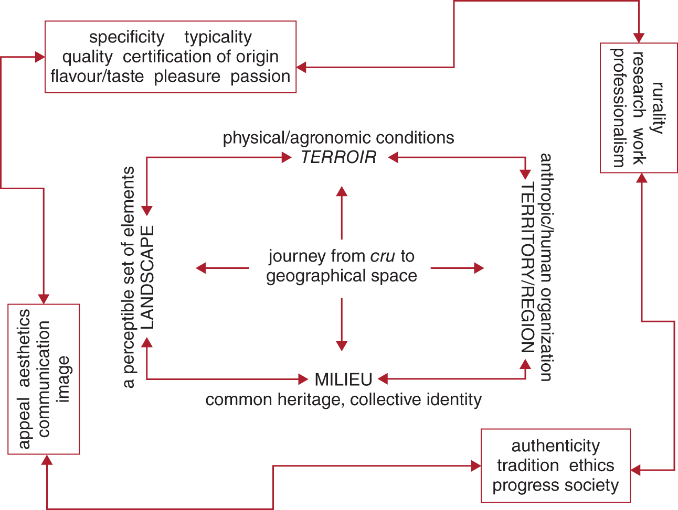
Figure 2.1. The ‘geographical flavour’ of food and wine tourism: key concepts for successful planning.
CABI TOURISM TEXTS

Slide 5
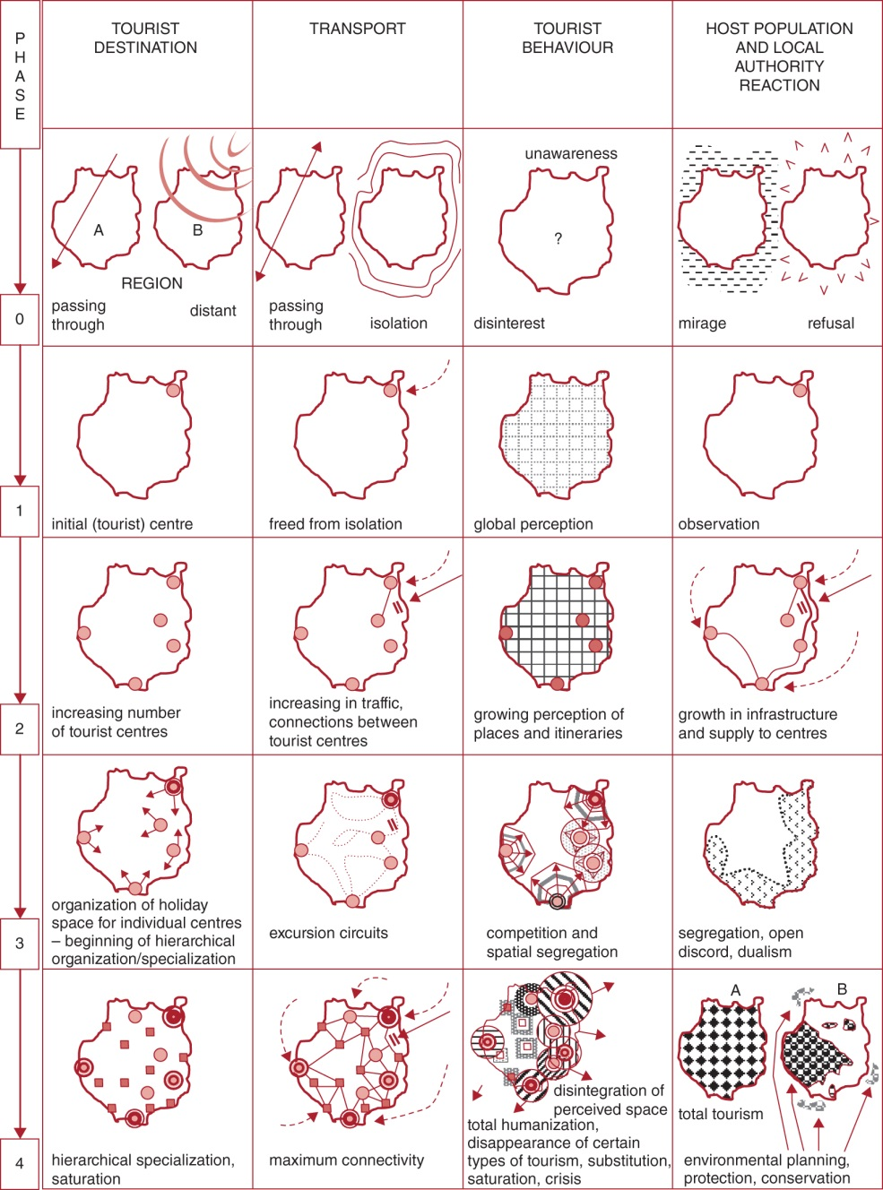
Figure 2.6. Miossec’s model (source: the authors’ own adaptation from the original model).
CABI TOURISM TEXTS

Slide 6
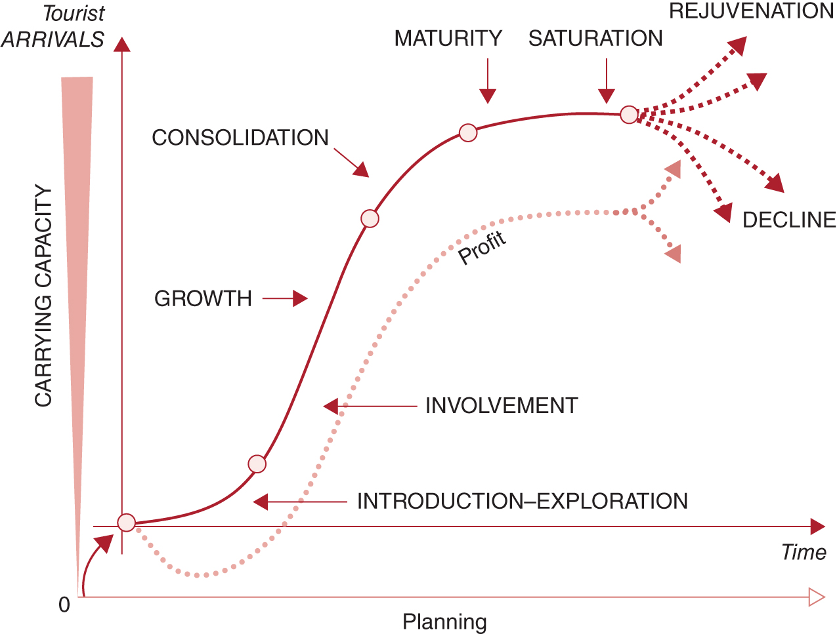
Figure 2.7. The life cycle of a tourist product (source: the authors’ own adaptation of ­Butler, 1980).
CABI TOURISM TEXTS

Slide 7
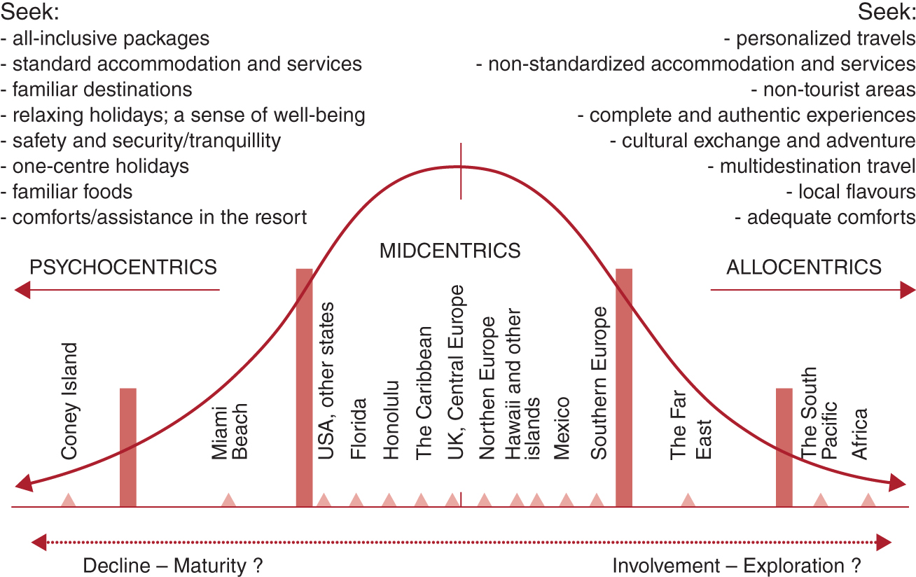
Figure 2.8. Plog’s psychographic travel model (source: the authors’ own adaptation from Minca, 1996).
CABI TOURISM TEXTS

Slide 8
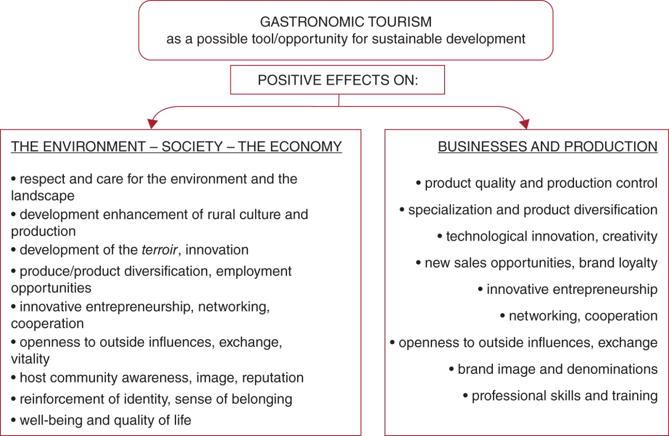
Figure 2.9. Sustainable effects of gastronomic tourism.
CABI TOURISM TEXTS

Slide 9
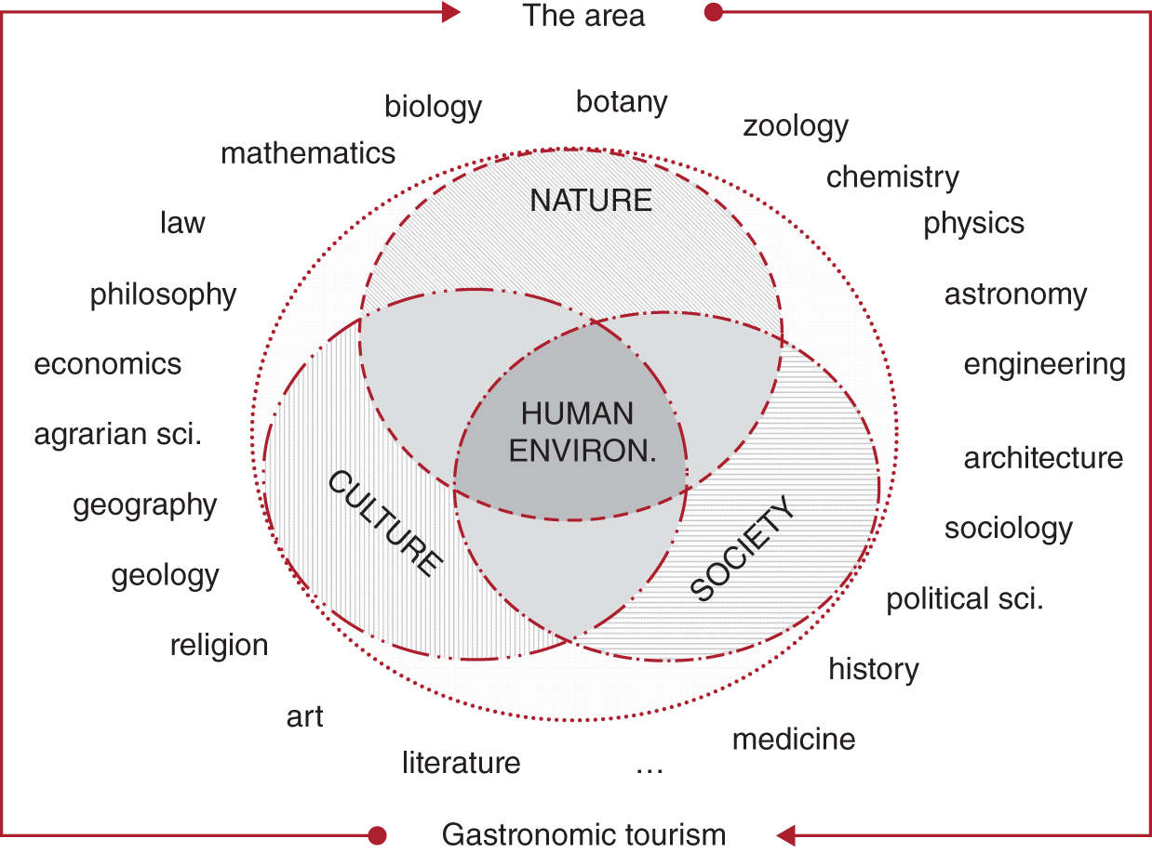
Figure 2.10. An interdisciplinary approach to interpret the landscape and create multiple experiences in a gastronomic destination.
CABI TOURISM TEXTS

Slide 10
CABI TOURISM TEXTS
Review Questions and Tasks
Explain what terroir is and why this concept is vital for an operator to give the proper value to food and wine tourism activities.
The evolution of (food and wine) tourism destinations: explain how organization of geographical spaces, kind of tourists and tourist flows shape the identity of a place. If possible, refer to real tourist destinations.
If well managed and planned, what are the (positive) effects of gastronomic tourism on local environment, society, economy, businesses and production?

