Slide 1
CABI TOURISM TEXTS
2nd Edition Food and Wine Tourism
ERICA CROCE AND
GIOVANNI PERRI
COMPLIMENTARY TEACHING MATERIALS

Slide 2
CHAPTER 1
CABI TOURISM TEXTS
The Spirit of a Place on a Plate

Slide 3
CABI TOURISM TEXTS
LEARNING OBJECTIVES
To define and contextualize food and wine tourism as a fairly recent phenomenon.
To explore how sustainable practices may affect food and wine tourism strategic vision and operational marketing.
To consider the importance of ‘quality’ as the combination of technical, emotional and environmental aspects.

Slide 4
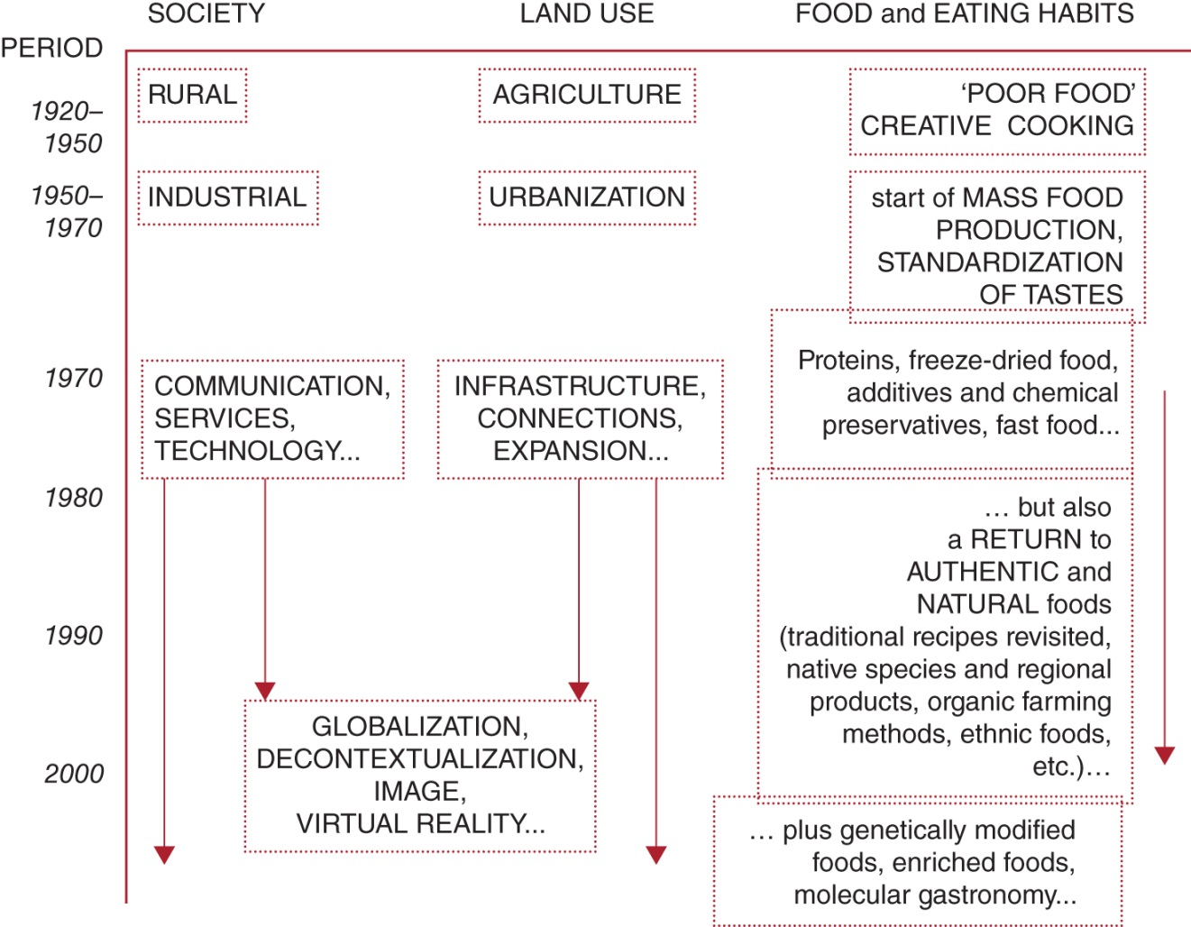
Figure 1.2. Evolving social conditions and changes in attitude towards land use and food in Italy between 1920 and 2000.
CABI TOURISM TEXTS

Slide 5
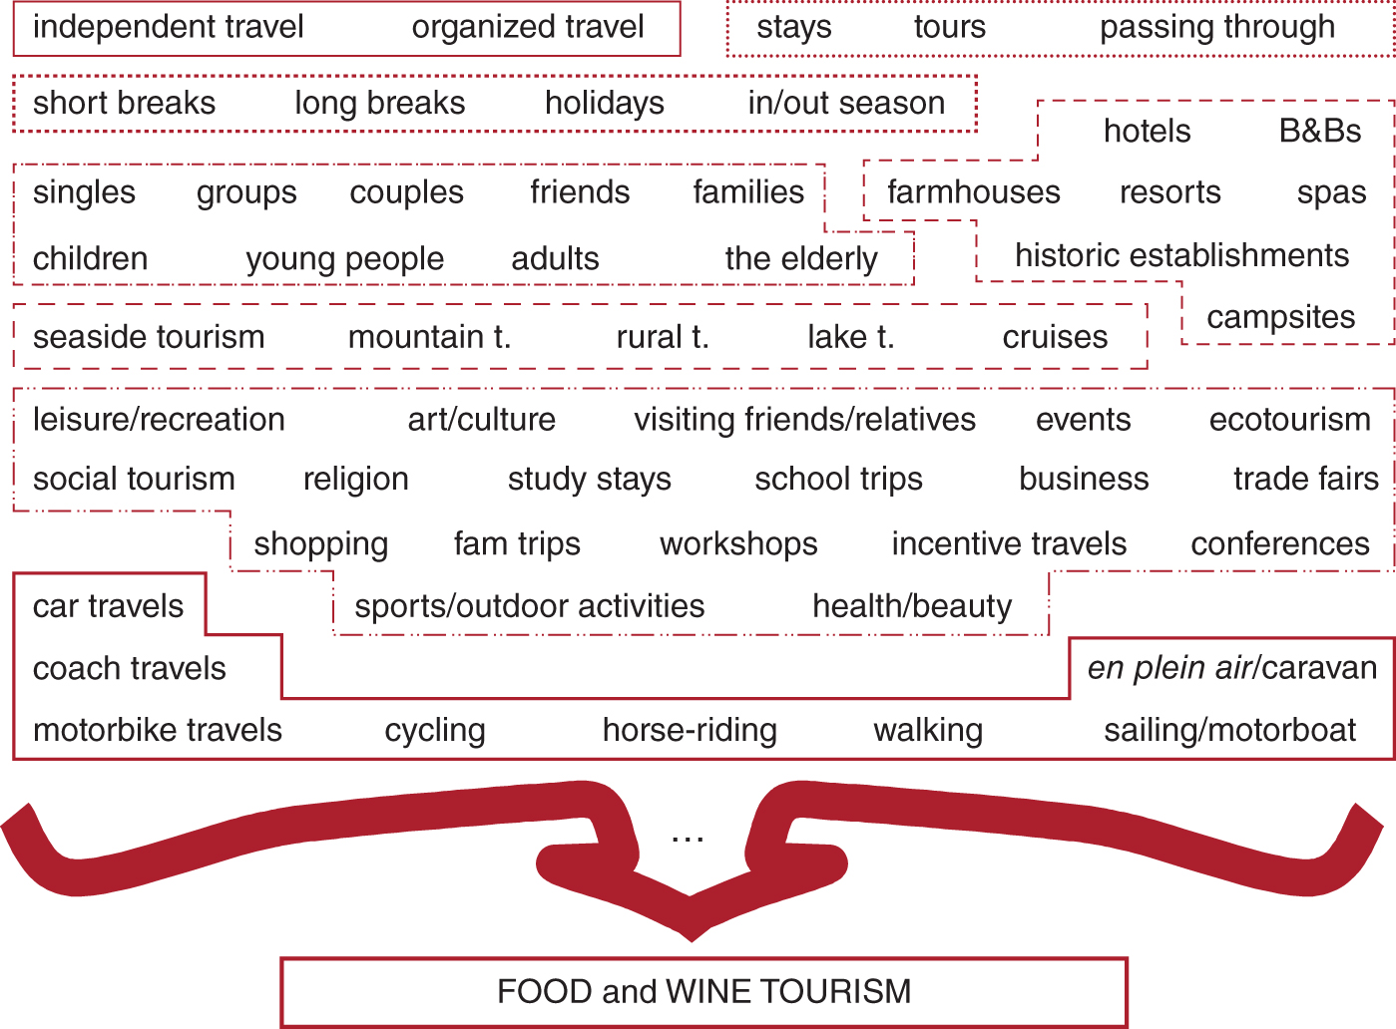
Figure 1.3. Integrating food and wine tourism with other types of tourism.
CABI TOURISM TEXTS

Slide 6
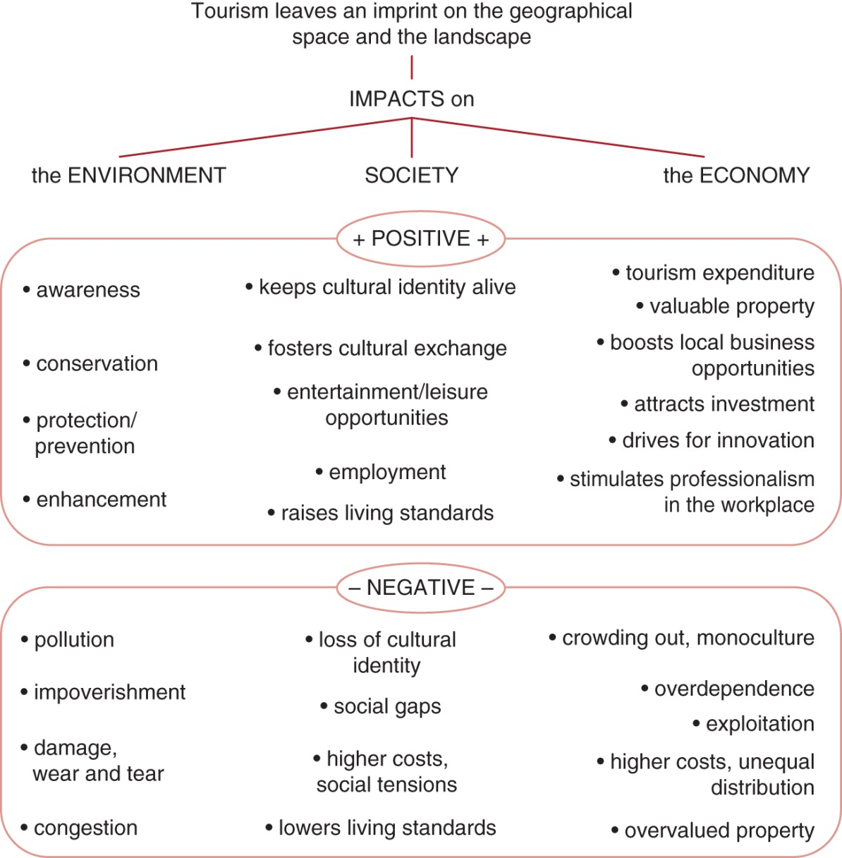
Figure 1.5. The main impacts of tourism.
CABI TOURISM TEXTS

Slide 7
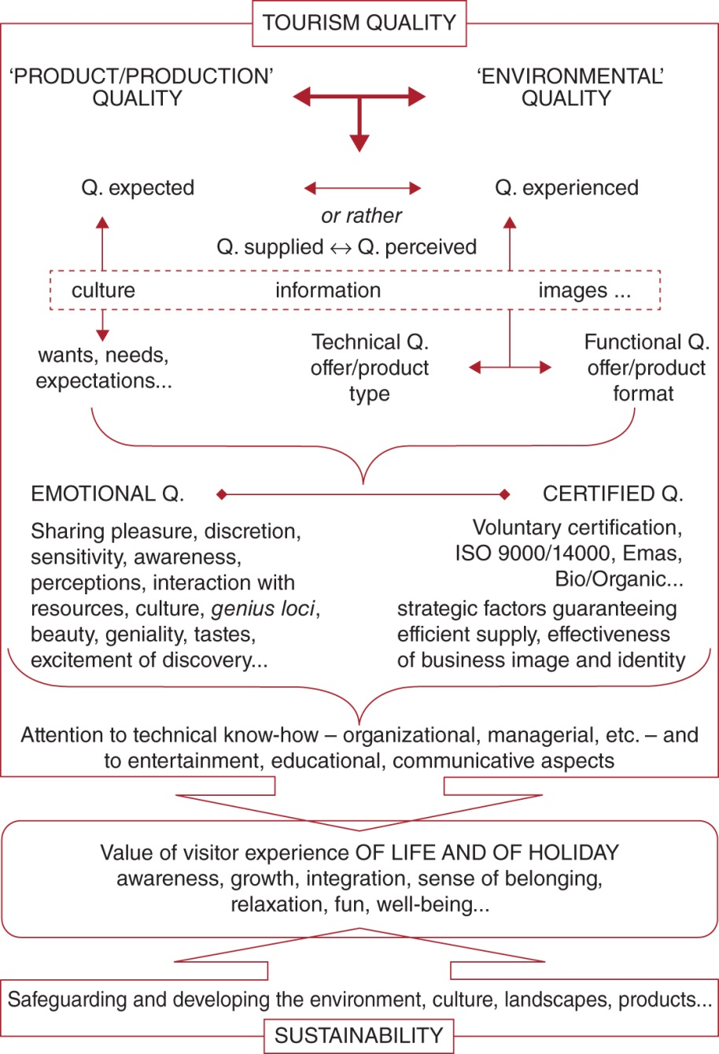
Figure 1.7. Tourism quality
CABI TOURISM TEXTS

Slide 8
CABI TOURISM TEXTS
Review Questions and Tasks
How would you define ‘food and wine tourism’ in your own words? Describe at least three essential activities typical of a visitor to a food-producing company/area.
Imagine running your own business in food and wine tourism: list ten sustainable practices that you consider most important.
How is it possible to combine technical, environmental and emotional quality?

